Slide 1
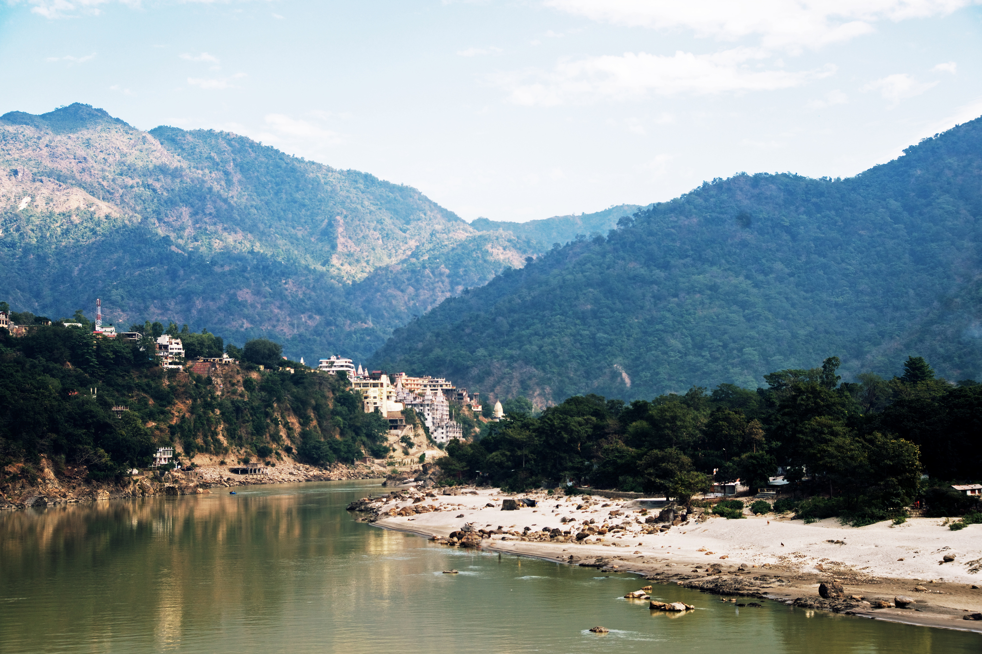
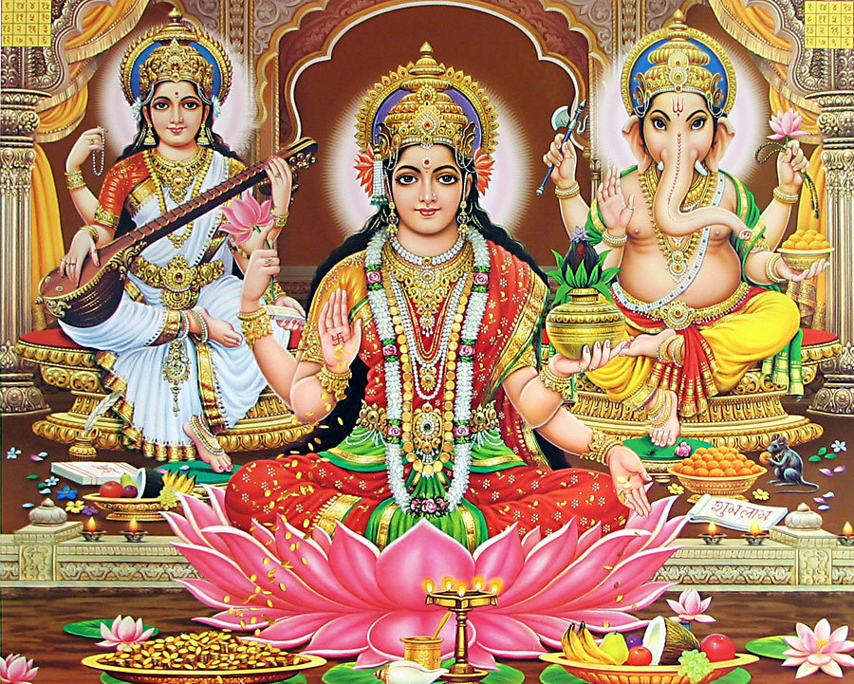
Religion: Hinduism
Key Question: Would visiting the River Ganges feel special to a non-Hindu?

Slide 2
Tuesday 22nd June LO: To understand the significance of the River Ganges both for a Hindu and non-Hindu.

Slide 3
Today we are going to learn about the River Ganges.

Slide 4
Let’s look where the River Ganges is on Google Earth:

Slide 5
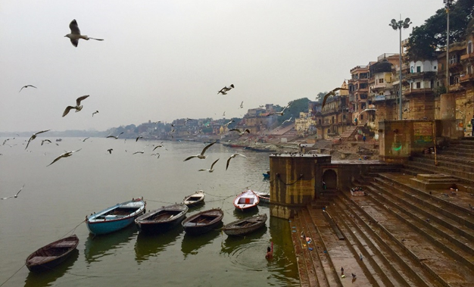
The Ganges is 2,525km long and starts its journey in the Himalayas
The river flows through Nepal, India and Bangladesh, where it empties into the Bay of Bengal
The Ganges deposits minerals and nutrients into the surrounding land, making it ideal for farming
The Ganges is heavily polluted due to the many cities that deposit waste products into it. Pollution threatens both humans and more than 140 fish species

Slide 6
We are going to read a story of the Goddess Ganga and how Hindus believe the River Ganges was formed.

Slide 7
Hindus worship three main gods:
Brahma, who creates the universe
Vishnu, who preserves the universe
Shiva, who destroys the universe.

Slide 8
Who is Lord Shiva?
Shiva is the destroyer god. He destroys, so he can get rid of all the bad in the world.
He is the third member of the Hindu trinity of Brahma (the creator god) and Vishnu (the preserver god)

Slide 9
Symbols associated with Lord Shiva
Sacred Ganga
Crescent
Matted hair
Cobra
Trident
Tiger skin

Slide 10
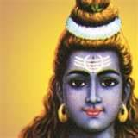
Sacred Ganga
The holiest of rivers, the Ganga (also known as the Ganges) glows from the crown of Shiva’s head. This represents the causal waters from which the earth arises. It also represents the essential instrument of ritual purification. By holding the Ganga on his head, Shiva allowed an outlet to the great holy river to cross the earth and bring purifying water to humans.

Slide 11
Crescent
Shiva bears on his head the crescent of the fifth day (panchami) moon. This is placed near the fiery third eye and this shows the power of Soma, the sacrificial offering, which is the representative of the moon. It means that Shiva possesses the power of procreation along with power of destruction.

Slide 12
Matted hair
The flowing jata or matted hair of Shiva represent him as the lord of wind, Vayu, who is the subtle form of breath present in all living beings.

Slide 13
Cobra
Shiva is beyond the power of death, even though he is surrounded by death. This is emphasised by his name Nilakantha. The god drank the deadly poison Kalakuta to free the world from its effects. The cobras around his neck also represent the dominant energy called Kundalini, the serpent power.

Slide 14
Trident
The Trishula of Shiva is the symbol of the three functions of God – the Creator, the Preserver and the Destroyer. It also represents the instrument of punishment to the evil doer on all the three planes – spiritual, subtle and physical.

Slide 15
Tiger skin
The tiger is the vehicle of Shakti, the goddess of power and force. Shiva is beyond and above any kind of force. He is the master of Shakti. The tiger skin that he wears symbolises victory of every force.

Slide 16
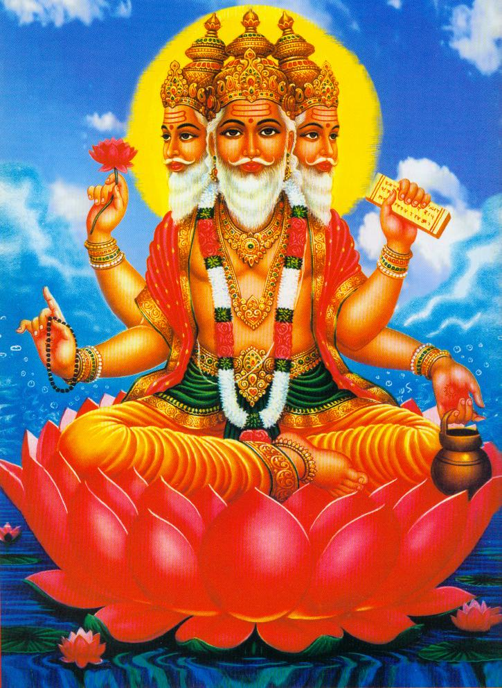
Long, long ago, when the great god Lord Brahma was looking down upon the earth, he saw that a terrible fire had spread over all the land.

Slide 17
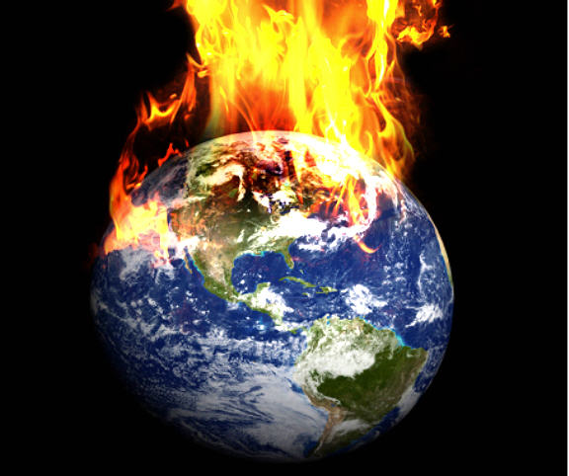
Horrified, he watched the hungry flames destroying everything in their path all over the world.

Slide 18
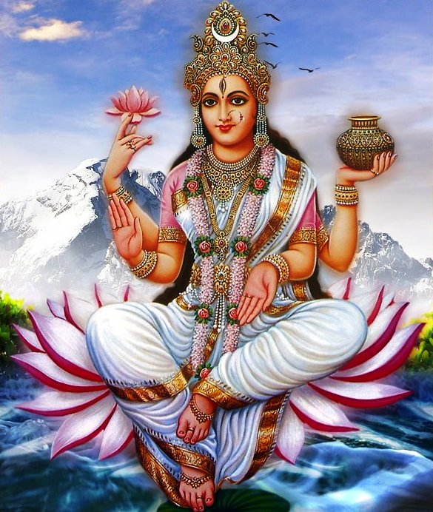
The goddess Ganga, full of purity, leapt to offer her help: “Send me to earth Lord Brahma, I will quench the fire.”

Slide 19
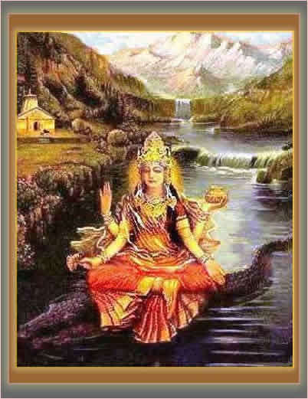
The mighty Ganga was strong and passionate; her beautiful hair and clothes flowed around her in watery splendour.

Slide 20
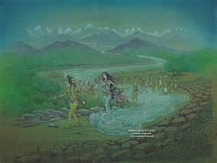
Lord Brahma told her to take the form of a rushing mighty torrent of water, because water puts out fire the best. She swiftly leapt to help, and transformed herself into a cascading river in full flow, and she dashed down to earth.

Slide 21
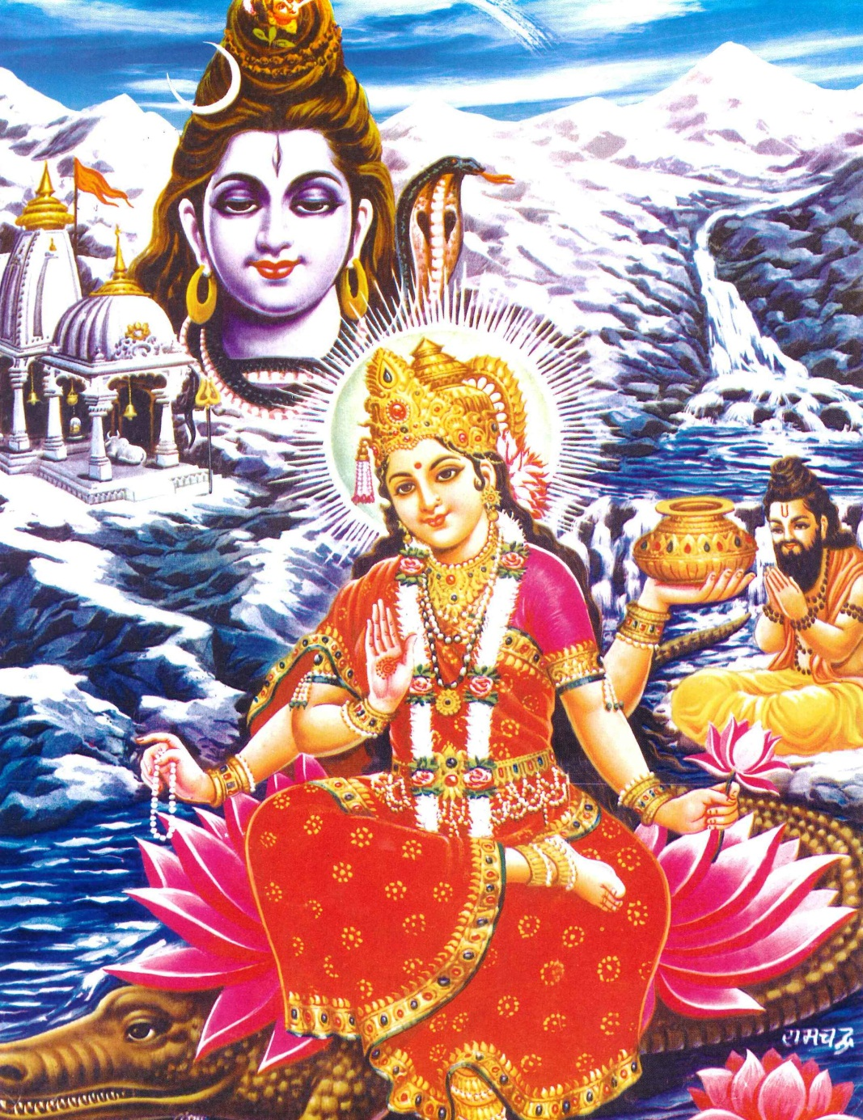
Lord Shiva, another of the gods, watched as goddess Ganga dashed to the rescue. He realised at once that she was so strong that she would not just put out the fire: she would destroy the whole earth as well.

Slide 22
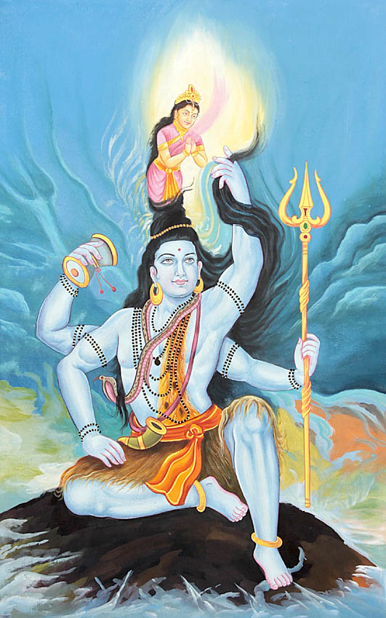
Shiva wanted to help too, so he jumped down to the burning earth even faster than Ganga, and stood firmly on the ground.

Slide 23
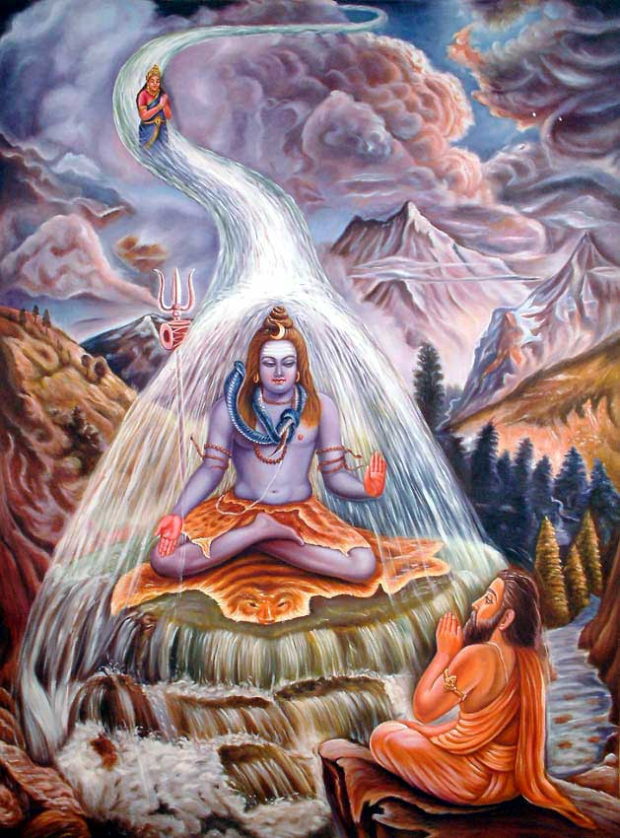
Ganga’s torrents of water hit Shiva with full force on the head. Her mighty waterfall splashed through his long hair, and cascaded down to the earth below in seven fast flowing streams. Instead of destroying the earth, the waters of Ganga splashed off Shiva’s tangled hair and quenched the fires that burned.

Slide 24
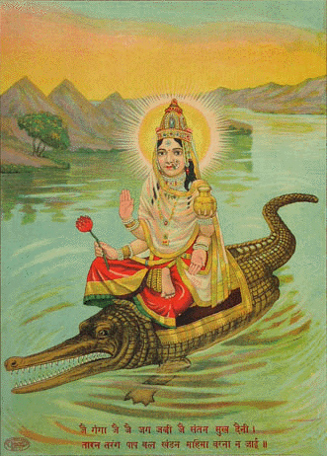
Ganga spread out across the hot dead lands, bringing life wherever she flowed. The rivers of Ganga filled with fish, who played in the water. The banks and plains flooded with water, and plants grew fast, animals came to drink, people to bathe.

Slide 25
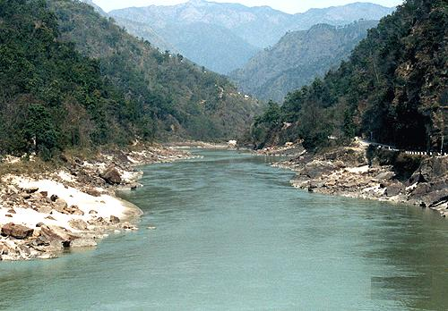
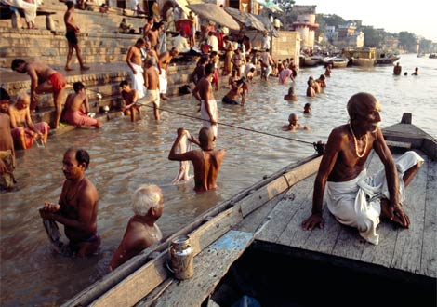
Ganga became the life-giving river, mother to all of India.

Slide 26
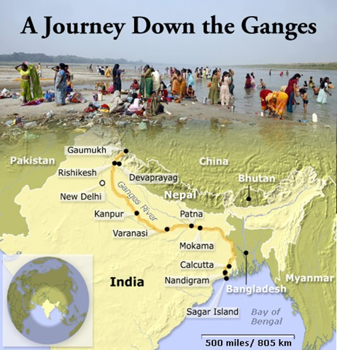

Slide 27
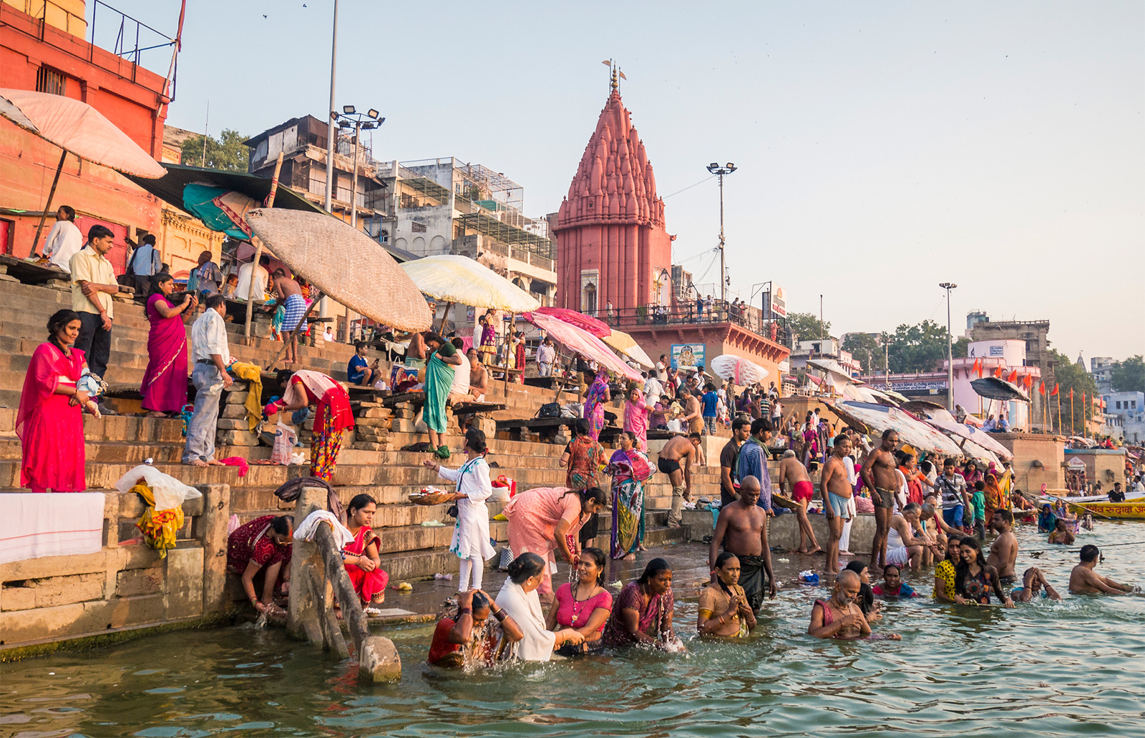
The river is a very significant river for both residents and pilgrims.
Pilgrim – A person who journeys to a sacred place for religious reasons.

Slide 28
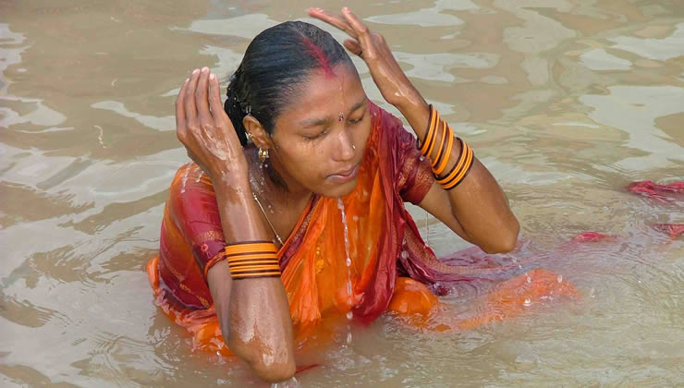
What do Hindus do when they visit the river?
They collect water
Make offerings
Cycle of life and death (people have their funeral service on the banks of the River Ganges)
Bathe

Slide 29
Why do people bathe in the river?
Hindus believe the waters of the Ganges are purifying and if they bathe in the river their sins will be forgiven, it will wash away the wrong things they have done then they will be pure (cleansed) and any illness’ will be cured.
‘Wishing candles’ are places in the river to represent a wish for a friend or family member.

Slide 30
Tuesday 21st June LO: To understand the importance of the River Ganges to Hindus. Can you draw a mind map in your book explaining what Hindus do when they visit the river?

