Slide 1

24.1.22
LO – I understand what the area of a shape is.

Slide 2
Let’s get our brains in gear…
Are we ready to think and use our growth mindset on a new topic….

Slide 3

What is a 2-D shape?
What is a 3-D shape?
Name these 2-D shapes.
What do these symbols mean?
$>$
  $=$
  $<$

Slide 4
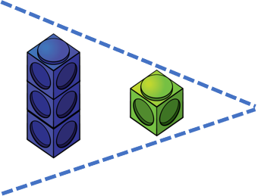

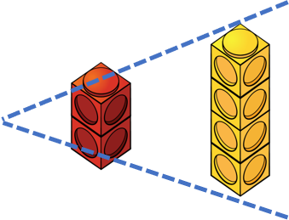
What is a 2-D shape?
What is a 3-D shape?
Name these 2-D shapes.
What do these symbols mean?
$>$
  $=$
  $<$
equilateral
isoceles
triangle
triangle
rectangle
circle
square
greater than
equal to
less than

Slide 6
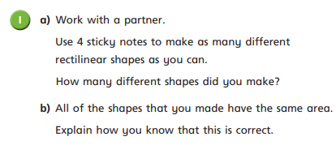
Have a go at question 1 on the worksheet

Slide 7
These shapes have the same area.
4 squares

Slide 8
What is area?
Area is the amount of space taken up by the 2D shape.

Slide 9
Can you visualise the areas of these shapes?
Area is the space taken up by a closed 2D shape.
Area is the space taken up by a 2D shape.

Slide 10


How can we find the area of this shape?
We could fill the space with something and count how many fit inside.
The area is 14
But what about all those gaps.

Slide 11
How can we find the area of this shape?
We could fill the space with something and count how many fit inside.
That’s better! So the area is 12
The area is 14
Why don’t we try a different shape?

Slide 12






Who do you agree with?
Why are the others incorrect?
The area is 12
The area is 11
The area is 20
Have a think

Slide 13



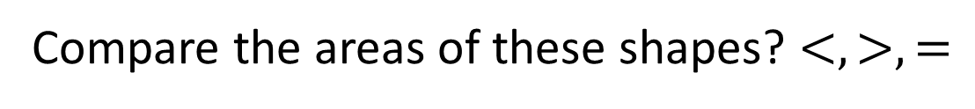
Compare the areas of these shapes? $<, >, =$
$$<$$
$$>$$
$$=$$

Slide 14


Compare the areas of these shapes? $<, >, =$
$$<$$
Draw a shape with a smaller area and
another with a larger area?
Have a think
$$>$$
$$<$$
$$=$$
$$<$$

Slide 15
Have a go at the rest of the questions on the worksheet

