Slide 1
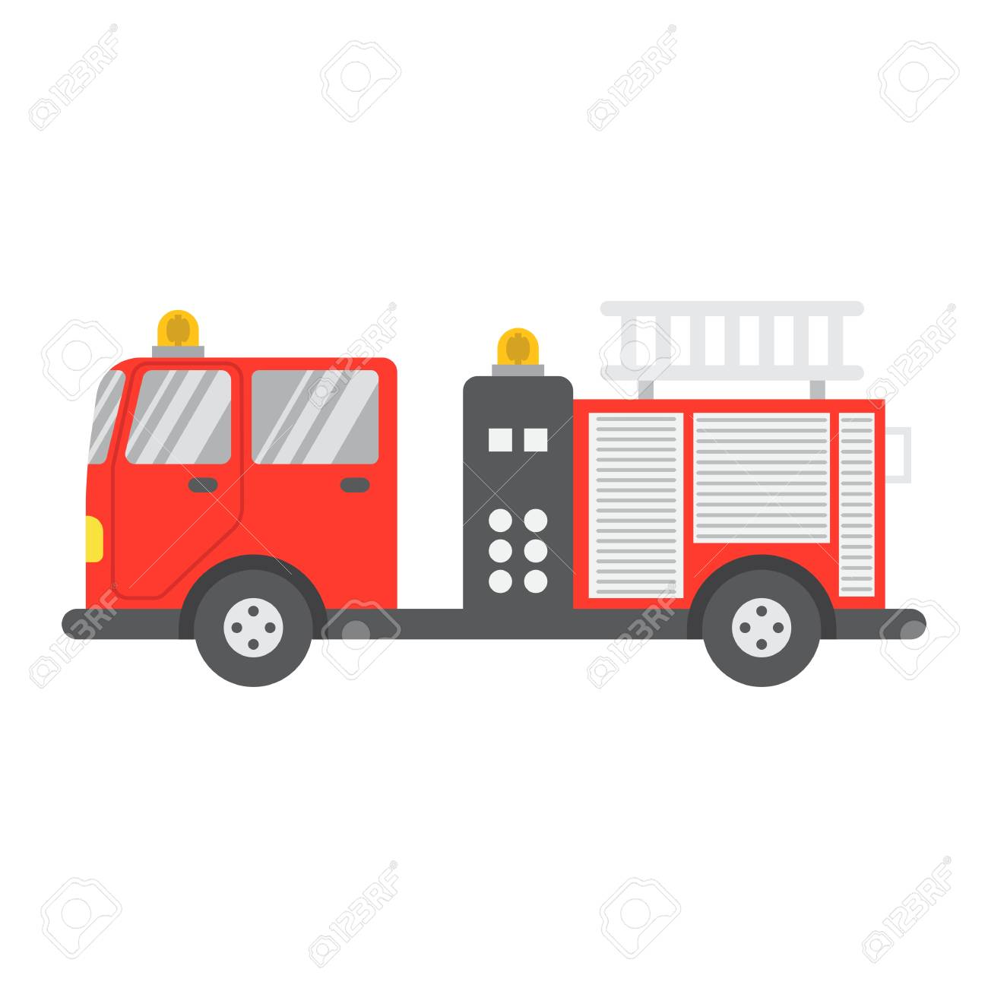
London’s Burning!
Why is this chant so important?
London's burning, London's burning
Fetch the engine, fetch the engine
Fire, fire! Fire, fire!
Pour on water, pour on water

Slide 2
Beat

Slide 3
The beat
The beat is the steady pulse that you feel in the tune, like a clock’s tick.

