Slide 1
19.1.22
LO – I can divide a 3-digit number by a 1-digit number.

Slide 2
Let’s quickly recap on our 12 x tables.
Let’s use the counting stick first.
Write your 12 x table on your whiteboard. Time yourself how long this takes.
Good luck ☺

Slide 3
Let’s recap on division
1) 84 ÷ 3 =
2) 85 ÷ 3 =
3) 83 ÷ 3 =
4) 490 ÷ 7 =

Slide 4
1) 84 ÷ 3 =
2) 85 ÷ 3 =
3) 83 ÷ 3 =
4) 490 ÷ 7 =
28
84
28 r 1
60
24
27 r 2
÷ 3
÷ 3
20
8
70

Slide 5
609 ÷ 3 =
2
0
3
H | T | O

Slide 6
576 ÷ 4 =
144
H | T | O
576
400
16
160
÷ 4
÷ 4
÷ 4
100
4
40

Slide 7
115 ÷ 5 =
23
H | T | O
115
100
15
÷ 5
÷ 5
20
3

Slide 8
765 ÷ 5 =
153
Have a think
67
2) 201 ÷ 3 =
H | T | O
H | T | O
201
765
500
15
180
21
250
÷ 3
÷ 5
÷ 3
÷ 5
÷ 5
100
3
60
50
7

Slide 9
776 ÷ 4 =
194
776 $−$ 400 = 376
776
400
16
360
÷ 4
÷ 4
÷ 4
100
4
90

Slide 10
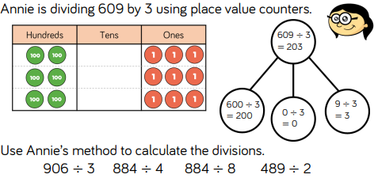
TTYP and work with them to complete this work using place value counters.

Slide 11
638 ÷ 3 =
212 r 2
638
638
600
8
600
2
30
36
÷ 3
÷ 3
÷ 3
÷ 3
÷ 3
÷ 3
200
2 r 2
200
r 2
10
12

Slide 12
Have a think
1) 708 ÷ 7 =
101 r 1
2) 865 ÷ 4 =
216 r 1
708
865
700
8
800
25
0
40
÷ 7
÷ 7
÷ 4
÷ 4
÷ 7
÷ 4
100
1 r 1
200
6 r 1
0
10

Slide 13
Have a think
Tom has £317
He gives each of his 5 grandchildren an equal amount of whole pounds.
How much money does Tom have left?
£2
317 ÷ 5 =
63 r 2
300 ÷ 10 =
30
317
30 × 2 =
60
300
17
÷ 5
÷ 5
60
3 r 2

Slide 14
There are some challenge questions on your sheet. Use either place value counters to help you or use part whole models to complete the questions. Good luck. You will need to use your times tables knowledge. ☺

