Slide 1
Anglo-Saxons

Slide 2
Monday 7th February 2022
LO: To learn how Anglo-Saxon Britain was ruled.

Slide 3
Vocabulary
cyning (pronounced ‘koo-ning’) - king
ceorl (pronounced ‘chairl/churl’) - common person or peasant

Slide 4
How was Anglo-Saxon Britain ruled?
Anglo-Saxon Britain wasn't ruled by one person and the Anglo-Saxons were not united. They invaded as many different tribes and each took over different parts of Britain.

Slide 5
Each group of Anglo-Saxon settlers had a leader or war-chief. A strong and successful leader became 'cyning', the Anglo-Saxon word for 'king'. Each king ruled a kingdom and led a small army.

Slide 6
From time to time, the strongest king would claim to be 'bretwalda', which meant ruler of all Britain.

Slide 7
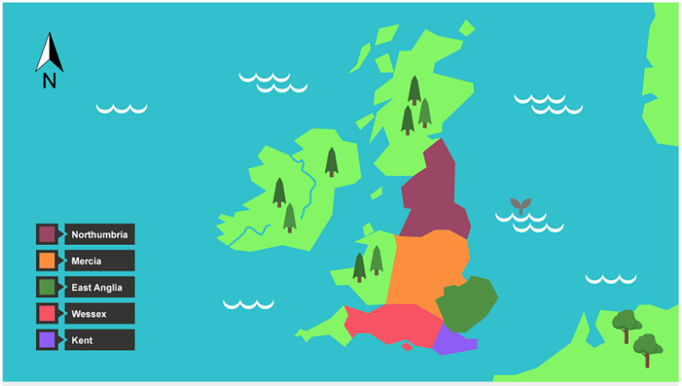
By around AD600, after much fighting, there were five important Anglo-Saxon kingdoms. They were Northumbria, Mercia, Wessex, Kent and East Anglia. Sometimes they got along, sometimes they went to war.

Slide 8
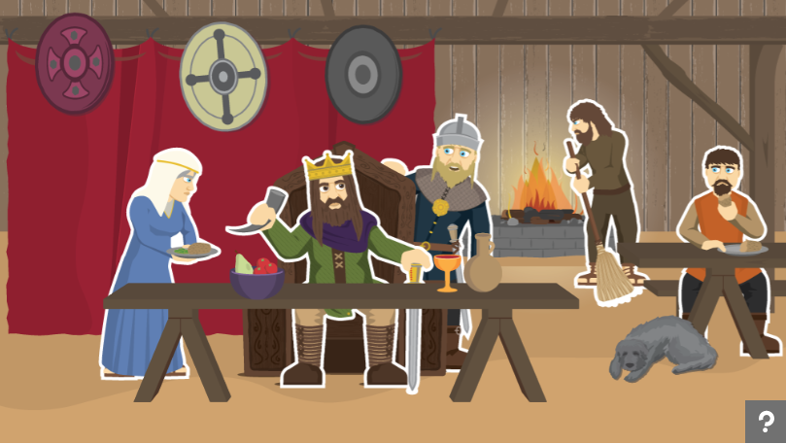
Anglo-Saxons were not all equal. Let’s find out about the different classes in Anglo-Saxon society.

Slide 9
Did they have laws?
The Anglo-Saxons didn't have prisons. People found guilty of crimes were either executed or punished with fines.
If they ran away, they became 'outlaws' (outside the law), and anyone could hunt them down - unless they hid in a church. The fine for breaking into someone's home was five shillings (25p), paid to the home-owner. For minor crimes like stealing, a nose or a hand might be cut off.

Slide 10
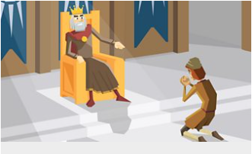
The Saxons had a system called 'weregild', which meant that if you injured someone, you had to pay for the damage!
The weregild payable for the murder of an Anglo-Saxon thane was 6,000 pennies. The weregild for a king was 90,000!

Slide 11
If a person killed someone, they paid money to the dead person's relatives. The idea was to stop long fights or 'blood feuds' between families by making them pay money instead.

Slide 12
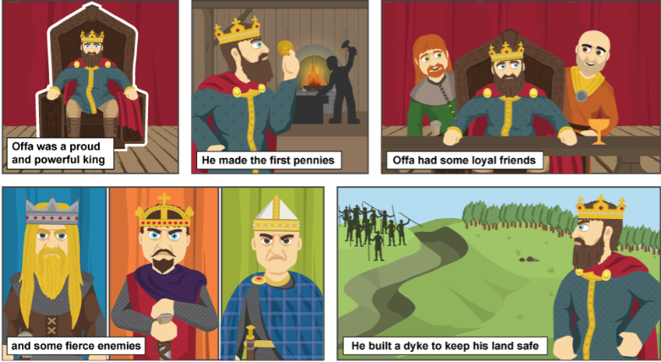
Click on this image and scroll to the bottom of the page to learn about Offa.
Click on each of the sections to learn more.
Then present what you have learnt in any way you choose e.g: fact file, poster, booklet, verbal presentation.

