Slide 1
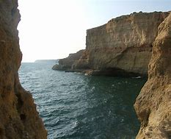
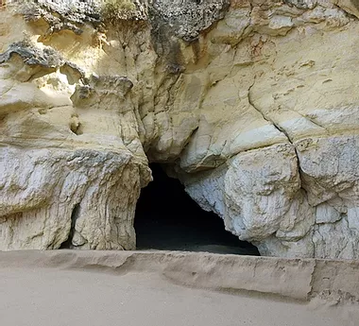
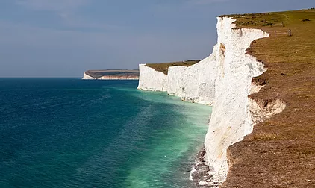
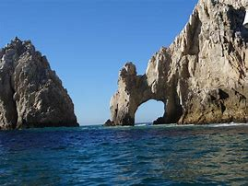
Coasts

Slide 2
The surface of the Earth is completely covered in rock. Most of this rock is submerged by the oceans and seas but the higher areas, which are called land, are not covered.

Slide 3
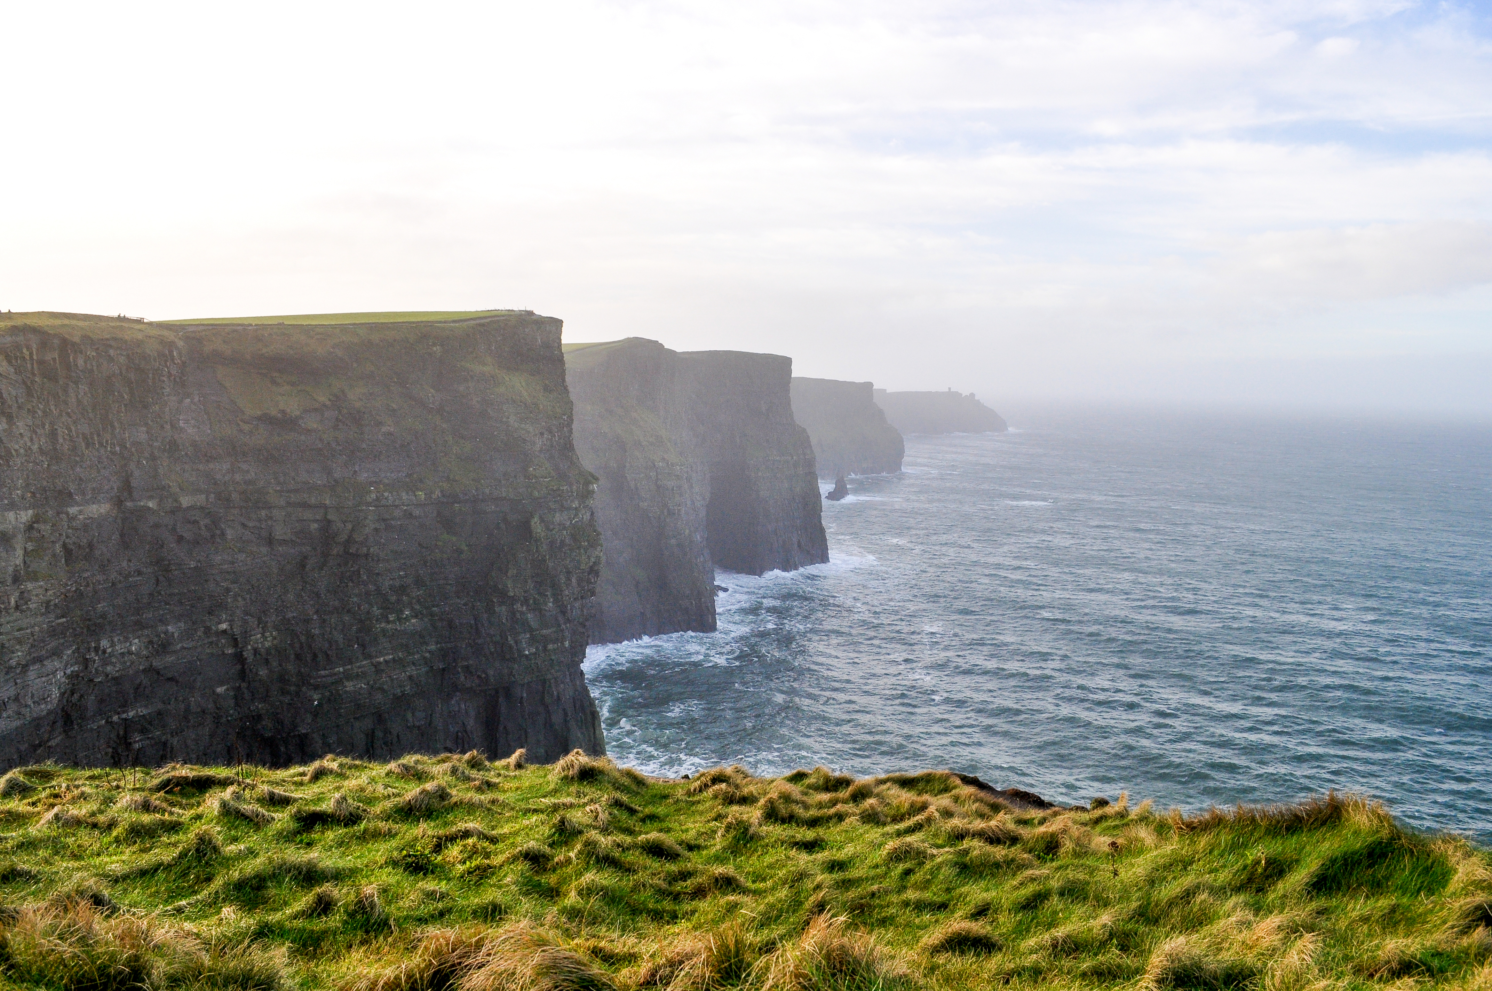
Coasts are where the edges of the higher land meet the oceans or sea.

Slide 4
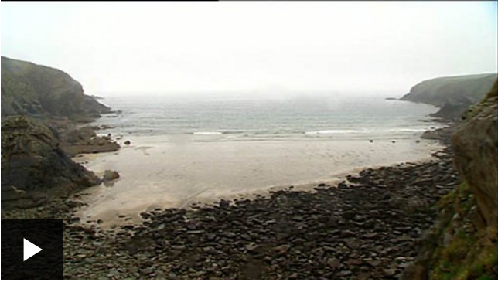

Slide 5
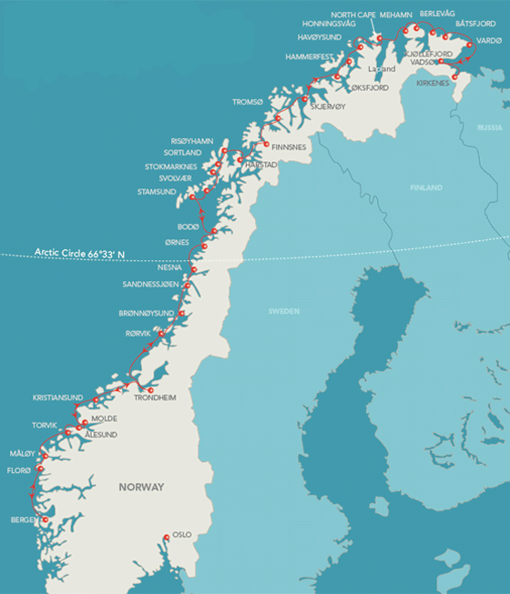
Norway has the longest coastline in Europe. It is 62,000 miles (99,780 km) in length and it is the second longest in the world.

Slide 6
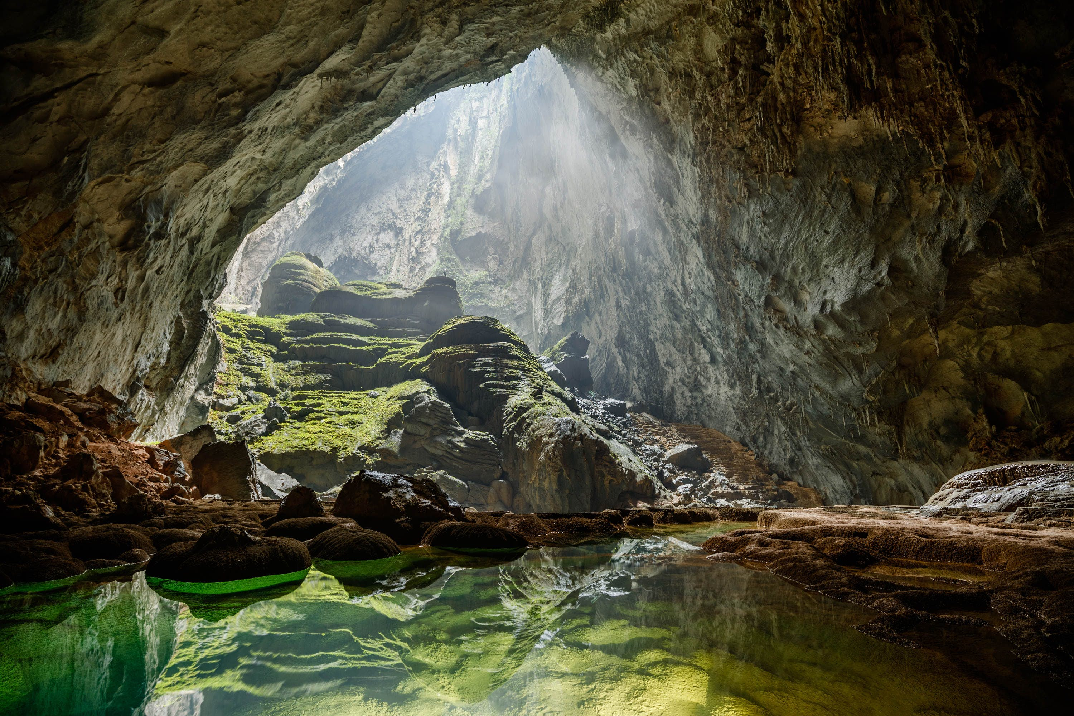
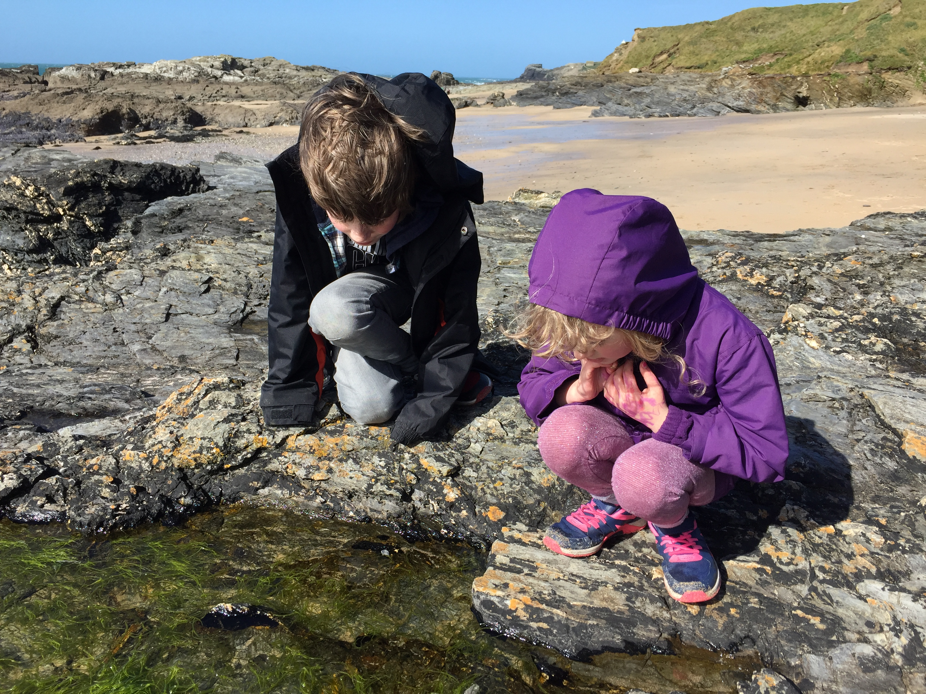
Coasts are also tourist destinations where people sunbathe on the beach, paddle in the sea and explore rock pools and caves.

Slide 7
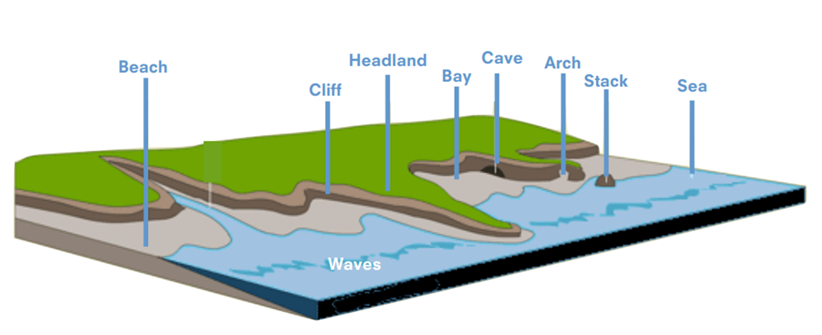
Some of the geographic features that are found there are beaches, cliffs, arches, stacks, headlands and bays. These features are formed through the processes of erosion and deposition.

Slide 8
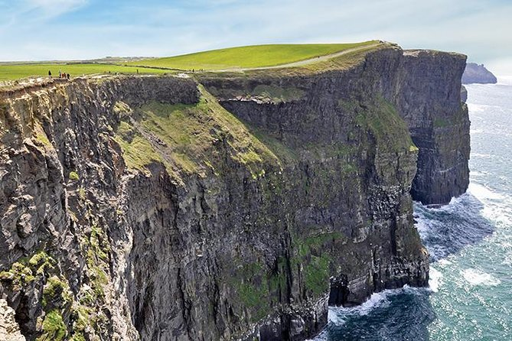
Cliffs are rocks that are very hard and not easily worn away by the sea.

Slide 9
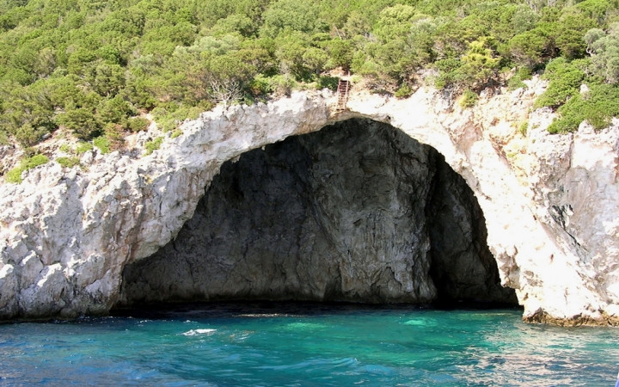
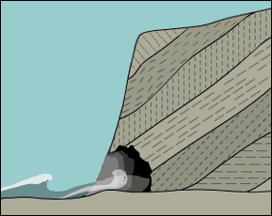
Waves are formed when wind blows over the seas or oceans. The force of the waves erodes the land. Waves erode softer areas of rock, which forms caves, short tunnels into a cliff.

Slide 10
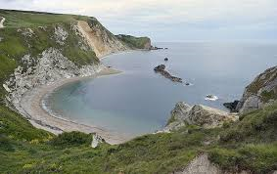
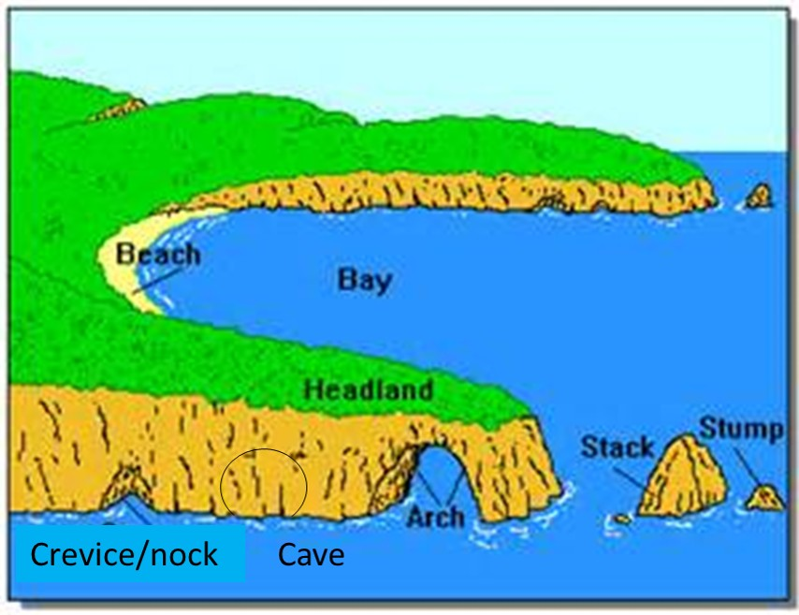
Waves also erode larger areas of the land which forms bays. The edges of the bay, where the land sticks out are called headlands.

Slide 11
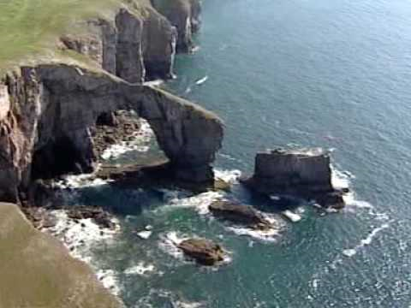
When a cave forms in a headland it sometimes gets so large that it forms an arch. When the roof of an arch collapses it forms a stack.

Slide 12
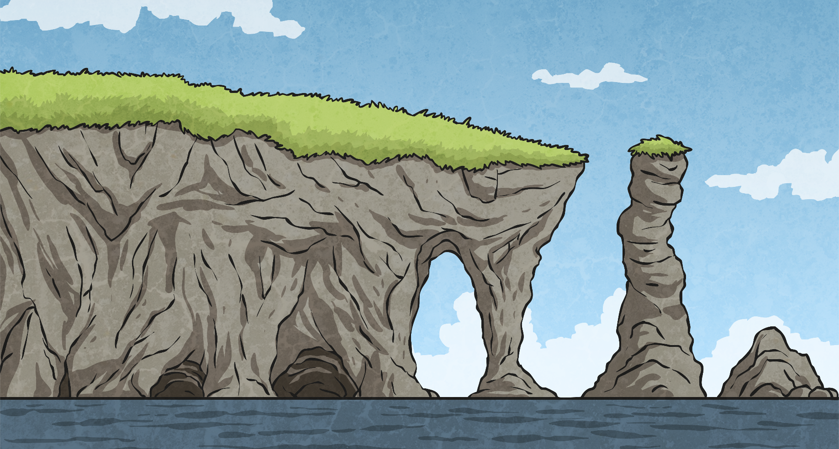
Coastal erosion causes many different features that are commonly found on a headland. Within the cliff, softer or weak sections of the rock erode more easily.
Over time, the force of the waves and the grinding action caused by materials in the water, such as sand, cause small cracks to open up in the cliff. As the water forces itself into the cracks, they continue to grow in size, eventually forming caves.
If a cave forms in a headland, it may break through to the other side of the cliff, causing an arch to form.
Over time, the stack will erode, causing it to fall and leave a small stump of rock behind.
As erosion continues, the base of the arch gets wider. This can weaken the top of the arch, causing it to collapse into the sea, leaving behind a stack (column of rock).
2
×
4
×
1
×
3
×
crack
cave
larger cave
arch
stack
stump
Click on the numbers…

Slide 13
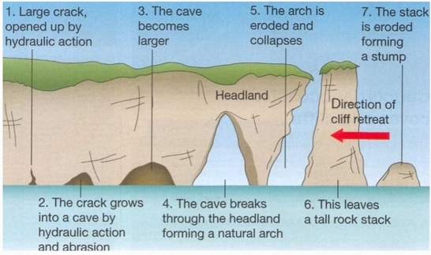

Slide 14
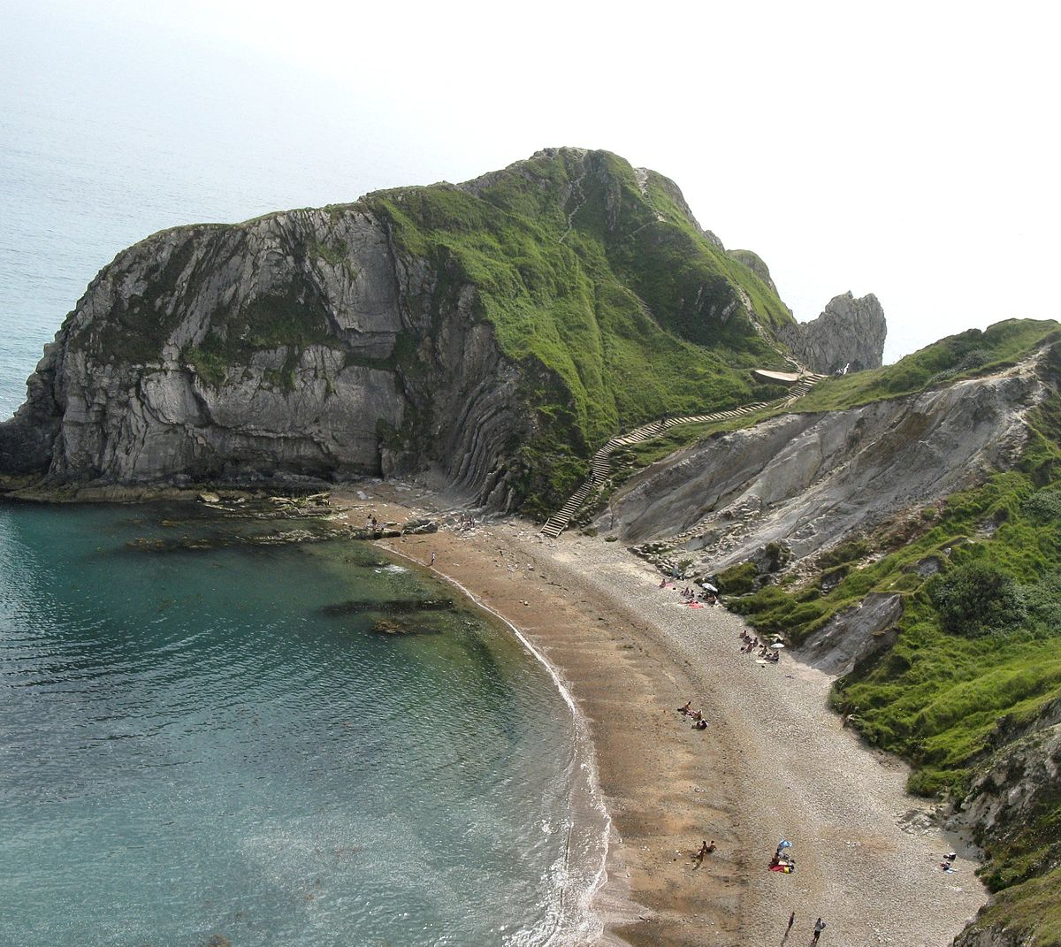
Waves also deposit the materials they erode. This forms beaches.

Slide 15
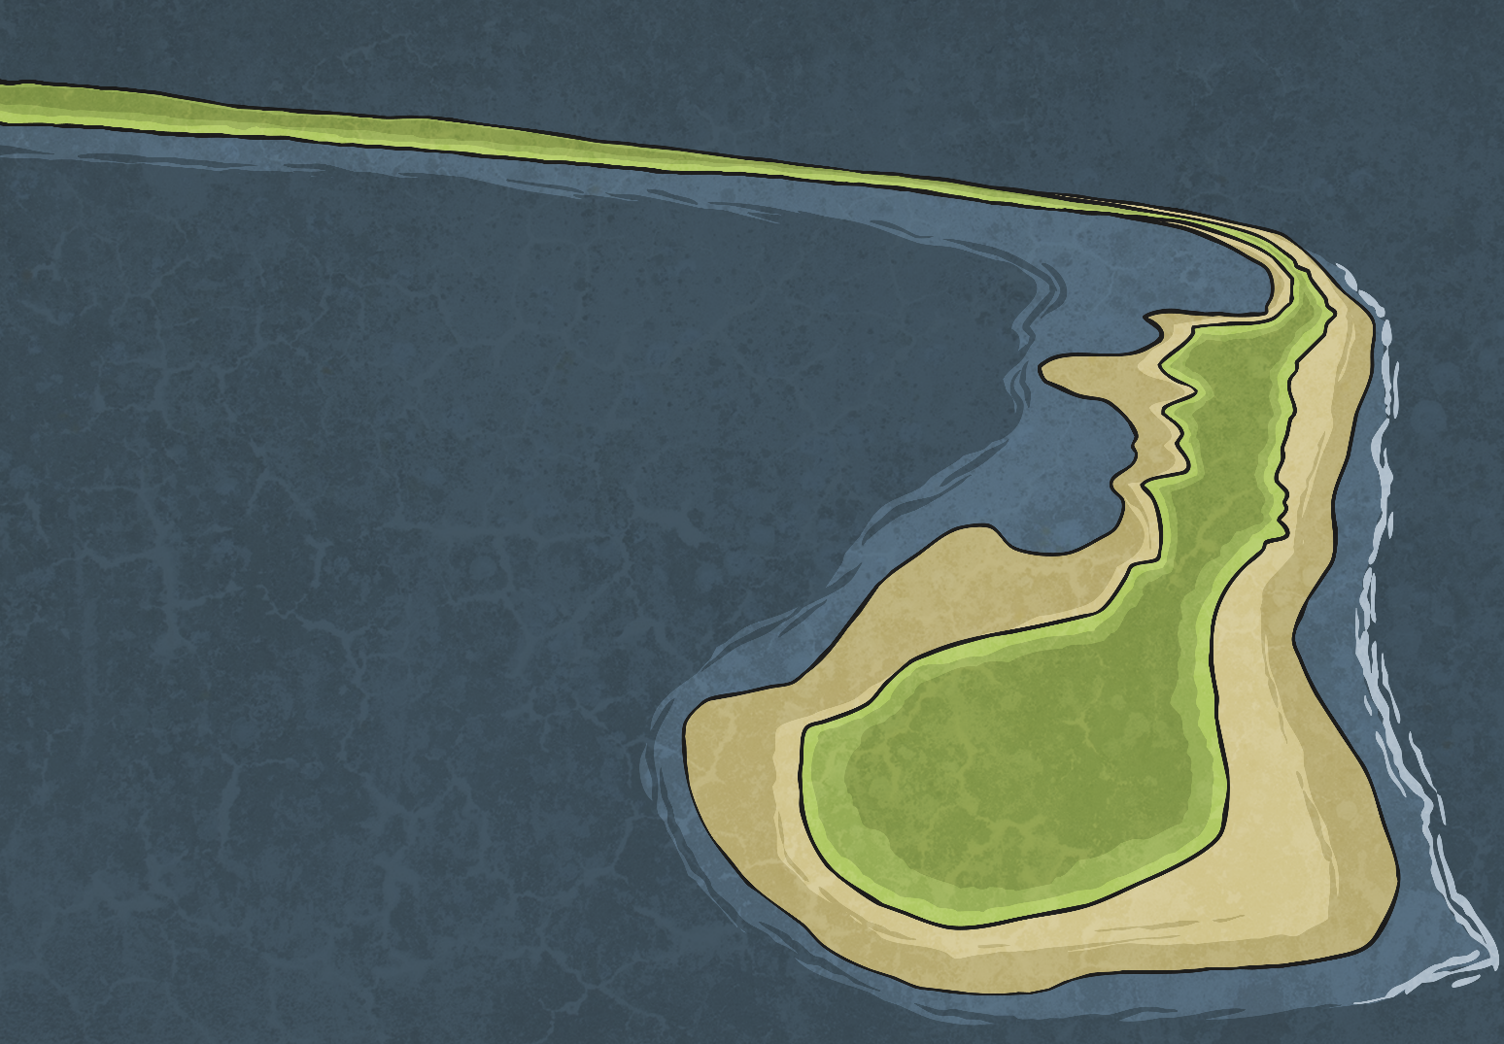
Spit
A spit is formed by deposition.
The tide carries eroded material along the coastline coast
The deposits form a long, thin sandy area of land.
Changing winds may cause the spit to form a hook shape.
Mud flats develop on the inland side of the spit.
1
2
4
3

Slide 16
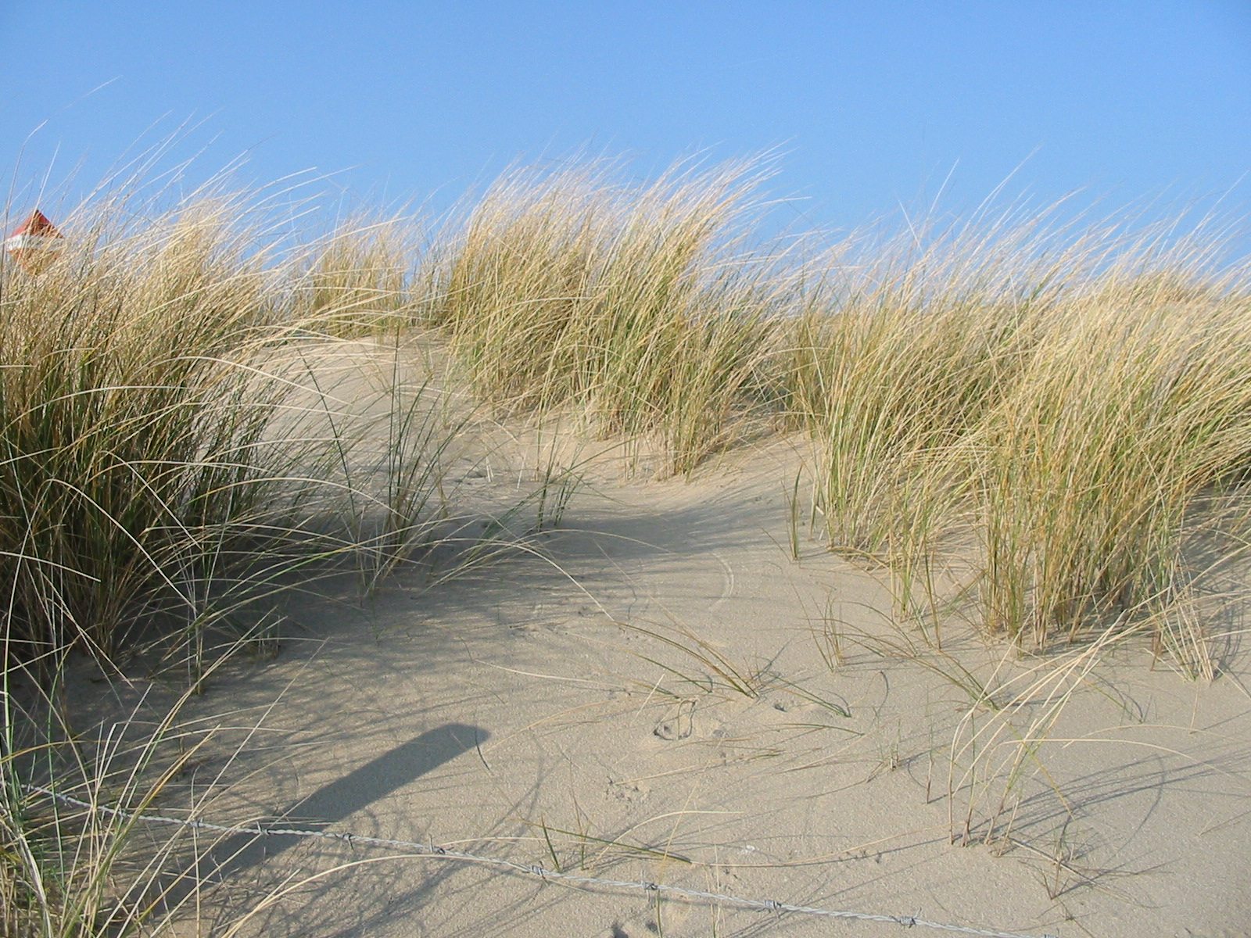
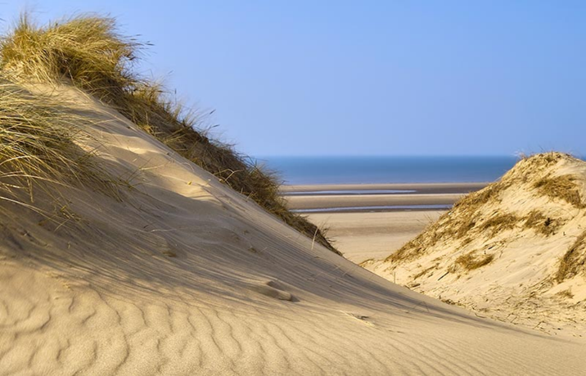
Wind along the coast can blow sand inland, which, if obstructed, can then form piles of sand called dunes.

Slide 17
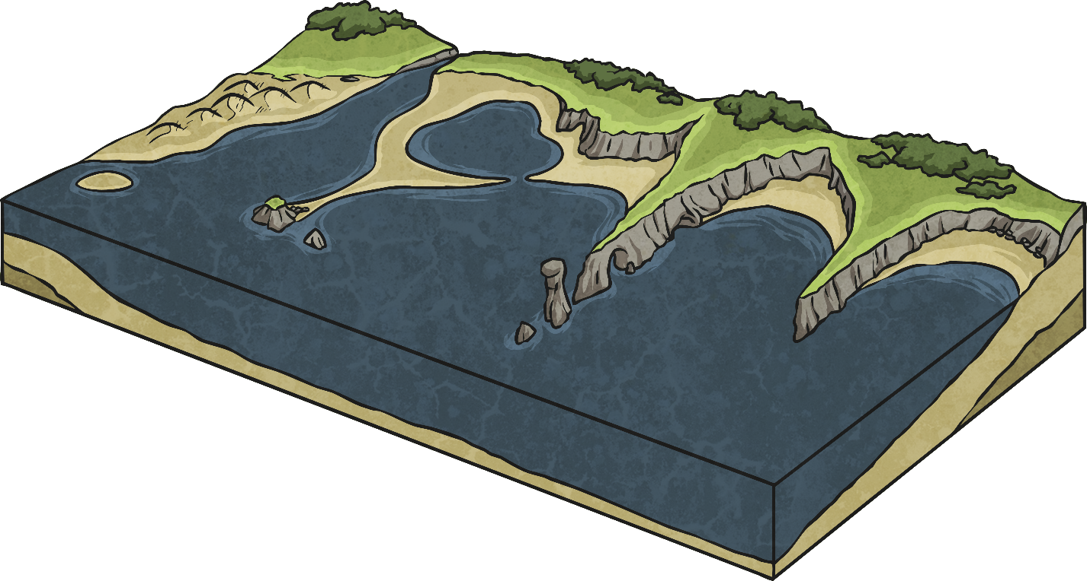
Features of Coastlines
coast
bay
headland
beach
dune
cave
cliff
arch
stack
stump
spit
dune
coast
cave
bay
stack
stump
beach
headland
cliff
spit
arch

Slide 18
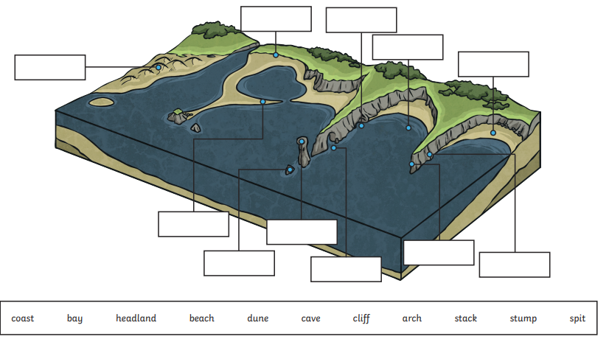
Can you label the key features of the coastline on the diagram in your books.

