Slide 1
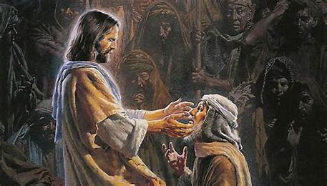
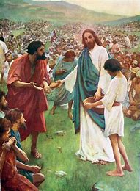
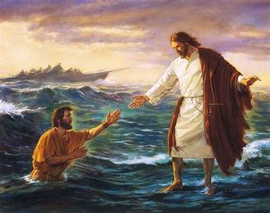
RE – Christianity Jesus’ Miracles Key Question: Could Jesus heal people? Were these miracles or is there some other explanation?
Lesson 1

Slide 2
Thursday 13th January LO: We are learning to retell Bible stories when miracles have happened and question whether Jesus really did perform miracles. LO: To think of ways we can try to make ourselves feel better, if we are ill.

Slide 3
Can you give Huey some advice on how he can get better?
I don’t feel very well ☹

Slide 4
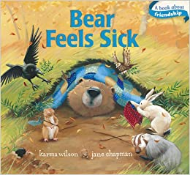
Listen to the story Bear Feels Sick by Karma Wilson

Slide 5
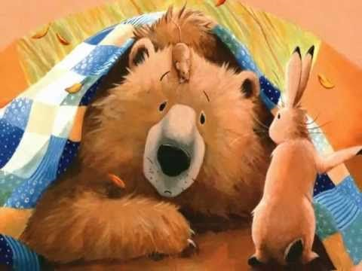
Think about and discuss the following questions:
What happened to Bear?
How did he feel better?
Was it a miracle?
How do our bodies get better when we are poorly?
What do you think the word ‘miracle’ means?

Slide 6
What happens and how does it feels when we get poorly or sick?

Slide 7
If you are poorly what do you do?
Who looks after you?
How do you get better?
Do you go to the doctor/need medicine?

Slide 8
Sometimes we can help ourselves. But how? Does frame of mind help?

Slide 9
Activity: Can you draw a picture of yourself and write ways of how you can try to make yourself feel better, if you are ill.

