Slide 1
French
Getting to Know You
Year One
Subject | Year 3 | Getting to Know You | Hello

Slide 3
Aim
To greet people in different ways.
Success Criteria
I can say hello at different times of day.
I can use formal and informal language appropriately.
I can use gestures to support my conversation.

Slide 4
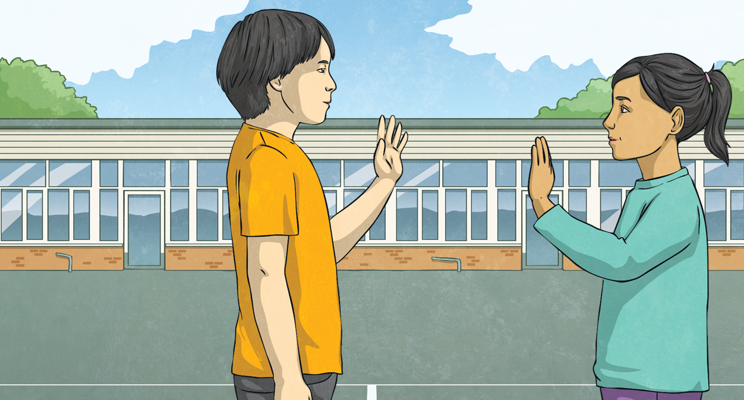
Click play buttons throughout to hear phrases and words.
Bonjour!
Bonjour means ‘good day’.
Turn to a friend and greet them with ‘bonjour’.

Slide 5
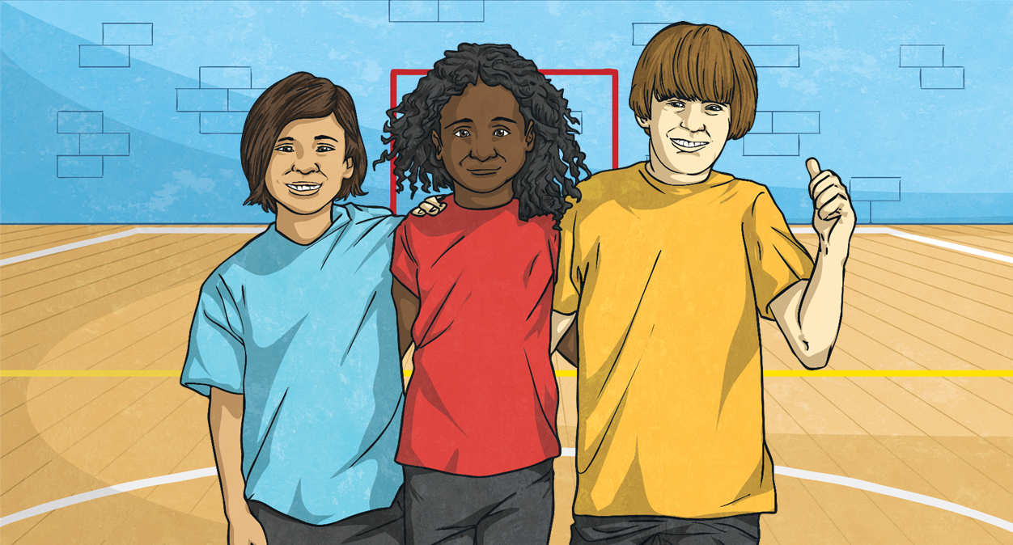
Salut!
Salut means ‘hi’.
Who might you say ‘salut’ to?

Slide 6
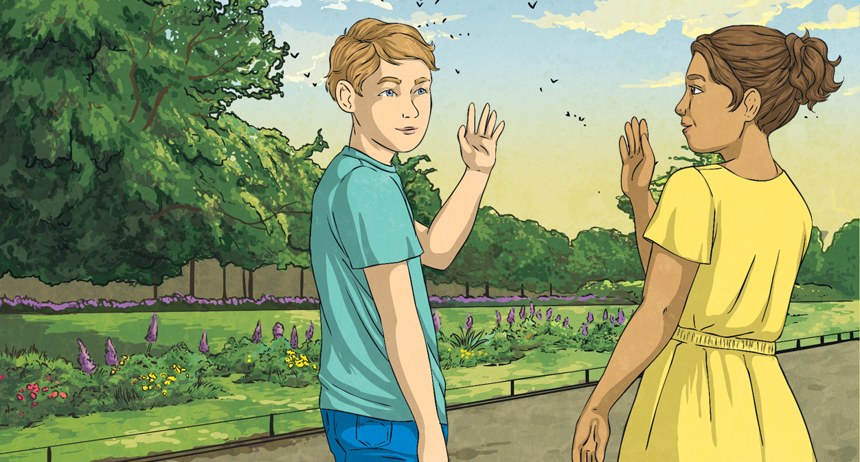
Bonsoir!
Bonsoir! means ‘good evening’.
When might you say ‘bonsoir’ to someone?

Slide 7
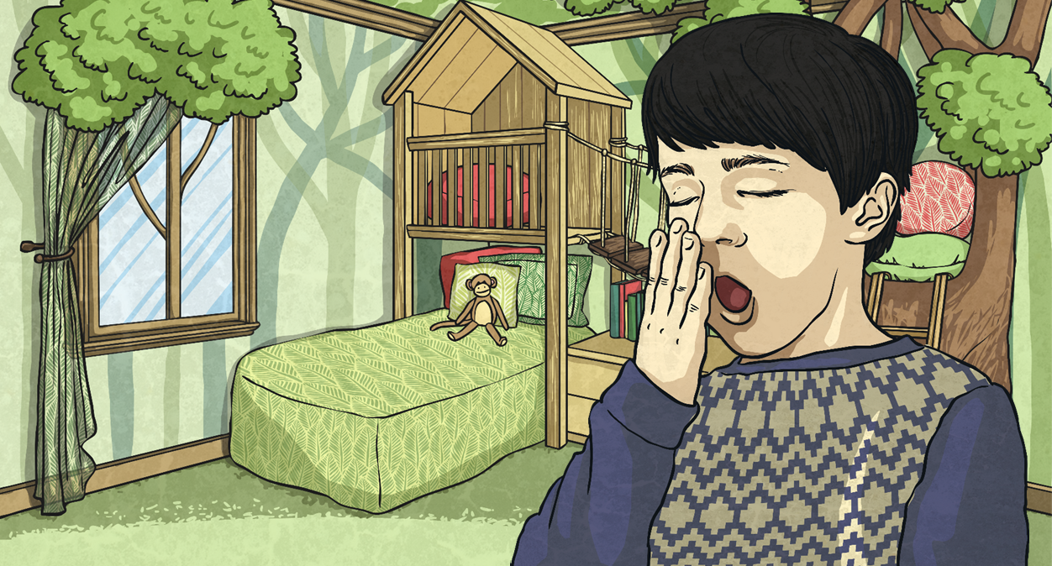
Bonne nuit!
Bonne nuit! means ‘good night’.
Who might you say ‘bonne nuit’ to?

Slide 8
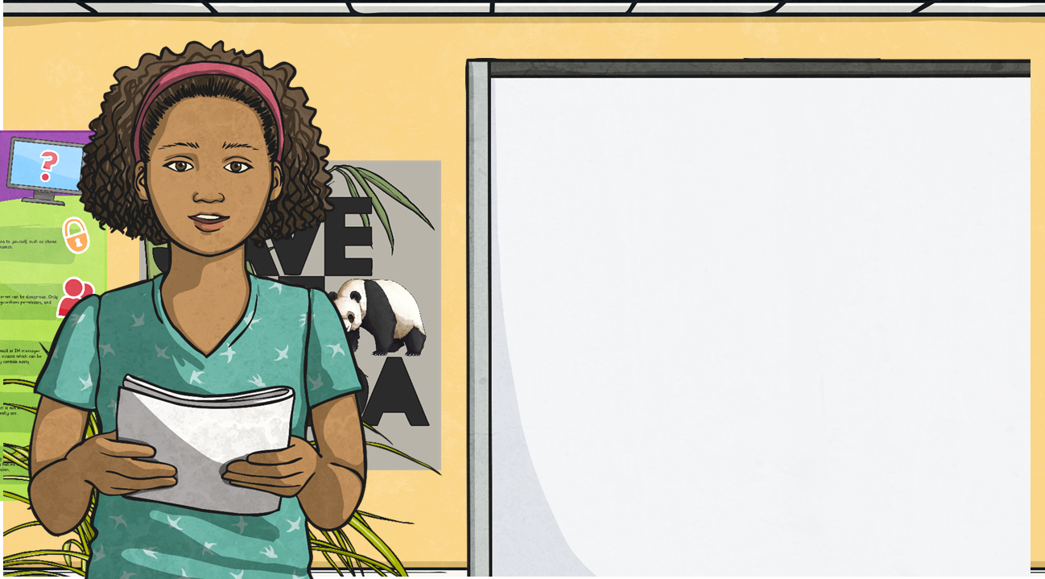
Meet and Greet Song
Click the button to listen to the Meet and Greet Song.
Bonjour.
Salut.
Listen out for these phrases:
Bonne nuit!
Sing along when you have got the hang of it.
Bonsoir!

Slide 9
Aim
To greet people in different ways.
Success Criteria
I can say hello at different times of day.
I can use formal and informal language appropriately.
I can use gestures to support my conversation.

