Slide 1
The Dark
Lemony Snicket

Slide 2
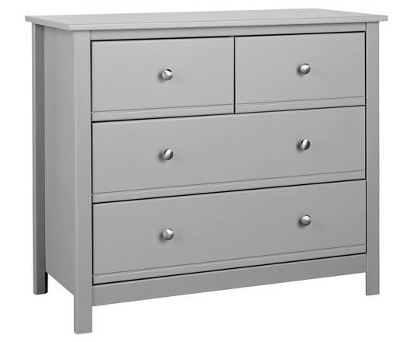
Vocabulary Check
a chest of drawers
peek - to look in a cautious way
a closet
a shower curtain
creak - a squeaking noise
basement - part of a building that is below ground level

Slide 3
Quick Start
How does Laszlo feel about the dark?
Where does the dark live?
Where does the dark visit Laszlo?
What does the dark help Laszlo find?

Slide 4
Partnered Talk
How do you think Laszlo feels when the dark tells him to come closer?

Slide 5
Partnered Talk
How do you think Laszlo feels when the dark tells him to come closer?
Laszlo might feel nervous and a little bit scared because he is scared of the dark.

Slide 6
Individual Thinking
Why is the dark back in the basement in the morning?

Slide 7
Individual Thinking
Why is the dark back in the basement in the morning?
The dark comes out of the basement when it is night time because it is dark outside. It goes back to the basement in the morning when it is bright.

Slide 8
Partnered Talk
How can you tell Laszlo is no longer afraid of the dark towards the end of the story?

Slide 9
Partnered Talk
How can you tell Laszlo is no longer afraid of the dark towards the end of the story?
At the end of the story it tells us that the dark never bothered him again. This means that he was no longer afraid.

Slide 10
Independent Thinking
Explain how Laszlo’s feelings have changed throughout the story.

Slide 11
Independent Thinking
Explain how Laszlo’s feelings have changed throughout the story.
At the beginning of the story, Laszlo is afraid of the dark. At the end of the story Laszlo is braver and no longer afraid of the dark.

Slide 12
Solo Work
Summarise the events of the story in fewer than 30 words.

