Slide 1
Tuesday 16th November 2021
LO: To create a text map and learn to say the text.

Slide 2
Today we are continuing with creating our text map and learning to say the text about the Kingston Frost Dragon.
Remember to add in actions as you learn it as this will help you to remember the text.

Slide 3
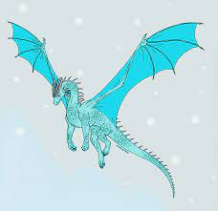
The Kingston Frost Dragon

Slide 4
The Kingston Frost Dragon is a type of dragon.

Slide 5
Have you ever wondered what a Frost Dragon looks like? In fact, they are similar to the majority of dragons. Like most dragons, they have huge wings, large jaws, a spiny back and a long tail. Typically, they are a sparkling white colour. However, some have been spotted that are an icy blue. Furthermore, their teeth are made of diamonds and look like icicles.
(This paragraph continues on the next slide)

Slide 6
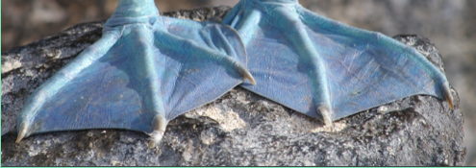
The main feature of this dragon is that it does not breathe flames. They breathe frost and snow. A few dragons of this variety have the ability to breathe on any creature and freeze it to stone. Additionally, they all have webbed feet that they use for swimming.

Slide 7
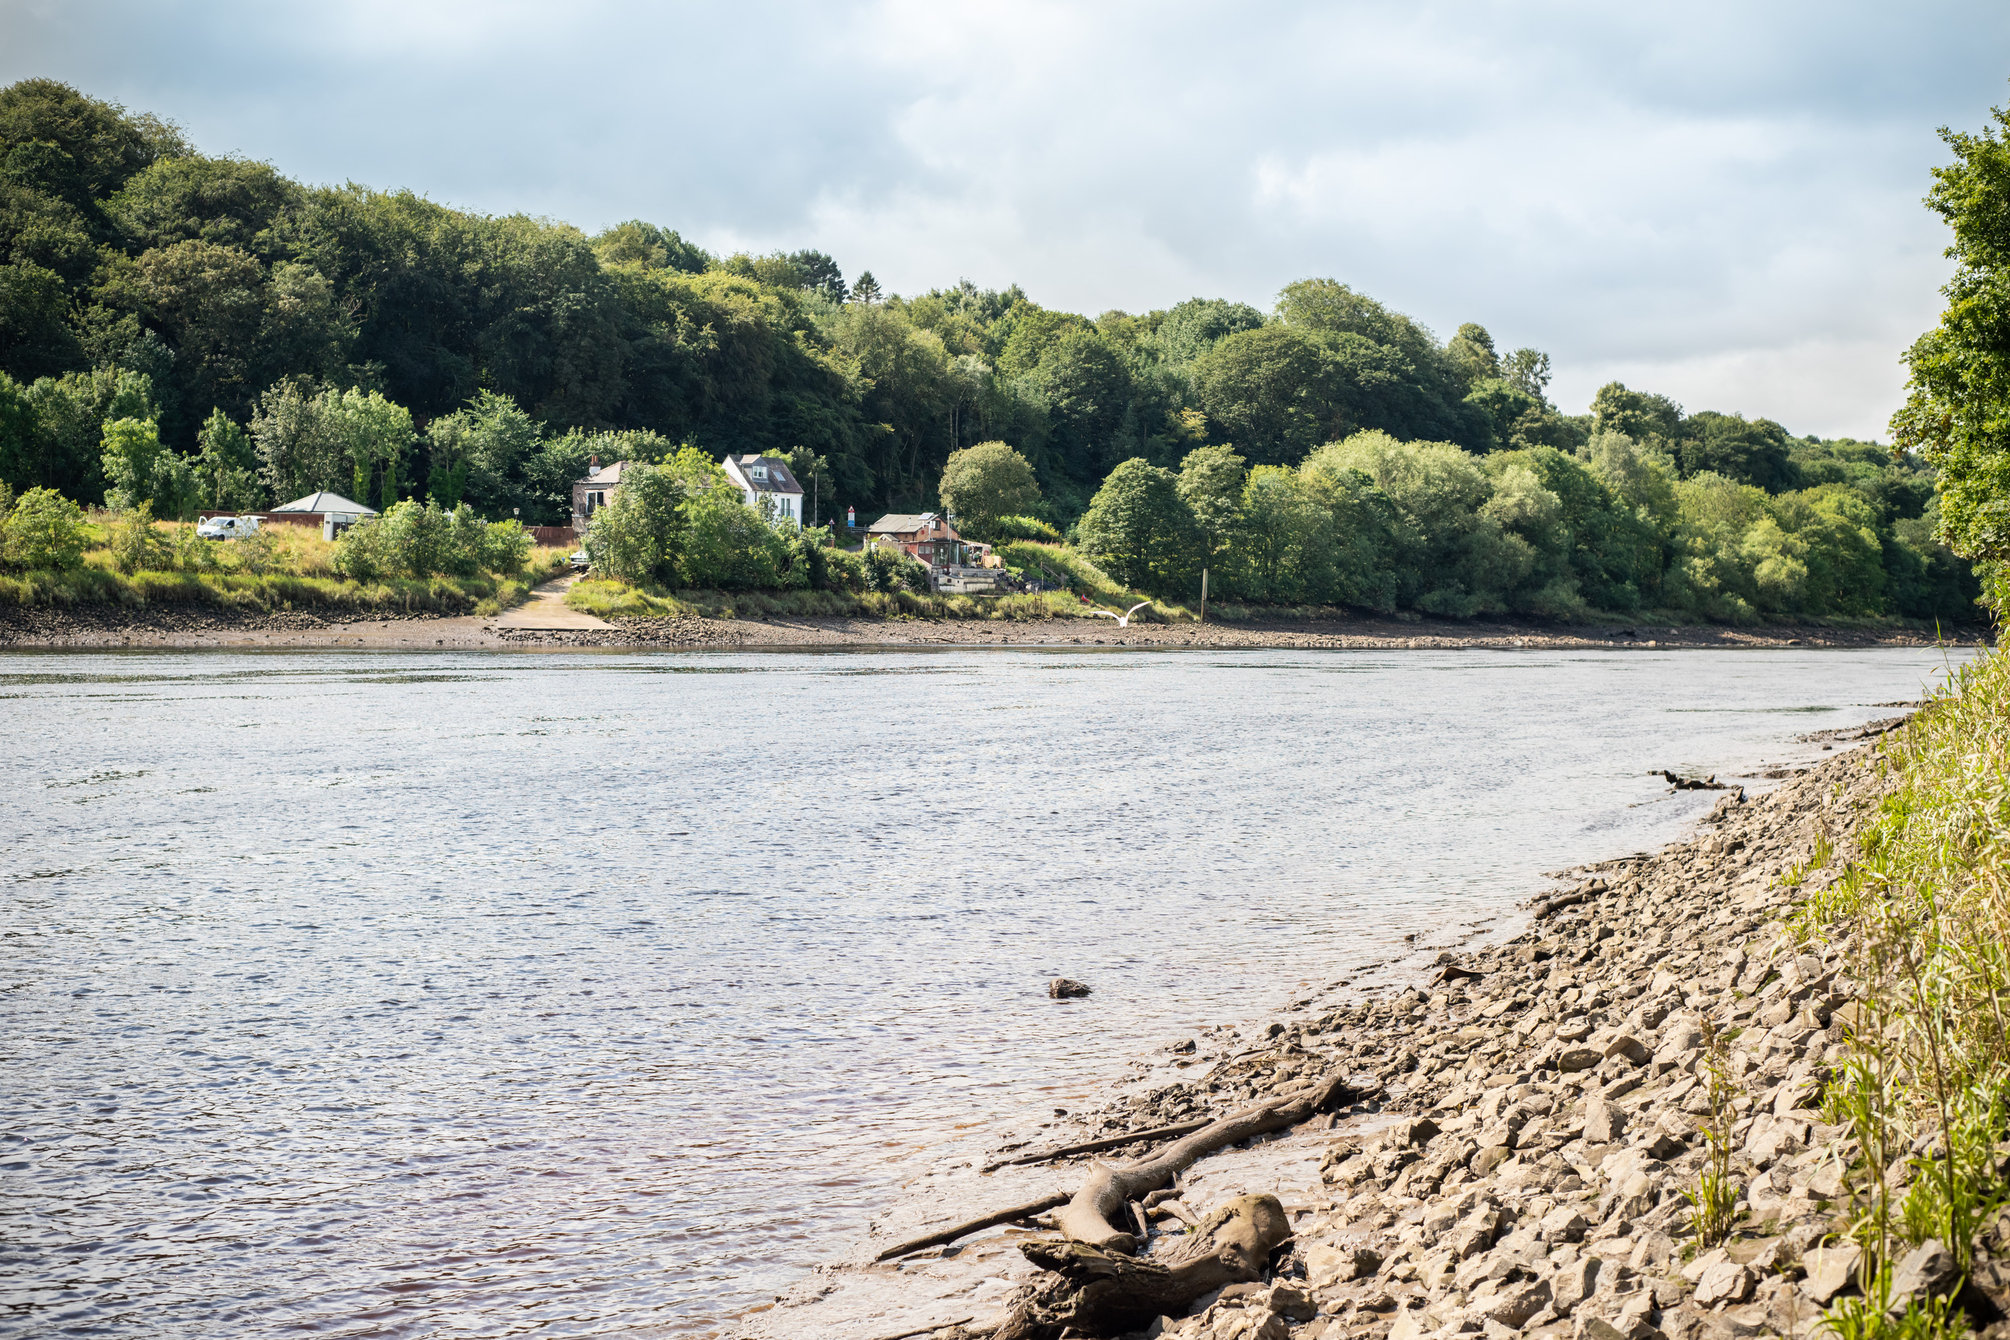
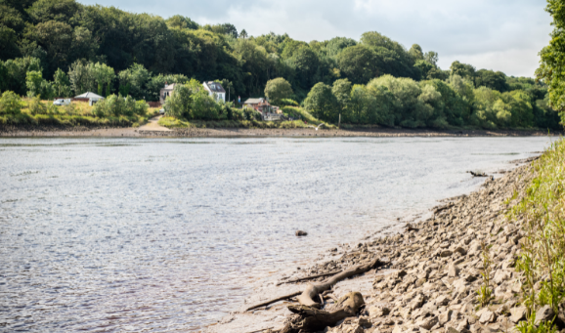
The Frost Dragon lives by the River Tyne. It hides in the tops of trees and is difficult to see because most of them can become almost invisible. This dragon likes to hide in frosty fields or mist. This makes them difficult to track down. They only come out at night and tend to move round the countryside when it is snowing or misty.

Slide 8
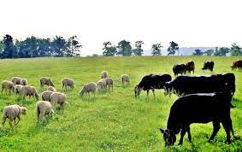
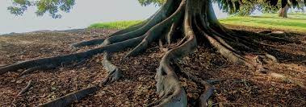
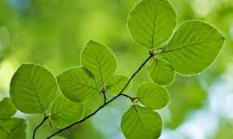
Are Frost Dragons dangerous? Many humans fear these dragons because they believe that they eat only princesses. However, this is not true. They will steal cattle and sheep but actually have never been known to attack a human. Indeed, in the summer, they are more likely to eat the roots of trees and fresh leaves than animals. This habit makes their skin glow a strange green colour.

Slide 9
The most interesting thing about a Frost Dragon is that they tell great stories. They can enchant people with their tales that have been known to last over a year long. Indeed, many people believe that the story of a thousand and one nights was actually told by a patient Frost Dragon! It has been suggested that they might be able to tell stories in schools.

Slide 10
When we have completed our text map, let’s see if we can use it to say the whole text with actions.

