Slide 2
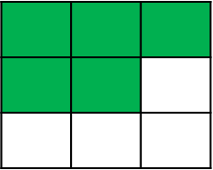
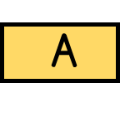
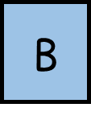
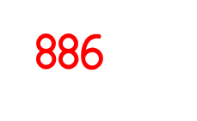
2

Slide 3
2

Slide 4
TTYP about all you can remember about fractions so far. Do we need to add anything else to our learning wall?

Slide 5
1) What fraction of each shape is shaded?
2) How many sevenths are there in one?
3) How many tenths are there in two?

Slide 6
1) What fraction of each shape is shaded?
$$\frac{\text{5}}{\text{9}}$$
$$\frac{\text{1}}{\text{4}}$$
$$\frac{\text{1}}{\text{1}}$$
Or 1
2) How many sevenths are there in one?
7
3) How many tenths are there in two?
20

Slide 7
I want you to write the definition of equivalent in your books.

Slide 8
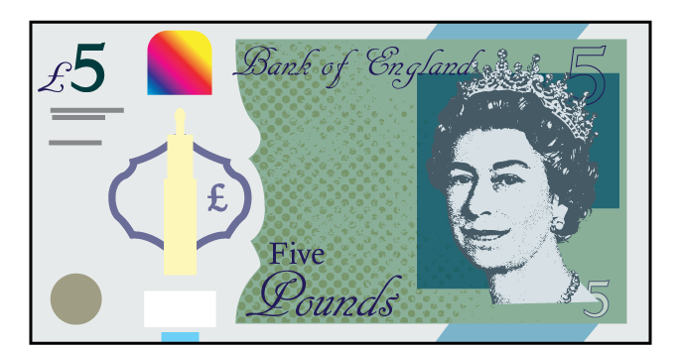
equivalent
“of equal value, amount or meaning”
are equivalent to
3 $+$ 3
is equivalent to
5 $+$ 1
1 cm
is equivalent to
10 mm

Slide 9
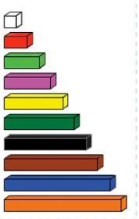
You are going to spend 10 minutes with your partner using the Cuisenaire rods to investigate and record equivalent fractions.
How many red rods are
the same as a purple rod?
This is an equivalent.
Model this.

Slide 10
$$\frac{\text{1}}{\text{2}}$$
$$\frac{\text{1}}{\text{2}}$$
$$\frac{\text{1}}{\text{4}}$$
$$\frac{\text{1}}{\text{4}}$$
$$\frac{\text{1}}{\text{4}}$$
$$\frac{\text{1}}{\text{4}}$$
$$\frac{\text{1}}{\text{2}}=\frac{\text{2}}{\text{4}}$$

Slide 11
$$\frac{\text{1}}{\text{4}}$$
$$\frac{\text{1}}{\text{4}}$$
$$\frac{\text{1}}{\text{4}}$$
$$\frac{\text{1}}{\text{4}}$$
$$\frac{\text{1}}{\text{8}}$$
$$\frac{\text{1}}{\text{8}}$$
$$\frac{\text{1}}{\text{8}}$$
$$\frac{\text{1}}{\text{8}}$$
$$\frac{\text{1}}{\text{8}}$$
$$\frac{\text{1}}{\text{8}}$$
$$\frac{\text{1}}{\text{8}}$$
$$\frac{\text{1}}{\text{8}}$$
How many eighths are equivalent to a half?
$$\frac{\text{2}}{\text{4}}=\frac{\text{1}}{\text{2}}=\frac{\text{4}}{\text{8}}$$
Have a think

Slide 12
Have a think
$$\frac{\text{2}}{\text{3}}=\frac{\text{4}}{\text{6}}$$

Slide 13
$$\frac{\text{1}}{\text{3}}=\frac{\text{4}}{\text{12}}$$
$$\frac{\text{2}}{\text{3}}=\frac{\text{8}}{\text{12}}$$
$$\frac{\text{3}}{\text{3}}=\frac{\text{12}}{\text{12}}$$

Slide 14
$$\frac{\text{4}}{\text{12}}$$
$$\frac{\text{1}}{\text{3}}$$
Have a think

Slide 15
Have a go at questions 1, 2 and 3. Think back to the work with Cuisenaire rods.

Slide 16
Have a think
I could use any of these bar models to show $\frac{\text{1}}{\text{2}}$

Slide 18
Complete the rest of the questions on your sheet. There are some challenge questions for you to explain.

