Slide 1
Thursday 1st July. Key question: Do people need to go to church to show they are Christians?
LO – I know reasons why people may go to church.

Slide 2
Question for discussion. TTYP about whether you have ever been in a church.
Talk about the services or celebrations that you attended at church. Is it somewhere you go regularly.

Slide 3
Why do Christians go to church?
Do all Christians go to church?

Slide 4
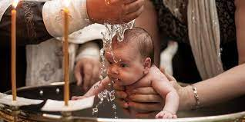
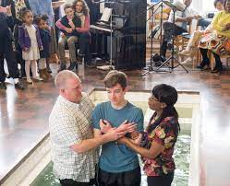
Baptisms.
www.bbc.co.uk/education/topics/ztkxpv4/resources/1
There are four short videos about Christian baptism to watch.
What is a baptism? Write a definition in your RE books.

Slide 5
Baptisms – questions to think about.
Why do you think some parents choose to have their babies baptised?
Why do you think some adults choose to be baptised?
Why do you think some choose to be baptised in rivers/seas and others in church?
Do you think it makes a difference where people choose to be baptised.

Slide 6
Tasks. In your books, write a definition of baptism and then answer the questions on the following slide.

Slide 7
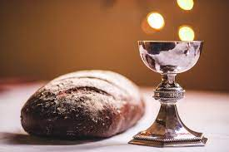
Holy Communion.
www.bbc.co.uk/education/clips/zwcd2hv
Christians choose to have a special meal (it isn’t really a meal, it is just a reminder of a meal) to do just what Jesus did: break bread to remember his body (death) and a drink of juice or wine to remember his blood. At the end of the Lord’s Supper, Christians have remembered that Jesus died for them and forgave them and loves them.
Holy Communion often happens in churches, but it can be taken with a group of Christians who just want to thank him for giving his life for them. Do Christian’s need to be in a church to take Holy Communion? Where else could they do this?

Slide 8
Tasks. In your books, write a definition of Holy Communion and then answer the questions on the following slide.

Slide 9
Holy Communion – questions to think about.
What is Holy Communion?
Does it have to be taken in a church?
Where else could it be taken?
In your books, write a definition of Holy Communion. Then write a sentence or two describing where it can be taken.

Slide 10
Thursday 1st July. Key question: Do people need to go to church to show they are Christians?

