Slide 1
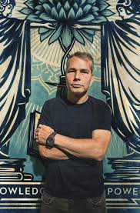
Shepard Fairey Street Art

Slide 2
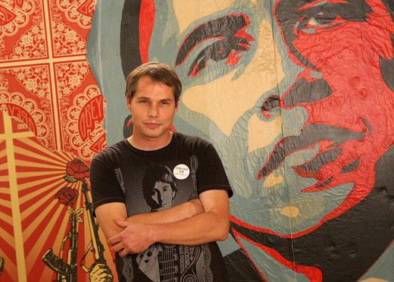
Who is Shepard Fairey?
He was born on 15th February 1970; he is 50 years old.
Shepard Fairey is an American street artist, graphic designer, illustrator, and founder of OBEY Clothing.
His most recognisable work is The Barack Obama "Hope" poster which came to represent Obama’s campaign to become the President of the United States.

Slide 3
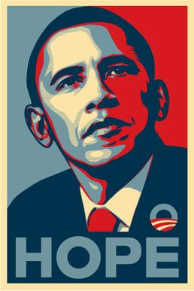
Barack Obama “Hope” poster
As a designer his goal was to design a piece of artwork that would help Obama to win the election.

Slide 4
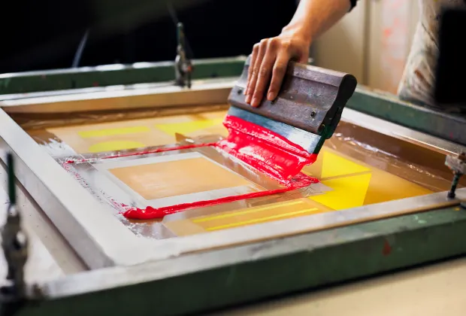
He used a technique called “screen printing” to create the image

Slide 5
Shepard Fairey also creates murals.
A mural is a painting or other work of art executed directly on a wall.
Lets take a look…

Slide 6
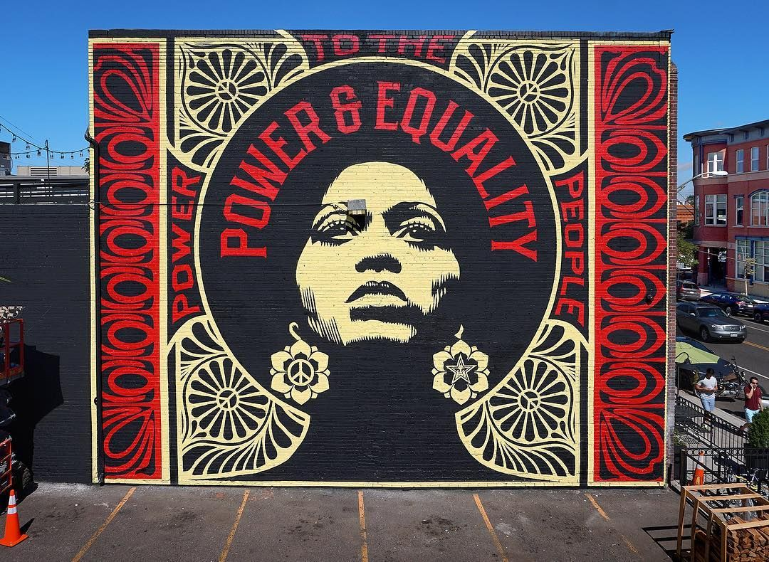

Slide 7
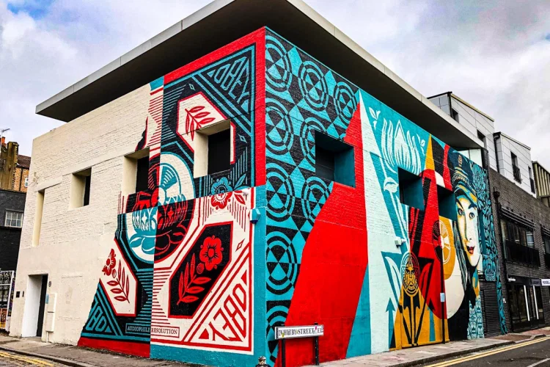

Slide 8
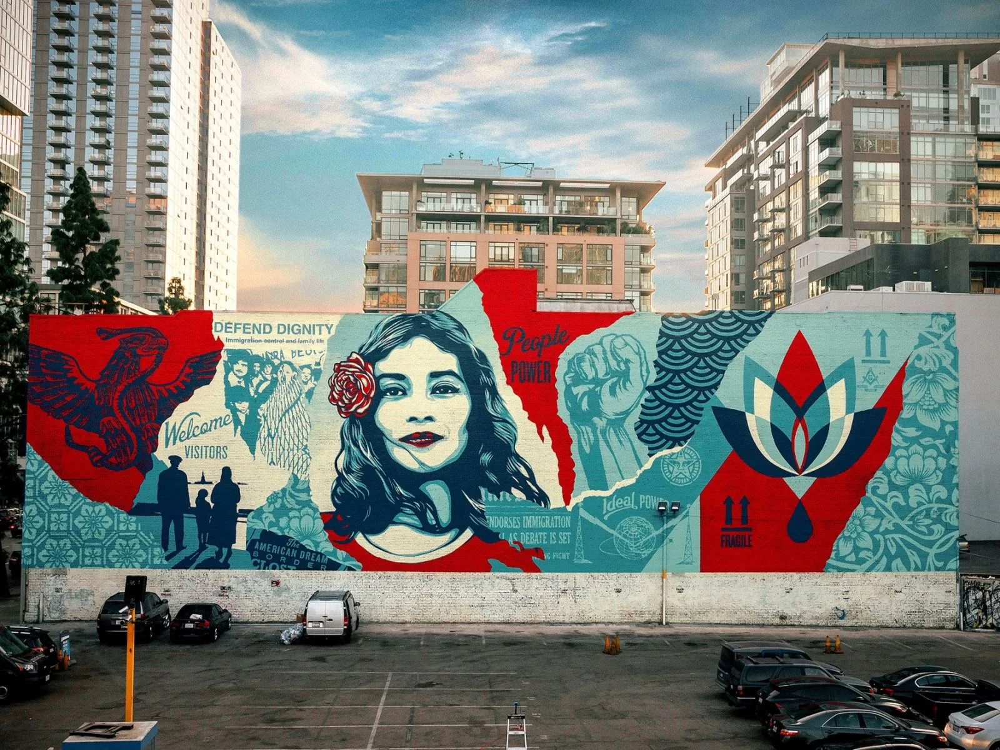

Slide 9
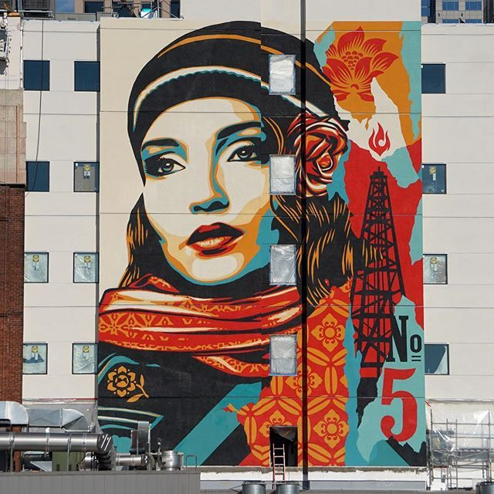

Slide 10
What do you think of Shepard Fairey’s murals? Do you like them? Why or why not?

Slide 11
Here are some examples of murals created by other artists.

Slide 12
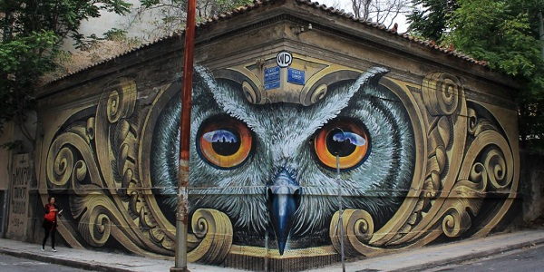

Slide 13
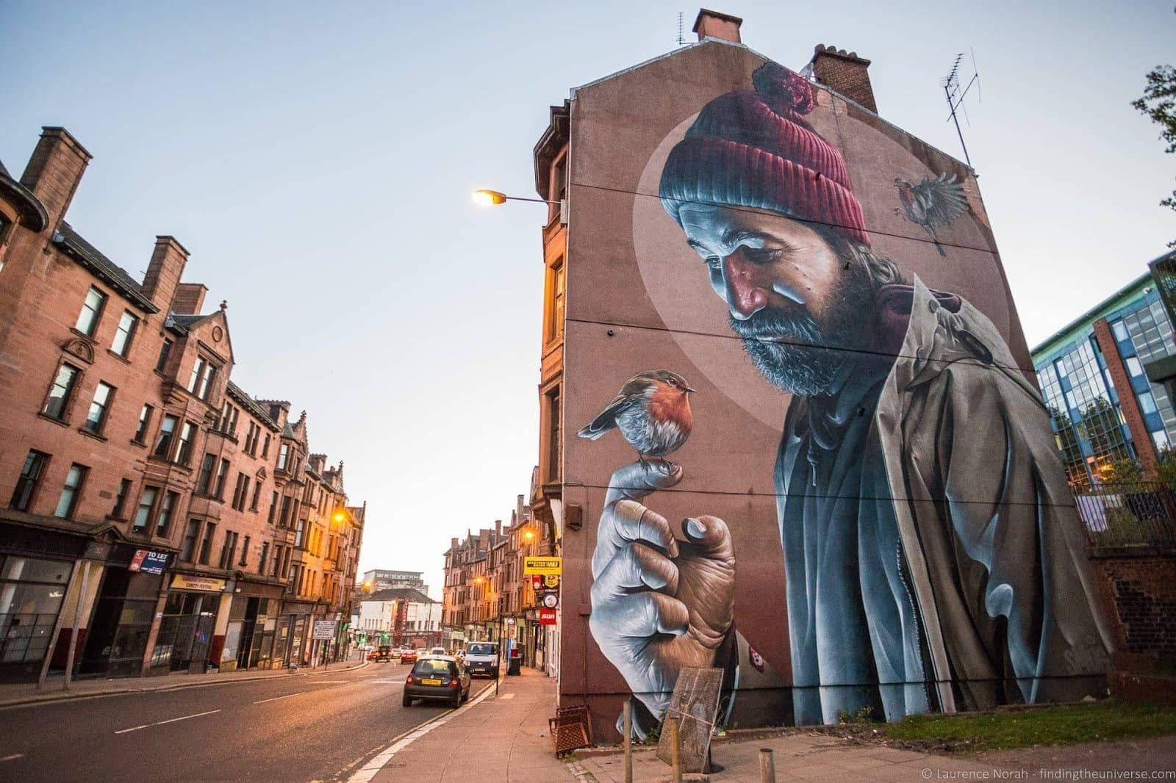

Slide 14
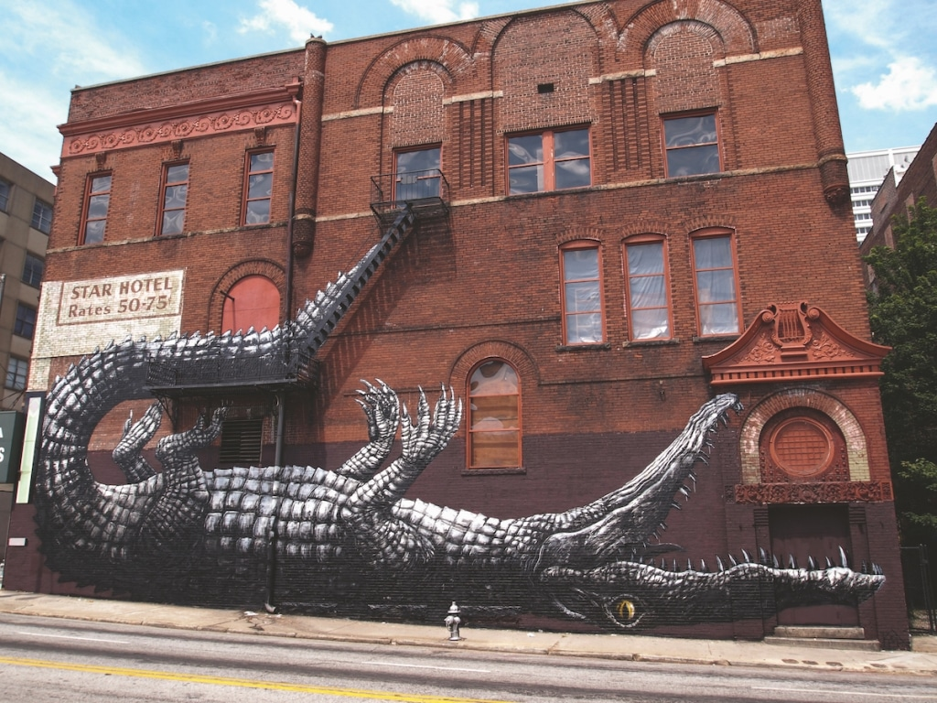

Slide 15
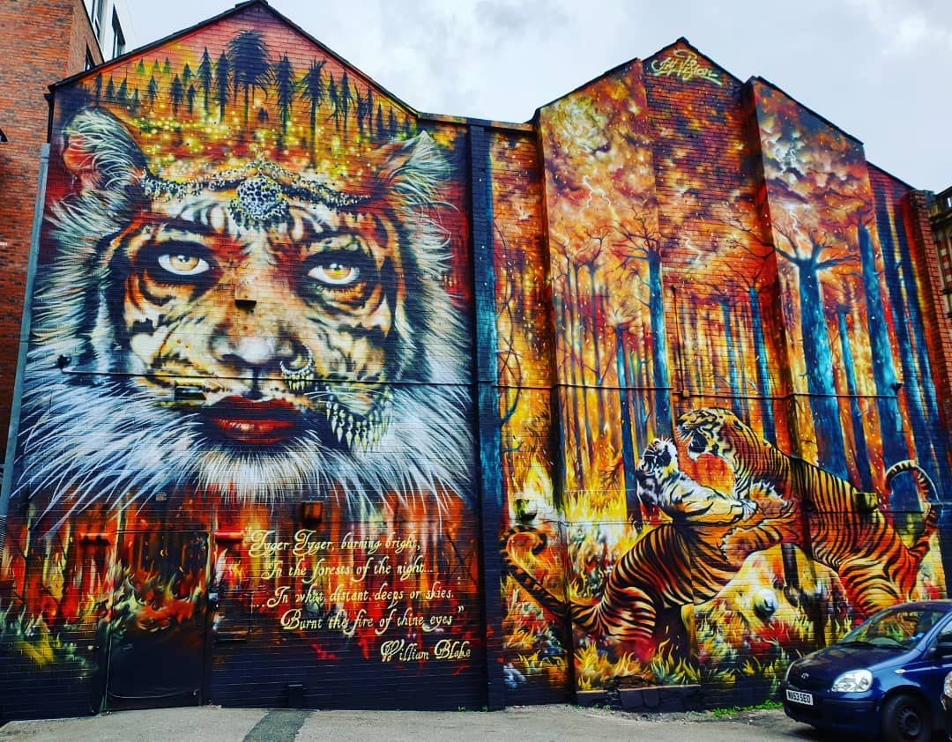

Slide 16
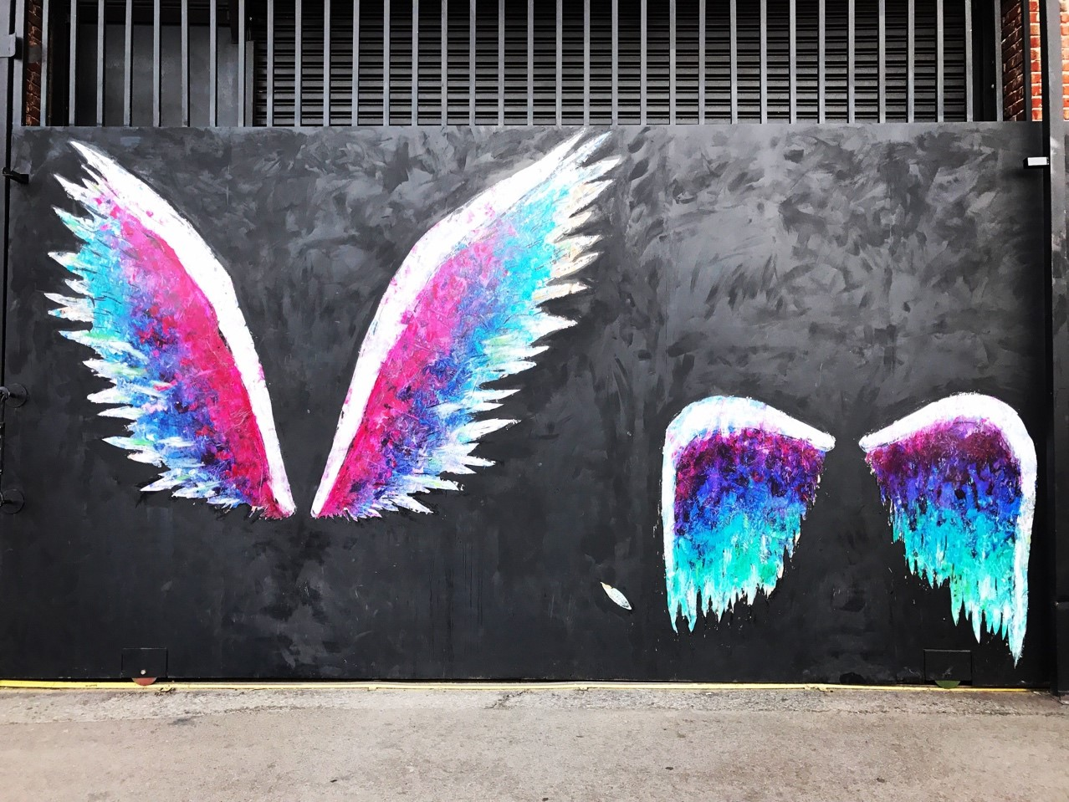

Slide 17
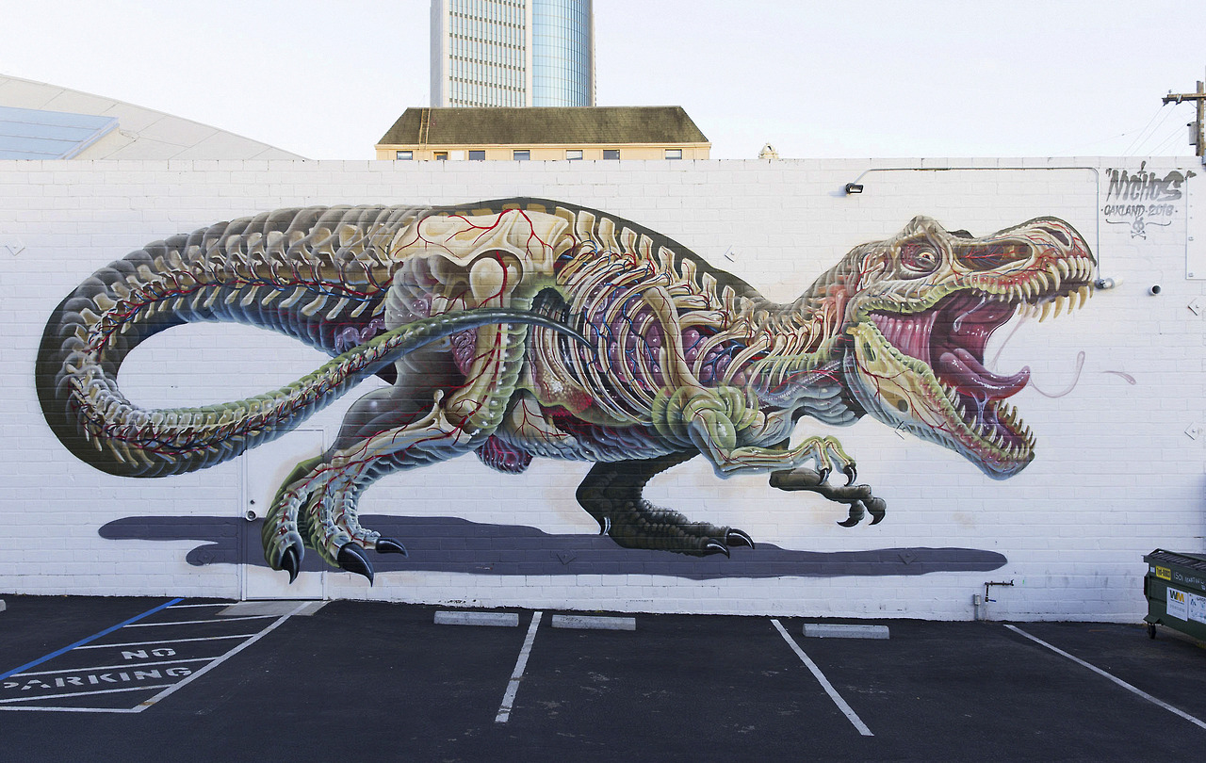

Slide 18
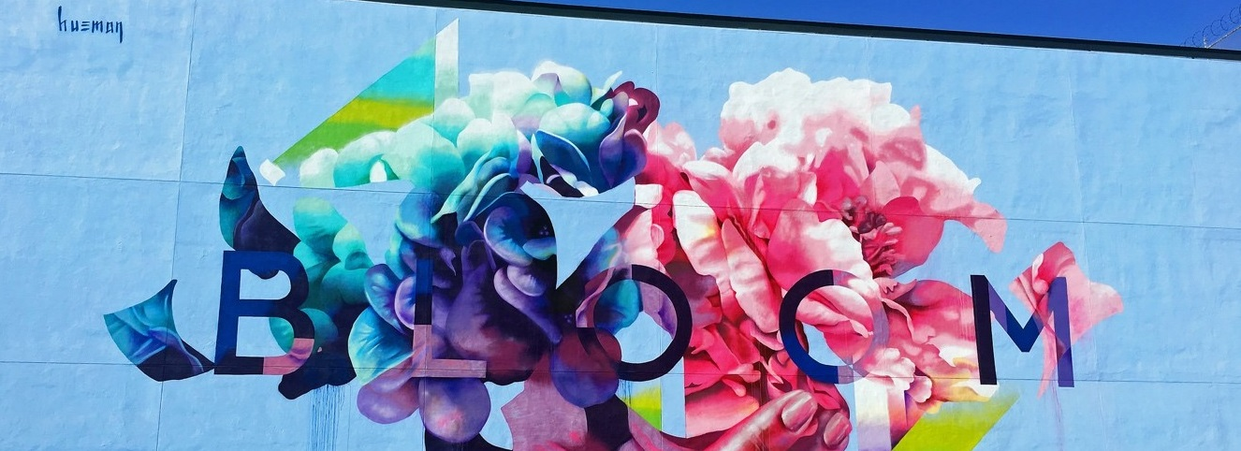

Slide 19
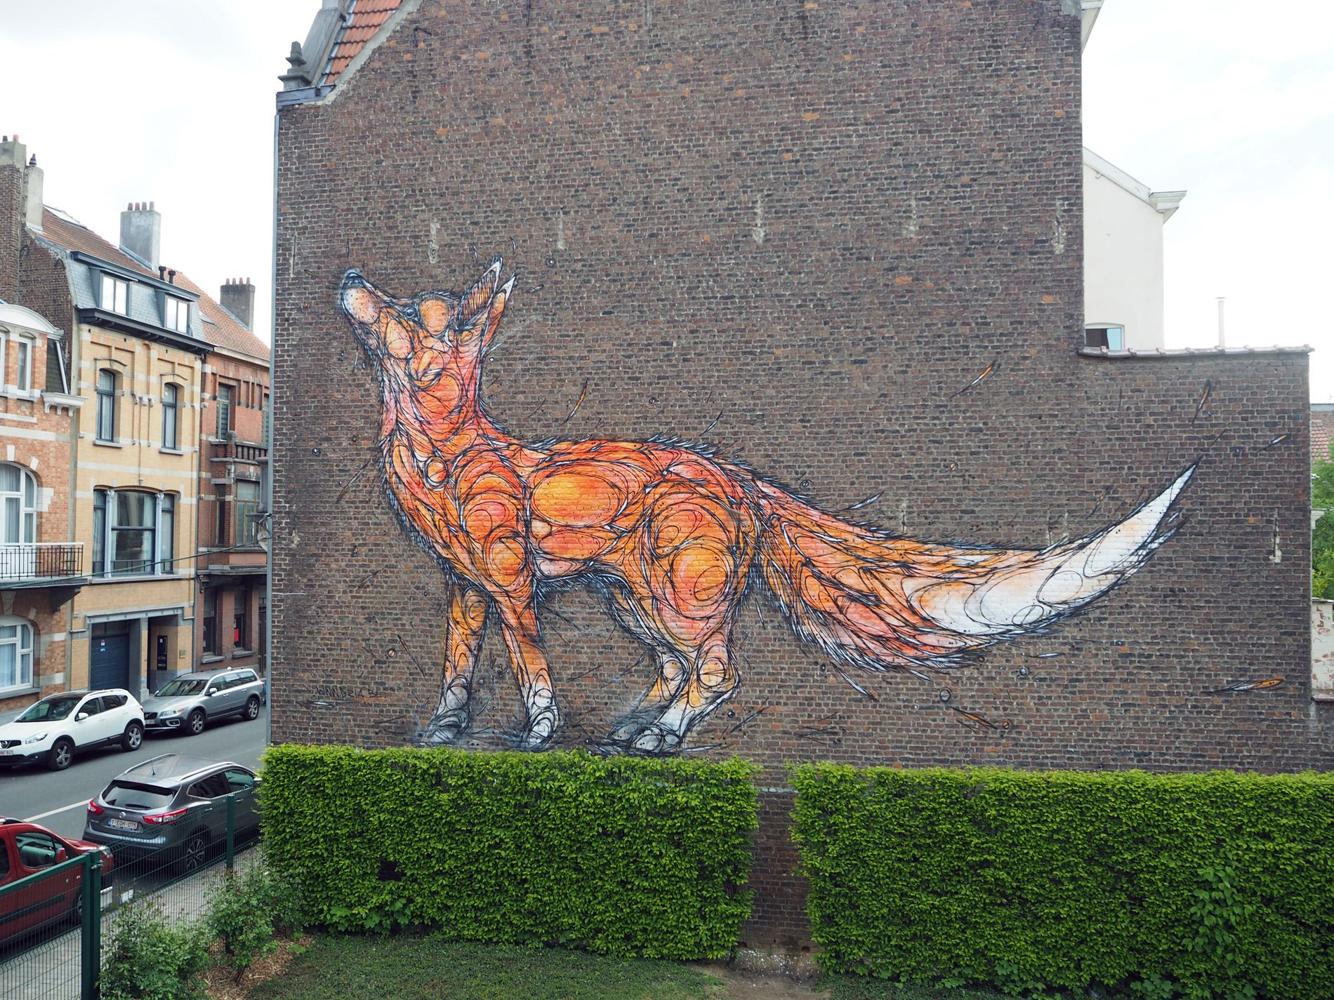

Slide 20
https://www.tate.org.uk/kids/games-quizzes/street-art
Your task
I would like you to design your own mural.
You can do this either on paper or you can click on the link below and create some street art on the Tate Kids website.
Your mural should tell me about you; it might show your interests, your likes, your family, your friends or something you love.

