Slide 1
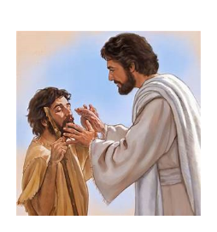
RE – Christianity Jesus’ Miracles Key Question: Could Jesus heal people? Were these miracles or is there some other explanation?
Lesson 4

Slide 2
Monday 14th February LO: Learning to retell Bible stories when miracles have happened and question whether Jesus really did perform miracles.

Slide 3
In our last lesson were discussing 'miracles'. A miracle is something that happens outside the usual rules of nature/ expectations.
What were the two 'miracles' that we have discussed in our last two lessons which Jesus was said to have performed?

Slide 4
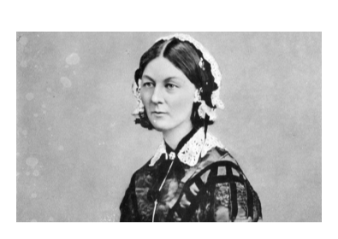
Florence Nightingale (1820 - 1910) When Florence was 16 years old, she believed she heard a voice from God calling for her to carry out important work to help those suffering. She wanted to be a nurse. By 1853 she was running a women’s hospital in London, where she did a fantastic job improving the working conditions as well as patient care.

Slide 5
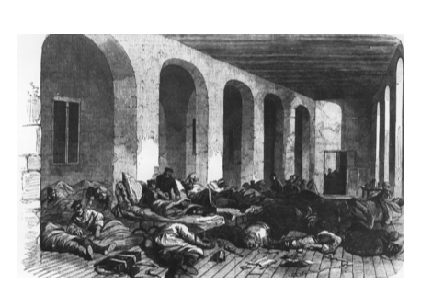
In 1854, the Crimean War broke out – a war with Britain, France and Turkey on one side, and Russia on the other.
News soon reached home of soldiers dying from battle wounds, cold, hunger and sickness, with no real medical care or nurses to treat them.
Help was needed fast, so Florence lead a team of nurses to the war.

Slide 6
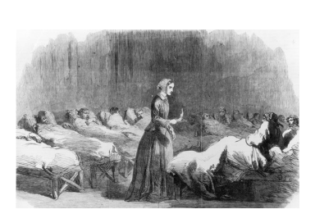
When they arrived, the nurses found the Army hospital in a terrible state. It was overcrowded and filthy, with blocked drains, broken toilets and rats running everywhere. Imagine the smell! There weren’t enough medical supplies or equipment, and wounded soldiers had to sleep on the dirty floor, without blankets to keep warm, clean water to drink or fresh food to eat. Not surprisingly, disease spread quickly and most of the soldiers died from infection.

Slide 7
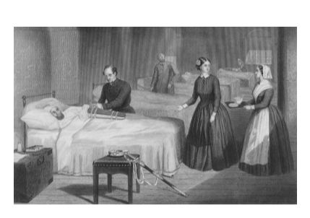
Florence knew that the soldiers could only get well again if the hospital conditions improved. With funds from back home, she bought better medical equipment and decent food, and paid for workmen to clear the drains. Together with her team, she cleaned the wards, set up a hospital kitchen and provided the wounded soldiers with quality care – bathing them, dressing their wounds and feeding them. As a result of all the improvements, far fewer soldiers were dying from disease.
Is this a miracle?

Slide 8
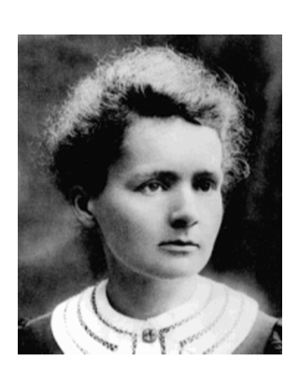
Alexander Fleming (1881-1955) The Scottish microbiologist -Alexander Fleming was a medical scientist who discovered penicillin, the first antibiotic.
Is this a miracle?

Slide 9
Grace Darling was born on 24th November 1815 in Bamburgh, Northumberland.
William Darling, Grace’s father was the main keeper of the Longstone Lighthouse on the Farne Islands (a group of islands off the coast of Northumberland).
On 6th September 1838 a massive storm wrecked the SS Forfarshire about 3/4 of a mile from the Longstone Lighthouse. Early on 7th September, Grace’s father assessed the situation and decided that they needed to try and rescue any survivors.

Slide 10
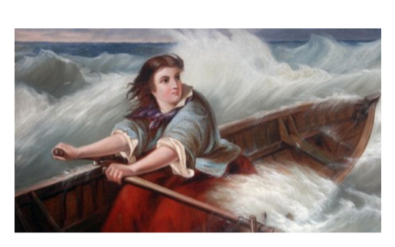
Grace Darling became a national heroine after risking her life to save the stranded survivors of the wrecked steamship.
She managed to rescue nine survivors.

Slide 11
Have you or your family ever been poorly and had to go to hospital? Did you notice all the hard work the doctors and nurses were doing to care for the patients and help them get better?

Slide 12
Do you have any questions for Huey Owl? Write them on a post-it note and bring them to the circle.

Slide 13
Huey has some questions for you...
Do stories have to be true (i.e. actually happen) to be meaningful?
Were Jesus' miracles just stories to make people think Jesus was special/ God on earth, or that we should help people who are sick?
Was it possible that Jesus did make people better even though He wasn't a doctor?

