Slide 1
16.03.21 LO: To know how to divide by 3.

Slide 2
Vocab
array
bar model
remainder
repeated addition
multiplication sentence
division statement
equal
multiply
divide
times-tables
sharing
grouping
division facts
factor

Slide 3
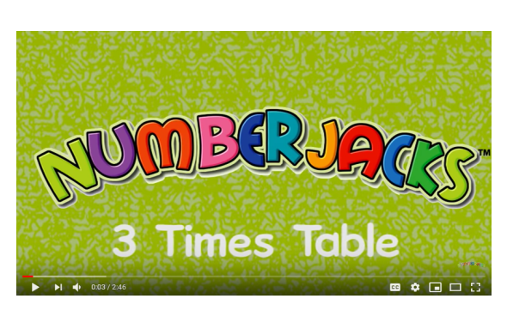

Slide 4
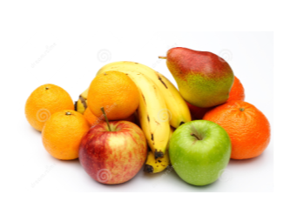
There are 15 pieces of fruit. They are shared between 3 bowls equally.
How many pieces of fruit are in each bowl?
Use cubes/ counters to represent fruit and share between 3 circles.

Slide 5
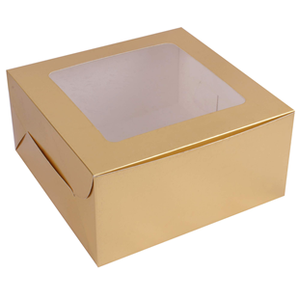
Each box holds 3 cupcakes.
How many boxes are needed for all the cupcakes?
Work this out by writing a division statement.
___ ÷ ___ = ___

Slide 6
David buys 27 cakes. He shares them equally between 3 people.
How many cakes do they get each?

Slide 7
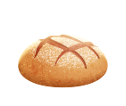
Bread rolls are packed in 3s. How many packs can be made?
There are ___ bread rolls.
There are 3 bread rolls in each pack.
___ ÷ 3 = ___
So ___ packs can be made.

Slide 9
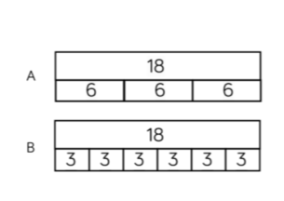
4) Jack has 18 seeds. He plants 3 seeds in each pot.
Which bar model matches the problem? Explain your choice.

Slide 10
Class discussion:

