Slide 1
Friday 19th November
L.O. – I can design and build a bridge.

Slide 2
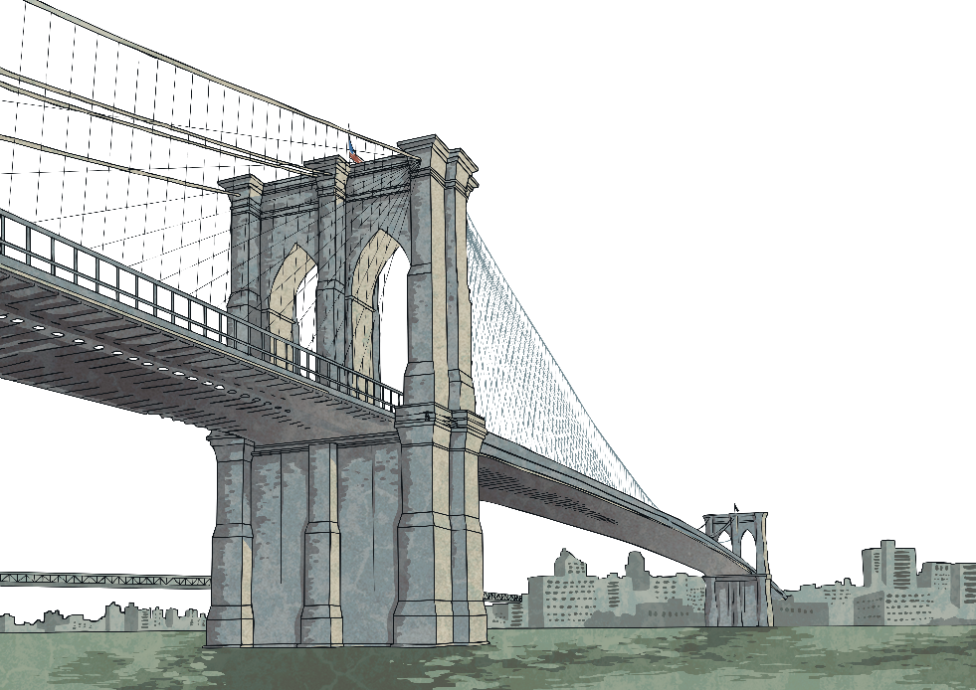
Types of Bridges
What are bridges used for?
What bridges have you seen in real life? Where were they? Were they designed for people to walk over?
Do you know the name and location of any famous bridges?
Did you know that there is more than one type of design for bridges?
Let’s take a look at some of them.

Slide 3
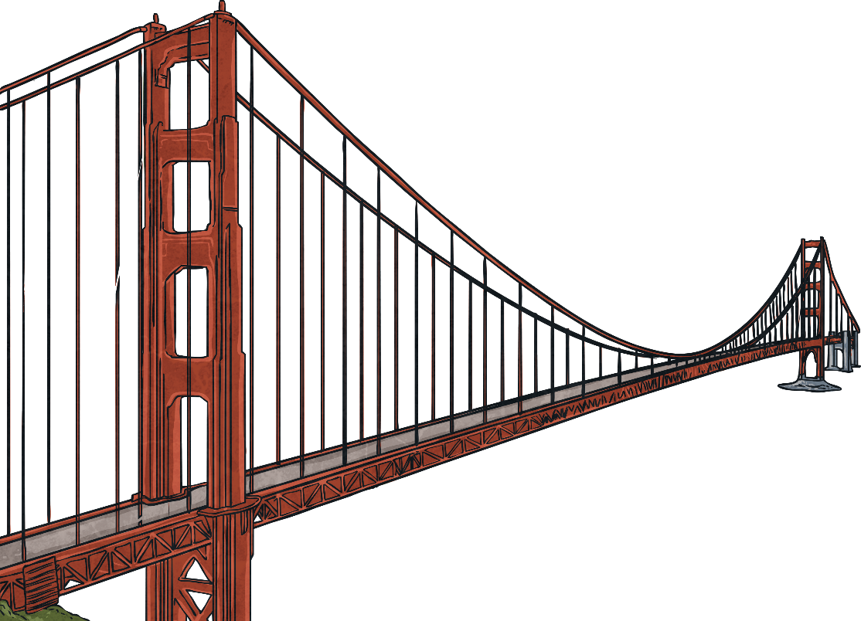
Suspension Bridges
A suspension bridge uses ropes, chains or cables to hold the bridge in place. Vertical cables are spaced out along the bridge to secure the deck area (the part that you walk or drive over to get from one side of the bridge to the other).
Suspension bridges can cover large distances. Large pillars at either end of the waterways are connected with cables and the cables are secured, usually to the ground.
Due to the variety of materials and the complicated design, suspension bridges are very expensive to build.

Slide 4
Suspension Bridges
The structure of suspension bridges has changed throughout the years. Jacob’s Creek Bridge in Pennsylvania was built in 1801. It was the first suspension bridge to be built using wrought iron chain suspensions. It was 21 metres long.
If one single link in a chain is damaged, it weakens the whole chain which could lead to the collapse of the bridge. For this reason, wire or cable is used in the design of suspension bridges today.
Even though engineer James Finlay promised that the bridge would stay standing for 50 years, it was damaged in 1825 and replaced in 1833.

Slide 5

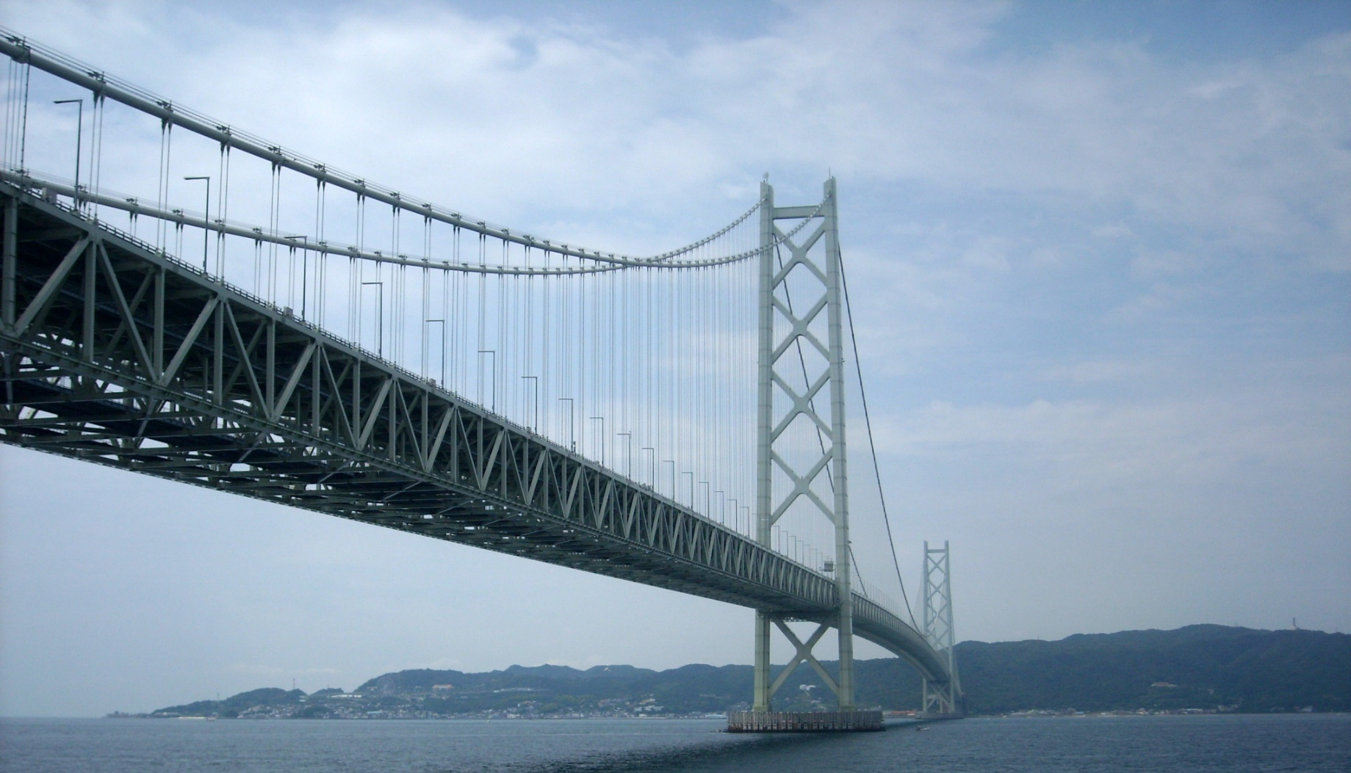
Suspension Bridges
Akashi Kaiko Bridge, Japan
The world’s longest
suspension bridge is
the Akashi Kaikyo
Bridge in Japan.
It is almost 2.5
miles long.
“Akashi Kaikyo Bridge, Kobe, Japan” by Andrew Green is licensed under CC BY 2.0

Slide 6
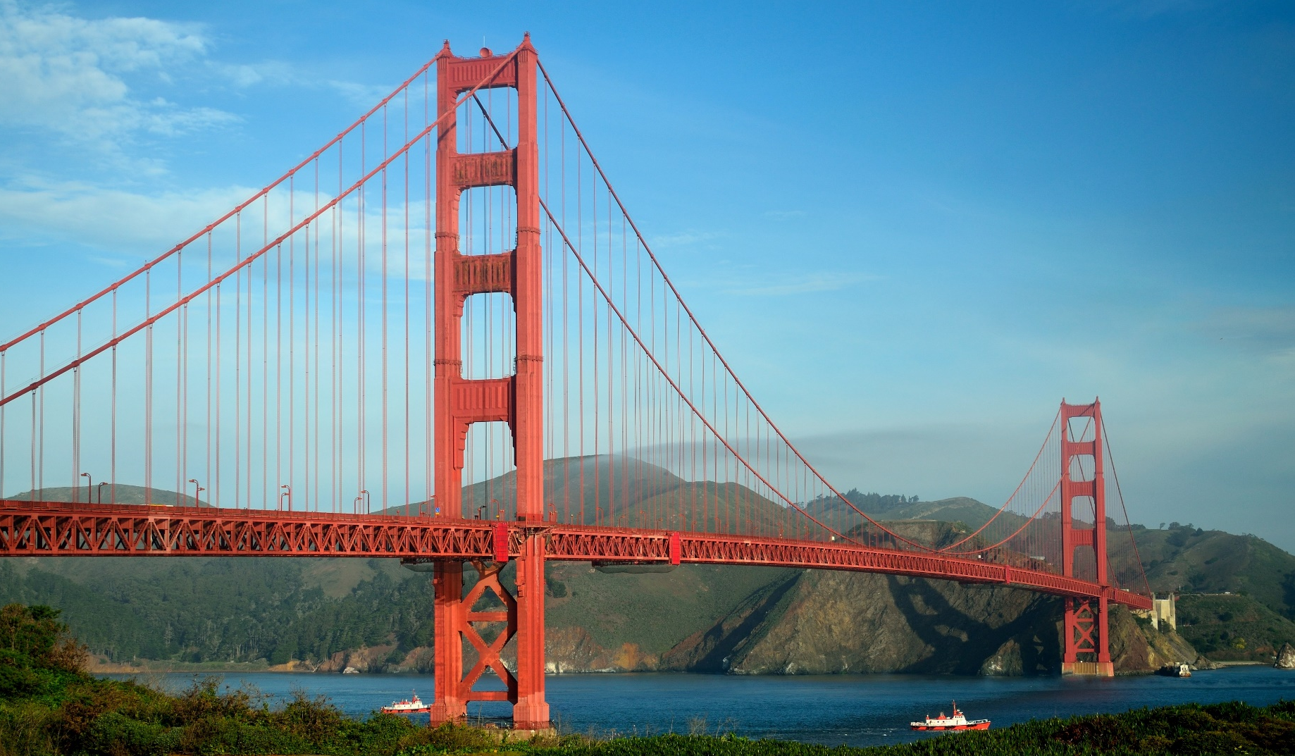
Suspension Bridges
Golden Gate Bridge, USA
Modern suspension bridges
use thin pieces of steel twined
together to make a strong
cable. The Golden Gate
Bridge in San Francisco
uses 80,000 miles
of cable.
“Golden Gate Bridge” by Tom Hilton is licensed under CC BY 2.0

Slide 7
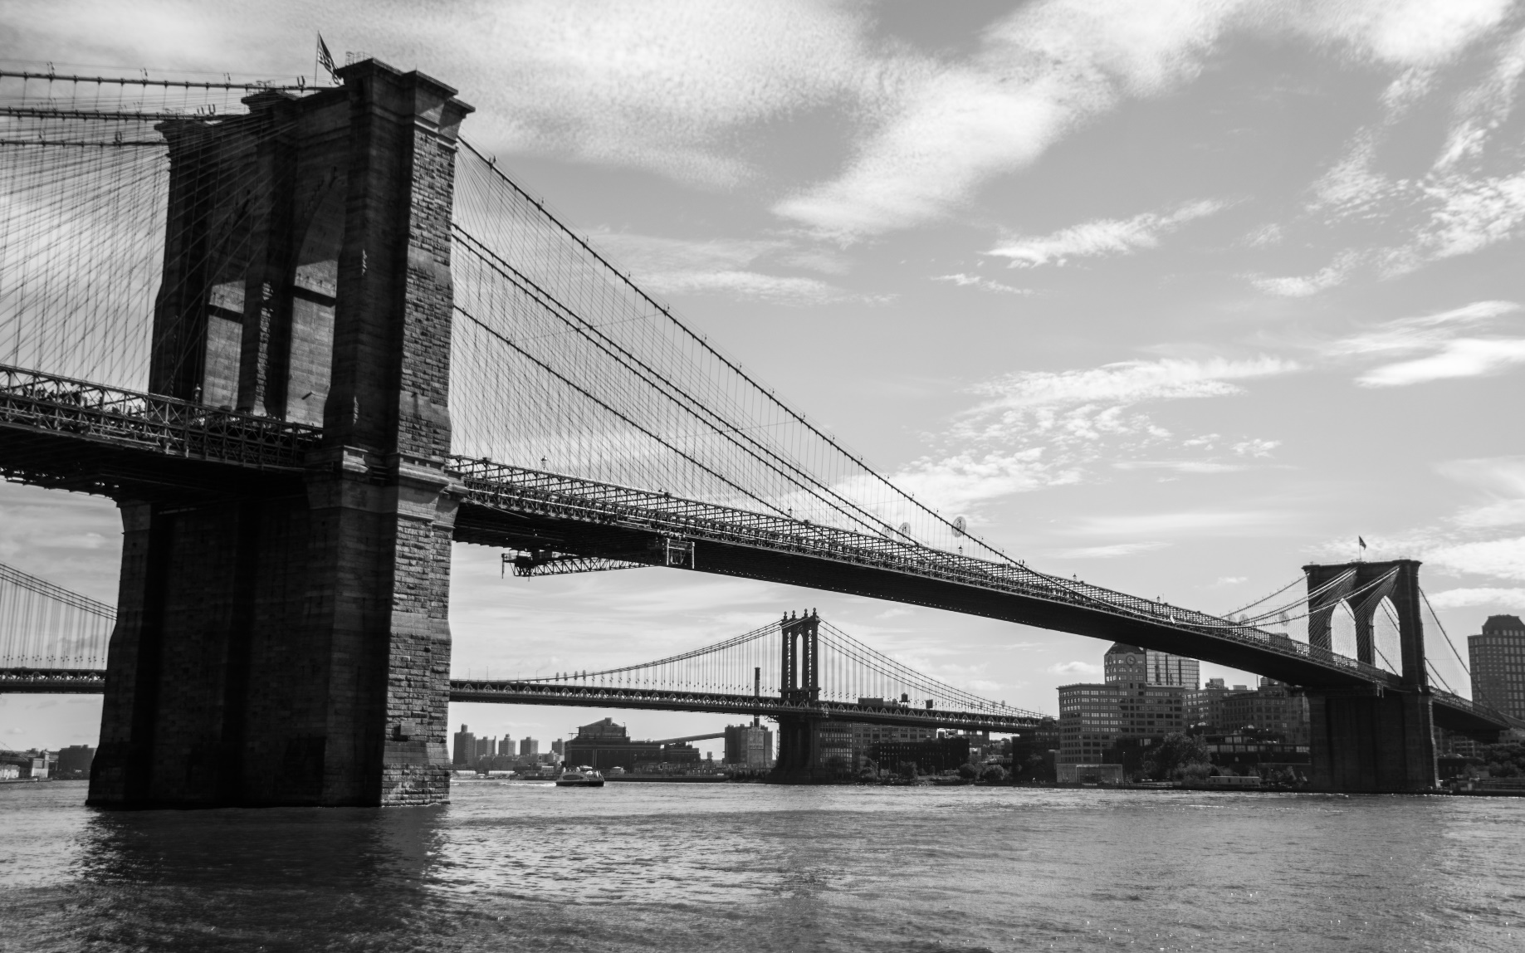
Suspension Bridges
Brooklyn Bridge, USA
The Brooklyn Bridge in
New York crosses
between Manhattan
and Brooklyn.
“Brooklyn bridge” by Tomasz Baranowski is licensed under CC BY 2.0

Slide 8
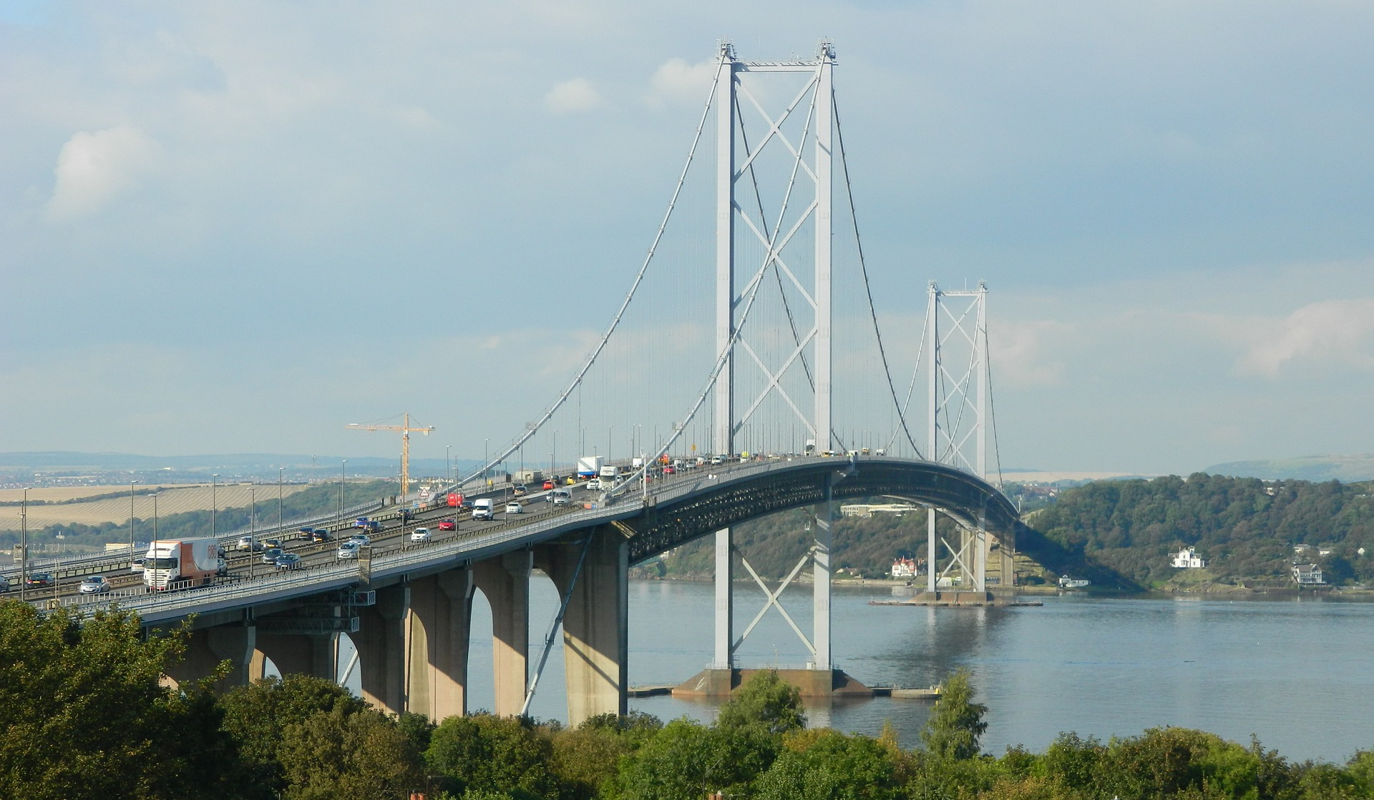
Suspension Bridges
Forth Road Bridge, Scotland
The Forth Road Bridge is
made up of almost 40,000
tonnes of steel, 125,000 cubic
metres of concrete and
30,000 miles of steel wire.

Slide 9
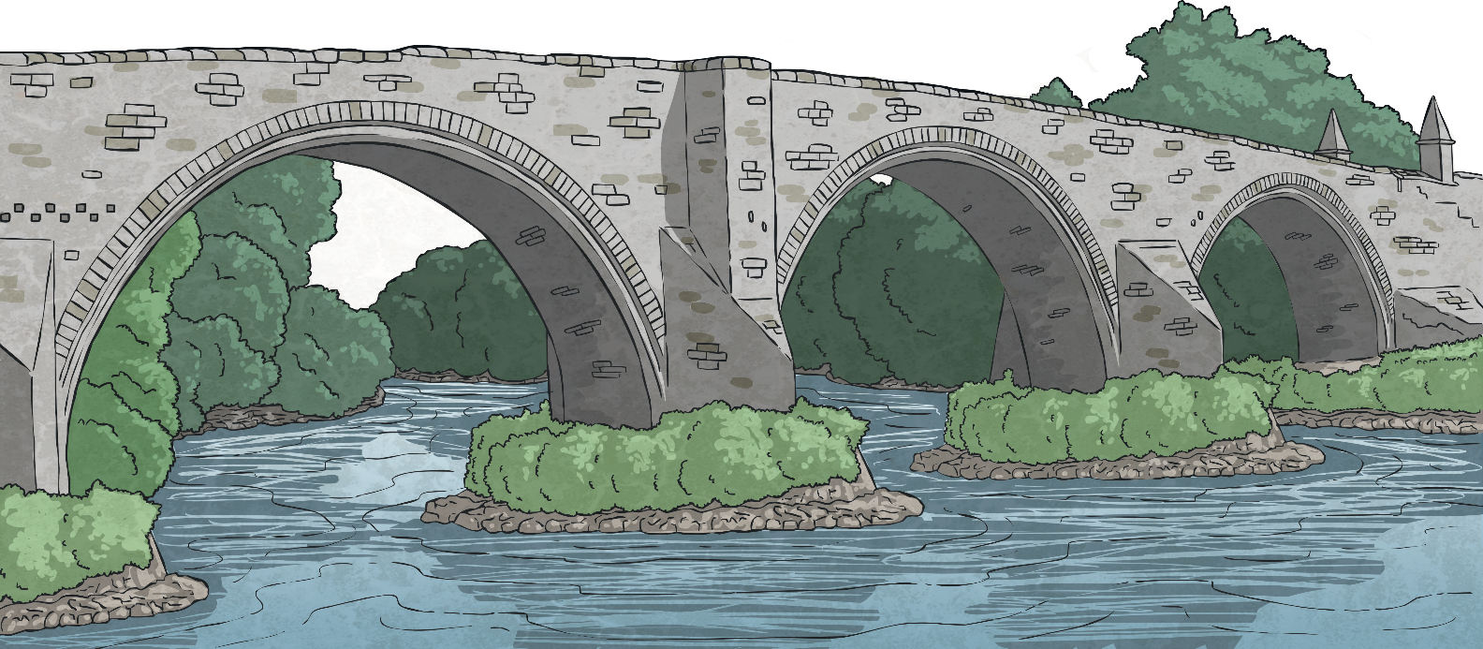
Arch Bridges
The arch bridge design is over 3000 years old. In the past, arch bridges were usually made of stone, brick or wood. More modern arch bridges are usually reinforced with steel or concrete. The supporting pillars that are at either end of the arches are called abutments.

Slide 10
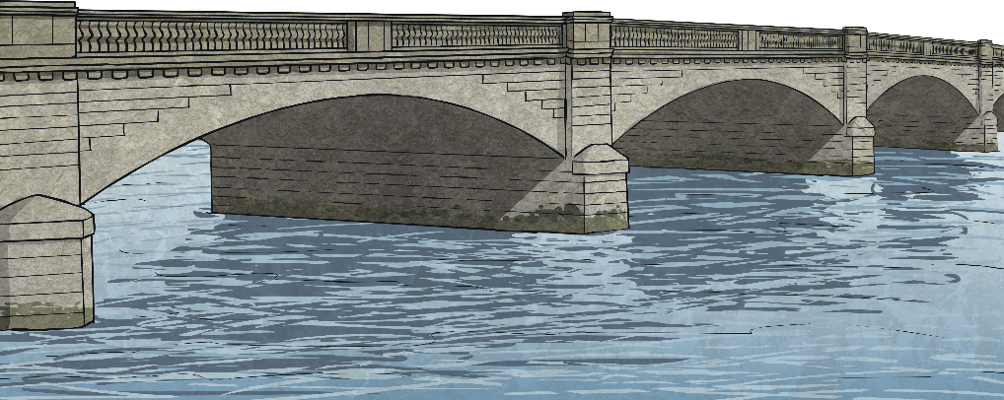
Arch Bridges
An arch bridge uses a curved shape to spread the weight from the bridge over the curve, rather than the weight bearing straight down. Any weight put on the bridge is carried outwards towards supports that are built into the ground on either side of the bridge. The arch is usually a semicircular shape.
The design of the arch bridge and the materials they are made with means that they are usually very strong bridges.

Slide 11
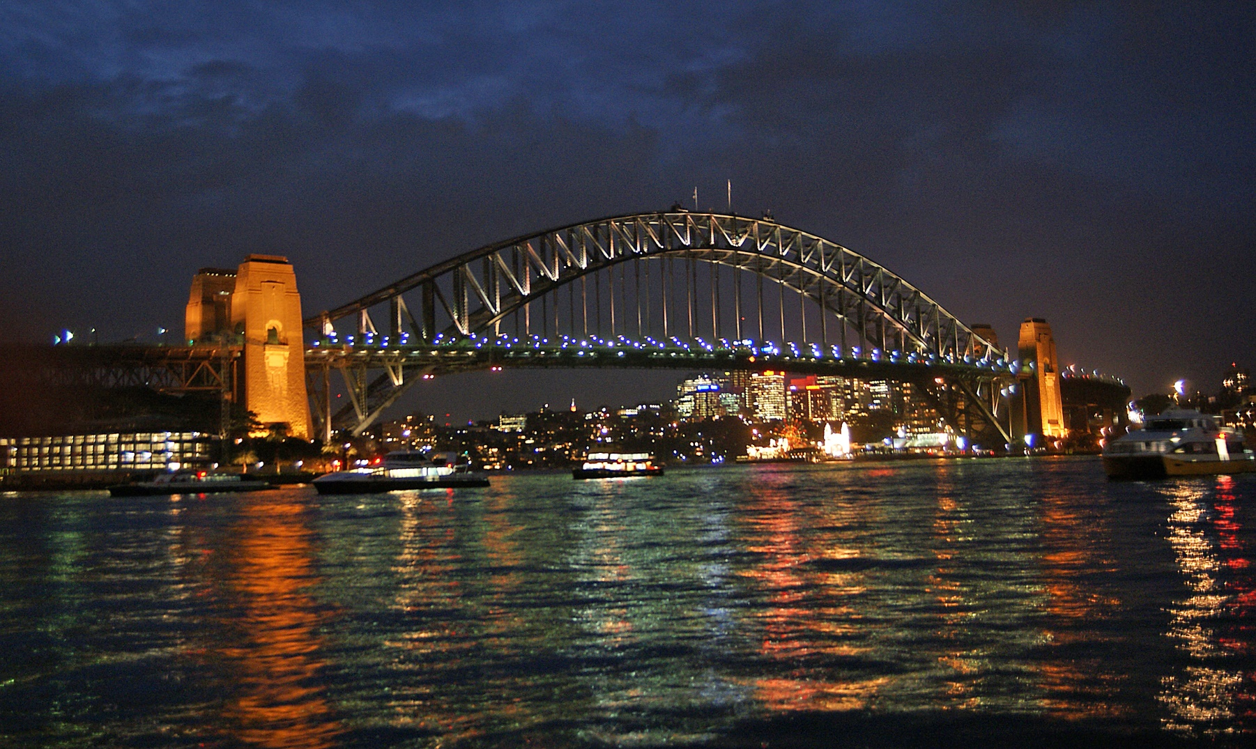
Arch Bridges
Sydney Harbour Bridge, Australia
Between 2500 and 4000
people were involved in the
building of Sydney Harbour
Bridge. The bridge has the
nickname ‘The Coat Hanger’ due
to its shape. Can you see why?

Slide 12
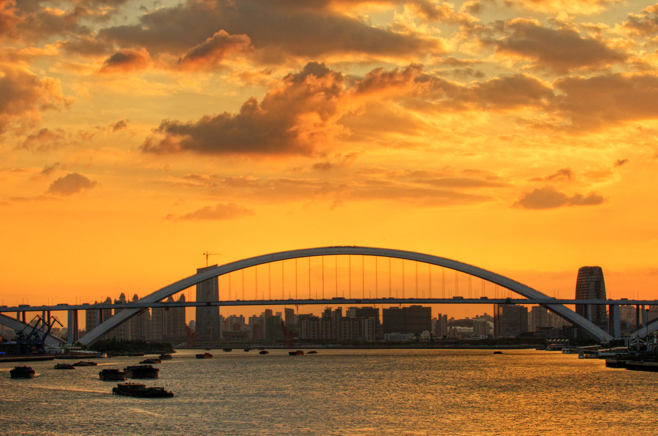
Arch Bridges
Chaotianmen Bridge, China
The Chaotianmen Bridge
has six lanes of traffic going
across it. There are also two
‘lanes’ for people to use to
walk across the bridge.
“DSC_7601” by lwtt93 is licensed under CC BY 2.0

Slide 13
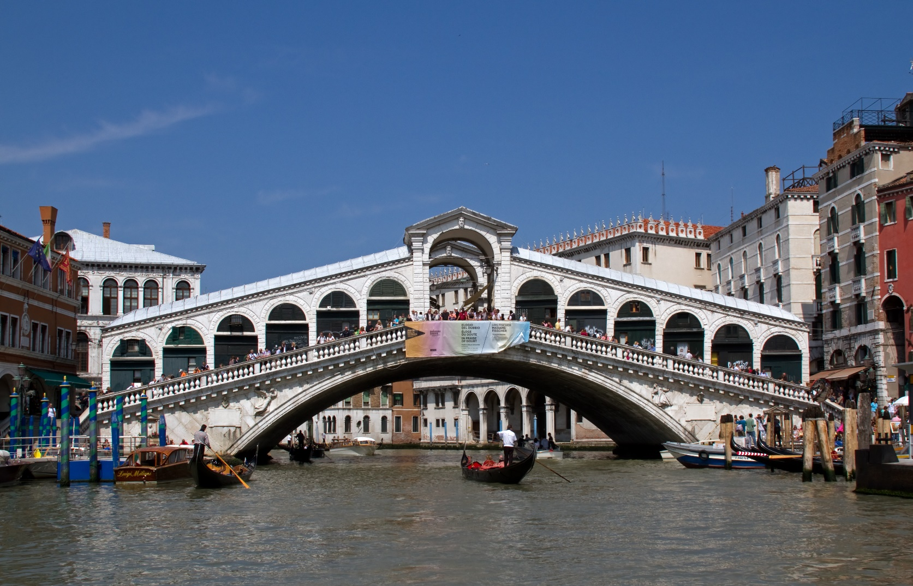
Arch Bridges
Rialto Bridge, Italy
The Rialto Bridge is in
Venice. It is the oldest
bridge to cross over the
Grand Canal. It was built
between 1588 and 1591.
“Rialto Bridge 1” by Tony Hisgett is licensed under CC BY 2.0

Slide 14
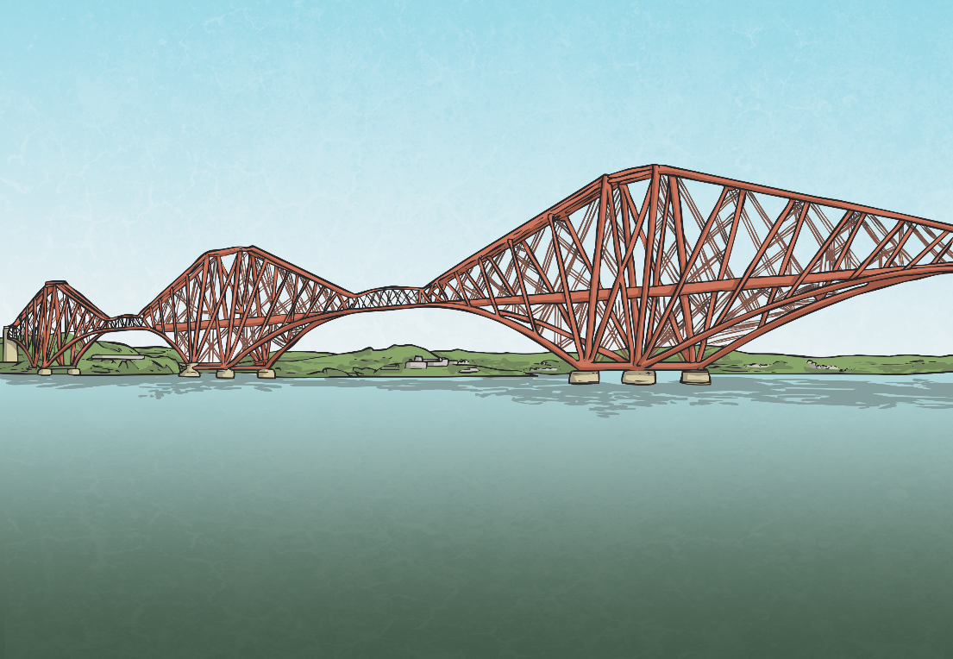
Cantilever Bridges
The first cantilever bridge was built in 1867 by Heinrich Gerber. He wanted to create a bridge long enough to cross larger distances, such as the Main River in Germany. He was able to create a structure which had arms that met in the middle of the Main River, allowing it to be crossed.
Compared to today’s cantilever bridges, Gerber’s was basic and small but this design allowed more complex and larger structures to be built. It was innovative and new, making Gerber a famous name in the engineering of bridges.

Slide 15
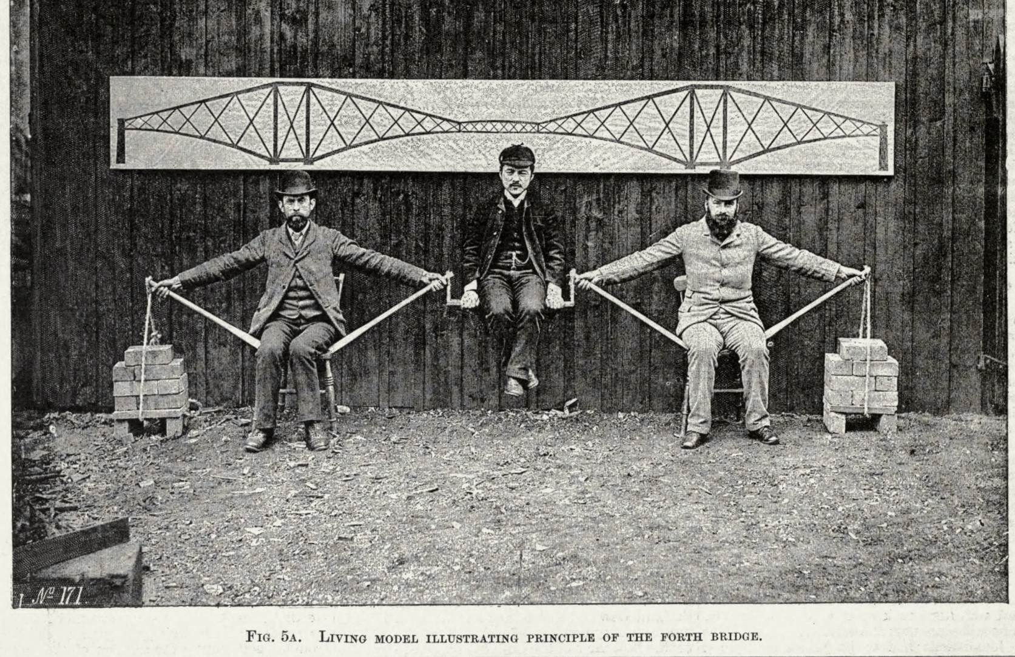
Cantilever Bridges
A cantilever bridge uses
cantilevers to create an area
This is a very old
for people or vehicles to travel
picture but it shows
on. A cantilever is something
us how the cantilever
that sticks out to the side while
structure works.
being supported by something else.

Slide 16
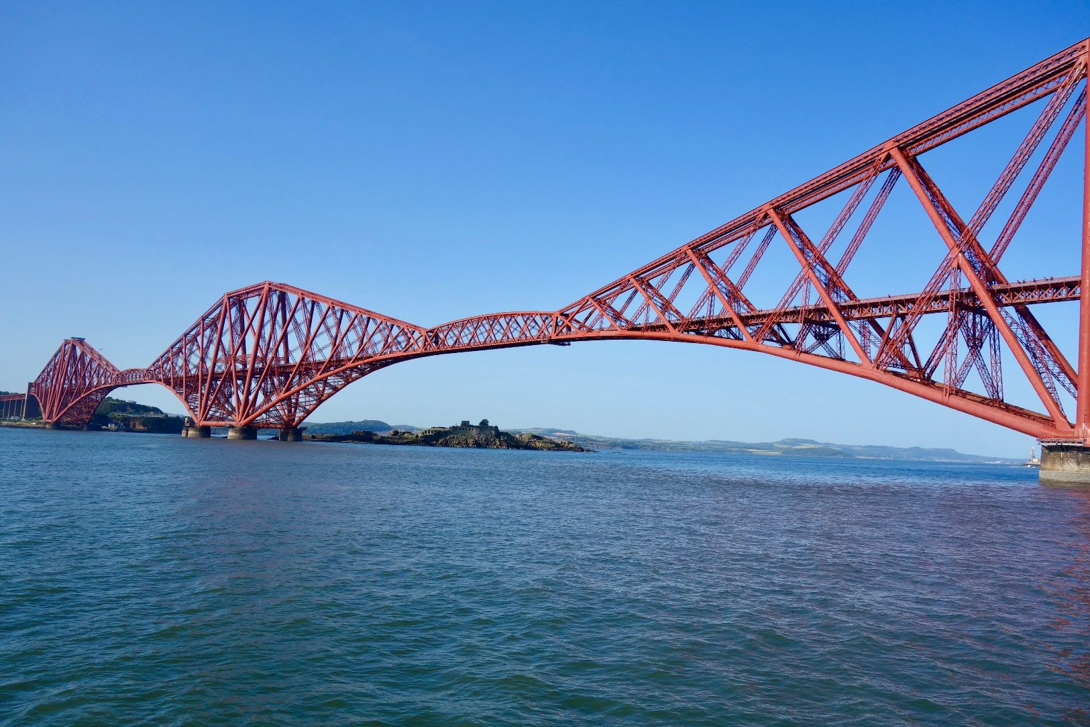
Cantilever Bridges
Cantilever bridges
When this happens,
are often used to cross
an extra bridge can be
over areas of water.
added in-between the two
Sometimes these areas of
arms. It usually has
water are too wide for the
supporting beams and is known
cantilever arms to cover.
as a beam or a truss bridge.
“Forth Bridge (1890)” by Sonse is licensed under CC BY 2.0

Slide 17
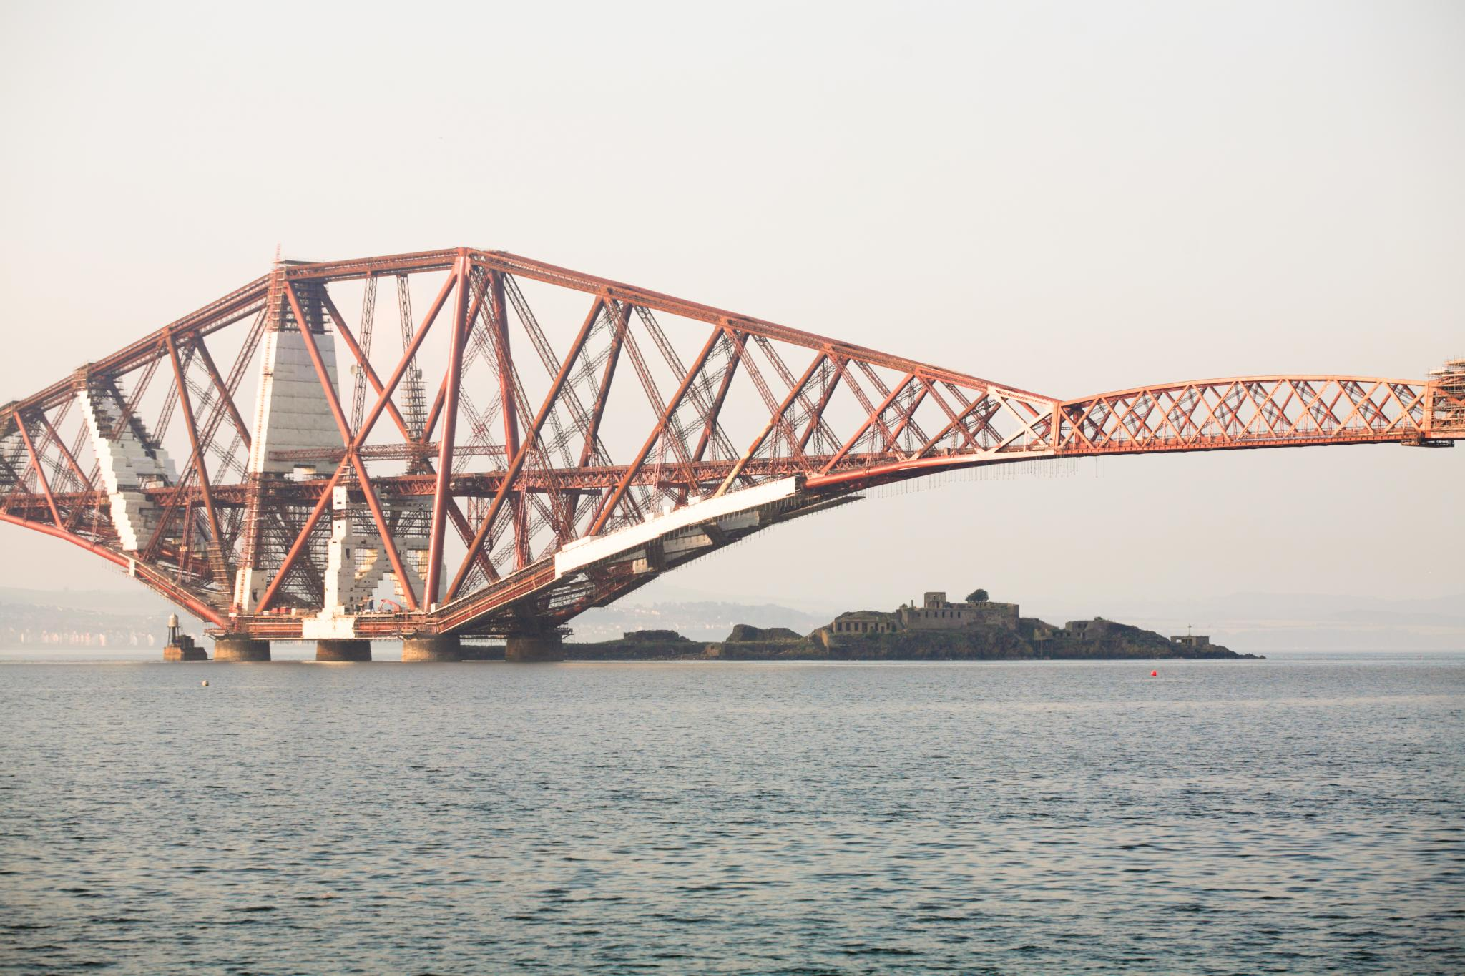
Cantilever Bridges
Forth Bridge, Scotland
The Forth Bridge is
about 9 miles away from
Edinburgh. In 2016, it was
voted ‘Scotland’s Greatest
Human-Made Wonder.’
“Forth Bridges” by Chen Haohsuane is licensed under CC BY 2.0

Slide 18
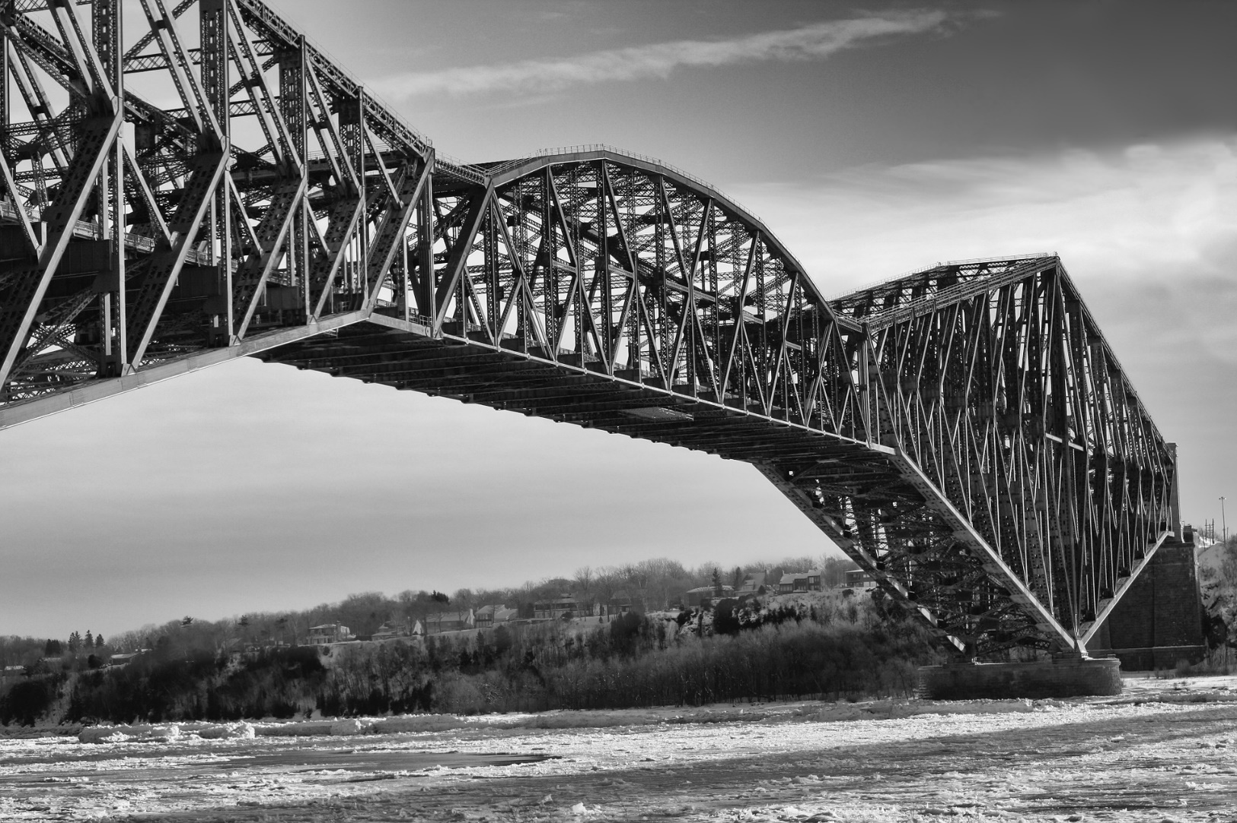
Cantilever Bridges
Quebec Bridge, Canada
The Quebec Bridge
crosses over the Saint
Lawrence River in Canada.
While it was being built, it
collapsed twice killing
88 people.

Slide 19
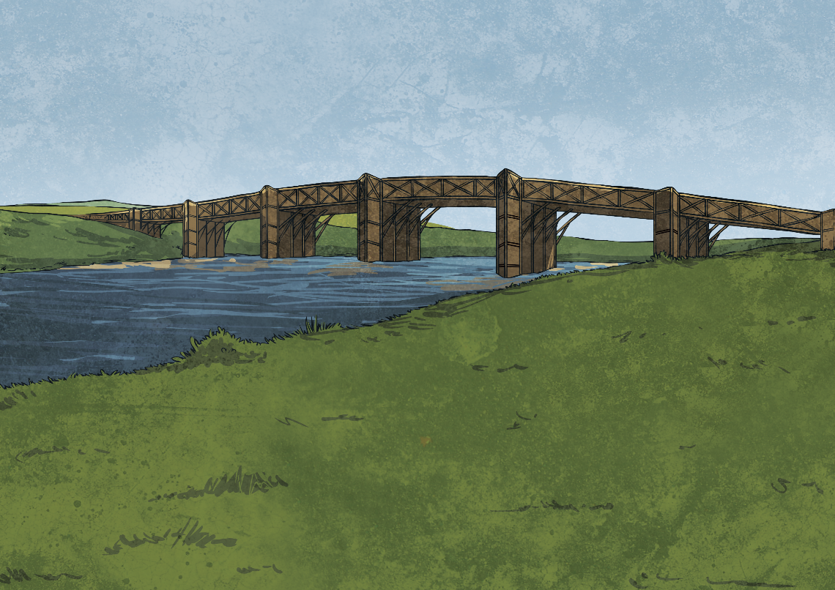
Beam Bridges
A beam bridge is the simplest type of bridge that you may come across. Think of a plank of wood that someone might use to cross a stream: this is a simple beam bridge. The beam part of the bridge is supported at either end, where the weight of the bridge pushes down.
You might also hear a beam bridge being called a ‘girder’ bridge.

Slide 20
Beam Bridges
A beam bridge is usually short, with a maximum length of 250 feet. This is because the further apart the supports are, the weaker the bridge becomes. Imagine a ruler positioned between two tables, with an eraser at either end of the ruler. Putting a small amount of weight on the ruler will cause the bridge to collapse. By bringing the tables and erasers closer together, more weight can be put on the beam.
One beam bridge can be joined to another to create one long stretch of beam bridges.

Slide 21
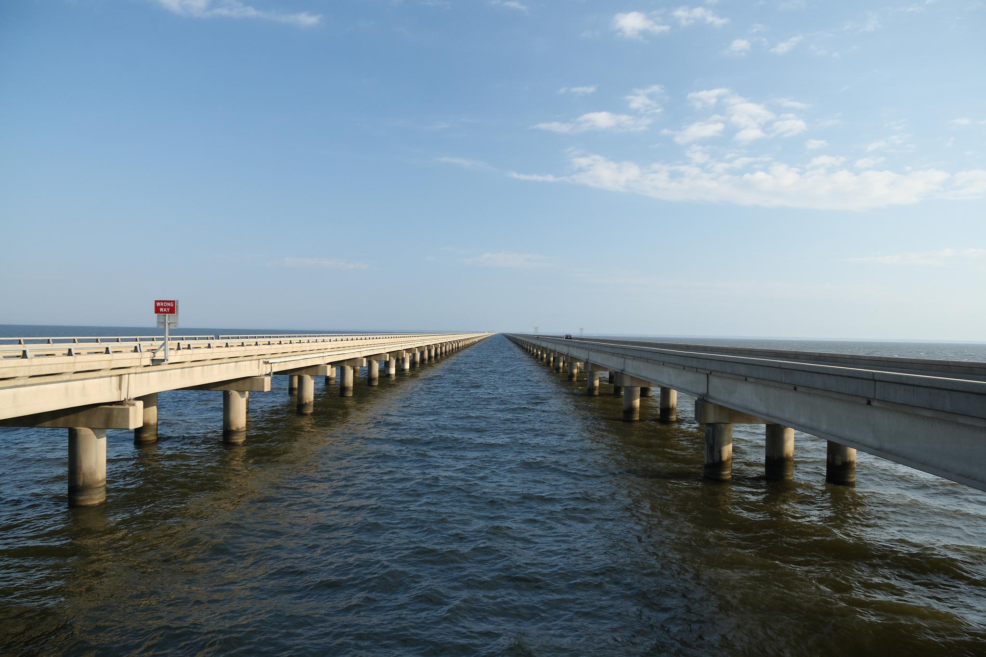
Beam Bridges
Lake Pontchartrain Causeway, USA
The Lake Pontchartrain
Causeway is almost 24
miles long. That is nearly
the same distance as
Glasgow to Stirling!
“Lake Pontchartrain Causeway” by glennaa is licensed under CC BY 2.0

Slide 22
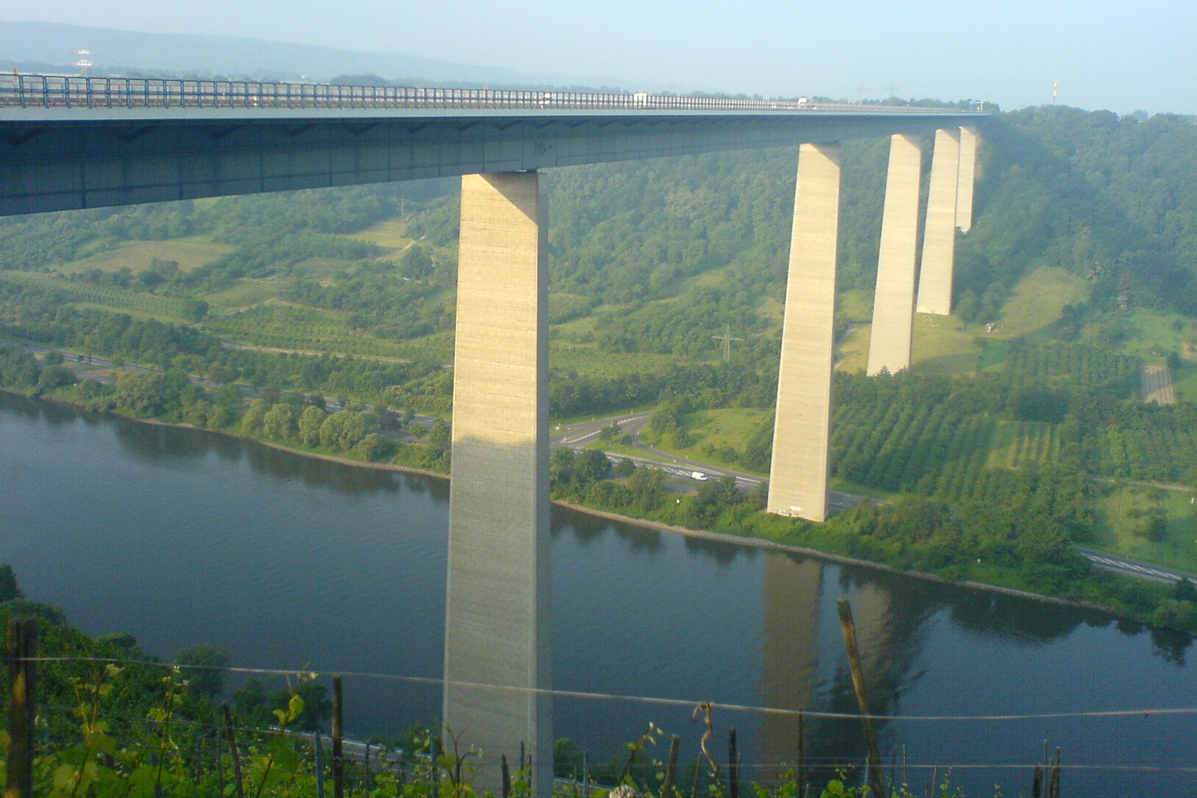
Beam Bridges
Moselle Viaduct, Germany
The Moselle Viaduct is a
steel beam bridge. It is just
over 3000 feet long and
sits 136 metres above
the ground.

Slide 23

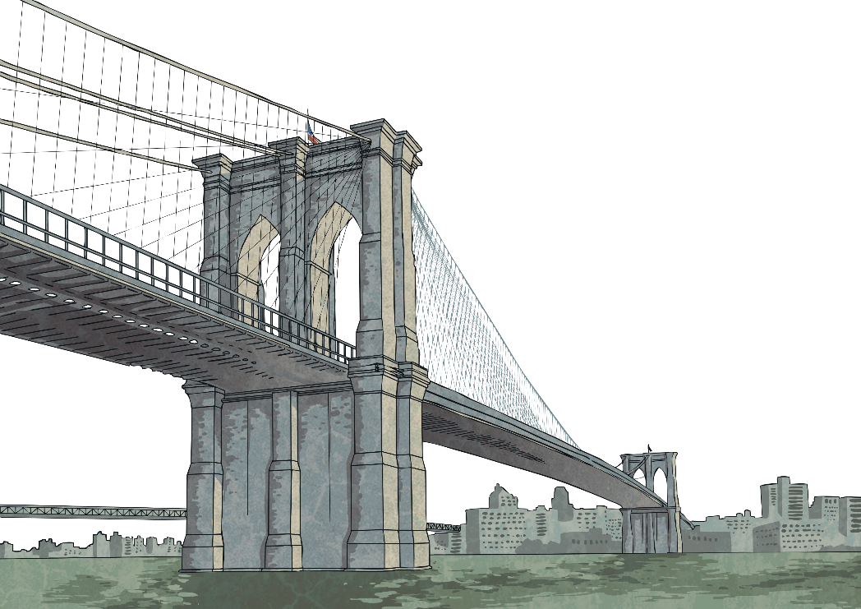
What Have We Learnt?
Share something that you have learnt about one of the following types of bridges:
Suspension
Beam
Arch
Cantilever
If you were asked to build a bridge that was strong, which design would you base it on and what materials would you use?

Slide 24

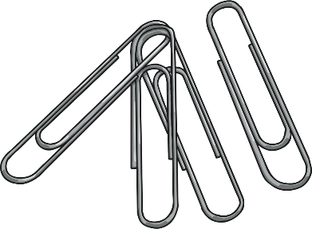


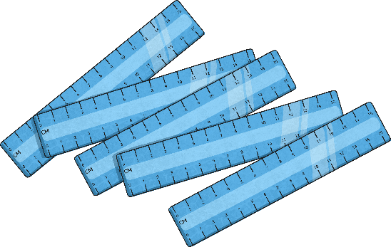
Can you work with your partner to design and build a bridge. Using the ideas we have just looked at, can you build a bridge that meets the following criteria?
Your bridge must be strong enough to hold the weight of five small cubes.
You can only use paper and paperclips.
Your bridge must span a 20cm gap.

