Slide 1
Friday 12th February
LO – I can retrieve and record information from a non-fiction text.

Slide 2
Today we are going to be doing some guided reading, looking at a newspaper report. There are two different reports to look at, a longer version and a shorter version. They tell the same story and the questions are very similar, but you should choose which version to use based on your reading level.
Longer version
Shorter version

Slide 3
Try to look for the key features of a newspaper report when you are reading, as we will be writing our own after half term.
5 w’s
Writing in columns
A quote from an eye witness
Catchy headline
Name of a newspaper
An image with a caption

Slide 4
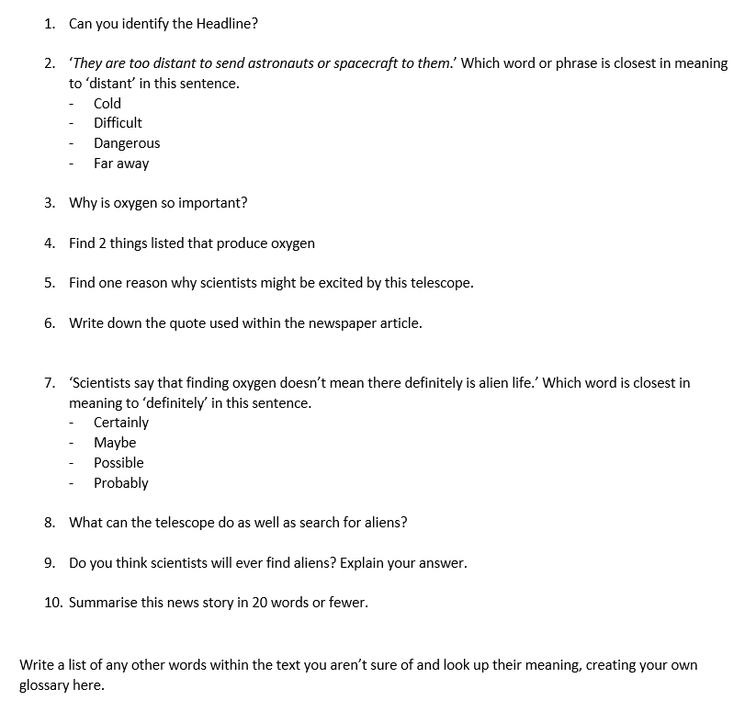
You will then have some different questions to answer using the text. You can write these on a piece of paper or in a book you don’t need to print them off.
Once you have completed them, please upload your work onto SeeSaw for your teachers to see.

