Slide 2
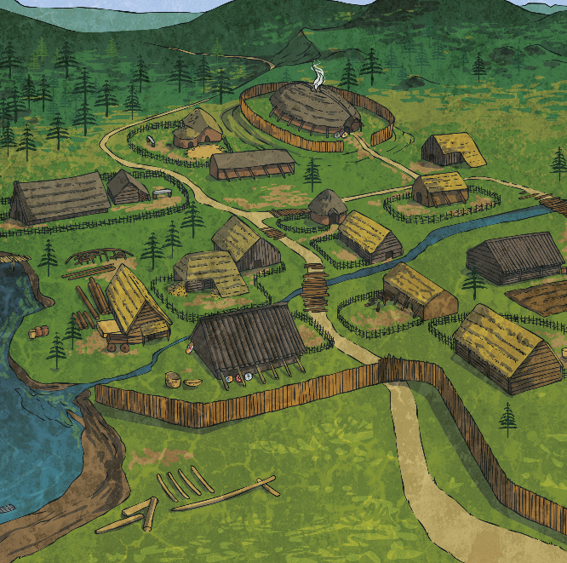
Who Were the Vikings?
Vikings came from Scandinavia. They set out in boats called long ships to ‘go Viking’. This means to go travelling around looking for resources and land to claim as their own.
Vikings first arrived in Britain around AD 787. By AD 878, Vikings had settled permanently and taken over many places across the country.

Slide 3
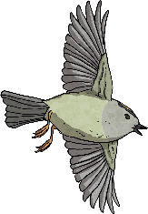
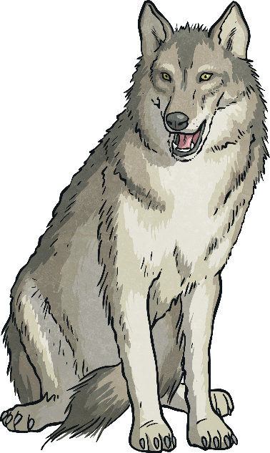
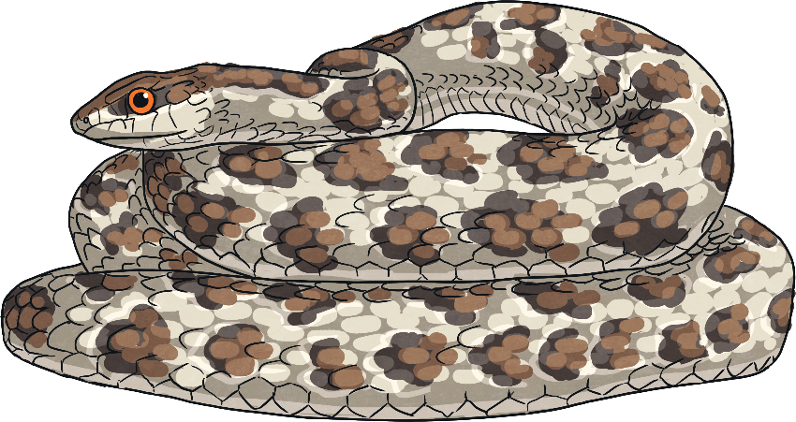
Viking Designs
Vikings decorated many of the things they used:
weapons
ships
everyday common items
They used elaborate designs, many of which depicted animals including:
wolves
birds
mythical creatures
?
Snake-like animals (serpents) were the most popular design in the 11th Century. Vikings told sagas about giant serpents and used many depictions of the creatures in their art.

Slide 4
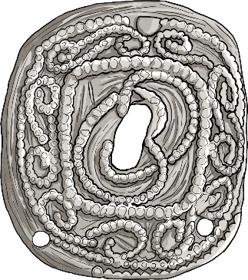
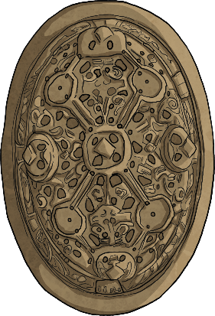
Viking Clothing
Vikings wore fine clothes and expensive jewellery to show off their wealth and status. The poor made their jewellery from animal bones, whereas the rich used gold and silver.
Viking woman wore dresses with straps that were held up by brooches. Between the two brooches there was often a string of beads. The brooches often had intricate designs.

Slide 5
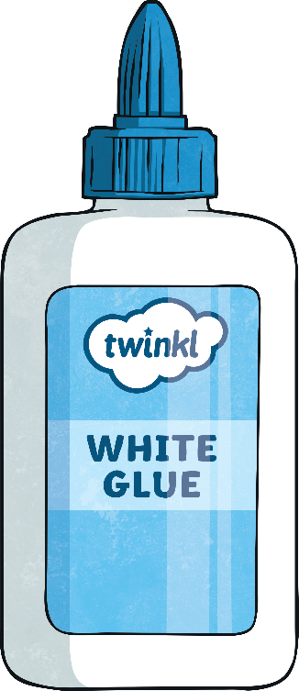
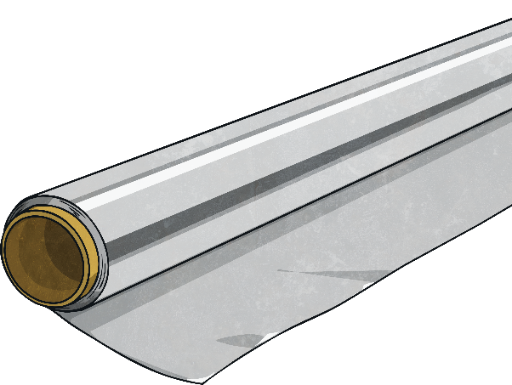
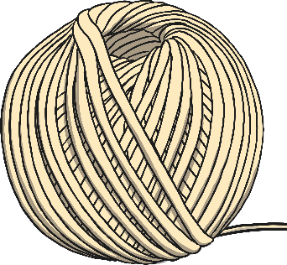
To create a Viking brooch, you will need:
a small piece of thick card
string
white glue
aluminium foil
a black chalk pastel or a piece of charcoal

Slide 6
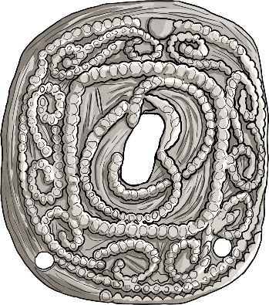
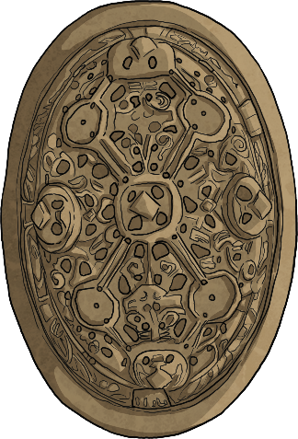
1
First, draw the outline of your brooch on to your card and carefully cut it out. Most Viking brooches were oval or circular in shape.
Next, draw your Viking-themed design on to your brooch. Use the images below as inspiration and think about the animals such as wolves, birds and serpents. You might consider including a mythical creature!
Think about the different types
of Viking designs.

Slide 7
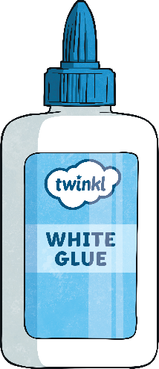
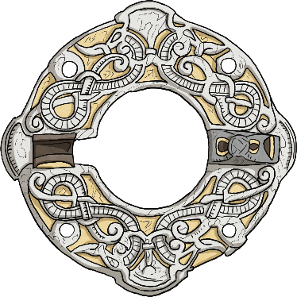
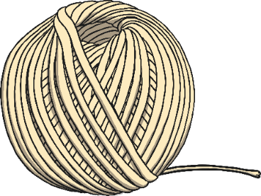
2
Once you are happy with your design, carefully apply glue to the lines of your design using a thin paintbrush. Make sure to only put the glue on the lines!
Next, stick the string on top of the glue making sure to follow the lines of your design.
!
Handy Hint
Press the string down and hold it in place for a few minutes to allow the glue to take hold.
Leave your brooches somewhere safe and dry to let them set overnight.

Slide 8
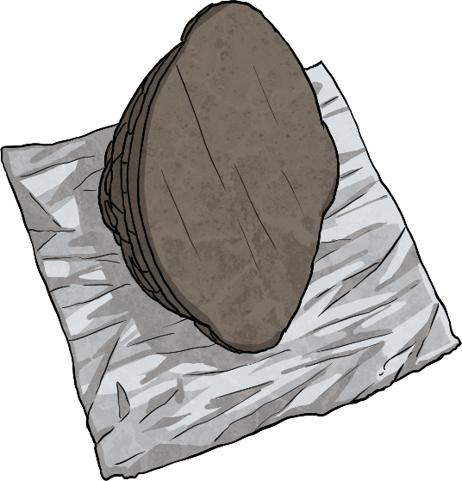
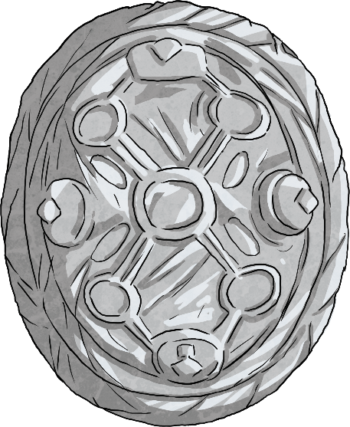
3
When your design has completely dried, place a square of aluminium foil under it (design-face
down). Think about whether you want the dull or the shiny side of the foil showing.
Turn the brooch over. Carefully press the foil over the string using the end of a paintbrush then rub your finger gently over the top to reveal the design.

Slide 9
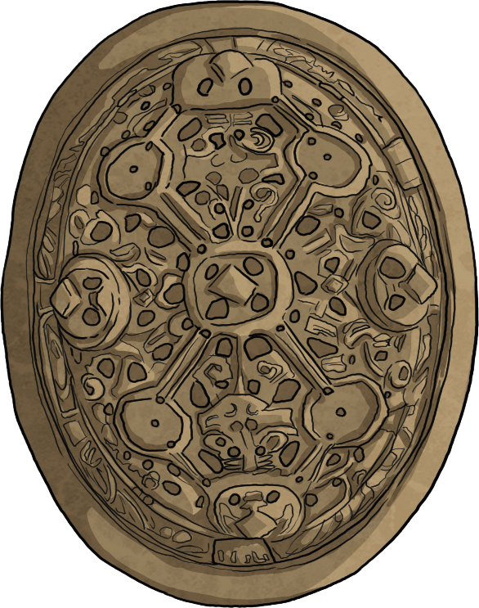
4
Finally, to make the brooch look old and distressed, rub over the design with either a black chalk pastel or charcoal.
Use the tip of your finger to reach the intricate parts of the design.

