Slide 1
Year 2 Home Learning – Day 1

Slide 2
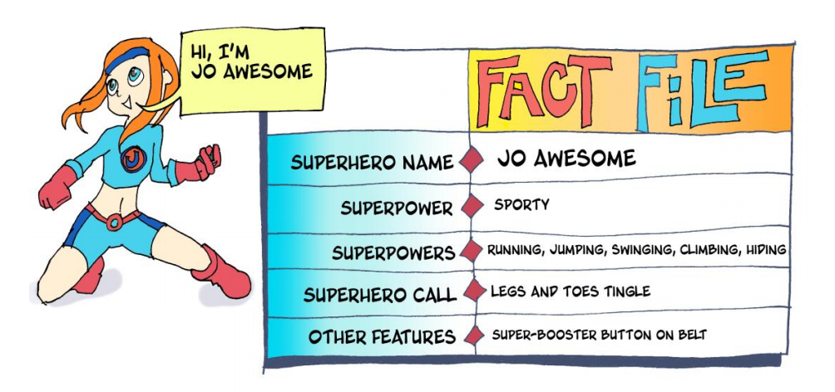
Meet the superheroes…

Slide 3
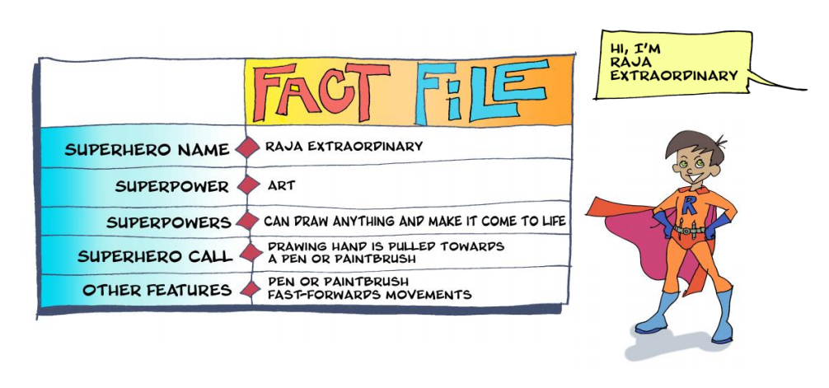
Meet the superheroes…

Slide 4
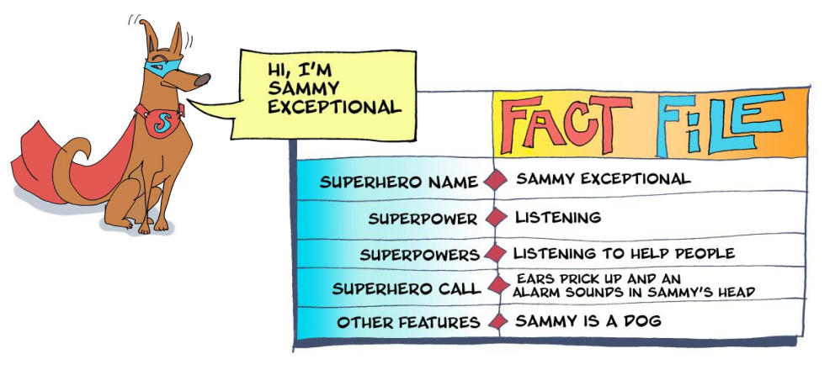
Meet the superheroes…

Slide 5
Jo, Raja and Sammy have helped lots of people. Here is one of their stories….
https://soundcloud.com/talkforwriting/playground/s-UJObMpzawKu
Playground Rescue
It was an ordinary day. Jo was on her own in the backyard, kicking a football into the makeshift goal that she’d once scratched into the wall with the edge of a sharp stone. She was dreaming of a time when she would play for the local football team again. Raja was covered in paint. She’d been busy occupying her brothers and sisters while her mum tried to get her work done, and Sammy, in the meantime, slept soundly in his basket. One of his enormous ears had flopped over his eye, his favourite squeaky bacon toy was trapped beneath a podgy paw and his droopy eyelids flickered as he chased wasps in his dreams.

Slide 6
Story continued…
Activity in the local park was ordinary too, or so it seemed. Children played on the playground whilst adults chattered, groups of teenagers were gathering, and joggers sprinted along the paths.
“HELP! HELP!” came a sudden shout from the playground.
Jo’s legs and feet began to tingle. Raja’s drawing hand pulled her towards a paint brush and Sammy stretched, turned over noisily and went back to sleep! As Jo and Raja left their homes, they changed. Jo Awesome’s blue cape glided behind her as she dashed towards the park, activating her super-booster to help her get there more quickly. Raja Extraordinary’s red cuffs glowed as she desperately held onto the flying paintbrush.

Slide 7
Story continued…
They arrived at the park at the same time, “What’s the problem?” panted Jo.
“Follow me!” Raja called over her shoulder as the paintbrush dragged her towards the playground.
As Raja and Jo reached the edge of the playground, they could see that a crowd had gathered at the bottom of the spider’s web climbing frame. Children giggled and pointed, and adults stared up in silence. “Look!” whispered Jo, nodding her head towards the top of the spider’s web. Raja followed her gaze up to a small, snivelling child who was dangling from the top of the climbing frame with one hand, about to fall!

Slide 8
Story continued…
“This one’s mine!” declared Jo …
Quick as a flash, Raja painted a mini trampoline which Jo used to bounce up and over the crowd and then grabbed the child as she somersaulted them both down to safety. With the crowd’s whoops and cheers buzzing in their ears, Jo raced home while Raja flew back to her house on the flying carpet she’d painted. Jo returned to ordinary Jo playing keepy-uppy in the back yard and Raja returned to ordinary Raja cleaning up the painting mess she’d left behind.
And as for Sammy, an alarm sounded in his head and his ears pricked up. Someone somewhere was crying. They needed to talk and Sammy Exceptional to listen…

Slide 9
Vocabulary challenge
Read each sentence and think about what the word in bold might mean.
It was an ordinary day.
Jo was on her own in the backyard, kicking a football into the makeshift goal
She’d been occupying her brothers and sisters
Sammy, in the meantime, slept soundly in his basket.
A small, snivelling child was dangling from the top of the climbing frame.

Slide 10
Task – write a sentence or two for each of the following statements.
What I liked about the story:
What I didn’t like about the story:
Questions I have about the story:

Slide 11
Year 2 Home Learning – Day 2

Slide 12
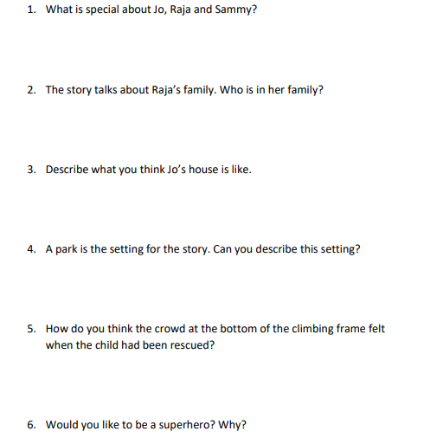
Read the story again and have a go at answering these questions in full sentences. ☺

Slide 13
Year 2 Home Learning – Day 3

Slide 14
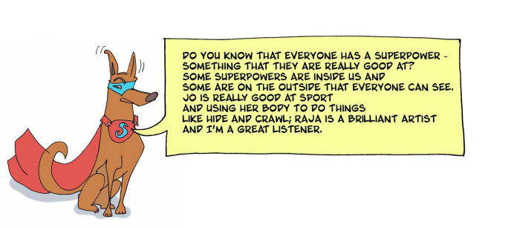

Slide 15
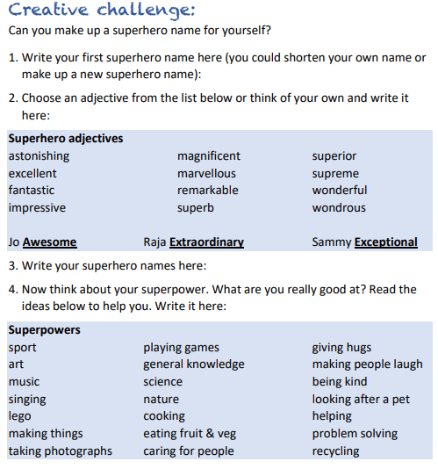

Slide 17
Do you know which superhero is represented below?

Slide 18
Draw your own superhero symbol. It could be the first letter of your name, or a shape that shows what your super power is.
Write a few sentences to explain your symbol and tells me what your chosen symbol represents.
____________________________________________________________________________________________________________________________________________________________________________________________________________________________________________________________________________________

Slide 19
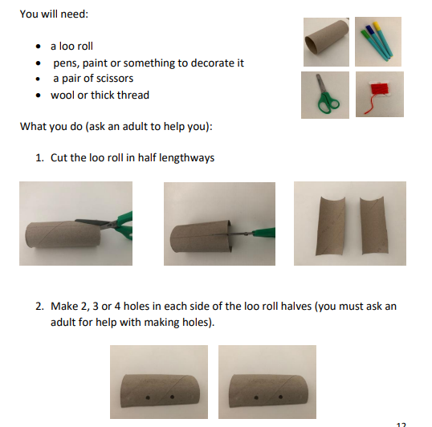
Become your hero! Follow these instructions to create your own superhero cuffs.

Slide 20
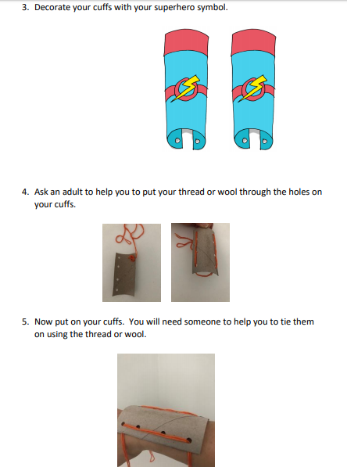

Slide 21
Year 2 Home Learning – Day 4

Slide 22
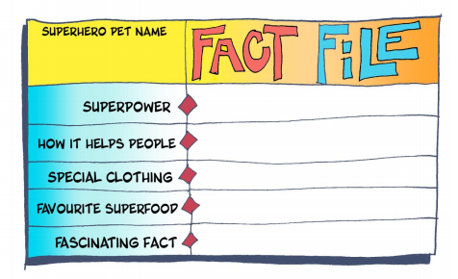
Superhero Pet
Today, you need to think of a superhero pet like Sammy Exceptional. Draw a picture, and give them a name, and once you have done that, fill in this fact file about your pet.

Slide 23
Year 2 Home Learning – Day 5

Slide 24
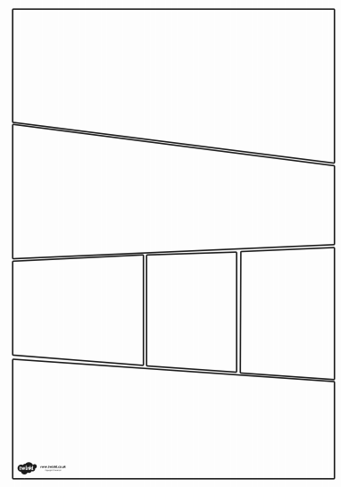
Invention time…
Use the comic strip template (there is a larger version on a worksheet uploaded on the website, but only print the pages you need as it is a large document with lots of examples on) and create your own superhero tale using the ideas you have generated this week.

