Slide 1
Children’s Mental Health Week
2022
Theme: Growing Together

Slide 2
In this lesson, we are going to learn to be kind to ourselves.

Slide 3
When we are busy, facing challenges or dealing with change, we can forget to consider and take care of our own wellbeing. Looking after yourself is an important part of being resilient and coping with challenges well. It is essential to be kind to yourself.

Slide 4
Wellbeing -
What does it mean to you?
People use this word to mean “being happy, comfortable and healthy” - think about all the things in your life that help you feel happy, comfortable and healthy.

Slide 5
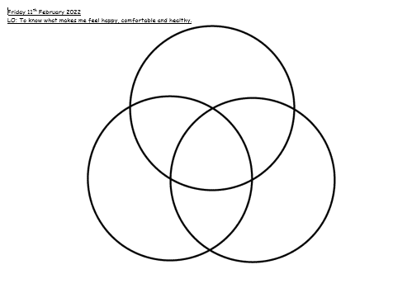
Use the sheet provided. Label one circle “happy” one “comfortable” and one “healthy” and write or draw the things that help you feel this way in the circle.
Let’s share some ideas.

Slide 6
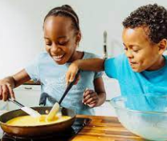
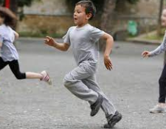
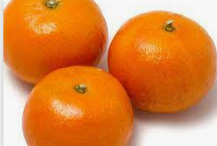
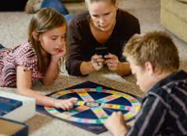
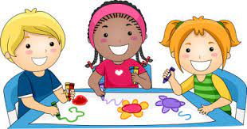
Here are some things you might have thought of.

Slide 7
Some things will make you feel happy and comfortable, or healthy and happy, you can write these things in the spaces where the circles overlap.
For example: eating healthy food can help you feel fit. It might make you feel happy if you like healthy food. It can also make you feel comfortable because being healthy helps you feel relaxed.

Slide 8
It doesn’t matter if you can’t decide which circle things go in. It is important just to think about the different ways that different things affect your wellbeing.
What did you learn about yourself and your wellbeing from this activity?

Slide 9
Breathing activity: Blowing bubbles
Sometimes we are so full of emotion we can’t think very well. There are many things we can do to help us so that we can then think more clearly and start to understand what we are feeling and thinking. One activity is the ‘blowing bubbles’ breathing exercise. Sit somewhere quiet or close your eyes. Imagine you have a bottle of bubbles, or if you have some real ones, blow some real bubbles. Gently blow a bubble and watch it float away. Breathe in and then blow another bubble out. Keep blowing bubbles until you feel better. Does an activity like this help you? How does it help?

Slide 10
Now we are going to have some time doing something that makes us feel happy, comfortable or healthy.

