Slide 3
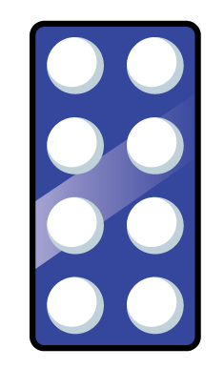
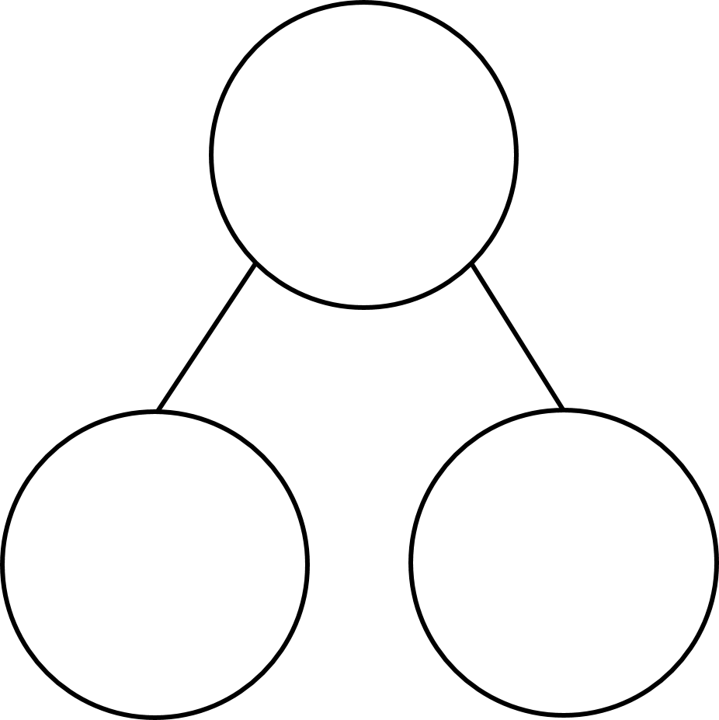
1) One less than is
2) Count backwards from 16 to 12
3) How do you spell the number 14?
4) What number is missing?
7
2

Slide 4
1) One less than is
2) Count backwards from 16 to 12
3) How do you spell the number 14?
4) What number is missing?
7
16, 15, 14, 13, 12
fourteen
5
7
2

Slide 6
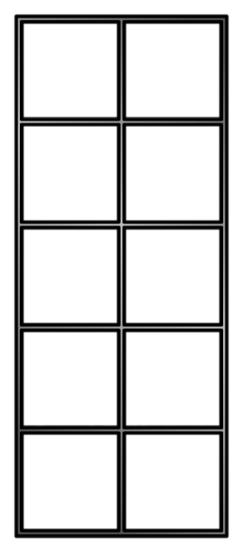
Subtraction - taking away
18 $−$ 2 =
16

Slide 7
Have a think
Subtraction- taking away
15 $−$ 4 =
11

Slide 8
Have a think
Subtraction- taking away
17 $−$ 3 =
14

Slide 9
Have a go at question 1 on the worksheet

Slide 10
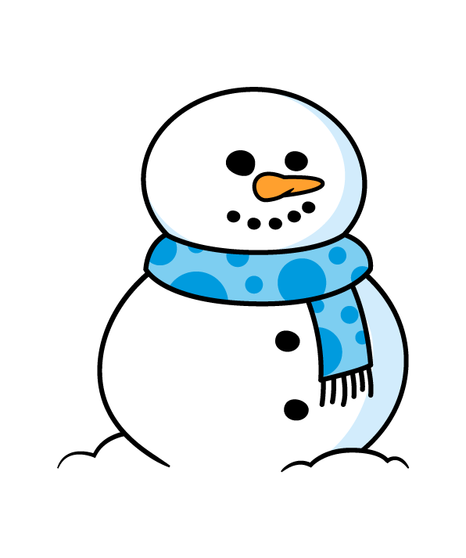
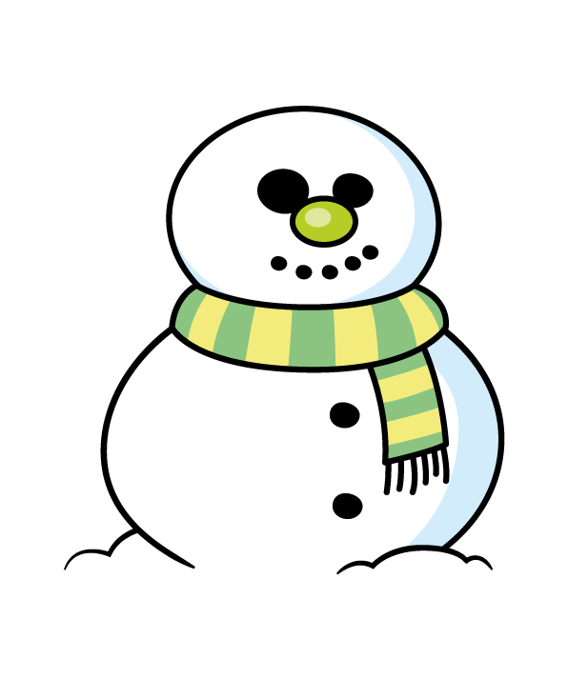
Subtraction
The children built 13 snowmen.
2 snowmen melted overnight.
How many snowmen are there now?
13 $−$ 2 =
11

Slide 11
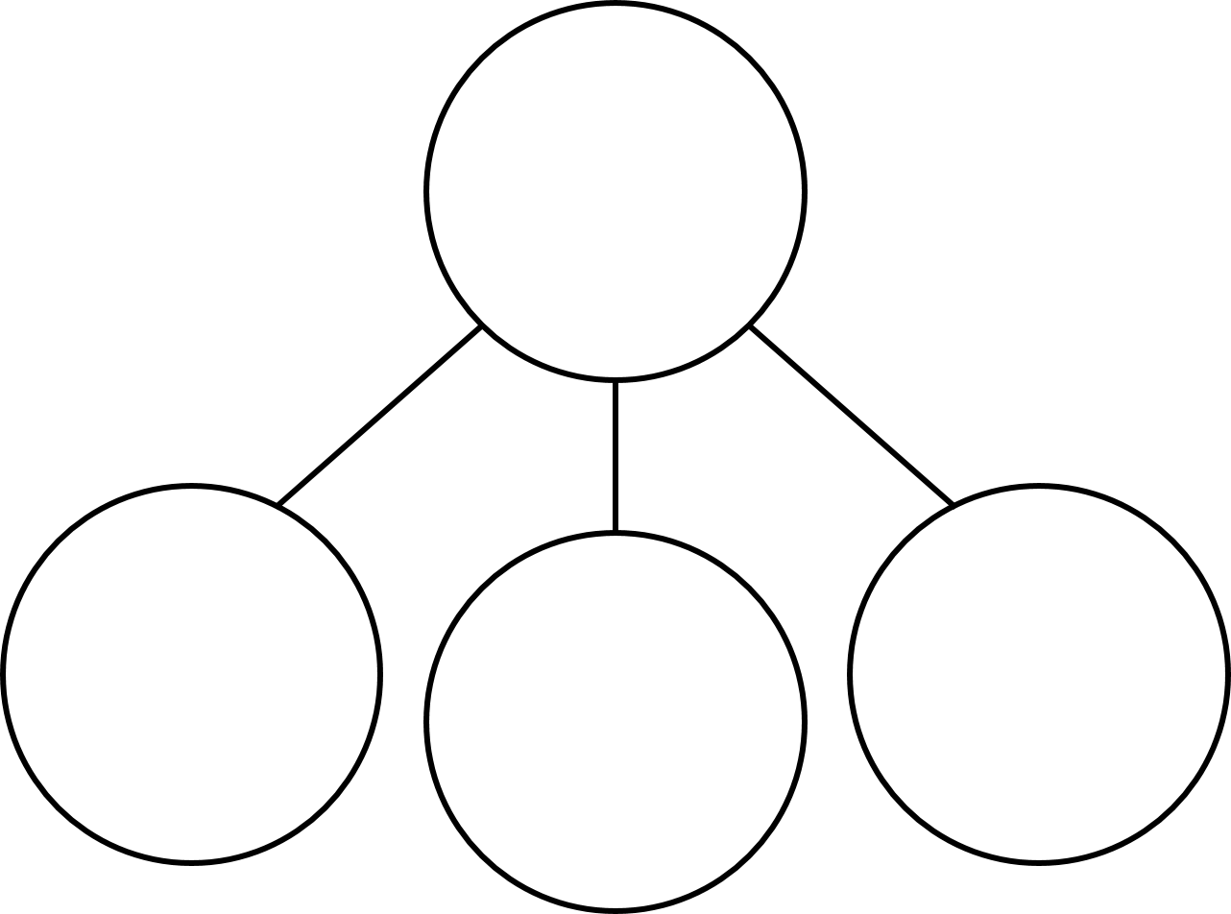
Using number bonds
7 $−$ 2 =
17 $−$ 2 =
15
5
7
17
2
5
10
5
2
7 ones $−$ 2 ones
1 ten + 7 ones
subtract 2 ones
Is equal to 5 ones
1 ten + 5 ones

Slide 12
Have a think
If….
Then….
3 $−$ 2 =
13 $−$ 2 =
1
11
9 $−$4 =
19 $−$ 4 =
5
15
8 $−$ 6 =
18 $−$ 6 =
2
12

Slide 13
Have a think
If….
Then….
6 $−$ 2 =
16 $−$ 2 =
14
4
7 $−$4 =
17 $−$ 4 =
13
3
9 $−$ 6 =
19 $−$ 6 =
13
3

Slide 14
Have a go at question 2 on the worksheet.

Slide 15
Fluency
First there were 14 counters.
Then 2 were taken away.
How many now?
FIRST | THEN | NOW
14
-
2
=
12

Slide 16
Fluency
First there were 16 counters.
Then 3 were taken away.
How many now?
FIRST | THEN | NOW
16
-
3
=
13

Slide 17
Fluency
First there were 17 counters.
Then 6 were taken away.
How many now?
FIRST | THEN | NOW
17
-
6
=
11

Slide 18
Problem solving
Kat’s answer in the NOW box is between 10 and 12. What is her calculation?
FIRST | THEN | NOW
Kat’s calculation is 17 – 6 = 11.

