Slide 1
Forces and Magnets
This half term, our science topic is:

Slide 2
LO: To know how magnets behave.
LO: To begin to use a science model to describe.

Slide 3
Vocabulary
force push pull contact force
distance force gravity force arrow
movement (associated terminology) magnetic magnetism poles (north, south) attract repel non-magnetic
These are some of the words we will be using over the course of the unit.

Slide 4
What is a magnet?

Slide 5
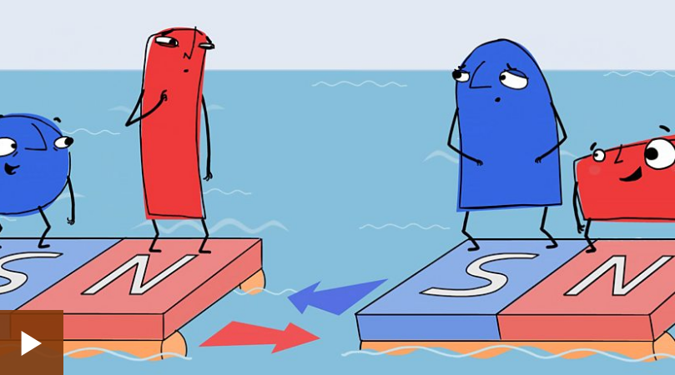
Let’s find out…

Slide 6
Magnetic forces
When two magnets are close, they create pushing or pulling forces on one another.
These forces are strongest at the ends of the magnets. The two ends of a magnet are known as the north pole and the south pole.

Slide 7
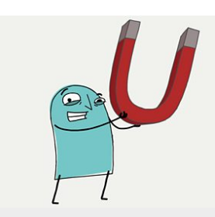
Some magnets are stronger than others.
Strong magnets will create bigger pushing or pulling forces than weak magnets.

Slide 8
Same poles repel
If you try to put two magnets together with the same poles pointing towards one another, the magnets will push away from each other. We say they repel each other.

Slide 9
Different poles attract
If you put two magnets together with different poles pointing towards one another, the magnets will pull towards each other. We say they attract each other.

Slide 10
Now we are going to explore magnets.
Predict what you think will happen. Use the vocabulary.
Do they attract or repel?

Slide 11
Draw a science model in your book with force arrows to describe the effect of a magnet on an object and a magnet on a magnet.
Use the vocabulary: attract repel

Slide 12
Role play
With your partner, can you use your bodies to show what magnets do?

Slide 13
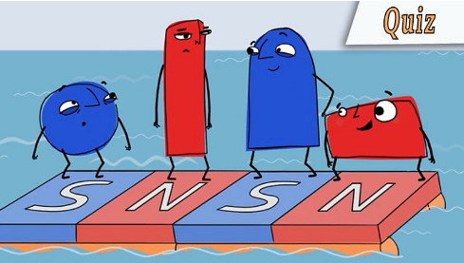
Let’s test our knowledge with a quiz.

Slide 14
Tell your partner 3 things you have learnt about magnets.

