Slide 1
Thought for the Day – Background information for Adults.
Collective worship in schools aims to provide the opportunity for pupils to worship God, to consider spiritual and moral issues and to explore their own beliefs; to encourage participation and response, whether through active involvement in the presentation of worship or through listening to and joining in the worship offered; and to develop community spirit, promote a common ethos and shared values, and reinforce positive attitudes. Collective worship allows time for personal reflection and prayer.
Acts of collective worship may include exploring an idea or theme, hearing quotes from an individual or a story about someone’s life and their impact in the world, for example. It gives opportunities for pupils to reflect on a diverse range of world views, religious and otherwise. Collective acts of worship can contain some elements which relate specifically to the Christian religion, and, where appropriate, address the special status accorded to Jesus, but when such material is shared with non-Christian pupils it is shared in a spirit and in a manner which is educational in intent. In other words, pupils are informed that Christians believe that Jesus is the Son of God. Christians who attend the act of collective worship might be afforded an opportunity to worship him. However, whilst non-Christian pupils will not be required to worship Jesus, they shall be invited, to encourage the feeling of community, to reflect in silence on what they have heard.

Slide 2
Taken from a Save the Children Document

Slide 3
Monday

Slide 4
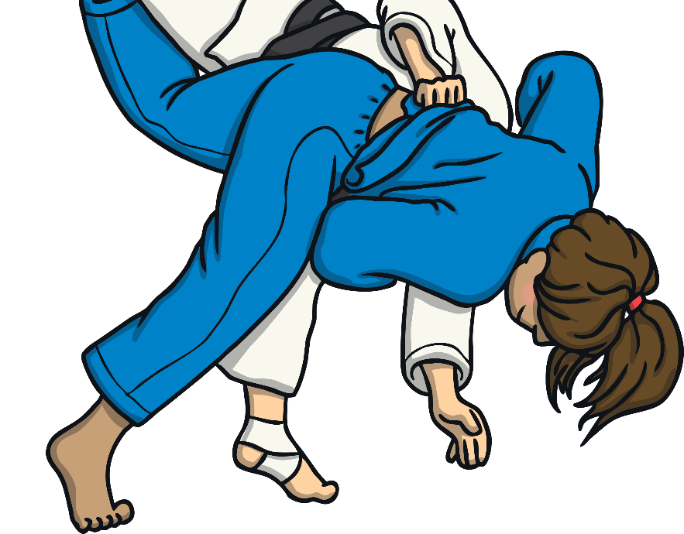
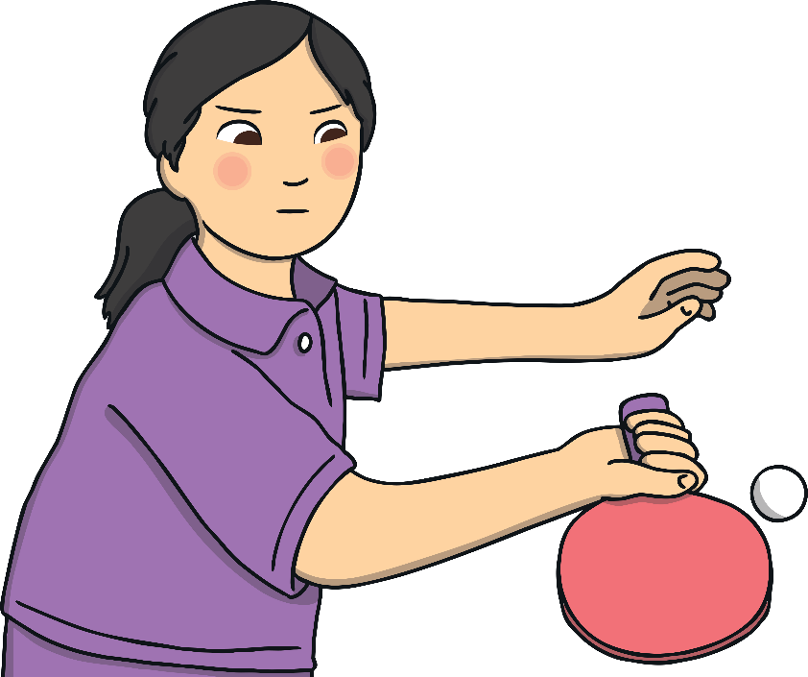
Olympic Games
The Olympic Games take place every four years.
Athletes meet up from all over the world to compete in different events.
There are many sports in the Olympic Games, including rowing, gymnastics, horse riding, table tennis, skateboarding and swimming.
The Olympic Games are not just about being the best at sport - they also focus on people’s values and qualities.
Have you ever tried any of these sports?
These are called Olympic Values.

Slide 5
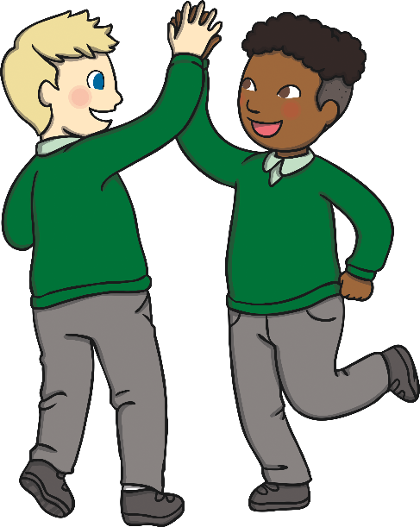
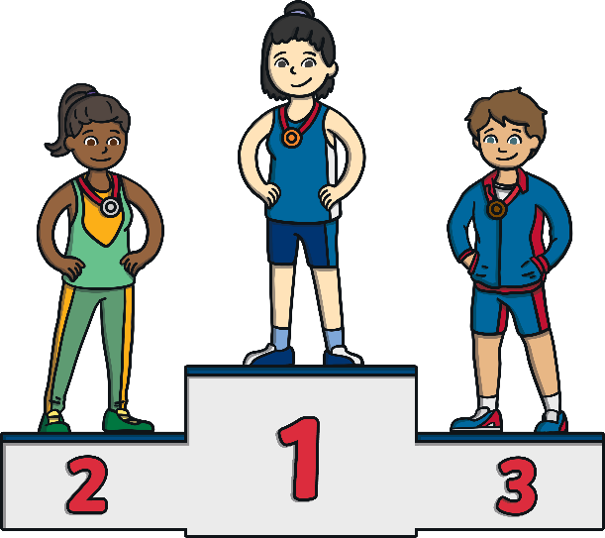
Values
Values are types of behaviours that we think are important to show.
Can you match these pictures with these values?
Can you describe what these values mean?
Excellence
Friendship
Hardworking
Determination

Slide 6
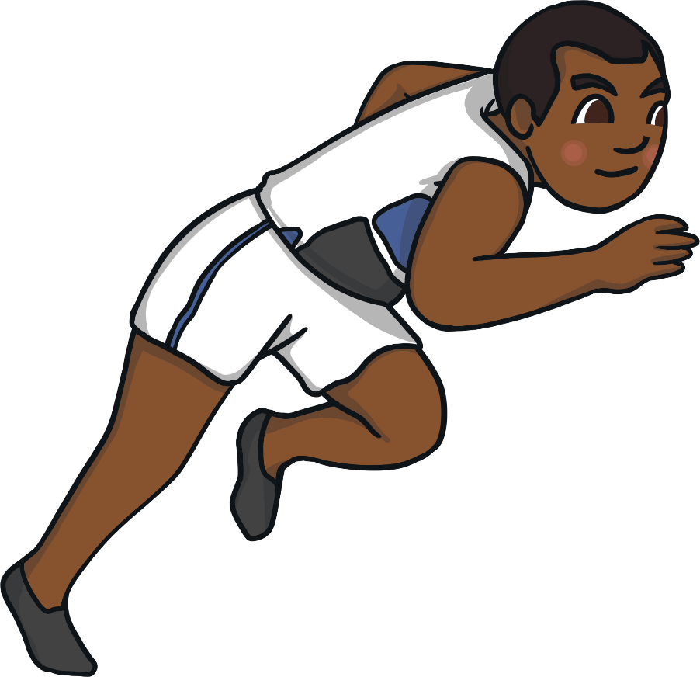
Olympic Values
The Olympic Values are a list of behaviours for athletes to show at the Olympic Games.
What are the Olympic Values?
The Olympic Values are:
Excellence
Respect
Friendship
Courage
You feel this when you have an excited feeling or idea after hearing, seeing or experiencing something.
This can be lots of things but includes having fun, helping each other and showing that you care.
Being brave is when you do something even when it might worry or scare you.
This means that you treat others how you would like to be treated.
You try to be the best that you can be.
You show this when you work hard towards a goal and don't stop, even if it is hard.
This means to treat everyone equally and fairly.
Determination
Equality
Inspiration

Slide 7
Tuesday
Today we are going to talk about:
Respect
Friendship
Equality
Watch the video.
Can you see examples of people treating others with respect?
Can you see any examples of friendship?
Can you see any examples of people being treated the same and included?
https://www.getset.co.uk/resources/olympic-paralympic-values

Slide 8
Wednesday
Today we are going to talk about:
Excellence
Determination
Michael Phelps:- Swimmer
https://www.eurosport.co.uk/olympics/essential-stories/2021/the-essential-olympic-stories-michael-phelps-bullet-with-butterfly-wings_vid1476841/video.shtml

Slide 9
Thursday
Today we are going to talk about:
Courage
Inspiration
(and determination again)
Some stories of athlete’s bravery, can inspire others to have a go too!
Derek Redmond
https://www.youtube.com/watch?v=-_JUKNfYNpc

Slide 10
Friday
Our School Prayer.
God bless our school.
Bless those who teach,
Bless those who learn,
Bless us with knowledge.
Amen.
What do you like about working from home or at school?
What have you learned this week?
Have you helped someone else to learn?
Ask the children to listen to our school prayer.
You might like to change the word ‘school’ to ‘home’,
if you have been at home this week.
Remind the children that
Amen means- “I agree”
The children might like to say “Amen” at the end.

