Slide 1
French
What’s the Time?
Year One
French | Year 4 | What’s the Time? | My Day | Lesson 2

Slide 3
Aim
I can say/write at what time I do things.
Success Criteria
I can start a sentence using a time connective, stating at what time something happens.
I can write a whole sentence choosing from a list of simple sentences.

Slide 4
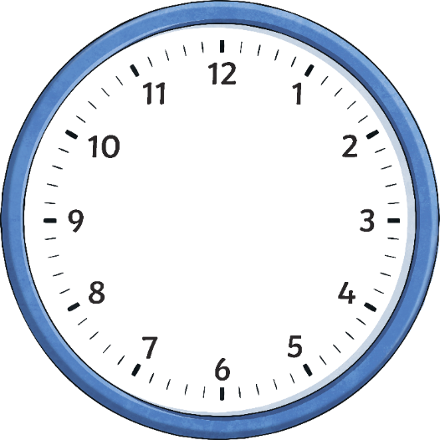
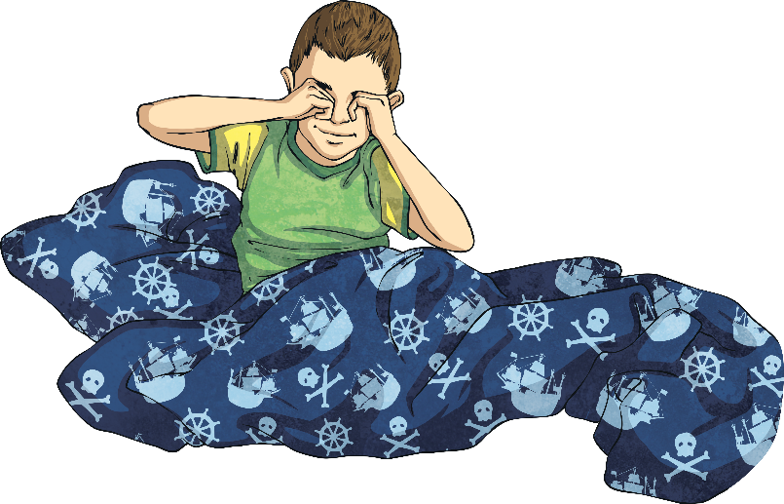
Ma Journée My Day
Click play buttons throughout to hear phrases and words.
À sept heures,
je me lève.

Slide 5
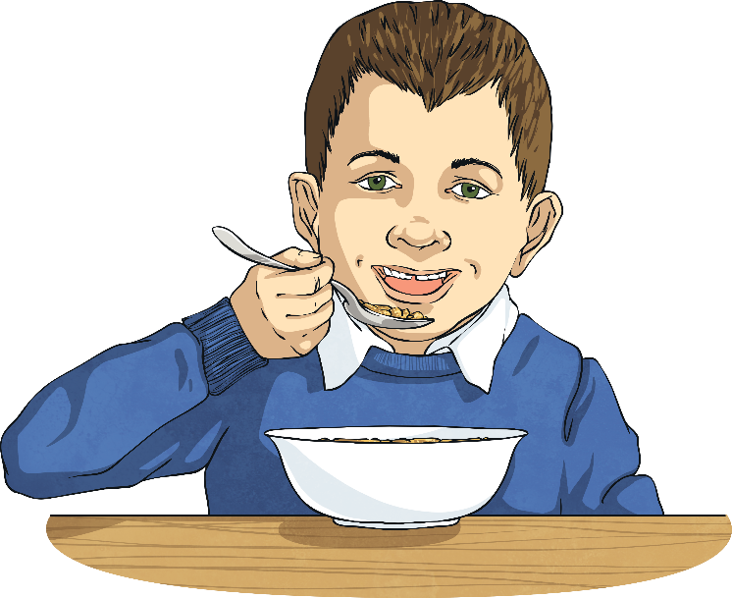
Ma Journée My Day
À sept heures et demie,
je mange mon petit déjeuner.

Slide 6
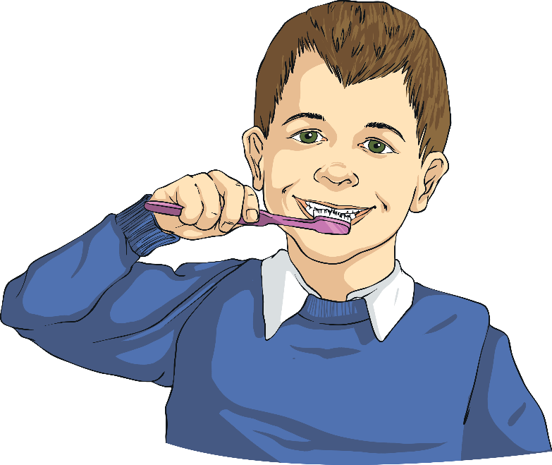
Ma Journée My Day
À huit heures,
je me brosse les dents.

Slide 7
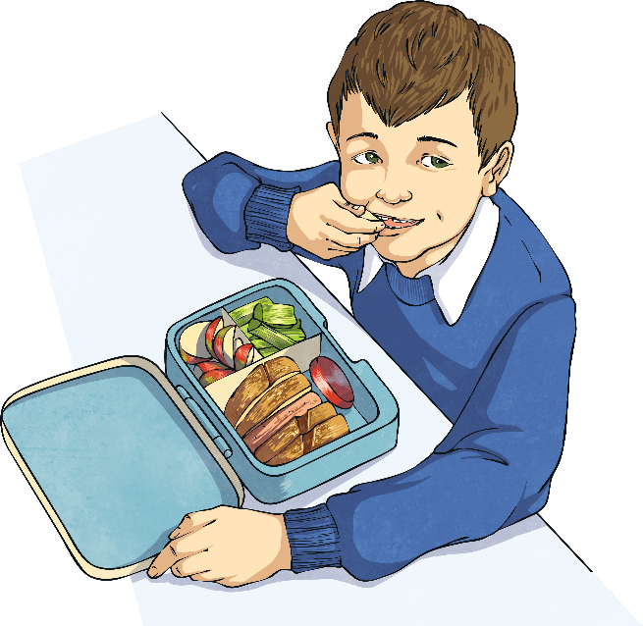
Ma Journée My Day
À douze heures et demie,
je mange mon déjeuner.

Slide 8
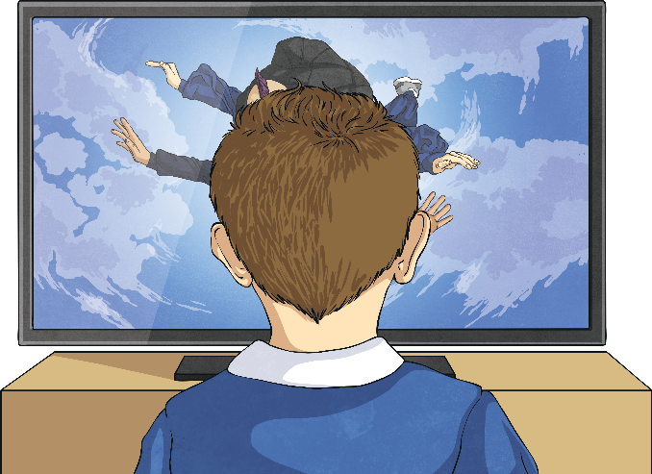
Ma Journée My Day
À quatre heures,
je regarde la télévision.

Slide 9
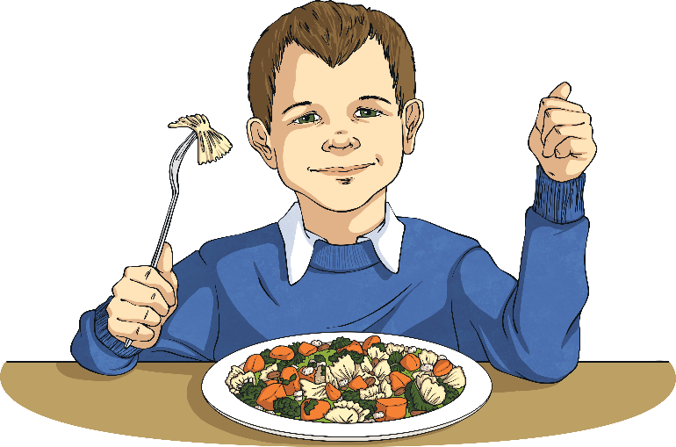
Ma Journée My Day
À cinq heures,
je mange mon dîner.

Slide 10
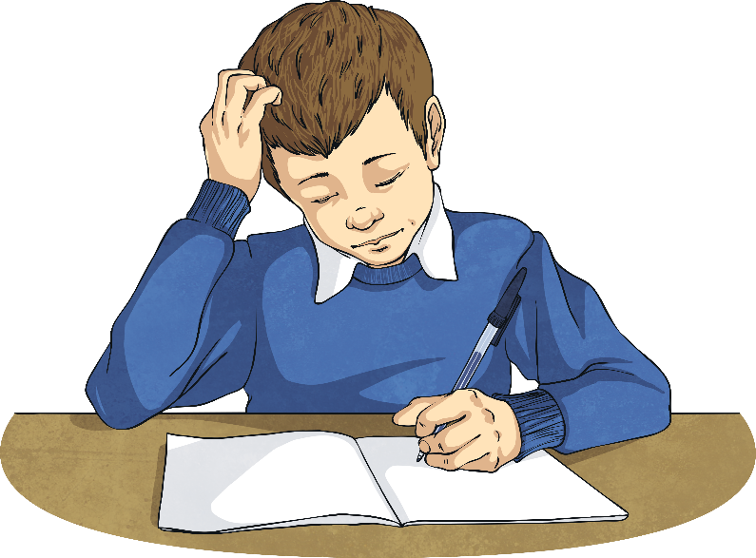
Ma Journée My Day
À six heures et demie,
je fais mes devoirs.

Slide 11
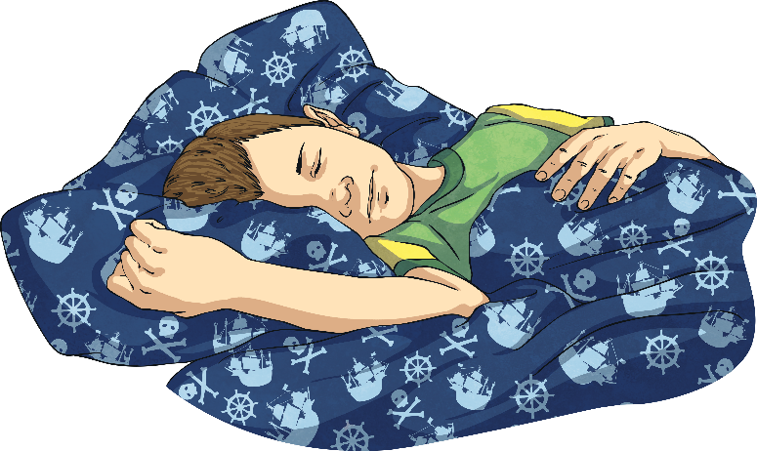
Ma Journée My Day
À neuf heures,
je me couche.

Slide 12
Which One?
...je me couche
...je regarde la télévision
...je rentre chez moi

Slide 13
Which One?
…je me brosse les dents
…je mange mon dîner
…je me couche

Slide 14
Which One?
…je me brosse les dents
…je rentre chez moi
...je me couche

Slide 15
Which One?
...je me lève
…je me brosse les dents
...je rentre chez moi

Slide 16
Which One?
...je me lève
…je mange mon petit déjeuner
…je me brosse les dents

Slide 17
Which One?
…je mange mon déjeuner
…je me lève
…je regarde la télévision

Slide 18
Which One?
…je me couche
…je fais mes devoirs
…je me lève

Slide 19
To help you talk about your day, here are some school subjects you might be doing.
Click play buttons throughout to hear phrases and words.
Here are subject names in French
français | English
le français
le dessin
la géographie (la géo)
l’anglais
l'éducation physique (l’E.P.S.)
l'informatique
les mathématiques (les maths)
la musique
l'histoire
les sciences
French
art
geography
English
PE
IT
maths
music
history
science

Slide 20
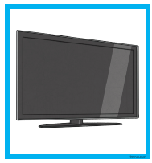
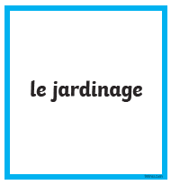
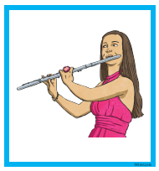
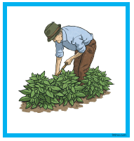
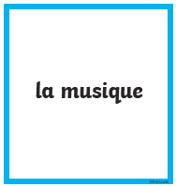
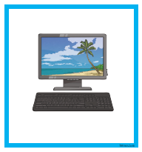
Let’s look at activities other than school work. Match the activities to their pictures.
1.
2.
3.
4.
a.
b.
c.
d.

Slide 21
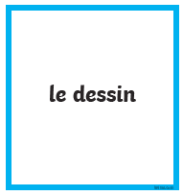
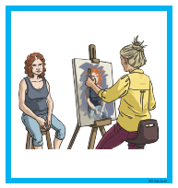
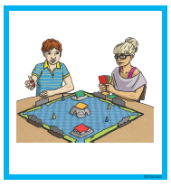
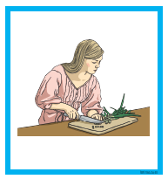
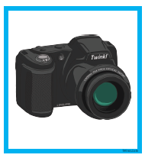
Let’s look at activities other than school work. Match the activities to their pictures.
5.
6.
7.
8.
e.
f.
g.
h.

Slide 22
Let’s look at activities other than school work. Match the activities to their pictures.
1.
2.
3.
4.
a.
b.
c.
d.

Slide 23
Let’s look at activities other than school work. Match the activities to their pictures.
5.
6.
7.
8.
e.
f.
g.
h.

Slide 24
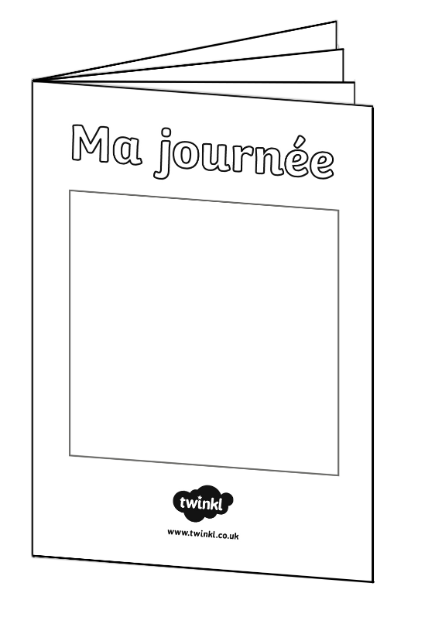
Allez-y ! Off You Go!
Use the Ma Journée worksheet (or make your own booklet) and write about what you do during a day or up to a week (in French!)
The subjects and activities slides will support your working.
Enjoy! I look forward to reading about your activities on Seesaw ☺

Slide 25
Allez-y ! Off You Go!

Slide 26
Extra Activities
Are you finding it difficult to decide what to do with your time? Would you like something to make the decision for you? Then make your very own ‘Hobbies Fortune Teller’ by following these instructions. You can print off the example sheet or make a fortune teller of your own.
Top Tips-
Remember to practise your pronunciation by saying the activity you land on in French.
Why not practise counting in French when using the fortune teller.
And don’t forget to enjoy yourselves ☺

Slide 27
How do you think you’ve got on?
Aim
I can say/write at what time I do things.
Success Criteria
I can start a sentence using a time connective, stating at what time something happens.
I can write a whole sentence choosing from a list of simple sentences.

