Slide 3
What do you know and what can you find out about the lengths of the pencils?

Slide 4
What do you know and what can you find out about the lengths of the pencils?
The lengths
8 cm
10 cm
The combined length
18 cm
The difference in lengths
2 cm

Slide 6
Have a go at question 1 on the worksheet

Slide 7
But it says 12

Slide 8
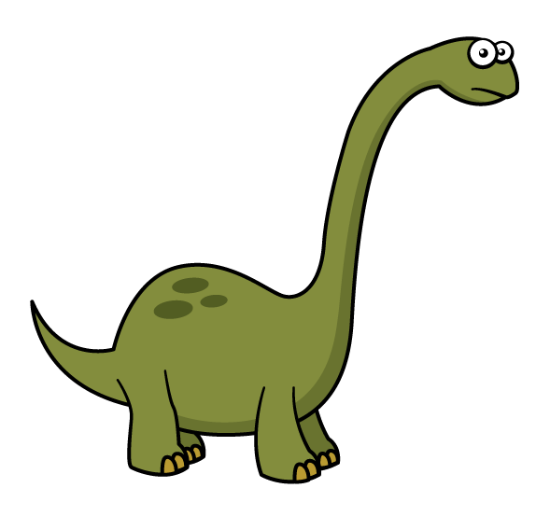
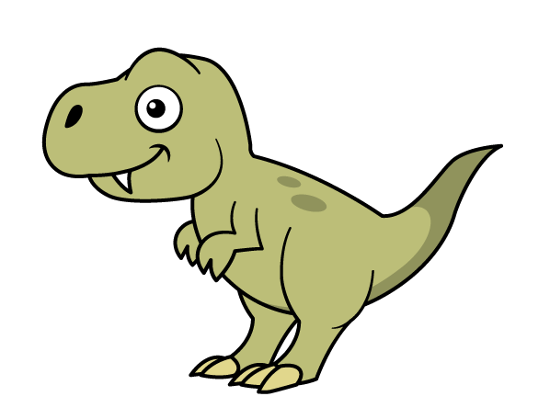
What do you notice?
taller
shorter
11 cm tall
5 cm tall

Slide 9
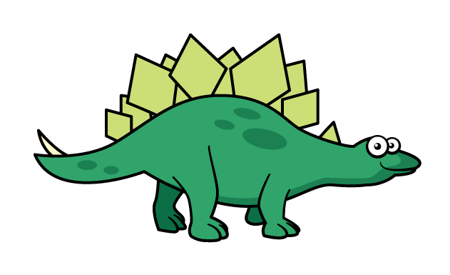
What do you notice?
8 cm
5 cm
The Stegosaurus is longer than the T-rex.
The T-rex is shorter than the Stegosaurus.
Have a think

Slide 10
True or False?
The yellow pencil is longer than the orange pencil.
It is false. Both pencils are the same length.

Slide 11
Equality and Inequality
$$=$$
$$=$$
$$>$$
30
30
3
1

Slide 12
Are these correct or incorrect?
$$>$$
22 cm 10 cm
$$=$$
20 m 2 m
$$<$$
10 metres 10 centimetres
Have a think

Slide 13
Can you make these correct?
$$>$$
22 cm 10 cm
20 m
$$=$$
20 m
centimetres
$$<$$
0
10 centimetres
1
2
3
4
5
6
7
8
10
9
Have a think

Slide 14
Add measurements to complete the comparisons
Have a think
100
_________ cm $=$ 1 m
99, 98, 97…
_________ cm $<$1 m
101, 102…
_________ cm $>$ 1 m

Slide 15
How tall could the stegosaurus be?
11 cm tall
? cm tall
5 cm tall
10, 9, 8, 7, 6
11 cm $>$ ___________cm $>$ 5 cm
Have a think

Slide 16
Have a go at questions 2 – 6 on the worksheet

Slide 17
Some cars and a bus park on
a street near a school.
2 m
2 m
Each car is 2 m long.

Slide 18
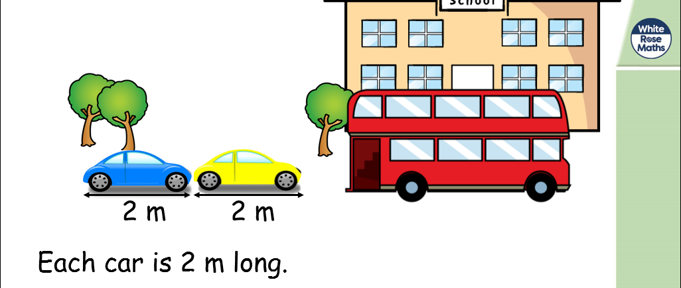
2 $+$ 2 $+$ 2 $+$ 2 $+$ 2 $=$ 10
2 $×$ 5 $=$ 10
?
4
10
8
?
?
2 $+$ 2 $=$ 4
2
2
4
2
2
4
2
2 $×$ 2 $=$ 4

Slide 19
Have a go at the last question on the worksheet

