Slide 1
6.12.21
L.O. – I can multiply and divide by 9.

Slide 2
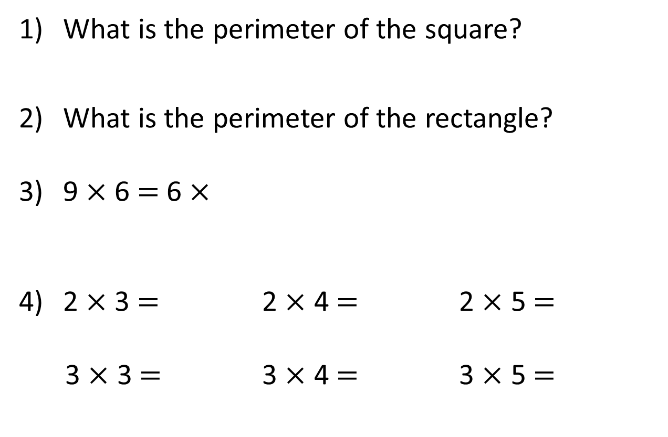
What is the perimeter of the square?
What is the perimeter of the rectangle?
9 $×$ 6 $=$ 6 $×$
2 $×$ 3 $=$ 2 $×$ 4 $=$ 2 $×$ 5 $=$
3 $×$ 3 $=$ 3 $×$ 4 $=$ 3 $×$ 5 $=$
3cm
8cm
2cm

Slide 3
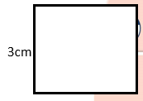
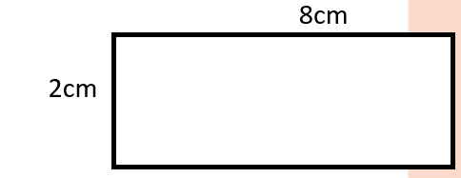
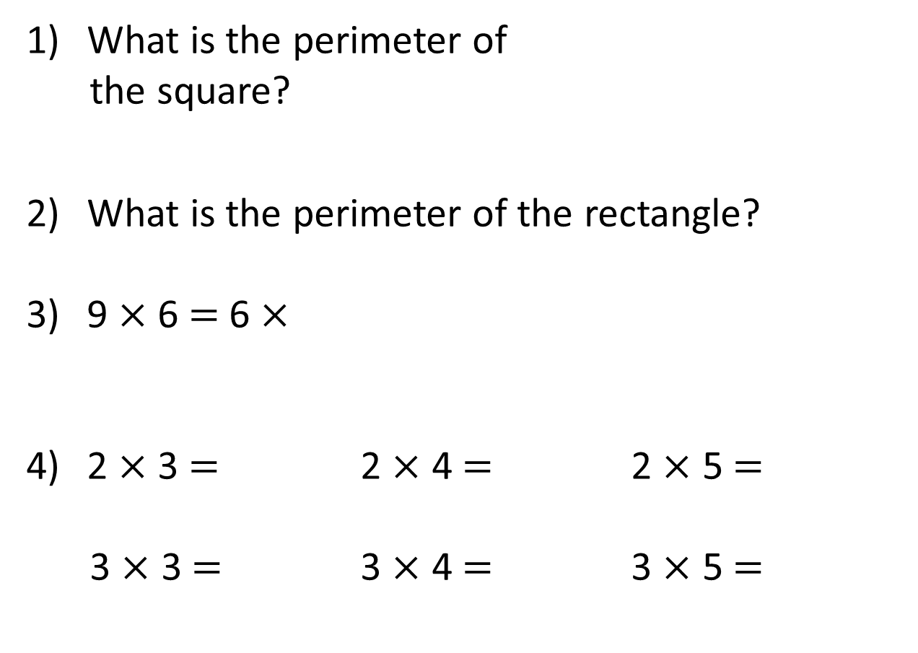
What is the perimeter of
the square?
What is the perimeter of the rectangle?
9 $×$ 6 $=$ 6 $×$
2 $×$ 3 $=$ 2 $×$ 4 $=$ 2 $×$ 5 $=$
3 $×$ 3 $=$ 3 $×$ 4 $=$ 3 $×$ 5 $=$
12cm
20cm
9
6
8
10
9
12
15

Slide 4

Complete the missing numbers.
4
There are ____ cookies.
There are ____ chocolate chips in each cookie.
There are ____ chocolate chips altogether.
9
36

Slide 5


Complete the missing numbers.
4
There are ____ cookies.
There are ____ chocolate chips in each cookie.
There are ____ chocolate chips altogether.
9
36
9
36
$+ + + =$
9
9
9
$× =$
4
9
36
$× =$
9
4
36

Slide 6




Each packet contains 9 sweets.
Have a think
9
9
9
9
9
9
54
$+ + + + + =$
$× =$
6
9
54
$× =$
9
6
54

Slide 7


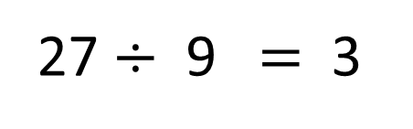
There are 27 fish.
An equal amount are put into each of the 9 tanks.
How many fish are put in each tank?
27 $÷$ 9 $=$ 3
Total number of fish
Number of fish tanks
Number of fish in each tank

Slide 8
There are 27 fish.
9 fish are put in each tank.
How many tanks are needed for all the fish?
27 $÷$ 9 $=$ 3
Total number of fish
Number of fish in each tank
Number of tanks

Slide 9
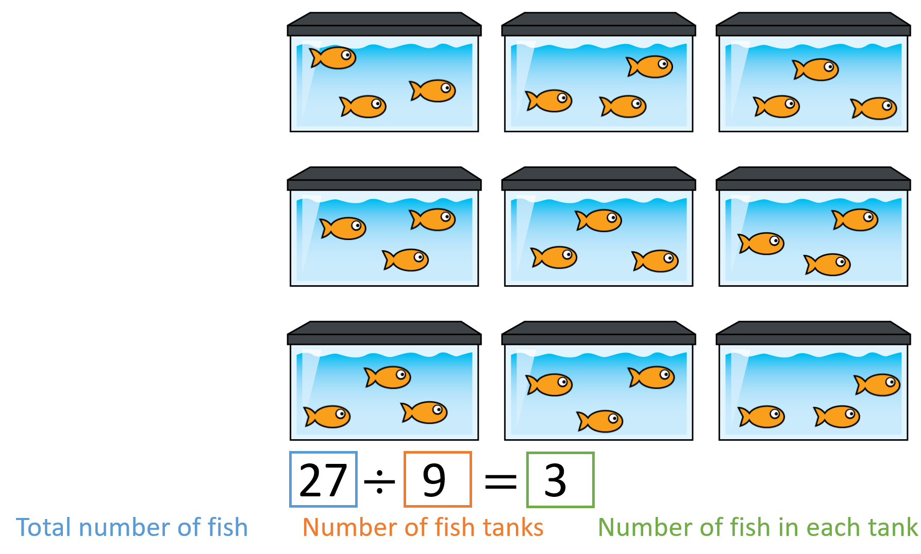
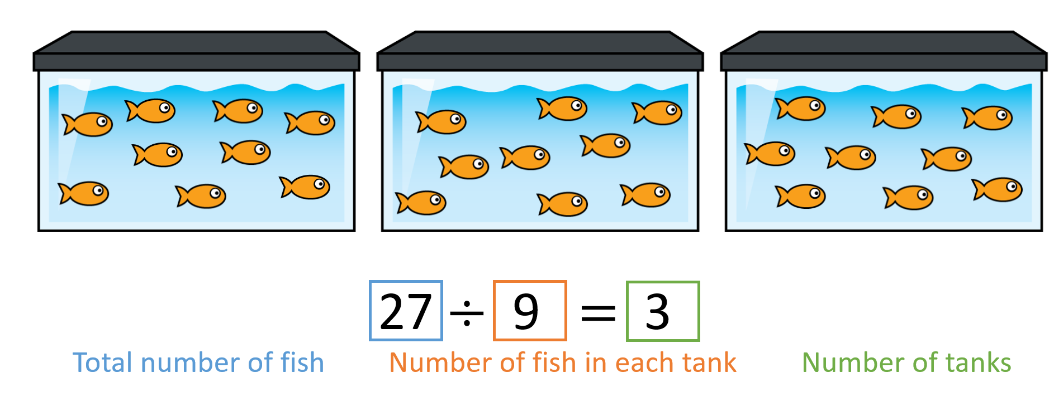
Sharing
Grouping

Slide 10
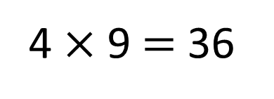
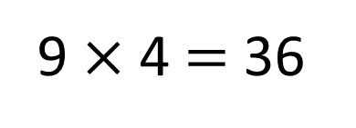
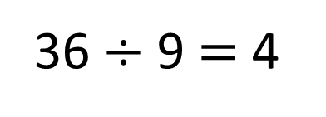
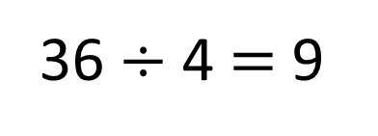
9 $×$ 4 $=$ 36
4 $×$ 9 $=$ 36
36 $÷$ 4 $=$ 9
36 $÷$ 9 $=$ 4

Slide 11
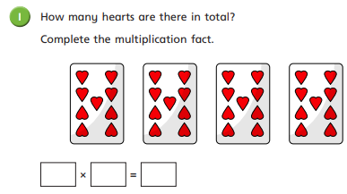
Complete question 1 on your worksheet.

Slide 12
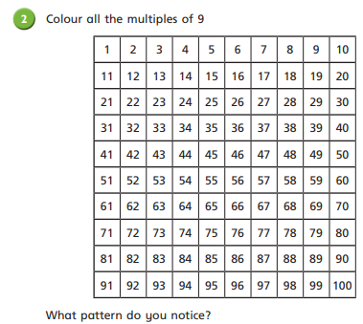
Colour in all of the multiples of 9 on your 100 square, what patter can you see?

Slide 13
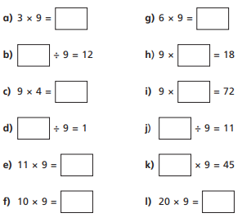
Copy and complete these calculations in your book.

Slide 14




2 $×$ 3
6
True or False?
5
2 $×$ 3 $×$ 9 $=$ 5 $×$ 9
9 $×$ 3 $=$ 3 $×$ 3 $×$ 3
2 $×$ 3 $×$ 9 $=$ 9 $×$ 6
9
9
False
3 $×$ 3
9
9
3
True
3
2 $×$ 3
6
True
9
9
Have a think

Slide 15

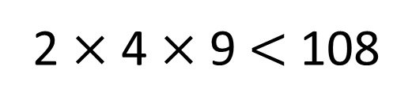
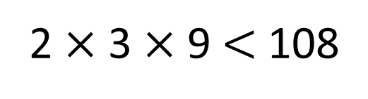

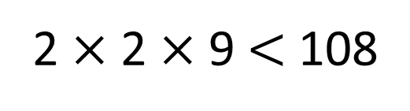
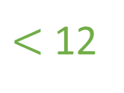
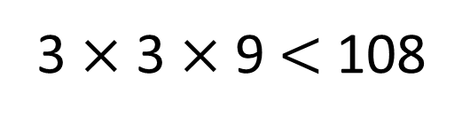

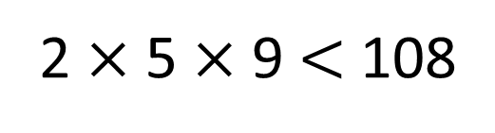
2
2
2
3
3
3
3
4
4
4
5
5
6
6
7
7
8
8
9
9
$×$ $×$ $<$ 108
9
12 $×$ 9
$<$ 12
How many different possible
solutions are there?
You can use each card more than once.
2 $×$ 2 $×$ 9 $<$ 108
2 $×$ 3 $×$ 9 $<$ 108
36
2 $×$ 4 $×$ 9 $<$ 108
2 $×$ 5 $×$ 9 $<$ 108
3 $×$ 3 $×$ 9 $<$ 108
Have a think

Slide 16
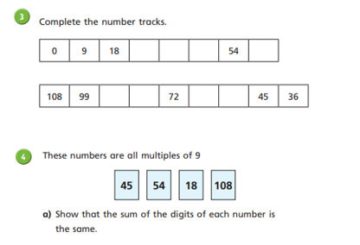
Now, finish the questions on your worksheet.

Slide 17
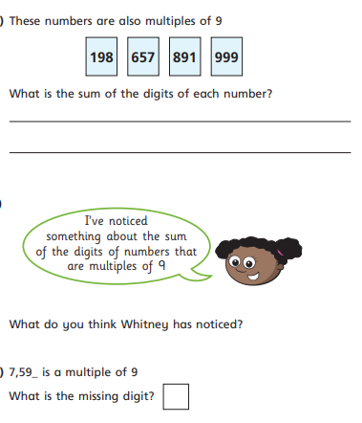
Let’s discuss this question as a class.

Slide 18
Now, we will have a few games of multiplication bingo. If you have a correct call you can move up the star chart.
Then, we will do a 9 times tables assessment using a PowerPoint presentation.
You will be shown a question about the 9’s and will only have a short amount of time to answer.
There will be 25 questions, so write the number 1-25 on some scrap paper and get ready.

