Slide 1
Wednesday 24th February.
LO – I can plan a persuasive advert using headlines and quotes.
Please write the date and learning objectives in your books.

Slide 2
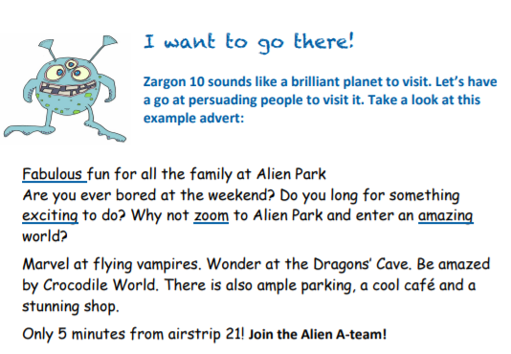
Take a look at this extract from pg. 19 of the alien booklet:
Pause the video and read through this advert.
Does it persuade you to want to visit Zargon 10?

Slide 3
We want a headline for this advert to catch the
reader’s eye! You may use alliteration.
Pause the video and read through this advert.
Try and think of a better headline/title for this advert.
Does it persuade you to want to visit Zargon 10?
Do you think a quote from someone that had already visited might persuade you to want to go?

Slide 4
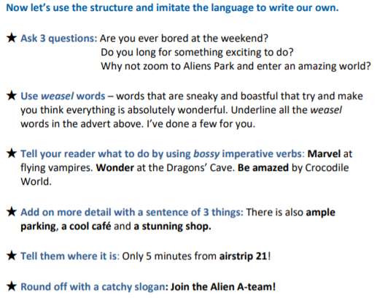
Persuasive advert.
You now need to work through these questions and this will help you plan your own advert.

Slide 5
Are you fed up of being in your house at weekends?
How exciting would it be to do something you have never done before?
Why not visit somewhere new?
Pause the video and have a think.

Slide 6
Weasel words.
Look back at the text on slide 2. Can you locate the weasel words that have been underlined?
Can you find some more? Pause the video and have a look.

Slide 7
Bossy verbs
Be in awe of the amazing erupting volcanoes.
Tremble at the sight of the flesh-eating ants!
Be mesmerized by the dancing melonfly.
Pause the video and think of some sentences with imperative verbs.

Slide 8
Sentence of three things.
There is also a jammed pack shop of souvenirs, an award winning restaurant and a fabulous fun park.
Pause the video and think of a sentence with three things.

Slide 9
Tell them where it is.
Zargon 10 can be found 10 minutes south east of Zargon 9. It’s an easy flight!

Slide 10
Catchy slogan
Become part of the Best Buddy Beasts!

Slide 11
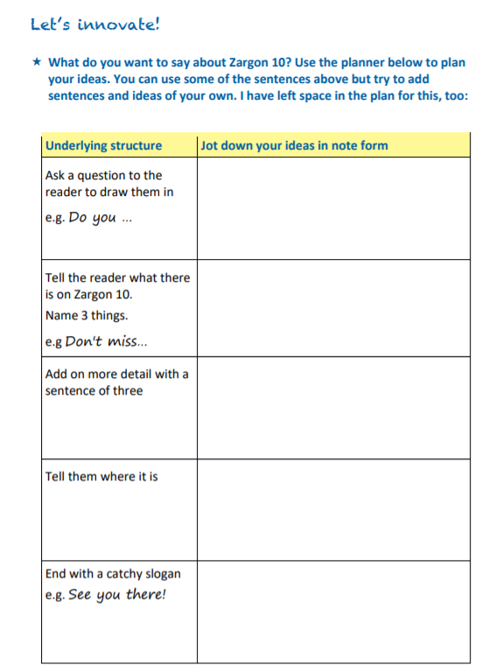
Planner for advert.
Using the planner, you are going to think about each part of the planner. This will allow you to write your advert during tomorrow’s session.
Because of all the work that you have completed so far, you can
Plan your ideas for your advert to encourage people to visit Zargon 10.
This does not have to be in complete sentences. It’s just your ideas. Pause the video to complete the planning.
Remember that we are going to include a headline/title to catch the attention of the reader. Can you think of a quote to add that would encourage people to visit too?

Slide 12
Completed task
Once you have completed your advert planning please
upload this work to Seesaw. Tomorrow you will be writing your advert up and illustrating it to try and encourage people to visit. This relates back to our spy gadget work in autumn term.
We look forward to looking at your work.
Miss Brewster, Miss Stevens and Miss Lamb.

