Slide 1
Oracy

Slide 2
What is Oracy?

Slide 3
“Oracy is the ability to articulate ideas, develop understanding and engage with others through spoken language.”
Voice 21
What does that mean?

Slide 4
It means:
Being able to speak clearly so that others can understand you
And
Being able to understand what other say to you
So that you can communicate ☺

Slide 5
Why is it important to learn how to do this well?
How many ideas can we collect?

Slide 6
Now let’s play a little game:
Back to Back
Stand back to back with your partner. One is A and one is B.
A asks B a question e.g. What did you do over the weekend? Who is your favourite sportsperson of all time and why?
B answers the question. A must show that they are listening by offering verbal reassurance and encouragement.
Afterwards…
Did B feel that they were listened to?
Why is it more difficult to be a good listener when you are back to back with someone?

Slide 7
On the next slide is the Oracy framework. I’m just going to share the headings with you today, but we will be learning more abut the Oracy framework later.
Let’s look at the headings and think about why each one might be important for successful Oracy.

Slide 8
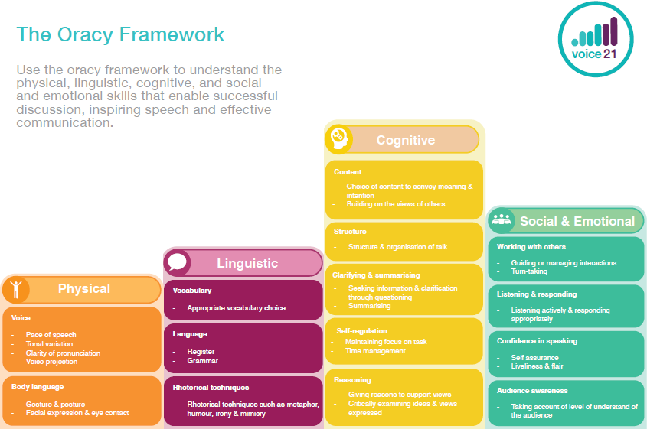

Slide 9
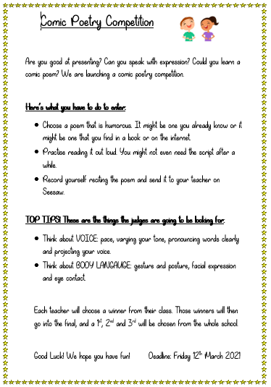
Lots of us have already shared some fantastic talk with our comic poem.
This is called:
Presentational Talk
(learning to talk)
In the Summer term we are going to have another competition!

Slide 10
There is another type of talk
Exploratory (learning through talk)
Can anyone think of examples when we do this?
How many can we think of?

Slide 11
List all of your ideas here:

Slide 12
Discussion roles
We are going to start with ABC that response for everyone. So when we are in class we can show why we want to speak.

Slide 13
Let’s practise these hand signals.
A is for

Slide 14
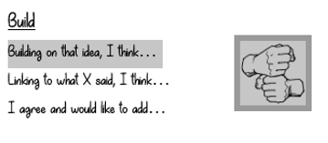
B is for

Slide 15
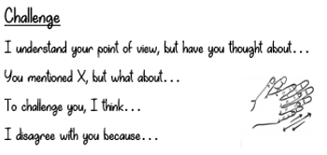
C is for

Slide 16
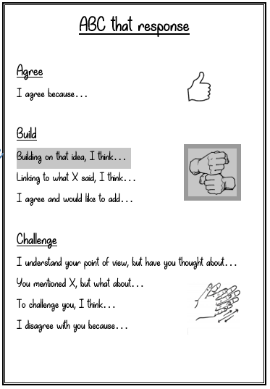
Today I would like you to design your own ABC that response poster.

