Slide 1
This PowerPoint is best used on a computer rather than printed off as it works through each problem as we would in the classroom taking you through to the answer in most cases.
It will be used alongside the recorded lesson to introduce the concepts on the worksheet which the children can answer once they have worked through the PowerPoint.
There is a separate answer sheet to support checking the worksheet.

Slide 2
14.01.21
LO. I can multiply a 3-digit number by a 1-digit number.

Slide 3
Task 1.
Let’s recap our 12 x table.
We will chant it all together.

Slide 4
Task 2.
Answer the following questions. Use your multiplication knowledge to support you.
1) 2 × 2 =
2) 40 × 2 =
3) 2 × 300 =
4) 342 × 2 =
4
80
600
684

Slide 5
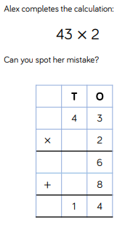
Today we are learning to multiply 3-digit numbers by 1-digit numbers.
We have already looked at multiplying a 2-digit number by 1-digit number.
Look at this problem.
What mistake has Alex made?
Write your idea in the comments.
Alex has multiplied 4 by 4 rather
than 40 by 2.
What should our answer be? 86

Slide 6
The following two slides will support you in answering questions 1-3 on your worksheet.

Slide 7
So now we are multiplying 3-digit numbers by 1-digit numbers.
We can group together counters and make exchanges.
Here we have written 243 out 4 times.
Hundreds | Tens | Ones
243 × 4 =
9
7
2

Slide 8
150 × 3 =
Is the turtle right?
Have a think
I think the answer is 45
Let’s use our method to help us answer this question.
Hundreds | Tens | Ones
150 × 3 = 450

Slide 9
The following two slides will support you in answering questions 4 and 5 on your worksheet.

Slide 10
123 × 4 =
492
H | T | O
1 | 2 | 3
 |  | 4
Hundreds | Tens | Ones
$$×$$
1 2
(3 × 4)
8 0
(20 × 4)
$$+$$
4 0 0
(100 × 4)
4
9
2

Slide 11
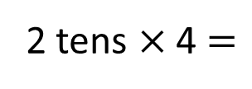
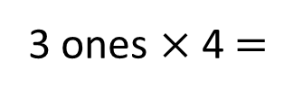
123 × 4 =
492
H | T | O
1 | 2 | 3
 |  | 4
Hundreds | Tens | Ones
$$×$$
4
9
2
1
3 ones × 4 $=$
12 ones
2 tens × 4 $=$
8 tens
8 tens + 1 ten $=$
9 tens
1 hundred × 4 $=$
4 hundreds

Slide 12
103 × 4 =
412
H | T | O
1 | 0 | 3
 |  | 4
3 × 4 =
12
0 × 4 =
0
100 × 4 =
400
$$×$$
Hundreds | Tens | Ones
4
1
2
1
103
100
3
0

Slide 13
153 × 7 =
1,071
 | H | T | O
 | 1 | 5 | 3
 |  |  | 7
Th
3 × 7 = 21
50 × 7 = 350
$$×$$
100 × 7 = 700
1
0
7
1
153
3
2
5 tens × 7 = 35 tens
100
3
50
35 tens + 2 tens = 37 tens
1 hundred × 7 = 7 hundreds
7 hundreds + 3 hundreds = 10 hundreds

Slide 14
Now have a look at the worksheet and answer the questions.
Use all the teaching from today to help you work out how to solve problems 6-8 on your worksheet.
Refer back to the PowerPoint if you are stuck, or message on Seesaw for more help.

