Slide 1
Wednesday 21st October.
LO- I understand the transport systems within the UK. I can work out how people may travel from city to city within the UK.

Slide 2
Recap on communication within a city.
Recap on the last Geography lesson. Can they remember the 8 points of the compass?
Can you remember why people may travel from city to city and the modes of transport that may be used?
What are the factors that affect people’s choices in the way they travel?

Slide 3
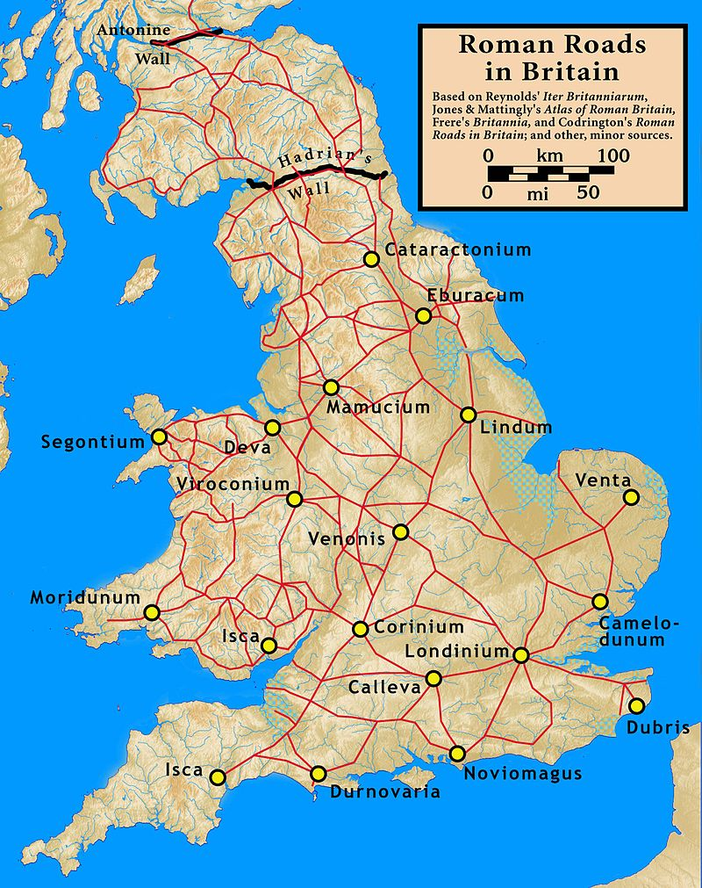
Transport systems around the UK.

Slide 4
Questions to answer about national travel.
What are the main reasons for national travel?
What modes of transport can be used to travel around the UK?
What factors influence the mode of transport that people use?
What are the major roads in England called?

Slide 5
Journeys from cities to cities.
Once you have answered the questions, stick the incomplete table in your book.
As a class, we will look at this and decide how we will complete it.
Teacher to model how to fill in the table.

Slide 6
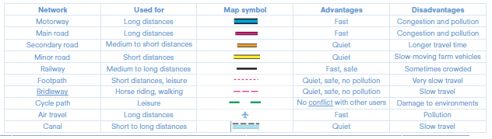
Advantages and disadvantages of the different ways to travel.

Slide 7
A table to show the advantages and disadvantages of different types of transport when travelling nationally.
Network | Used for | Map Symbol | Advantages | Disadvantages
Motorway | Long distances |  | Fast
Main road
Secondary road
Minor road
Railway
Footpath
Bridleway
Cycle path |  |  | No conflict with others
Air travel
Canal |  |  |  | Slow travel

Slide 8
Class discussion
TTYP about the advantages and disadvantages of national travel.
Complete the table. You can work with your learning partner.
TTYP about anywhere you would like to visit it in the UK and the reasons why. Use the atlas to help locate these destinations.

