Slide 1


Slide 3
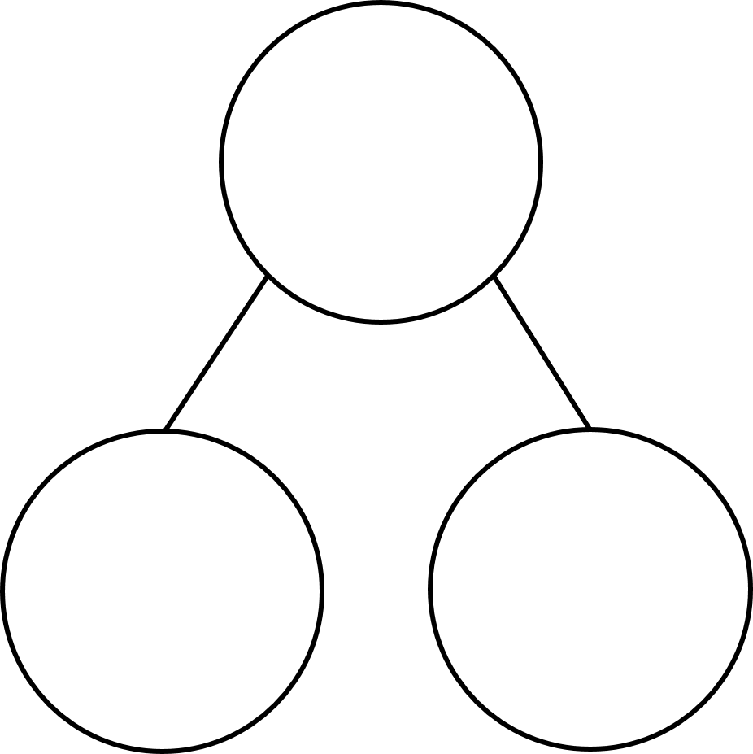
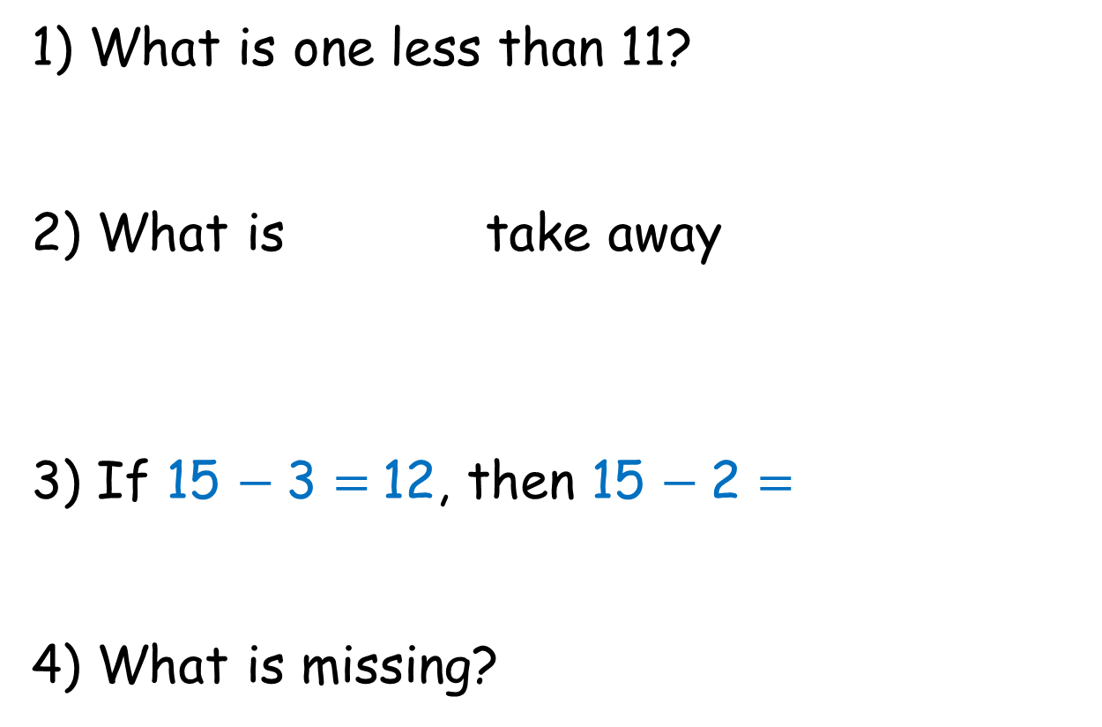
1) What is one less than 11?
2) What is take away
3) If 15 $−$ 3 = 12, then 15 $−$ 2 =
4) What is missing?
?
16
18

Slide 4
1) What is one less than 11?
2) What is take away
3) If 15 $−$ 3 = 12, then 15 $−$ 2 =
4) What is missing?
10
11
13
16
2
18

Slide 6




I can use a number line
to count back.
There were 12 chocolates.
4 chocolates were eaten.
How many chocolates are left?
4
3
2
1
6
7
8
9
10
11
12
13
14
15
16
17
18
19
20
12
$$−$$
4
$$=$$
8

Slide 7



Have a think
There were 14 bees at the hive.
5 bees flew away.
How many bees are left?
5
4
3
2
1
6
7
8
9
10
11
12
13
14
15
16
17
18
19
20
14
$$−$$
5
$$=$$
9

Slide 8
Have a go at question 1 on the worksheet.

Slide 9



I can use a number line
to count back.
17
$$−$$
9
$$=$$
8
9
8
7
6
5
4
3
2
1
2
3
4
5
6
7
8
9
10
11
12
13
14
15
16
17

Slide 10

I can use a number line
to count back.
17
$$−$$
9
$$=$$
8
2
7
2
3
4
5
6
7
8
9
10
11
12
13
14
15
16
17

Slide 11
I like to count back to 10 first.
15
$$−$$
8
$$=$$
7
3
5
2
3
4
5
6
7
8
9
10
11
12
13
14
15
16
17

Slide 12
Have a go at question 2 on the worksheet.

Slide 13




12
$$−$$
8
$$=$$
4
2
6
10
$$−$$
6
$$=$$
4
6
2
2
3
4
5
6
7
8
9
10
11
12
13
14
15
16
17

Slide 14


Have a think
16
$$−$$
8
$$=$$
8
6
2
It helps to count back to 10 first!
10
$$−$$
2
$$=$$
8
2
6
2
3
4
5
6
7
8
9
10
11
12
13
14
15
16
17

Slide 15
Have a go at the challenge on your tables.

