Slide 2
Thursday 1st July.
L.O. - I can ask questions and perform a scientific enquiry to answer them.
I can generate relevant scientific questions.
I can set up a simple enquiry with support.
I can make predictions and suggest equipment.

Slide 3
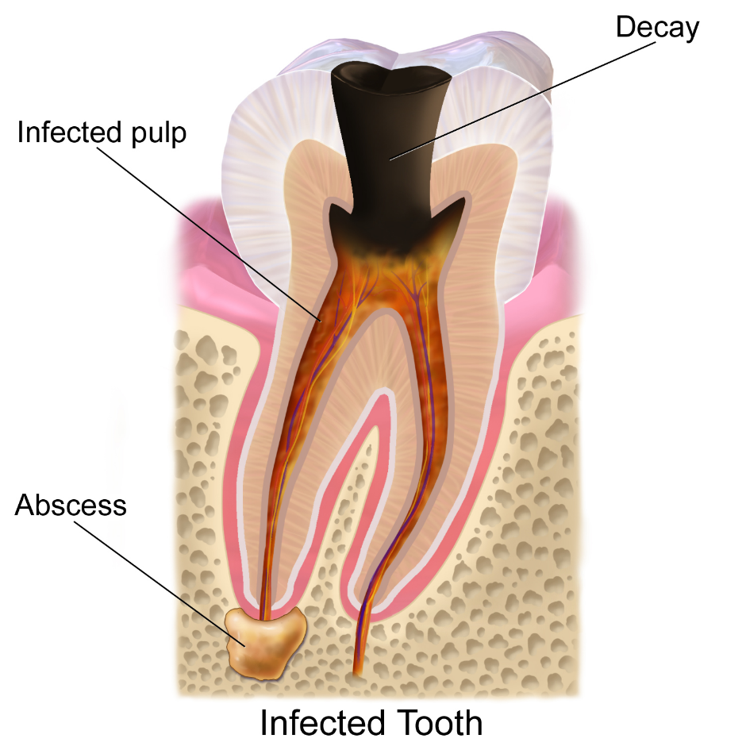
Tooth Decay
Discuss the following questions with your partner:
What is tooth decay?
What causes tooth decay?
How do you know?

Slide 4
Tooth Decay
Cavity - that's the word no one wants to hear at the dentist! A cavity develops when a tooth decays or breaks down. A cavity is a hole that can grow bigger and deeper over time, if you have a cavity, it's important to get it repaired.
But why would your tooth develop a hole? Blame plaque. That's a sticky, slimy substance made up mostly of the germs that cause tooth decay. The bacteria in your mouth make acids and when plaque clings to your teeth, the acids can eat away at the outermost layer of the tooth, called the enamel.

Slide 5
Tooth Decay
If you don't go to the dentist, the acids can continue to make their way through the enamel, and the inside parts of your tooth can begin to decay. If you've ever had a toothache or heard an adult complain about one, it may have been because there was a cavity that reached all the way inside a tooth, where the nerve endings are. Ouch!
Your dentist will carefully examine your teeth and may take X-rays. If your dentist discovers a cavity, he or she can repair it for you by first removing the rotted part of your tooth with a special drill. The dentist then fills the hole in your tooth with a special material. The result is called a filling.

Slide 6
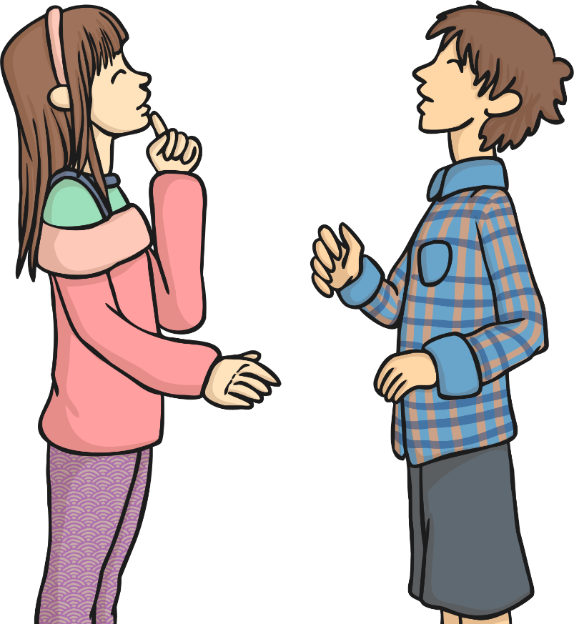
Questions!
Scientific Enquiry
We are going to be carrying out a scientific experiment to see how different liquids affect tooth decay. But first, we need to generate some questions.
Why do scientists ask questions?
Why do they carry out enquiries and tests?

Slide 7
Scientific or Not?
Categorise the questions based on whether they are scientific questions that can be tested or whether they are non-scientific questions:
Scientific Questions | Non-Scientific Questions
Does eating fruit keep you healthy?
How much sleep do rabbits need?
What time is dinner?
Does water always boil when heated?
Can you open the lid?
When should I do my homework?
Does sound travel through walls?
Do plants need soil to grow?

Slide 8
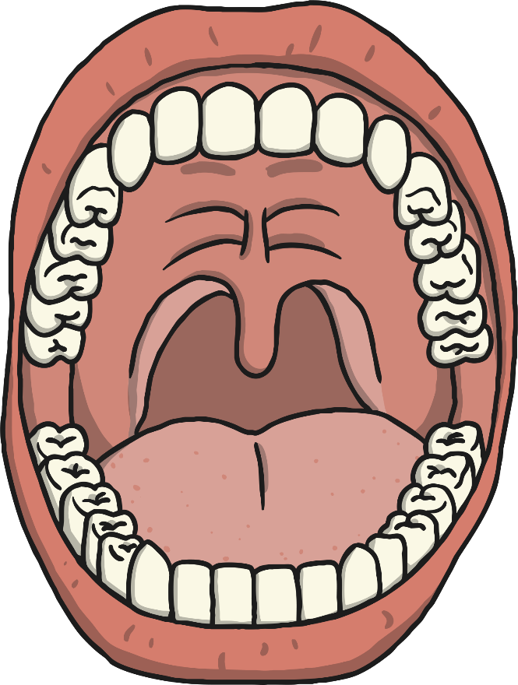
Creating Scientific Questions
Now we need to generate some scientific questions about tooth decay.
Remember we need to be able to test them so…
think about the equipment you would need
think about how the test would need to be carried out
Our Scientific Questions:
?

Slide 9
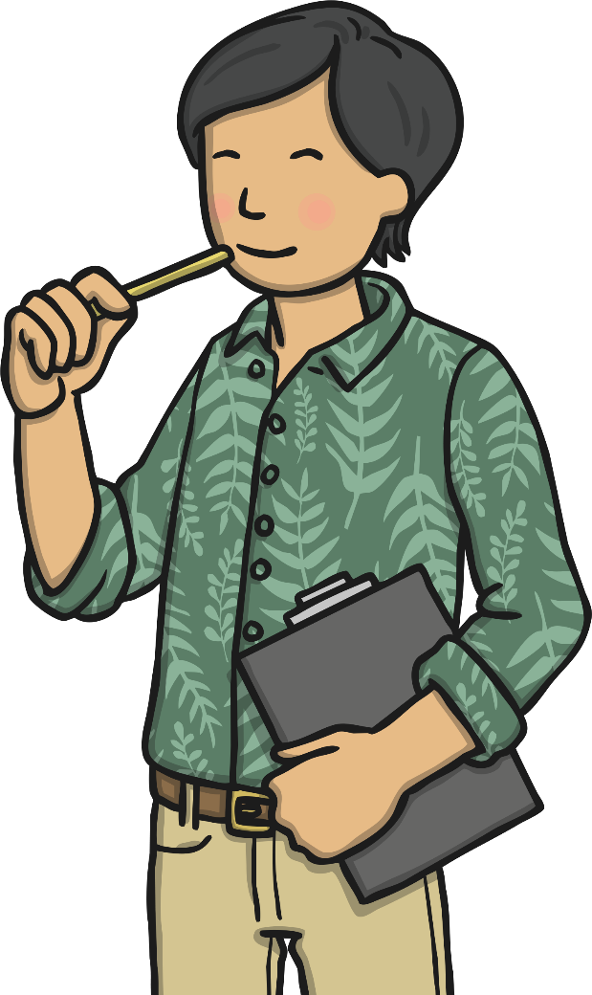
Types of Enquiries
What types of scientific enquiries are there?
Can you give examples of scientific enquiries or tests you have done?
How would you know what type of enquiry to choose?
We are going to look at some examples of questions and the kind of enquiries we could use to answer them.

Slide 10
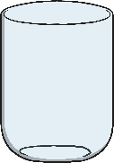
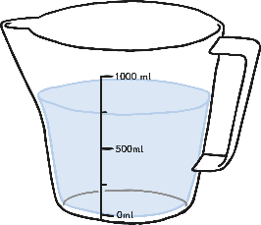
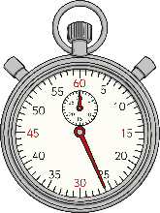
Practical Enquiries
A simple practical enquiry is when you want to just observe what happens.
So if I want to answer the question:
Question:
What effect does water have on chewing gum?
A simple practical enquiry would involve:
Placing the chewing gum in some form of liquid – for example water.
Observing what happens to the chewing gum (does it change colour, grow/shrink, change shape) either immediately or over time (what would be sensible time intervals?).
In this enquiry I would need:
Chewing gum
A container
Water
A timer/clock (way to measure time)
A table to record my observations.
Note: This is a very specific question.
Time | Observation

Slide 11
Variables
In the practical enquiry we are interested in the observation and what happens as we are not sure what the results will be.
When we conduct comparative or fair tests we want to test the particular effect of something.
You might ask - Question: Do different liquids affect the colour of chewing gum?

Slide 12
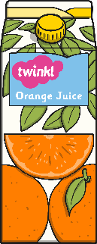
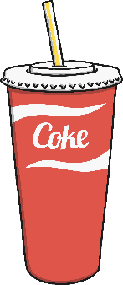
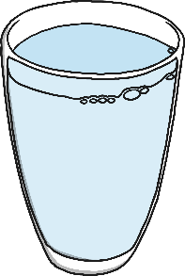
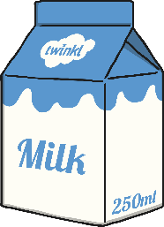
Variables
The variable you are testing is the thing you change every time you carry out the test.
In the comparative and fair tests we will look at this, it will be the liquids.
I want to change the liquids to see if different types of liquids have a particular effect on the chewing gum.

Slide 13
Variables
When you are carrying out a fair test, you need to change only one thing. All other variables should be kept the same so that they don’t affect your results.
In my tests I want to know if liquids change the colour of chewing gum but if I use different containers to put the liquid in or put the containers in different parts of the room then it could be the material of the containers that has the effect or the place in the room, not the liquid. These differences would mean I was testing lots of types of variables when I just want to test one type - liquid.
That’s why we have to keep some things the same throughout so that we know what is having the effect.

Slide 14
Variables
In my tests I would want the following things to be the same:
Containers
Where I place the containers
The amount of liquid in each container
The time between each observation
The type of chewing gum
The amount of chewing gum in each container.

Slide 15
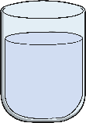
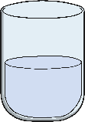
Carrying Out Fair and Comparative Tests
Question: Do different liquids affect the colour of chewing gum?
Liquids (milk, water, orange juice)
Colour
Containers
Where I place the containers
The amount of liquid in each container
The time between each observation
The type of chewing gum
The amount of chewing gum in each container.
Record observations at regular intervals of time.
Compare the results from different liquids.
Spot patterns.
Liquid | Observation after 1 day. | Observation after 2 days.

Slide 16
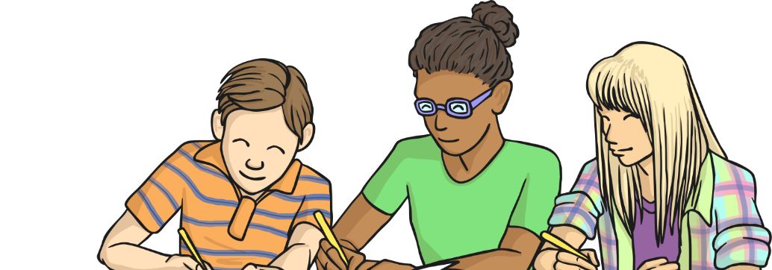
Experiment
Our experiment is going to look at the affect different liquids have on enamel. Can we test this? Do you have any spare teeth lying around for us to use?
Instead, I have done some research and found out that egg shell is made of a very similar material to enamel so we will use this instead.
What different liquids could we use to test?
Why have you chosen them?

Slide 17
Experiment
If you don’t have the equipment to carry out the Science experiment watch the video below which shows the same experiment being carried out.
https://www.youtube.com/watch?v=rYQ7ZIG7wQk

Slide 18
Tooth Decay Scientific Enquiry
Now we get to the fun part! Setting up the enquiry / test!
Make sure that: There is the same amount of liquid in each container.
We are going to use:
Water
Orange juice
Full fat coke
Milk
Sugar water.
Make sure that:
You are careful when placing the eggs. If they are broken then it will affect your results.

Slide 19
Writing up our experiment
First we need to give our experiment a title, let’s decide on one now together.
Then, we need to write an equipment list.
Next, we need to write the method.
This explains how we carried out the experiment, step by step.
Finally, we need to write our prediction.
We are going to monitor our eggs over the next week and write up our results in our next science lesson.

Slide 20
Thursday 1st July.
L.O. - I can ask questions and perform a scientific enquiry to answer them.
I can generate relevant scientific questions.
I can set up a simple enquiry with support.
I can make predictions and suggest equipment.

