Slide 1
Thought for the Day – Background information for Adults.
Collective worship in schools aims to provide the opportunity for pupils to worship God, to consider spiritual and moral issues and to explore their own beliefs; to encourage participation and response, whether through active involvement in the presentation of worship or through listening to and joining in the worship offered; and to develop community spirit, promote a common ethos and shared values, and reinforce positive attitudes. Collective worship allows time for personal reflection and prayer.
Acts of collective worship may include exploring an idea or theme, hearing quotes from an individual or a story about someone’s life and their impact in the world, for example. It gives opportunities for pupils to reflect on a diverse range of world views, religious and otherwise. Collective acts of worship can contain some elements which relate specifically to the Christian religion, and, where appropriate, address the special status accorded to Jesus, but when such material is shared with non-Christian pupils it is shared in a spirit and in a manner which is educational in intent. In other words, pupils are informed that Christians believe that Jesus is the Son of God. Christians who attend the act of collective worship might be afforded an opportunity to worship him. However, whilst non-Christian pupils will not be required to worship Jesus, they shall be invited, to encourage the feeling of community, to reflect in silence on what they have heard.

Slide 2
Taken from a Save the Children Document

Slide 3
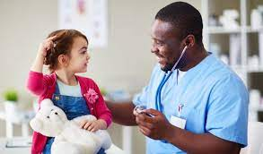
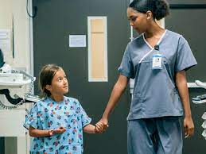
Monday
Nurses
Nurses are very caring people. They work with doctors to take care of us.
When we fall and cut ourselves badly, they clean the wound and bandage us up.
They give us injections to stop us from getting really ill.
Can you think of other ways nurses make you feel better?
Has anyone ever been in hospital? What did the nurses do?
Some people thank God for things in life.
Listen to this prayer and say Amen, if you agree.
Dear God,
Thank you for nurses who work so hard to take care of us.
Amen.
Adapted from ‘God and Me’ by Penny Boshoff

Slide 4
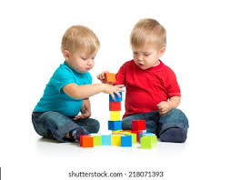
Tuesday
Working Together.
What can we make together? Harvey has a really good idea.
Ted knows a lot about building. Together they can make a really strong tower.
It’s great fun working together as a team.
Jesus chose 12 special friends to help him.
They are known as his disciples.
Some people ask God for help.
Listen to this prayer and say Amen, if you agree.
Dear God,
please help me to listen to my friends when they have good ideas. Amen.
Adapted from ‘God and Me’ by Penny Boshoff

Slide 5
Adapted from ‘God and Me’ by Penny Boshoff
Wednesday
A Strong Tower.
Ryan’s last tower wobbled and fell down, so he has started again.
What would you do to stop your tower from falling down?
This time Ryan is building his tower on a good, strong surface.
Christians believe that Jesus said that life is like building a tower.
If we want to have good, strong lives, we should do what he says.
Christians read a special book called The Bible.
The Bible tells us what Jesus said.
We can read God’s good rules for life, in the Bible.
Some people thank God for things in life.
Listen to this prayer and say Amen, if you agree.
Dear God,
Thank you for the Bible that tells us what you want us to do.
Amen.

Slide 6
Thursday
Fingerprints
You are different from every other boy or girl right down to your fingertips.
If you have ever done finger painting, you will know that each of your finger prints
is different.
Some people believe that God made every bit of you and you are very precious to him.
There is nobody else like you.
Some people thank God for things in life.
Listen to this prayer and say Amen, if you agree.
Dear God,
Thank you for making me and loving me.
Amen.
Adapted from ‘God and Me’ by Penny Boshoff

Slide 7
Friday
Our School Prayer.
God bless our school.
Bless those who teach,
Bless those who learn,
Bless us with knowledge.
Amen.
What have you enjoyed at school?
What have you learned this week?
Have you helped someone else to learn?
Ask the children to listen to our school prayer.
Remind the children that
Amen means- “I agree”
The children might like to say “Amen” at the end.

