Slide 1
Ancient Greece
L.O. 1. Understand that the climate and geography of modern Greece helps us understand Ancient Greece
2. Recognise the importance of archaeological evidence

Slide 2
How can we possibly know so much about the Ancient Greeks who lived over 2,500 years ago?
Before we begin our historical study of the Ancient Greeks, we need to look at the geographical features of Greece. These have played a major part in and influenced many of the political, economic and social developments for which ancient Greece is remembered, from the first governments to the first ideas about the Universe.

Slide 3
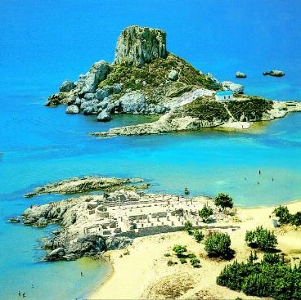
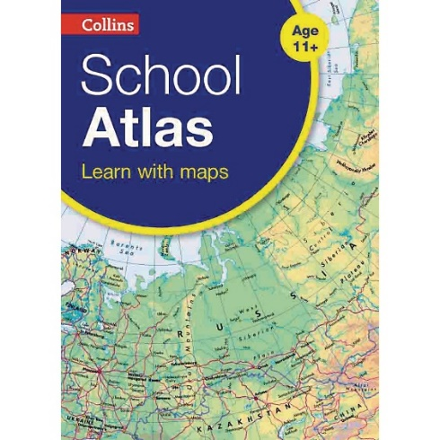
Has anyone here been to Greece? What was it like?
Let’s look at our atlases. What page is Greece on?
Work with your partner; fastest fingers first – how quickly can you find the features on the next screen?

Slide 4
Find the features:
Now record these features on your copy of the Greece map in your books; number them 1 - 5
Lots of islands
Mountainous regions
Areas of flat land
A very long coastline (trace you finger along the whole length)
Can you use the atlas to find out about climate?

Slide 5
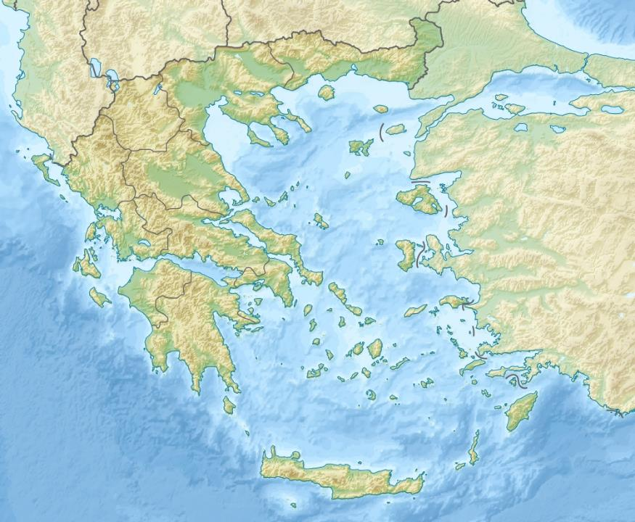
Very little flat land for farming
Long coastline with plenty of harbours
Mediterranean climate: mild, wet winters & hot dry summers
Lots of mountains areas inland
Over a thousand islands to sail between

Slide 6
So what are the consequences of these features? Discuss, reveal and then record under your map.
❶ With limited amounts of land on which they could grow crops the Ancient Greeks had to…..
search for new lands which could provide food and trade with them.
❷ With a long coastline there were plenty of …..
safe harbours from which boats could leave in search of other lands.
❸ With so much coast and so many islands to reach Greeks became ………
expert sailors and boatbuilders.
❹As the climate is mainly hot and dry Ancient Greeks spent a lot of time outdoors, ……..
meeting in places like the agora or market place to share ideas.
❺Mountains made it difficult to travel between different parts of Greece so individual areas became…
very independent. They were called city states. A city state was called a polis which gives us our word political.

Slide 7
Let’s find out a little about some of the important places we will encounter in our History lessons:
Scroll down the website page to use this interactive map. When we return to the PowerPoint, mark where Knossos is on your map.

Slide 8
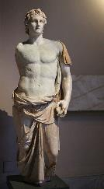
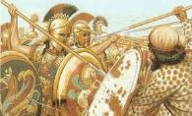
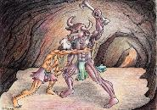
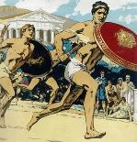
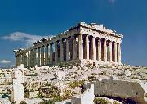
An Ancient Greek Timeline
Here are some of the key periods of Ancient Greece that historians know about:
Minoan civilization
The Trojan wars 1190BC
Golden Age of Athens
Wars between Athens and Sparta
Alexander the Great
Story of Theseus and the Minotaur
First Olympic games 776BC
Battle of Marathon
490BC
Building of the Parthenon 432BC

Slide 9
How can we possibly know about events that happened such a long time ago? Think about our work on the Ancient Shang Dynasty.
Physical evidence that has remained
Myths and legends
Today, we will look at the story of Theseus and the Minotaur. It is an ancient Greek legend, but is there any truth in it? Let’s assume the role of historical detectives:
While you are watching this animation (apologies for the American pronunciations), think about what sort of evidence might have survived, to prove that the legend of Theseus and the Minotaur may actually be based on fact. What might we find if we were archaeologists setting out to dig for evidence?

Slide 10
Evidence from the Past
So, what sort of evidence might have survived to suggest, or even prove that the legend of Theseus and the Minotaur may actually have been based on facts?
What might we find if we were archaeologists setting out to dig for evidence?
Clearly, the ship’s sails will no longer be with us, nor will Ariadne’s thread ; but what about the maze itself? And where did it all take place? Might there be any remains of the palace itself?

Slide 11
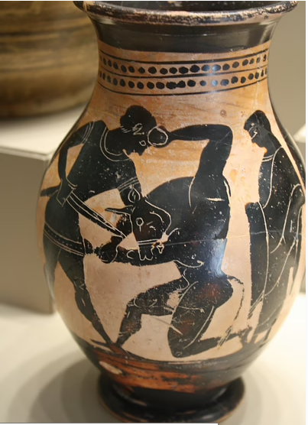
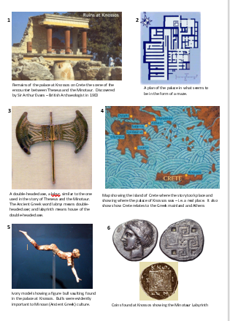
Until the English archaeologist, Sir Arthur Evans, unearthed the palace of Knossos in 1900, the half-man, half-bull killed by Theseus was considered just a popular legend portrayed on ancient Greek pottery; archaeology changed that perception.
With your partner, look at the six pieces of evidence that we now have, as a result of Arthur Evans’ archaeological findings.
Decide which of these are the most important in suggesting that the legend of Theseus and the Minotaur is based on fact.
Share your ideas with the class, using the images on the next few screens.

Slide 13
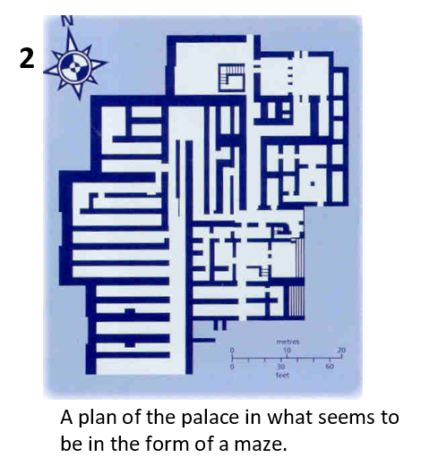

Slide 14
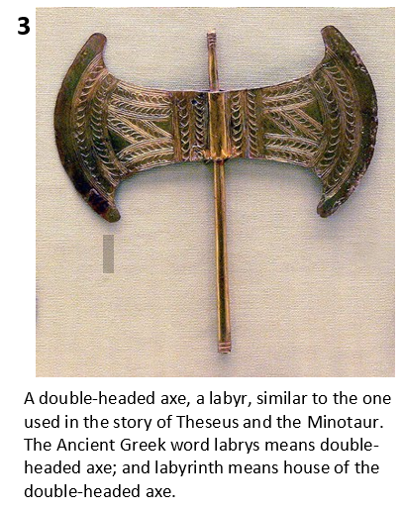

Slide 15
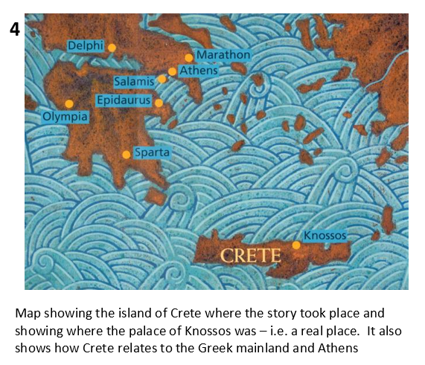

Slide 16
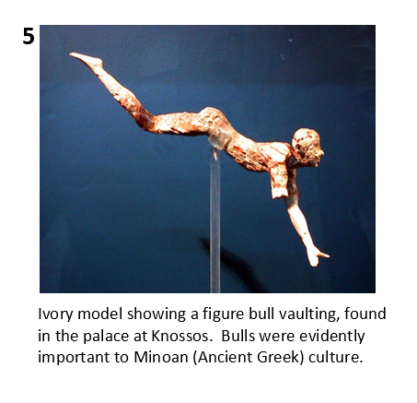

Slide 17
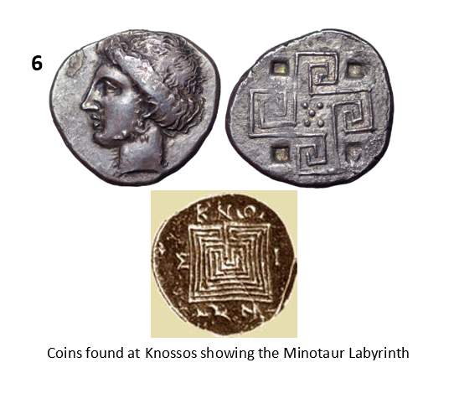

Slide 18
Choose your strongest piece of evidence, cut it out to stick in your book and write a short paragraph about why you think it proves that the legend of Theseus and the Minotaur might actually be at least partly true.
You can use more than one piece of evidence if you want.

