Slide 1
This term in PSHE our topic is: Celebrating Difference
Compliment Kites

Slide 2
LO: To tell you about a time when my words affected someone’s feelings and what the consequences were.
LO: To give and receive compliments and know how this feels.

Slide 3
Vocabulary:
Compliment Special Unique Difference Similarity

Slide 4
What is a compliment?
Compliment – a remark that expresses approval, admiration or respect.

Slide 5
Let’s play - Stand Up
Stand up if you can think of someone you would give the following compliments to:
• Thank you for being a special friend
• Thank you for helping me with my work
• I like playing with you at playtime
• I like how you are so kind and friendly
• I respect how good you are at PE
• I like how you can make people laugh

Slide 6
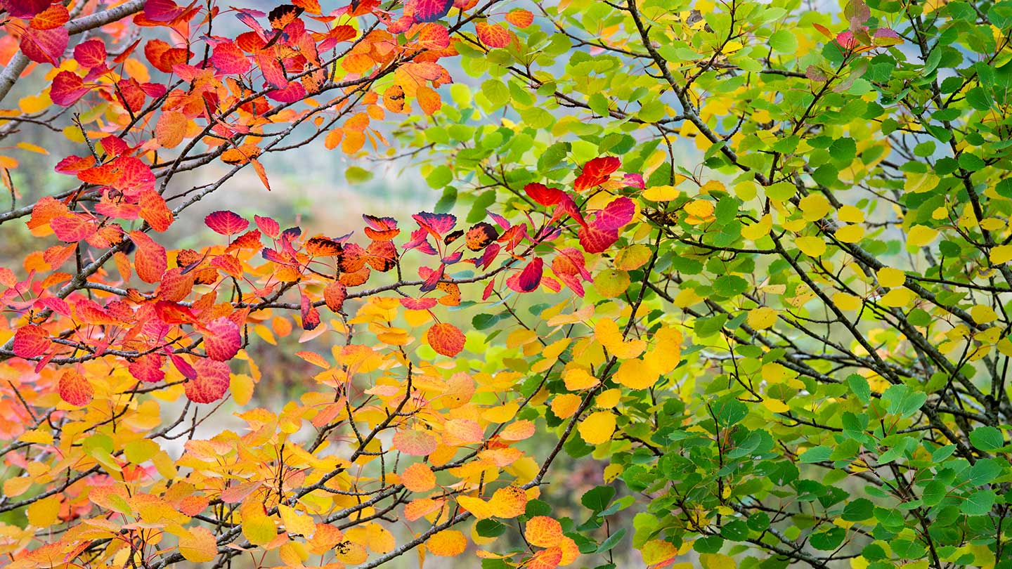
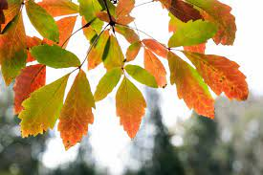
Calm Me

Slide 7
Calm Me
I invite you to sit comfortably in your chairs with your backs nice and straight but a little bit relaxed, not like soldiers. Let your shoulders relax, have both feet flat on the floor and your hands in your lap. Imagine there is a gold thread coming from the top of your head and pulling your spine nice and long and straight. You feel proud and relaxed and happy to be you. Close your eyes if you are comfortable to do so or fix your gaze on a point in front of you.

Slide 8
Calm Me
(Chime) Listen until you cannot hear any sound any more. Bring all your attention to this present moment and help your mind to concentrate on listening to the sound of the chime (strike it once more) until the sound is all gone, far away. Do this again and listen so carefully that when you can no longer hear the sound of the chime you can focus all your attention on the sounds you can hear outside the classroom. (Chime) this time when there is no more sound from it, change the channel and focus your attention to the sounds you can hear inside the classroom.

Slide 9
Calm Me
Put your hands on your tummy and breathe in gently, a nice deep breath, in through your nose, and out again gently. Feel yourself relax and feel peaceful as you breathe out. Smile as you keep breathing in and out gently. Can you feel your tummy going out and in as you breathe in and out? Gently breathe in 1,2,3,4 and out 1,2,3,4…..a few times and then listen until you can no longer hear any sound coming from the chime (strike the chime just once).

Slide 10
Open my mind
Start with a small kite shaped piece of paper. On it, write your favourite compliment. A compliment that would make you feel good or special.
Stick your compliment kite onto the large class kite.

Slide 11
Open my mind
How does it feel to receive a compliment?
What compliments could you give to someone in the class?

Slide 12
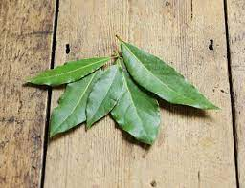
Take a 5 leaves, or look at the image. Choose one. Study your leaf carefully, looking for colour, lines, mark, patterns, unique and special features. Then lay all the leaves in the middle. Mix up the leaves. Can you find your leaf? How did you identify it? What was unique and special about it that enabled you to find it? How is your leaf special and different from all the other
leaves?

Slide 13
Are there similarities between the children in our class and the leaves?
While the leaves are different, they are all from the same tree (family) and all have the same needs.
Children are all different, are from very different families but are all human beings with the same needs.

Slide 14
Can you give a compliment to someone else based on the uniqueness and differences just discussed in the leaves activity. For example:
• I respect you for being the only person in our class to do kick boxing
• I admire for coping so well with your wheelchair
• I respect the way you keep trying so hard with your maths even though it is tricky for you

Slide 15
In small groups, each child writes a compliment on a bow for the child sitting on his right within their group. He then gives the child that bow. Repeat the process for the child sitting two places to his right, then three places, etc. so that each child gives a compliment bow to each member of his group. Each child then takes it in turns to read out his compliment bows, to thank his group for the compliments and to
express how receiving them makes him feel.
Each child then chooses one of the compliments they have been given to threads/stick onto the string of the large class kite.

