Slide 1
4.11.21
LO. I can subtract a 3-digit number from a 3-digit number.

Slide 2
1) Subtract 35 from 58
2) Calculate 79 $−$ 24
3) 8 $−$ 4 $=$ 9 $−$ ___

Slide 3
1) Subtract 35 from 58
2) Calculate 79 $−$ 24
3) 8 $−$ 4 $=$ 7 $−$ ___
23
55
3

Slide 4
As part of our subtraction work we are going to learn several different methods to support subtraction.

Slide 5
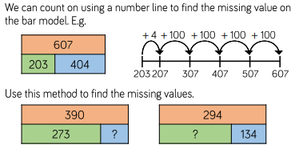
Stick this problem in your book we will work through it as a class.c

Slide 6
Dexter has 137 stickers.
Rosie has 449 stickers.
How many more stickers does Rosie have than Dexter?
137 + 449 =
H | T | O
4 | 4 | 9
1 | 3 | 7
312
?
D
137
R
449
$$−$$
3
1
2

Slide 7
Use the bar model method to support answer this question in your book discuss your working with your partner.
365 - 123
H | T | O
3 | 6 | 5
1 | 2 | 3
242
?
D
123
R
365
$$−$$
2
4
2
We can check our working using inverse operations 242 + 123 =

Slide 8
What is this question asking us?
How are we going to work out our answer?
Discuss and work this problem out as a class.
Use bar modelling and number lines to support your working.

Slide 9
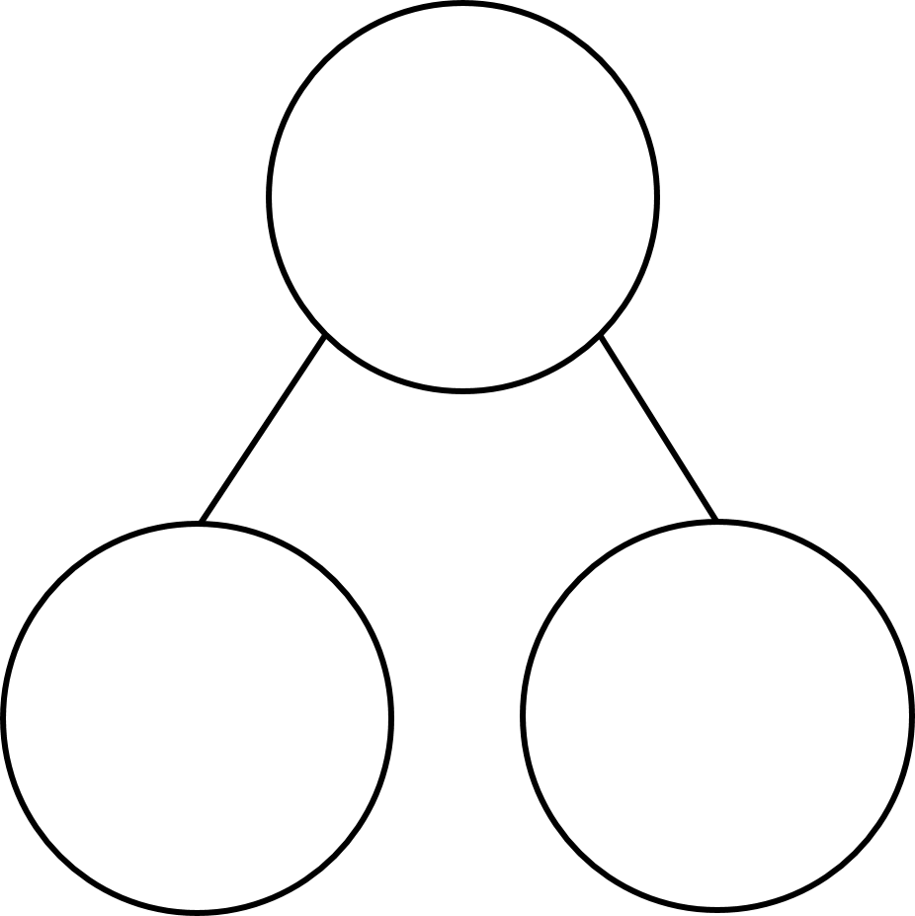
Inverse Operations.
How can we use fact families to help us with our working?
679
679 $−$ 515 $=$
164
679 $−$ 164 $=$
515
515 $+$ 164 $=$
679
164 $+$ 515 $=$
679
515
164
If we know that 679 – 515 is 164,
Then we know that 679 – 164 is…

Slide 10
Inverse Operations.
TTYP Use fact families to help you with your working
Use 526 – 124 = 402 to help you solve
526 - ________ = 124
526 $−$ 124 $=402$
526
526 $−$ 402 $=124$
402 $+$ 124 $=526$
124 $+$ 402 $=$ 526
402
124

Slide 11
Plenary.
679 $−$ 515 =
164
$−$ 5
$−$ 10
$−$ 500
164
169
179
679
515
500
5
10

Slide 12
679 $−$ 515 =
164
$−$ 5
$−$ 10
$−$ 500
164
169
179
679
$+$ 100
$+$ 60
$+$ 4
515
615
675
679

Slide 13
600 $−$ 353 =
$−$ 1
$−$ 1
What’s the same?
What’s different?
599 $−$ 352 =
353
3
600
?
6
247
9
H | T | O
5 | 9 | 9
3 | 5 | 2
$−$ 1
$−$ 1
$−$ 1
$−$ 1
$$−$$
3
?
599
352
247
8
5
2
4
7
Constant difference

