Slide 1
02.11.20
LO. I can add and subtract 1s, 10s, 100s

Slide 2
Always, Sometimes or Never.
When we add 1, the only place value column to change is the ones column.
Task: Prove or disprove this statement.
TTYP and show your working on your whiteboard.

Slide 3
Always, Sometimes or Never.
When we add 10, the ones column never changes.
Task: Prove or disprove this statement.
TTYP and show your working on your whiteboard.

Slide 4
On your whiteboards write out the number bonds to 10.
On your whiteboards write out the number bonds to 100.
How can you use your number bonds to 10 to support you in working out the number bonds to 100.

Slide 5
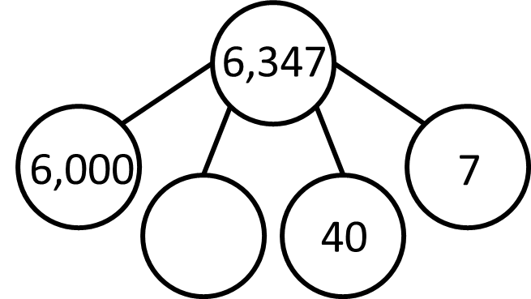
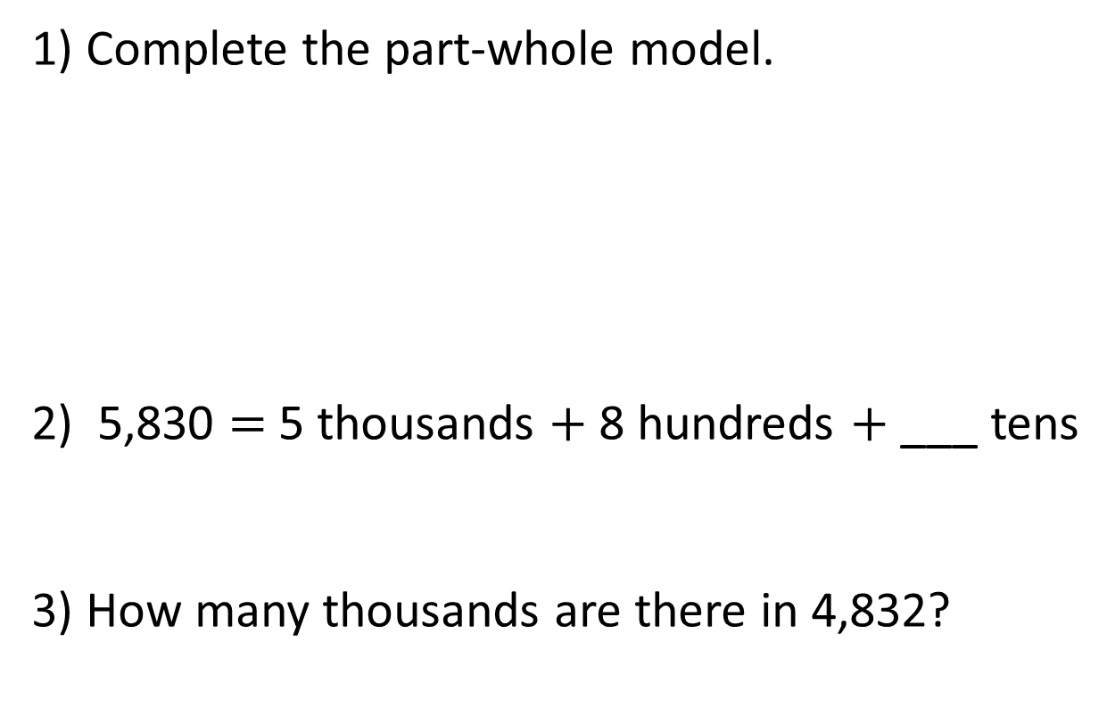
1) Complete the part-whole model.
2) 5,830 $=$ 5 thousands $+$ 8 hundreds $+$ ___ tens
3) How many thousands are there in 4,832?
Partition 17.
Partition 32.
How many ones are there in 16.

Slide 6
1) Complete the part-whole model.
2) 5,830 $=$ 5 thousands $+$ 8 hundreds $+$ ___ tens
3) How many thousands are there in 4,832?
300
3
4 thousands
Partition 17. 10+7
Partition 32. 30+2
How many ones are there in 16. 6

Slide 7
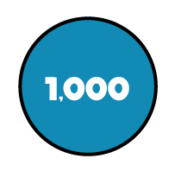
Th | H | T | O
Add 3 tens to the number.
What number have you got now?
6,377
Subtract 2 hundreds from the number.
What number have you got now?
6,147
Add 2,000 to the number.
What number have you got now?
8,347

Slide 8
Th | H | T | O
Sometimes changes when adding 10s
Sometimes changes when adding 10s
Always changes when adding 10s
Never changes when adding 10s
4,758 $+$ 10 $=$
4,768
4,808
4,758 $+$ 50 $=$
4,788
4,828
4,758 $+$ 30 $=$
4,758 $+$ 70 $=$

Slide 9
Th | H | T | O
Sometimes changes when adding 100s
Always changes when adding 100s
Never changes when adding 100s
Never changes when adding 100s
4,758 $+$ 100 $=$
4,858
4,758 $+$ 300 $=$
5,058
4,758 $+$ 200 $=$
4,958
4,758 $+$ 400 $=$
5,158

Slide 10
Whitney has a plank of wood 2,915 mm long.
Jack has a plank of wood which is 90 mm long.
How much longer is Whitney’s plank than Jack’s?
Whitney
2,915 mm
Jack
90 mm
?
2,825 mm
Th | H | T | O

Slide 11
In your maths books, answer the following questions.
1) 7,534 $−$ $=$ 5,534
2,000
2) 7 thousands $−$ $=$ 5 thousands
2 thousands
3) 7,534 $−$ $=$ 7,504
30
4) 3 tens $−$ $=$ 0 tens
3 tens

Slide 12
Plenary.
4,709 + = 5,209
500
7 hundreds + =
2 hundreds
5 hundreds
12 hundreds

