Slide 1
Year 5 History
To explore what life was like for the people of Britain during World War 1

Slide 2
LO: To explore what life was like for the people of Britain during World War 1
The last time we visited WW1 was in the Autumn term when we talked about
The events that led to the start of WW1
What life was like on the Western Front
Can you tell your partner how the war began, and the reasons behind it?
What can you remember about life in the trenches – what did the soldiers have to deal with?
Let’s watch a quick recap about how it all began from Horrible Histories

Slide 3
Useful vocabulary
Patriotism – devoted to and support for one’s country
Recruitment – finding suitable people to fill roles e.g. a soldier
Pals Battalion – men who joined the army with their friends, neighbours or colleagues and served together
Morale – the enthusiasm of a person or group

Slide 4
LO: To explore what life was like for the people of Britain during World War 1
Almost nine million men joined and fought in the British Army during WW1.
What do you think life was like at home during the war?
How do you think people in Britain felt about the war?

Slide 5
LO: To explore what life was like for the people of Britain during World War 1
At the beginning of the war Britain was one of the most powerful countries in the world. The British had a large empire which stretched to many places around the globe. Being an island nation, they had developed a powerful navy.
When war was declared on Germany, a wave of patriotism spread across the country. People were confident that the war wouldn’t last long and it would ‘be over by Christmas’.

Slide 6
LO: To explore what life was like for the people of Britain during World War 1
120,000 men signed up to the army; however, as the war went on, officials in the army like Lord Kitchener realised that a large army was going to be a key factor in winning the war against the Central Powers. He immediately set up several recruitment schemes to convince more men to join the army.

Slide 7
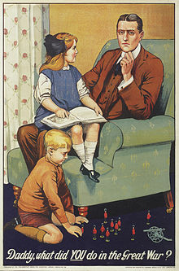
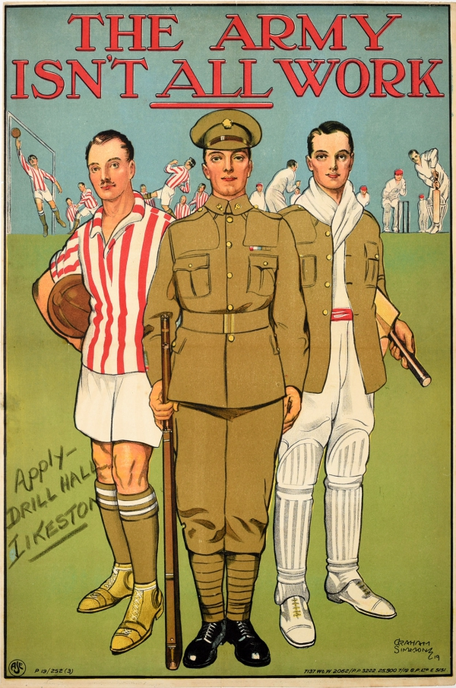
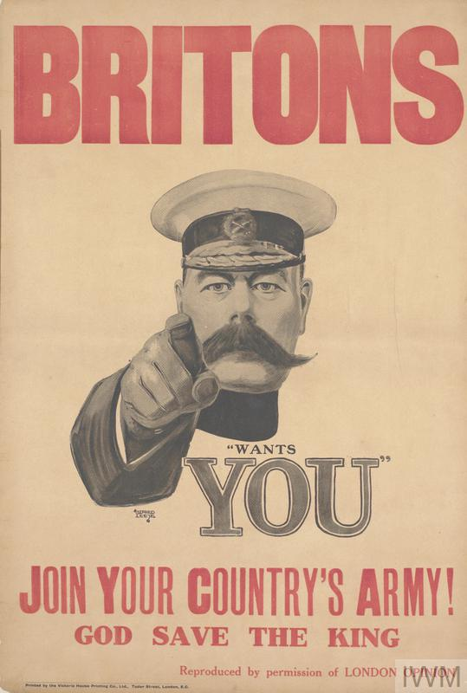
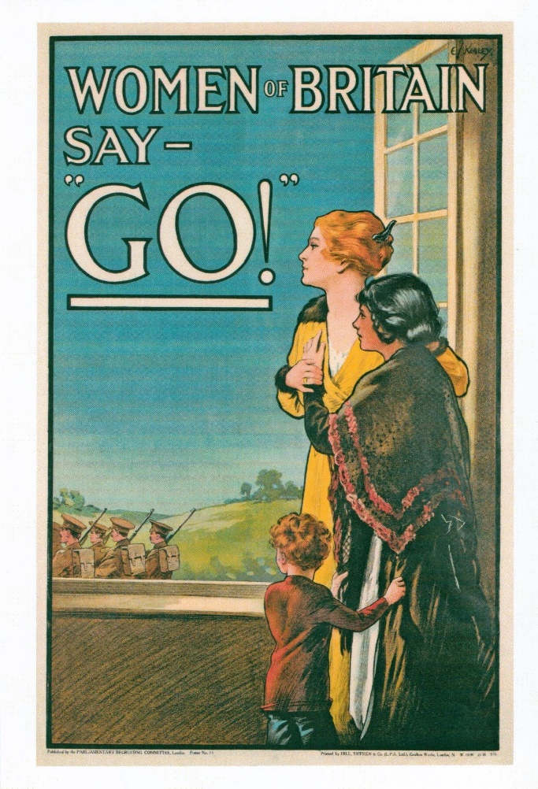
LO: To explore what life was like for the people of Britain during World War 1
Lord Kitchener used posters to persuade men to join up before compulsory conscription (any able bodied man aged 18 – 41 had to join the army) was introduced in 1916.
Here are a few examples

Slide 8
LO: To explore what life was like for the people of Britain during World War 1
Kitchener did as much as he could to make sure Britain had a large army. He used ideas such as allowing men to sign up and serve with their friends from home in the ‘Pals Battalion’ initiative.
Many young boys would lie about their age in order to sign up to the army. They wanted to serve their country and many of them from poorer backgrounds thought that it would improve life for them.

Slide 9
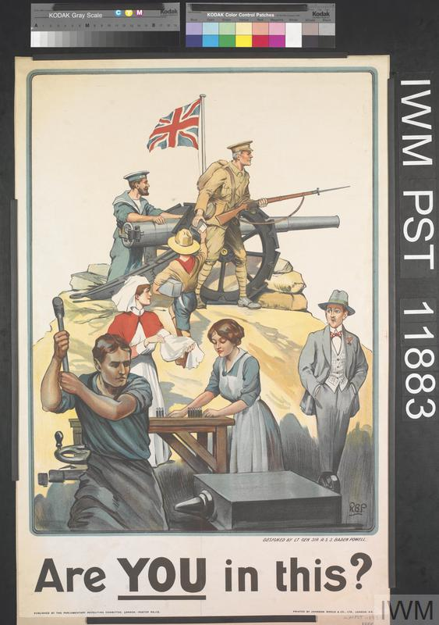
LO: To explore what life was like for the people of Britain during World War 1
With so many fathers, husbands, brothers and sons going to war, the women and children of Britain had to do their part to support the war effort from the home front.
More posters were created to increase morale for people at home. They called people to ‘do their bit’ for the war effort and support the soldiers who had gone to war.

Slide 10
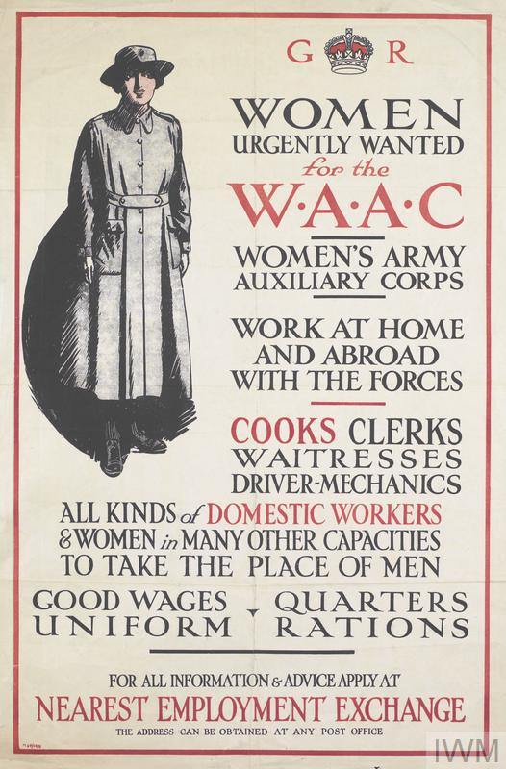
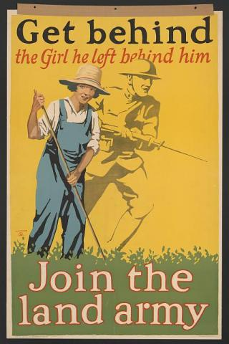
LO: To explore what life was like for the people of Britain during World War 1
Women filled all kinds of roles. Any roles that used to be mainly male orientated, such as policemen, firemen, factory workers and teachers, needed women to step into these jobs.
Women also took on new roles which helped with the war. Running communication stations and delivering messages was vital in making sure information reached the relevant people.

Slide 11
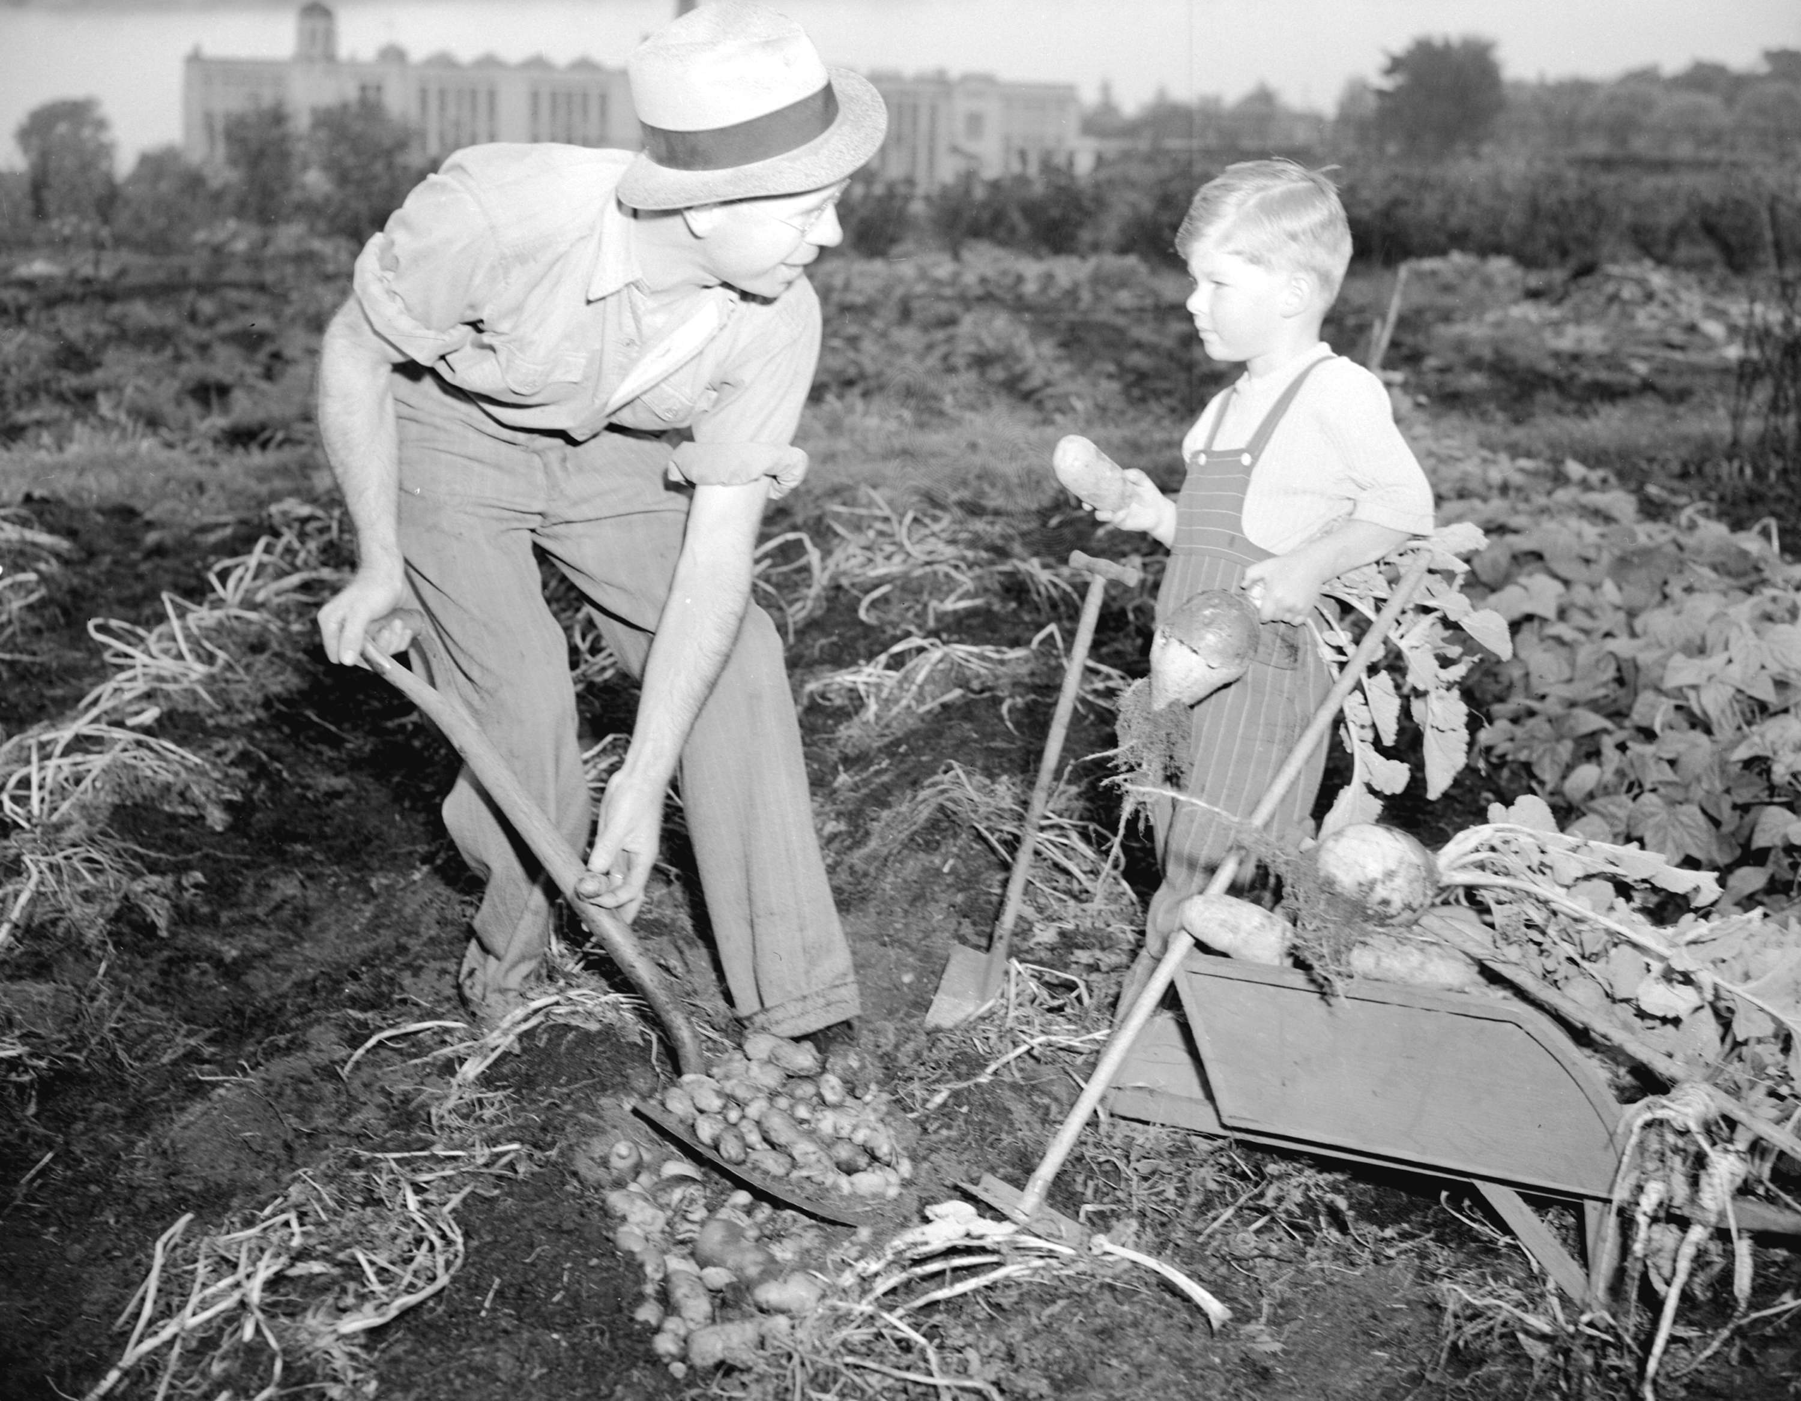
LO: To explore what life was like for the people of Britain during World War 1
Even children were asked to play their part during the Great War. They helped to grow food at home – this was important as the Germans were trying their best to make sure no supplies were getting to Britain.
Are any of you part of a group such as Scouts or Guides?
During the War, these two groups (known as Boy Scouts and Girl Guides) also had important parts to play

Slide 12
LO: To explore what life was like for the people of Britain during World War 1

Slide 13
LO: To explore what life was like for the people of Britain during World War 1

Slide 14
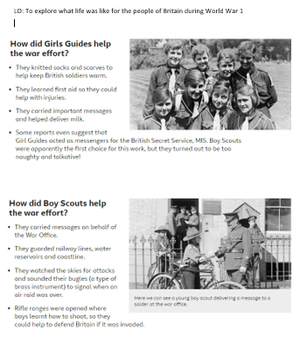
LO: To explore what life was like for the people of Britain during World War 1
Now it’s over to you. Choose the character of either a girl guide or a boy scout and write a diary entry of a typical day for you during the war.
Remember- for a diary entry you will need
To write using an informal tone
To use the first person (I, me, we etc)
Include details of what sort of things that you would have done to help with the war effort

