Slide 1
29.11.21 L.O: To add three 1 digit numbers.

Slide 2
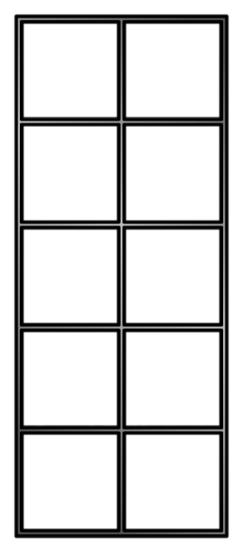
6 $+$ 4 $+$ 2 $=$ 12
4 $+$ 2 $+$ 6 $=$ 12
Notes:
Dora, Whitney and Teddy are on a role now.
But this one looks different! Let’s see if they can use what they know
Whitney knows that 100 take away 40 is equal to 60
And Dora knows that 60 take away 2 is equal to 58
So Teddy has realised that 100 takeaway 42 must be equal to 58
Great team work guys!

Slide 3
I like finding 10
Have a think
4 $+$ 2 $+$ 6 $=$ 12
7 $+$ 3 $+$ 4 $=$ 14
I like finding doubles
4 $+$ 2 $+$ 6 $=$ 12
7 $+$ 3 $+$ 4 $=$ 14
Notes:
Dora, Whitney and Teddy are on a role now.
But this one looks different! Let’s see if they can use what they know
Whitney knows that 100 take away 40 is equal to 60
And Dora knows that 60 take away 2 is equal to 58
So Teddy has realised that 100 takeaway 42 must be equal to 58
Great team work guys!

Slide 4
I like finding 10
4 $+$ 2 $+$ 6 $=$ 12
7 $+$ 3 $+$ 4 $=$ 14
I like finding doubles
4 $+$ 2 $+$ 6 $=$ 12
7 $+$ 3 $+$ 4 $=$ 14
Notes:
Dora, Whitney and Teddy are on a role now.
But this one looks different! Let’s see if they can use what they know
Whitney knows that 100 take away 40 is equal to 60
And Dora knows that 60 take away 2 is equal to 58
So Teddy has realised that 100 takeaway 42 must be equal to 58
Great team work guys!

Slide 5
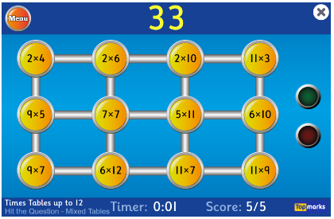
Let’s learn our number bonds
to 10 and doubles!

Slide 6
Can we find the totals of the rows and columns?
We must use our number bonds to 10 to help us!
Could we find some doubles?

Slide 7
Can we find the totals of the rows and columns?
We must use our number bonds to 10 to help us!
Could we find some doubles?

Slide 8
Can we find the totals of the rows and columns?
We must use our number bonds to 10 to help us!
Could we find some doubles?
7 + 3 = 10
10 + 5 = ?

Slide 9
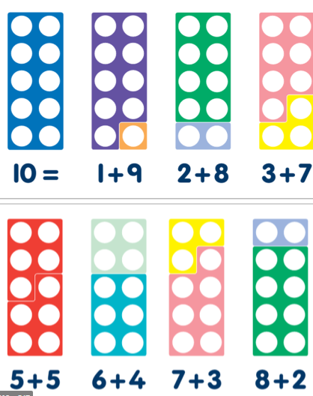
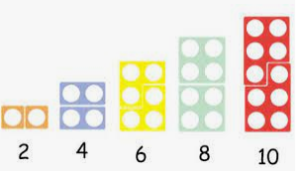
To add numbers quick, we have a trick!
Do they make 10?
Are there any doubles?

Slide 10
Can you spot the difference?
What is the same? What is different between the two sums?
Fluency
Use <, > or = to compare the number sentences.
5 + 4 + 2
>
3 + 4 + 2
2 + 4 + 6
=
3 + 7 + 2
7 + 4 + 5
<
7 + 8 + 3

Slide 11
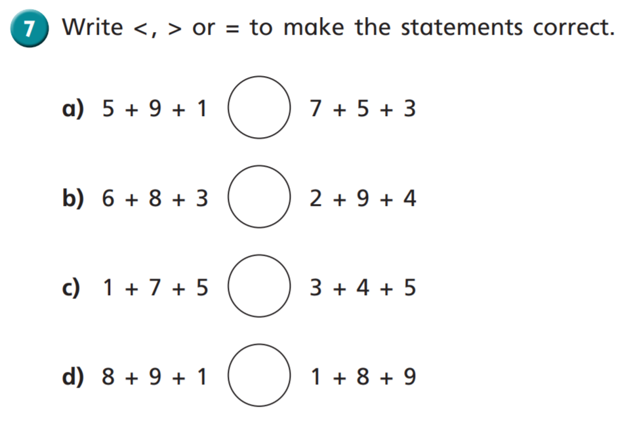
$$=$$
$$>$$
8 $+$ 3 $>$ 9
9 $+$ 2
$$>$$
8 $+$ 3
$$=$$

