Slide 1
Light
This half term, our science topic is:

Slide 2
LO: To know which materials reflect light well.
LO: To predict using cause and effect.

Slide 3
Vocabulary
light dark/darker/darkest bright/brighter/brightest dim
light source (various) eye reflect reflective shiny dull shadow
block (transparent, opaque)
These are some of the words we will be using over the course of the unit.

Slide 4
Which materials do you think might reflect light well?

Slide 5
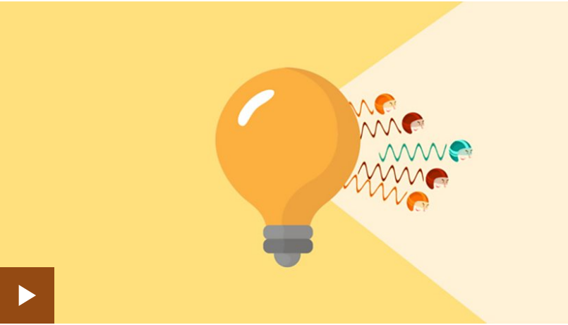
Which materials reflect light well?

Slide 6
Reflection
When light from an object is reflected by a surface, it changes direction. It bounces off the surface at the same angle as it hits it.
Smooth, shiny surfaces such as mirrors and polished metals reflect light well. Dull and dark surfaces such as dark fabrics do not reflect light well.

Slide 7
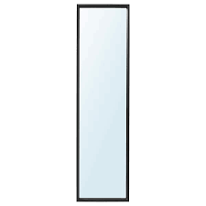
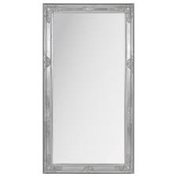
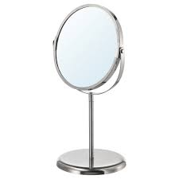
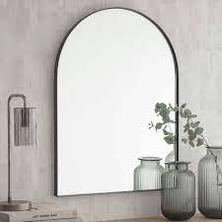
How many times a day do you look in the mirror?

Slide 8
Today we are going to have some fun experimenting with mirrors!

Slide 9
Can you explain why you can see your reflection in a mirror?
Touch one ear. Which ear are you touching? Which ear is your reflection touching?
Is there anything special about your face that is only on one side (a freckle or a mole)? Which side is it on in your reflection?

Slide 10
What would happen if the mirror had a bumpy surface?
Let’s try a piece of crumpled foil to find out.
What would happen if the mirror had a dull surface? Let’s put some baking paper over it.

Slide 11
Can you think of any other objects that can act as a mirror (spoons, puddles, windows. etc.)? What are differences between a regular mirror and those objects?
What are the differences you see in the images reflected in those surfaces? (try the back and front of a spoon)

Slide 12
Reflection game
Work with your partner. One of you pretends to be the reflection. The reflection has to copy everything the main image does (as if they were a reflection in a mirror).
The main image could: turn to the side, turn all the way around, jump up and down, raise one arm, kneel on one knee etc.
Then we will swap roles.

Slide 13
Predict
What do you think will happen when you look at some classroom objects in the mirror? Which objects will look exactly the same? Which objects will look different, and how?
e.g. a map, a ball, a clock, a book, a ruler, your name on a whiteboard.
Then test to see if your predictions are true.

Slide 14
Alphabet Reflections
Which letters of the alphabet (use capital letters) do you think will look the same in the mirror? Why?
Test this by writing each letter on your whiteboard and looking at it in the mirror.

Slide 15
Mirror (or reflection) symmetry divides a figure or design into halves that are mirror images. In other words, objects are the same on both sides of a line (usually in the middle). This centre line or axis can be located either vertically or horizontally.
We experience symmetry every day. Butterflies are good examples of mirror symmetry in nature. In fact, most animals and plants exhibit some form of symmetry in their body shape and their markings. Mirror symmetry is found in manufactured objects, too.

Slide 16
And now for a magic trick!
What does this look like? Why does it look like that?
(For those of you at home, ask someone to stand halfway behind a long mirror. Ask them to lift up the leg that is not behind the mirror. What happens?)

Slide 17
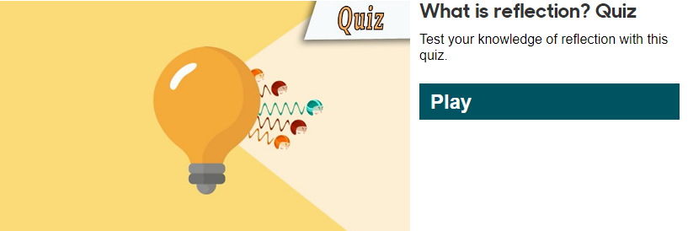

Slide 18
Tell your partner 3 things you have learnt about reflection.

