Slide 1
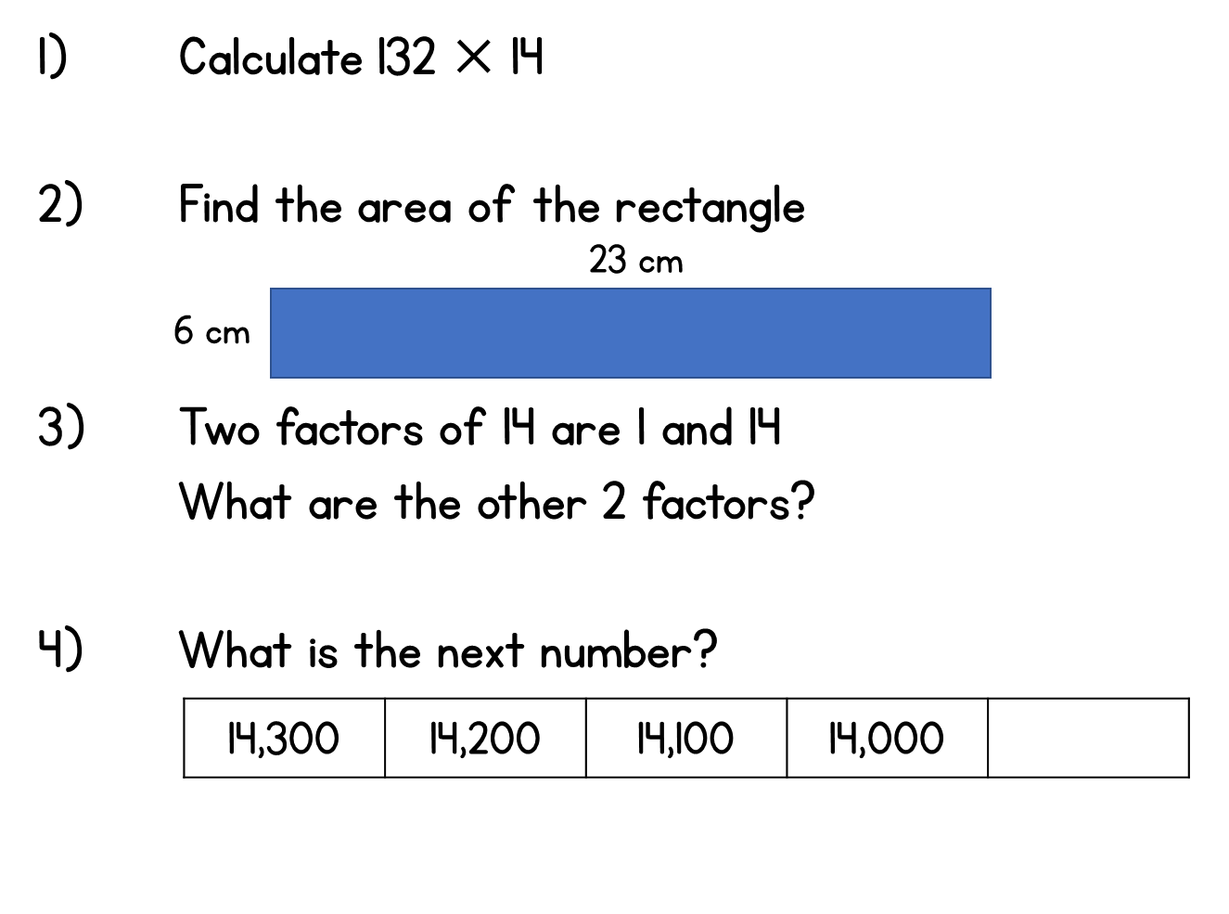
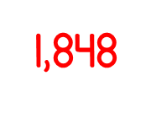
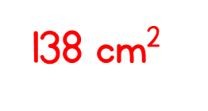
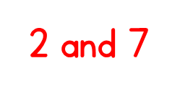
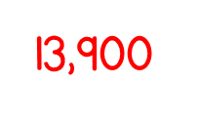
Year 5 | Week 2 | Day 5

Slide 4
1) 40 ÷ 4 =
2) 12 ÷ 4 =
3) 52 ÷ 4 =
4) 84 ÷ 7 =

Slide 5
1) 40 ÷ 4 =
2) 12 ÷ 4 =
3) 52 ÷ 4 =
4) 84 ÷ 7 =
10
3
13
12

Slide 7
39 ÷ 3 =

Slide 8
39 ÷ 3 =
13
Tens | Ones

Slide 9
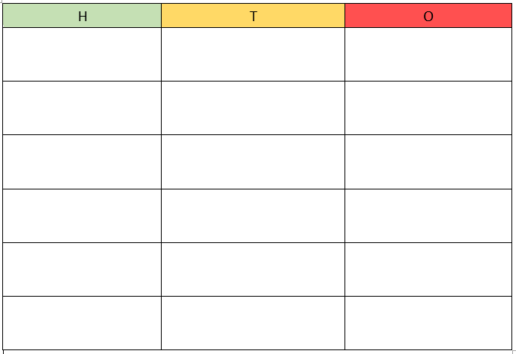
Try this one with your partner at the same time as we go through it on the board
45 ÷ 3 =
15
Tens | Ones
45
30
15
Use your own place value board & counters

Slide 10
Have a go at questions 1 - 4 on the worksheet Stick in Q3 – for the rest, write the questions and answers in your book.
Use your own place value board & counters where the questions ask you to.

Slide 11
51 ÷ 3 =
17
Can we use partitioning to help?
Can we partition a different way?
51
Largest multiple of 10 that will divide by 3, which fits into 51?
50
The remaining part of 51?
30
1
21
÷ 3
÷ 3
10
7
10 + 7 =
17

Slide 12
Write these two in your book as we work through them on the board.
Have a think
1) 64 ÷ 4 =
16
2) 75 ÷ 5 =
15
64
75
Largest multiple of 10 that will divide by 5, which fits into 75?
Largest multiple of 10 that will divide by 4, which fits into 64?
40
24
50
25
÷ 4
÷ 4
÷ 5
÷ 5
10
6
10
5

Slide 13
There are 60 doughnuts. A box holds 4 doughnuts.
How many full boxes of doughnuts will there be?
15 full boxes
Tens | Ones
60 ÷ 4 =
15
60
40
20

Slide 14
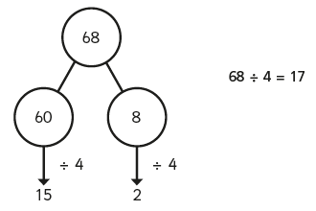
Have a go at questions 5 - 9 on the worksheet
Write the questions in your book and draw the partitioning diagrams.

