Slide 3
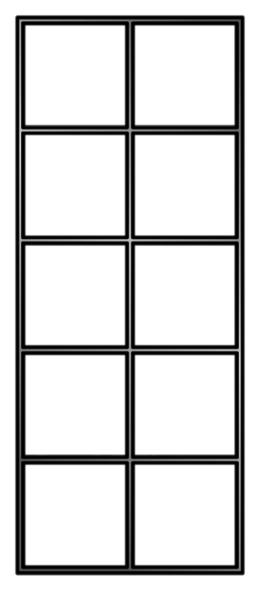
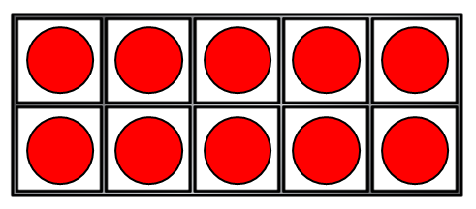
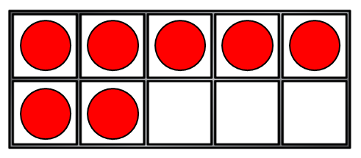
Counting forwards
17 | 18 | 19 | 20 | 21 | 22 | 23 | 24 | 25 | 26 | 27

Slide 4
Counting backwards
35 | 34 | 33 | 32 | 31 | 30 | 29 | 28 | 27 | 26 | 25

Slide 5
Have a go at question 1 on the worksheet. Tip – Are they going forwards or backwards?

Slide 6
Have a think
Counting forwards
with a number track
41 | 42 | 43 | 44 | 45 | 46 | 47 | 48 | 49 | 50
28 | 29 | 30 | 31 | 32 | 33 | 34 | 35 | 36 | 37

Slide 7
Have a think
Counting backwards
with a number track
41 | 40 | 39 | 38 | 37 | 36 | 35 | 34 | 33 | 32
28 | 27 | 26 | 25 | 24 | 23 | 22 | 21 | 20 | 19

Slide 8
Have a think
Can you spot the mistakes?
27 | 28 | 29 | 20 | 31 | 32 | 33 | 34 | 35 | 36
27 | 28 | 29 | 30 | 31 | 32 | 33 | 34 | 35 | 36
38 | 39 | 40 | 41 | 42 | 44 | 45 | 46 | 47 | 48
38 | 39 | 40 | 41 | 42 | 43 | 44 | 45 | 46 | 47

Slide 9
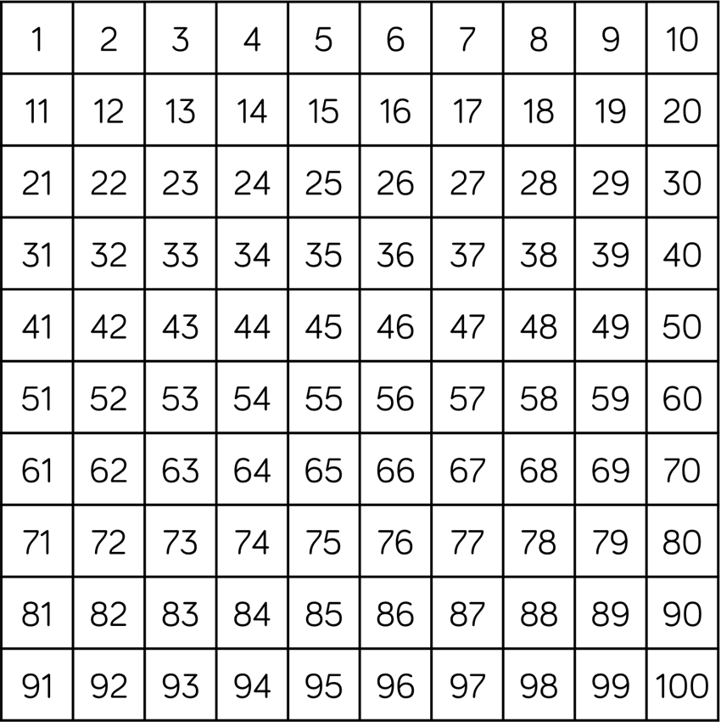
Have a think
What comes after…
35
36
22
23
49
50

Slide 10
Have a think
What comes before…
13
12
39
38
41
40

Slide 11
Have a think
What is missing?
27 | 28 | 29 | 30 | 31 | 32 | 33 | 34 | 35 | 36
?
?
38 | 39 | 40 | 41 | 42 | 43 | 44 | 45 | 46 | 47
?
?
?

Slide 12
Have a go at question 2 on the worksheet. Complete the challenge once you are done.

Slide 13
I have completed the number track correctly.
31 | 32 | 33 | 43 | 35 | 36 | 27
Is Kat correct?
If not, why? Explain your answer.
Kat has mistaken the number 43 for 34.
She has got the digits the wrong way round.

