Slide 1
Digiduck’s BIG Decision
By Lindsay Buck
P.12- 17

Slide 2
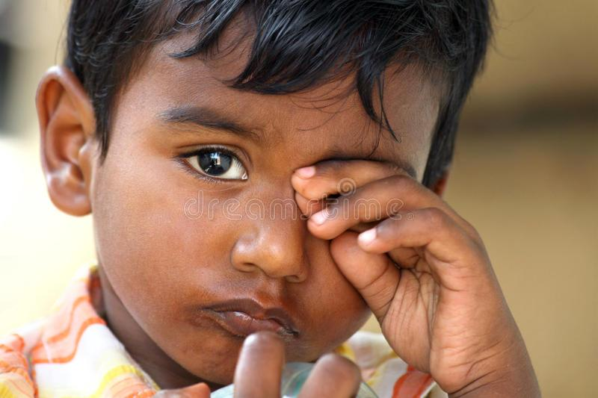
Vocabulary Check
wept - cried
whizzed - moved quickly
vanished - disappeared

Slide 3
Quick Start
What did Digiduck see through his window?
Why did the animals stop being friends with Digiduck?
What did Mummy Duck do?
What did Digiduck take with him to Proud.pig’s party?

Slide 4
Partnered Talk
“It’s my birthday, where are all my friends?” wept Digiduck, as tears rolled down his cheek.
How do these words make the reader feel?

Slide 5
Individual Thinking
Back in Digiduck’s room, Wise_Owl drew the covers and comforted him softly, “I know that, but sadly your friends didn’t.”
Which word suggests that Wise_Owl was trying to make Digiduck feel better?

Slide 6
Partnered Talk
He rushed across the room and the message was still there, just as it was last night. Digiduck was over the moon! He skipped and sang.
Which phrase/s show that Digiduck was elated.

Slide 7
Individual Thinking
What is the moral of the story?

Slide 8
Solo Work
How can you be a good friend to others on the internet?

