Slide 1
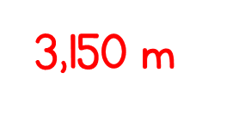
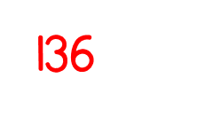
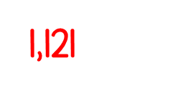
Year 5 | Week 3 | Day 1

Slide 2
WITH REMAINDERS

Slide 4
1) 21 ÷ 7 =
2) 22 ÷ 7 =
3) 34 ÷ 7 =
4) 35 ÷ 7 =

Slide 5
3
1) 21 ÷ 7 =
2) 22 ÷ 7 =
3) 34 ÷ 7 =
4) 35 ÷ 7 =
3 r 1
4 r 6
5

Slide 7
75 ÷ 6 =
Tens | Ones
75
Largest multiple of 10 that will divide by 6, which fits into 75?
60
15
÷ 6
÷ 6
10
2
r 3
10 + 2 r 3 =
12 r 3

Slide 8
1) 53 ÷ 3 =
17 r 2
Have a think
2) 64 ÷ 5 =
12 r 4
Tens | Ones
64
53
Tens | Ones
50
14
30
23

Slide 9
3
r 2
17 ÷ 5 =
Tens | Ones

Slide 10
25 ÷ 3 =
8
r 1
Have a think
Tens | Ones

Slide 11
Let’s look at remainders in more detail:
55 ÷ 5 = 11
Tens | Ones
56 ÷ 5 = 11 r 1
57 ÷ 5 = 11 r 2
58 ÷ 5 = 11 r 3
59 ÷ 5 = 11 r 4
60 ÷ 5 =
12
Is this true? Let’s check
11 r 5
This leads us to an important rule:
The remainder must be smaller than the divisor.

Slide 12
The remainder must be smaller than the divisor.
Have a think
1) When we divide by 7 the largest remainder we can have is ___
2) When we divide by 4 the largest remainder we can have is ___
3) When we divide by 36 the largest remainder we can have is ___
6
3
35

Slide 13
Have a go at questions 1 - 4 on the worksheet Write the division questions and answers in your books

Slide 14
Apples are packed in bags of 8
Dexter has 91 apples.
How many bags does Dexter need so that every apple is in a bag?
Have a think
91
8
___ ÷ ___ =

Slide 15
How many bags does Dexter need so that every apple is in a bag?
Tens | Ones
91
8
___ ÷ ___ =
11 r 3
12 bags
11 bags
91
80
11

Slide 16
Have a go at questions 5 - 6 on the worksheet if you have finished 1-4 Write your answers and workings in your book

