Slide 1
Notes:
Explain that everything we do online – messages, emails, chat, photo sharing etc. can be downloaded, saved and screenshotted by other people and spread across the internet. This is called a digital footprint. It’s very important to keep your personal details private and not to share photos with strangers.

Slide 2






Social media
Your Digital Footprint
Notes:
Ask: Which of these logos do the students recognise? Does anybody use them? Explain that you really should be 13+ to have social media accounts (Although social media accounts are for 13+ it is likely that many pupils will already have them, so the emphasis has to be on how to keep safe on them.) Refer back to the story of Becky in the Jigsaw video – what did she learn to help her keep safe?
Answers: Snapchat, Twitter, Pinterest, YouTube, Facebook, Instagram

Slide 3
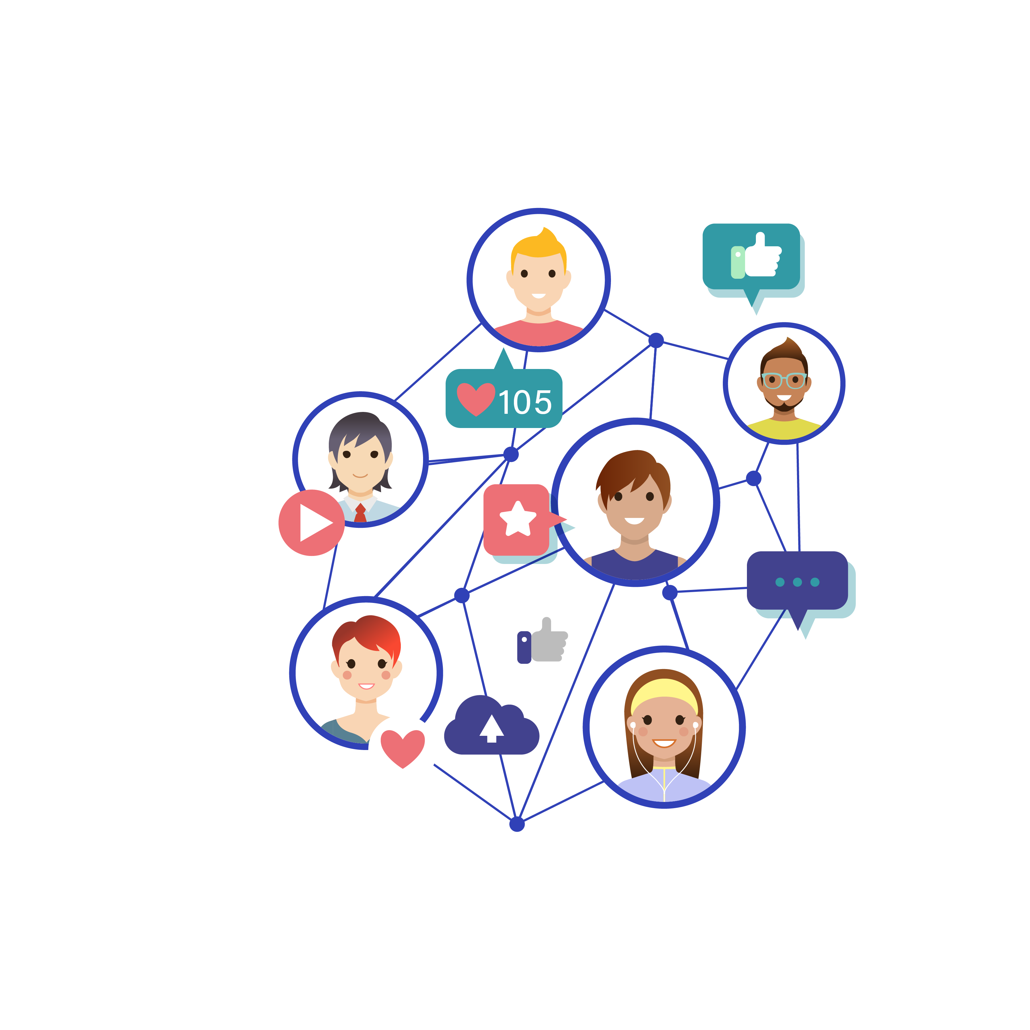
Social media
Your Digital Footprint
Remember: you should be 13+ to have social media accounts.
Good for: Keeping in touch with people, sharing pictures and videos.
DO: Keep your privacy settings to friends only
DON’T: give address, post photos you wouldn’t want your family to see, locations on photos, mobile number, school, or pictures of your school uniform with logo
Notes:
Talk through the responsibilities of social media using this slide.

Slide 4

Email
Your Digital Footprint
Notes:
Ask: what does this symbol mean? Who uses email? What is it great for?

Slide 5

Email
Your Digital Footprint
NEVER OPEN an email from someone you don’t know. It could contain viruses, scams, or access to your computer
DELETE emails from people you don’t know
NEVER GIVE OUT PERSONAL INFORMATION to people you don’t know
NEVER SEND PHOTOGRAPHS to anyone you don’t know personally
Treat people as you would like to be treated (rude or bullying emails can last forever on your digital footprint)
Notes:
Ask: What do you have to be careful of? (Emails from people you don’t know – never open it, delete, tell trusted adult) Never give out personal information or send pictures to people you don’t know in the real world. Treat people how you would like to be treated yourself.

Slide 6

Online chatting and chat rooms
Your Digital Footprint
Notes:
Ask: how do we chat online? (Instant messaging, texts, gaming chat, apps and blogs) Who do we chat to? (friends, but sometimes people we don’t know personally, e.g. on games)

Slide 7
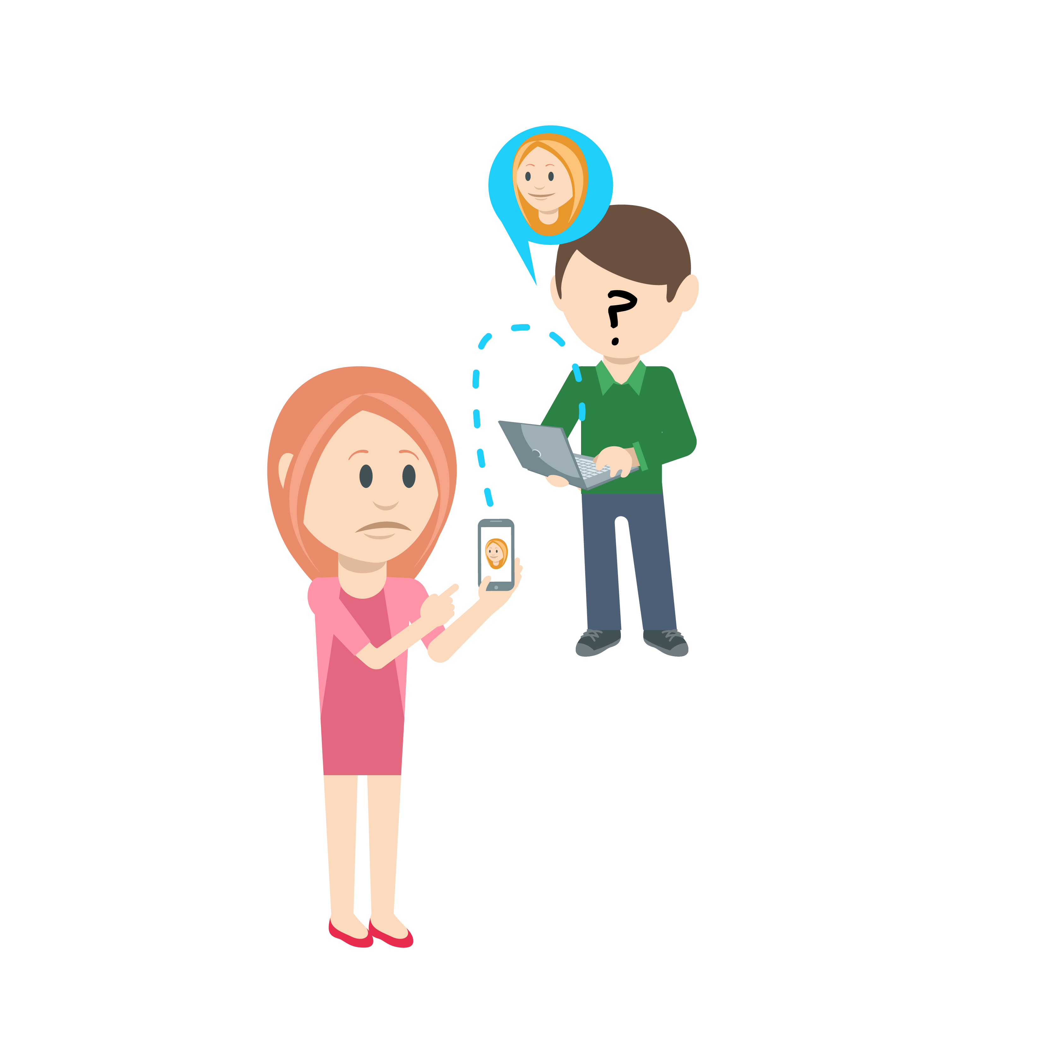
Your Digital Footprint
Online chatting and chat rooms
NEVER GIVE OUT PERSONAL INFORMATION (name, address or school). If someone asks you for personal information, tell a trusted adult.
NEVER ARRANGE TO MEET SOMEONE you have only met online. People may not be who they say they are…
Notes:
What must we never do when chatting to people online? (give out personal information – name/address/school. NEVER arrange to meet someone you have met online).

Slide 8





Instant messaging and messaging apps
Your Digital Footprint
Notes:
Ask: Which of these logos do the students recognise? Does anybody use them? Explain that you really should be 13+ to have social media messaging accounts (Although social media accounts are for 13+ it is likely that many pupils will already have them, so the emphasis has to be on how to keep safe on them.) What can you do with instant messaging apps (webcam/FaceTime video chat)? How can you keep them private?

Slide 9
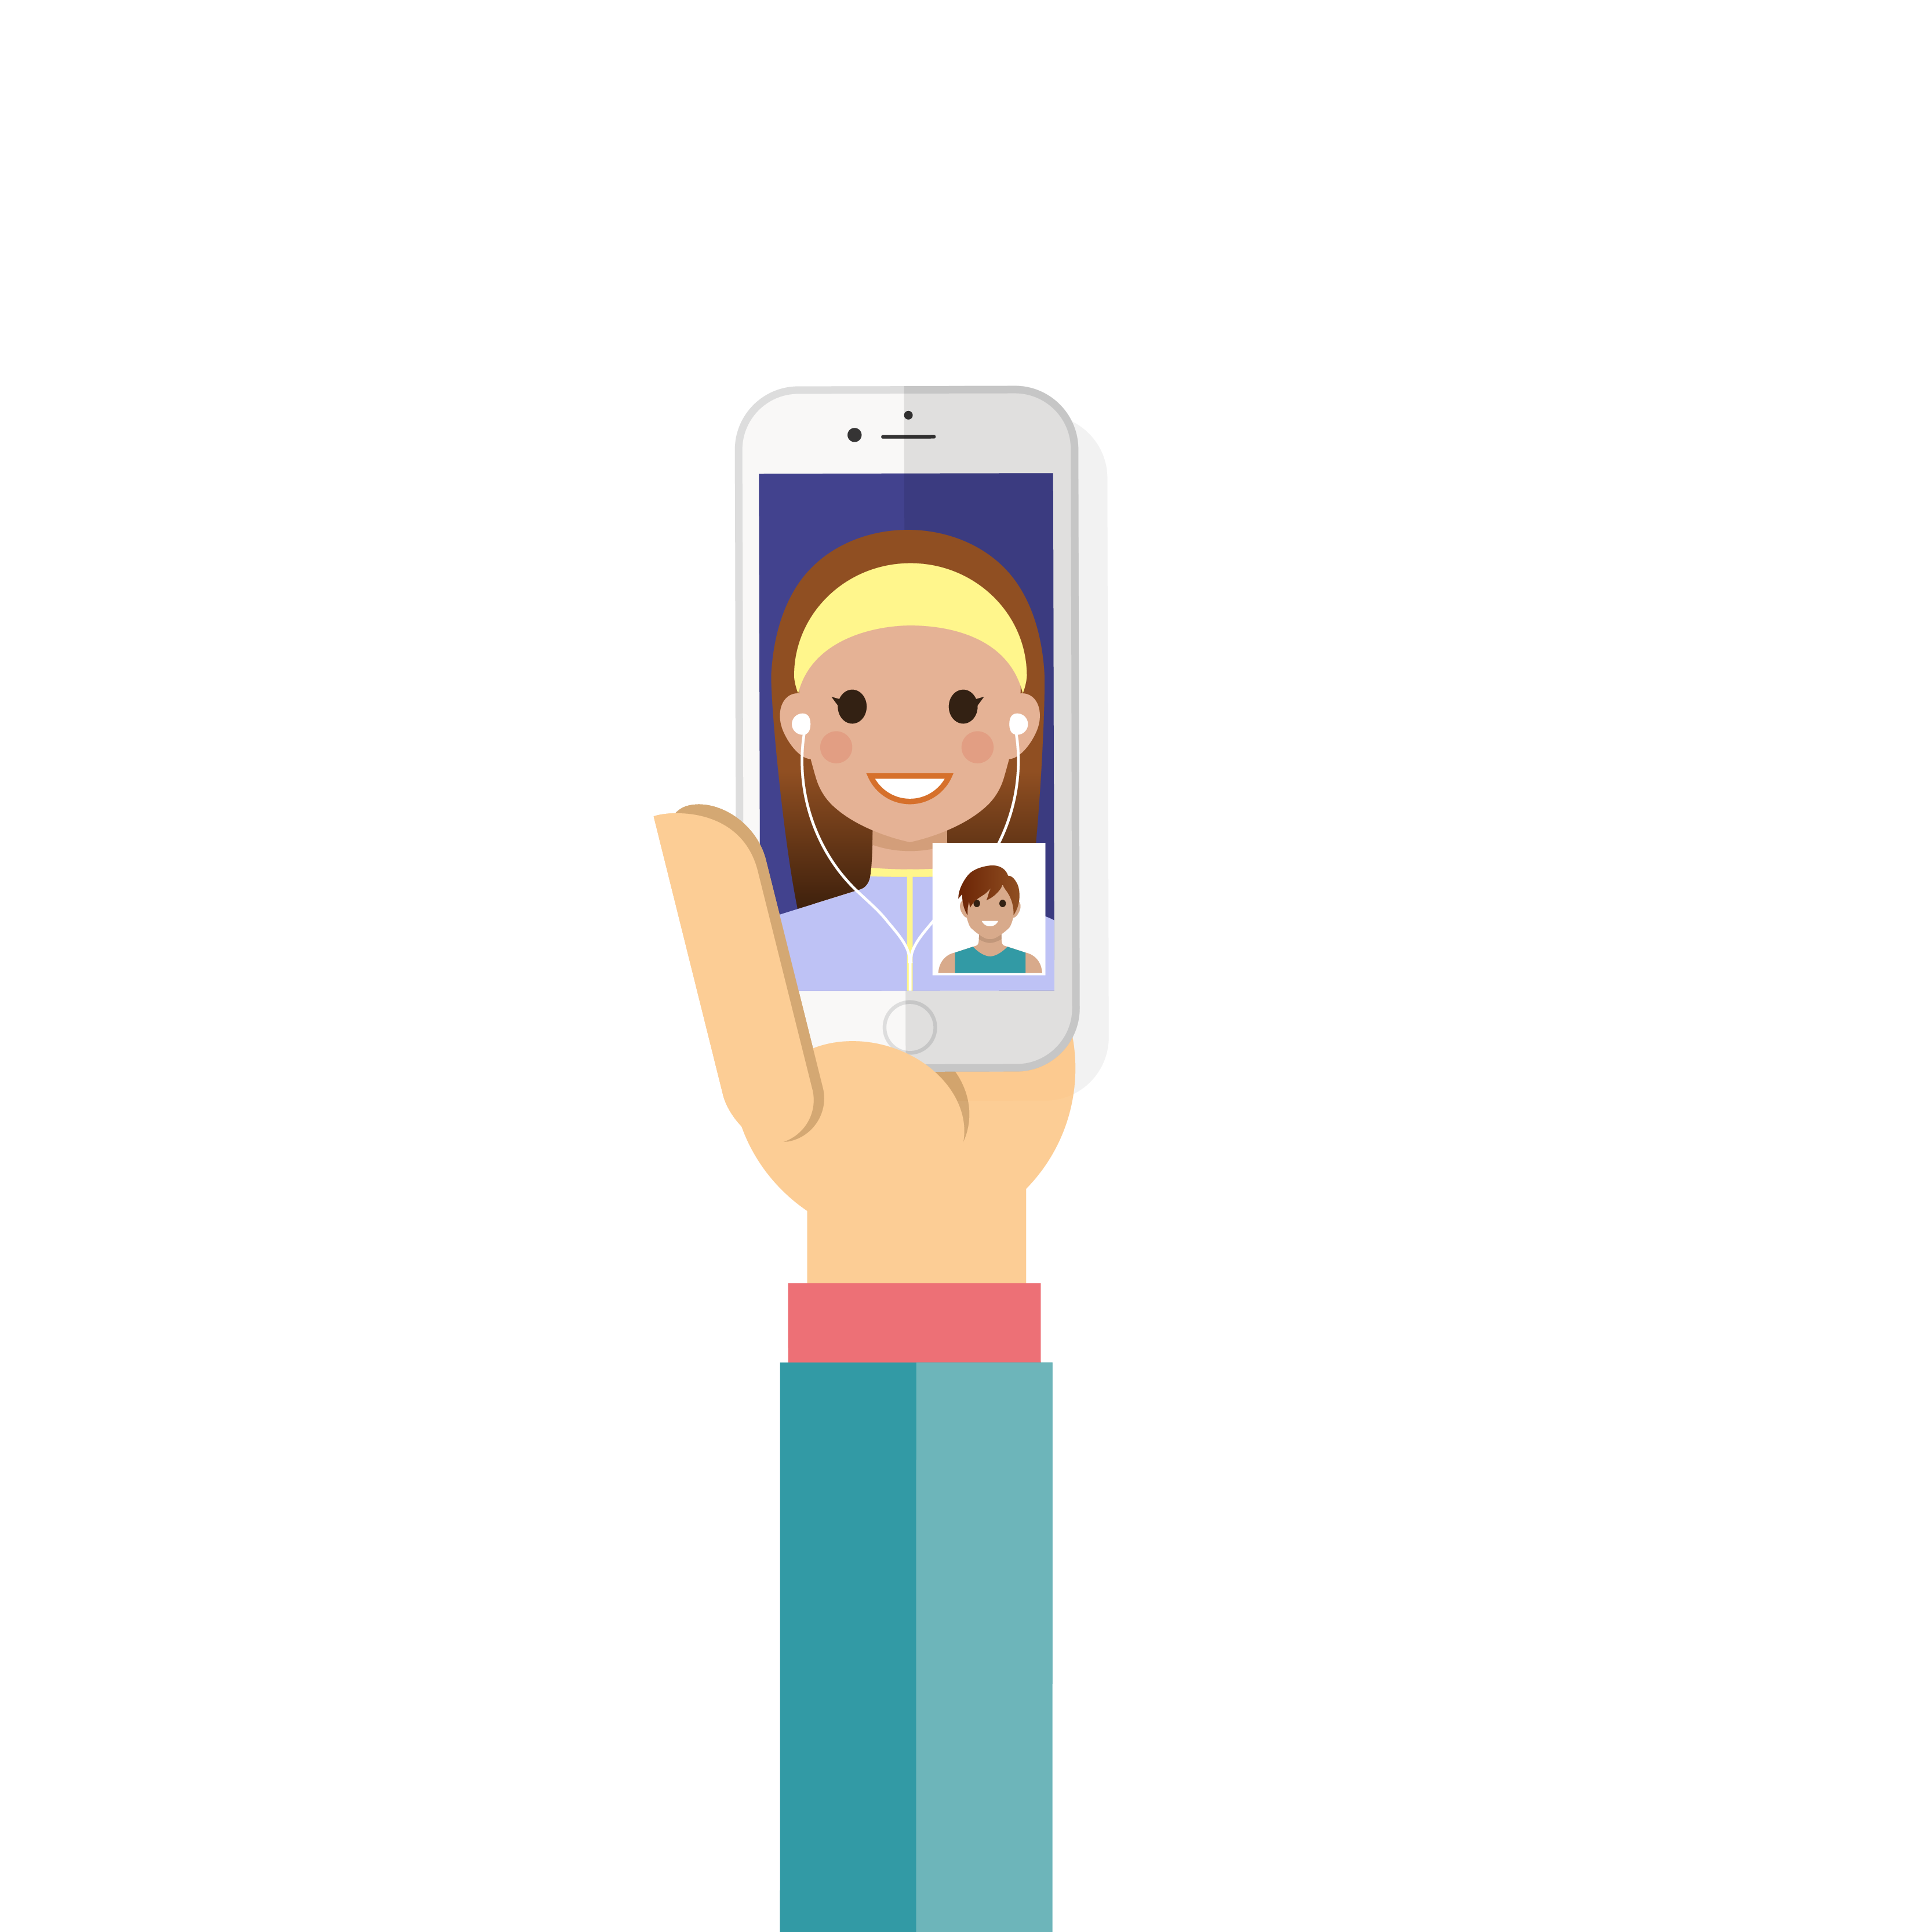
Instant messaging and messaging apps
Your Digital Footprint
A way to chat privately with friends and family
You can use webcams or FaceTime to see the other person
You have a contacts list
BLOCK anyone you don’t know who adds you to their contacts list
NEVER GIVE OUT PERSONAL INFORMATION (name, address or school)
AVOID using a photo of yourself on your profile
NEVER USE A WEBCAM with people you don’t know
Notes:
Ask: What can you do with instant messaging apps (webcam/FaceTime video chat)? How can you keep them private?

Slide 10

File sharing
Your Digital Footprint
Notes:
Ask: does anyone share files – music, films or pictures with friends? Where do you usually download music or films from?

Slide 11

File sharing
Your Digital Footprint
File sharing is not a good way of downloading music or films
Files could contain viruses or nasty images
Many files are illegally downloaded films or music (piracy)
You can try YouTube, but ask a trusted adult first
If you want new music or videos, it's better to get them from a reputable site where you can pay for content.
Ask an adult to help you share files legally
Notes:
Explain that a lot of file sharing sites do not have permission for people to download, so you could get into trouble for illegal downloads.

Slide 12

Online gaming
Your Digital Footprint
Notes:
Ask: Who plays online games? Which ones do you play? Are they suitable for your age?

Slide 13

Online gaming
Your Digital Footprint
You can play online games with lots of people, even people all around the world
You can make new gaming friends and chat to people
ALWAYS play games that are suitable for your age
ALWAYS use a nickname and NEVER give personal information
REMEMBER it is just a game, so behave in a sporting way
DON’T cheat, be nasty or upset anyone so you can win
Notes:
Ask: How do you keep safe when you are playing?

Slide 14



How to report
Your Digital Footprint
Tell a trusted adult
Save messages
Childline/CEOP (logos)
www.ceop.police.uk/ceop-report
Notes:
Explain to the pupils that if they are worried about anything they see online, in social media, games, chat, messages, they must tell a trusted adult and save the nasty messages as evidence. They can report online abuse at Childline, ThinkUKnow and through CEOP.

Slide 15


