Slide 1
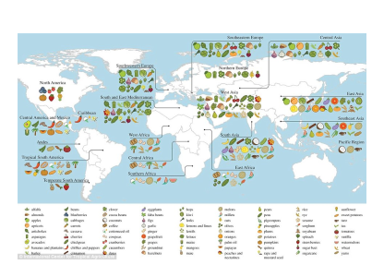
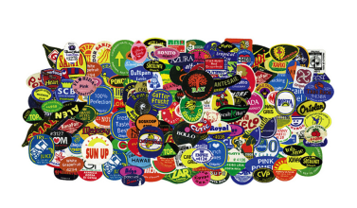
International/ Global Trade Food

Slide 2
18.01.22 LO: To discover how global trade increases the range of food items available to us in the UK. LO: To locate the source of popular food items found in our local supermarkets.

Slide 3
Flashback!
International trade is the exchange of goods and services between countries.

Slide 4
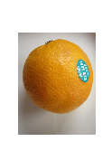
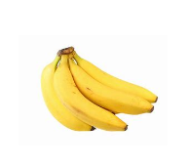
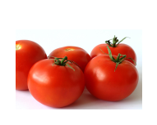
Trade: is the buying and selling of products we want and need.
Everything we want and need cannot be sourced within the national borders of the United Kingdom.
We therefore import items such as food products from other countries.
>Think of your favourite foods.
Could they be produced here in the U.K? If not, why?

Slide 5
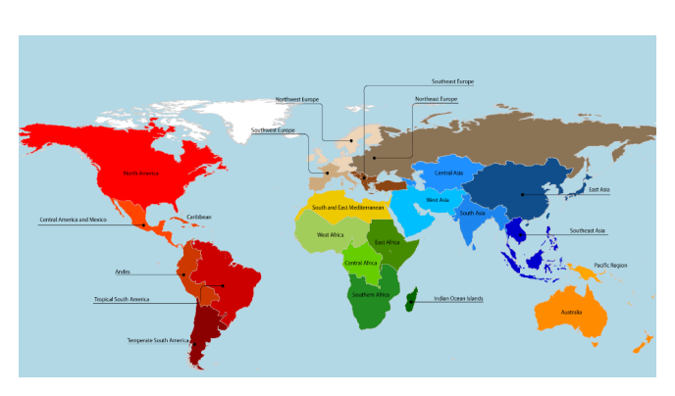
Click on the image below…

Slide 6
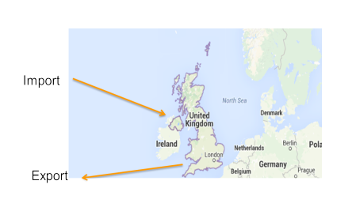
Countries import and export food products
Import:
Buy goods from another country.
Export:
Selling goods to another country.

Slide 7
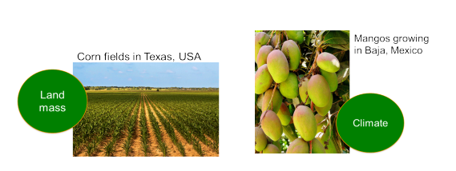
Over 50 % of food eaten in the UK is imported.
Why import?
The physical geography of the UK prevents us from growing certain foods growing here.
Climate and limited space to grow enough or the range of foods.
Climate: The general weather conditions usually found in a particular place

Slide 8
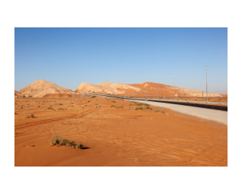
There are several reasons why international/ global trade in food is important:
Not all countries have suitable conditions for growing food and so they trade with other countries. For example, the United Arab Emirates is mostly desert and so it needs to import a lot of its food from other countries.

Slide 9
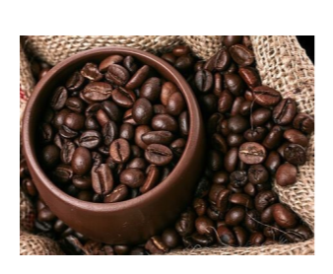
Different climates allow different types of food to be grown. For example, Colombia has a good climate for growing coffee beans and the United Kingdom does not.
Why do you think coffee is the most traded beverage?
Beverage: drink

Slide 10
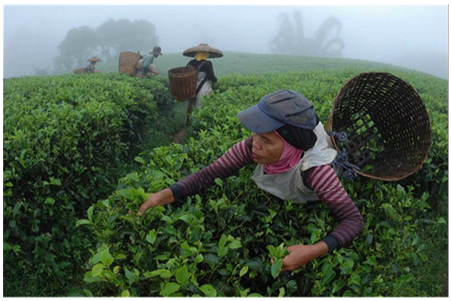
Tea pickers
West Java, Indonesia

Slide 11
Countries can earn money by exporting food to other countries. The world's biggest food exporter is the United States of America.

Slide 12
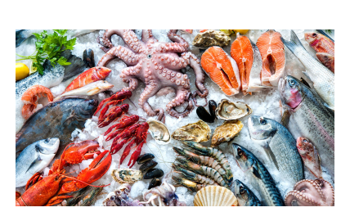
According to most sources, seafood is the most traded food in the world!

Slide 13
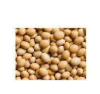
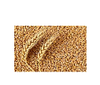
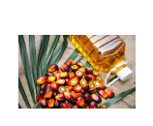
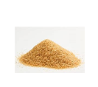
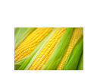
Other foods that are traded in huge quantities across the world include:
soya beans
wheat
palm oil
sugar
corn

Slide 14
Food Miles The term 'food miles' is used to describe how far the food we eat travels from where it is first produced, before it ends up on our tables. Below is a map that shows some popular imported foods in the UK and their food miles.

Slide 15
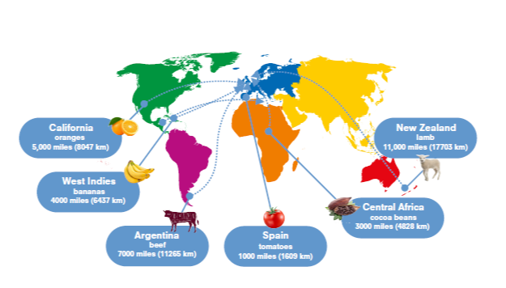

Slide 16
Food Miles Although food trade is essential, the vehicles that transport the food cause pollution. The more miles, the greater the pollution.

Slide 17
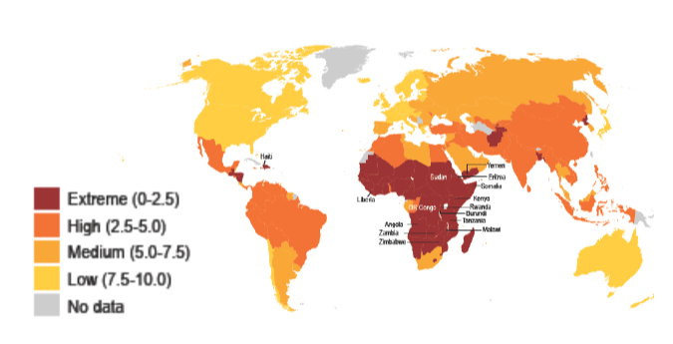
Food Security
The term 'food security' refers to the availability of and access of food. The map below shows levels of food security- the ability of countries to produce/ import enough food for their population.

Slide 18
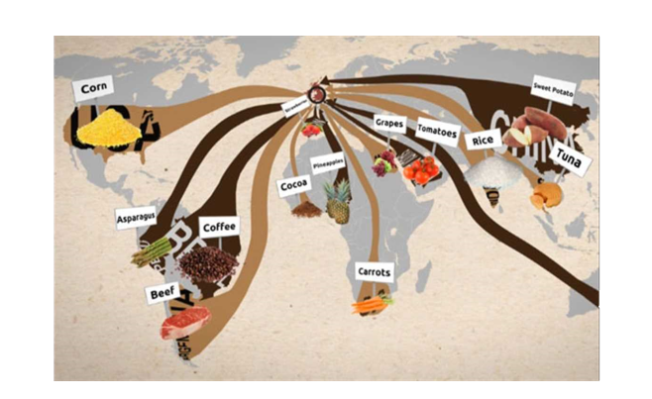
So, where does our food come from?

Slide 19
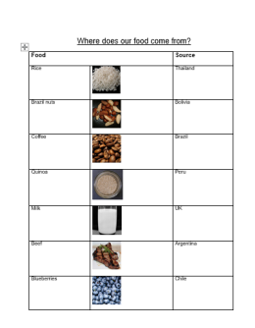
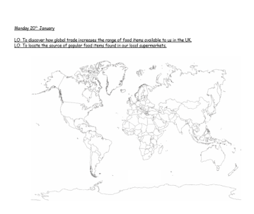
- Look at the source location of each food item on the activity sheet.
- Label the relevant countries on your world map.
- Stick the food item image at the source location.

Slide 20
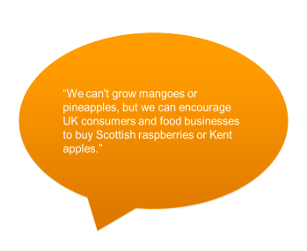
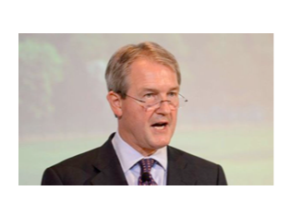
Buying seasonal produce that is grown in the U.K
when possible helps the national economy and can be better for the environment.

