Slide 1
29.11.21
L.O. – I can find the perimeter of rectilinear shapes.

Slide 2
17 $=$ ___ $+$ 9
6 $+$ 10 $+$ 4 $=$ 10 $+$ ___
3) Find the difference between 5 and 13

Slide 3
17 $=$ ___ $+$ 9
6 $+$ 10 $+$ 4 $=$ 10 $+$ ___
3) Find the difference between 5 and 13
8
10
8
Now, lets chant our 9x tables.

Slide 4
Find the perimeter of the rectilinear shape.
1 cm
A rectilinear
shape is a
shape where all the sides meet at right angles.
1 cm
2 cm
3 cm
5 cm
3 cm
2 cm
5 cm
2 cm
+ 3 cm
+ 3 cm
+ 2 cm
+ 5 cm
+ 5 cm
= 20 cm

Slide 5
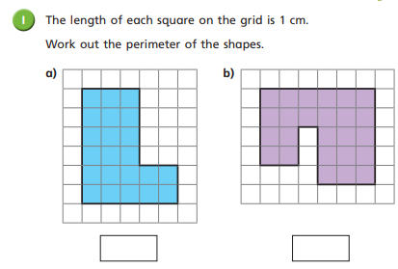
Look at question 1 and work out the perimeter of these shapes.

Slide 6
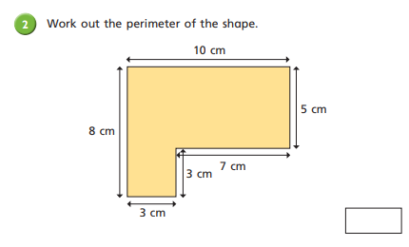
Now, work through question 2 on your worksheet.

Slide 7
6 cm
4 cm
4 cm
7 cm
? cm
5 cm
3 cm
3 cm
1 cm
= 26 cm
7 cm $+$ 6 cm $+$ 4 cm $+$ 5 cm$+$3 cm $+$ 1 cm

Slide 8
13 cm
13 cm
3 cm
8 cm
8 cm
9 cm
6 cm
13 cm $−$ 8 cm
= 5 cm
$=$ 13 + 13
13 + 5 + 8
$=$ 26
5 cm
3 + 6 + 9
$=$ 9 + 9
$=$ 18
26 cm + 18 cm $=$ 44 cm

Slide 9
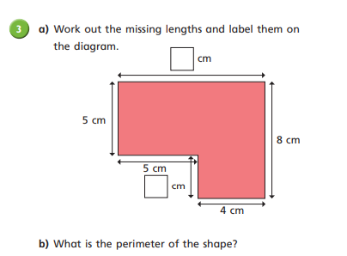
Next, work out the missing lengths of this rectilinear shape.

Slide 10
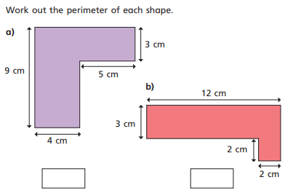
Let’s work through this example as a class.

Slide 11
A photo frame is 15 cm long and 12 cm high.
The frame around the photo window is 3 cm wide.
15 cm
3 cm
9 cm
6 cm
12 cm
3 cm
3 cm
3 cm
12 cm $−$ 3 cm $−$ 3 cm $=$
12 cm $−$ 6 cm $=$
6 cm
15 cm $+$ 12 cm $=$ 27 cm
27 cm $×$ 2 $=$ 54 cm
9 cm $+$ 6 cm $=$ 15 cm
15 cm $×$ 2 $=$ 30 cm
15 cm $−$ 3 cm $−$ 3cm $=$
15 cm $−$ 6 cm $=$
9 cm

Slide 12
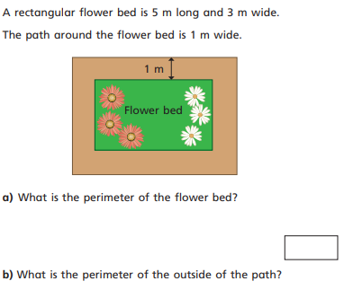
Now, work through the last question on your worksheet.
There is a challenge question if you get finished.

