Slide 1
Show Don’t Tell

Slide 2
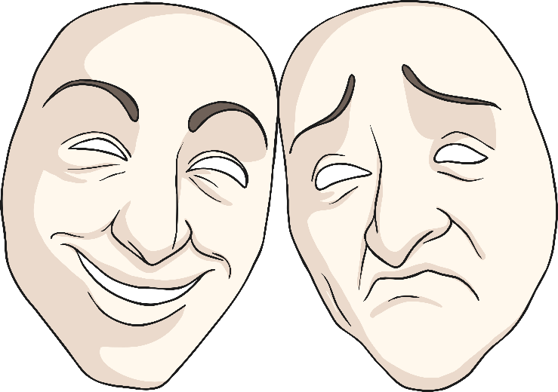
Show Don’t Tell
This is a technique that writers use to create a clear picture in the reader’s mind.
It makes the story much more interesting and allows the reader to fully understand how a character feels.

Slide 3
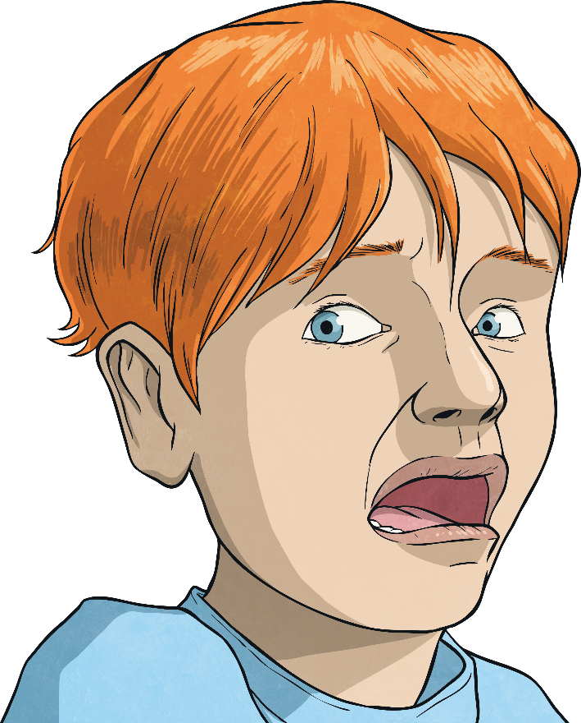
Which Sentence Do You Prefer and Why?
Connor was scared.
Connor’s tummy started to churn and
he was beginning to break out into a cold sweat.

Slide 4
Which Sentence Do You Prefer and Why?
Sadia felt happy.
Sadia’s eyes lit up as a huge smile appeared on her face.

Slide 5
Which Sentence Do You Prefer and Why?
Alex was shy.
Alex blushed and looked up at the sky.

Slide 6
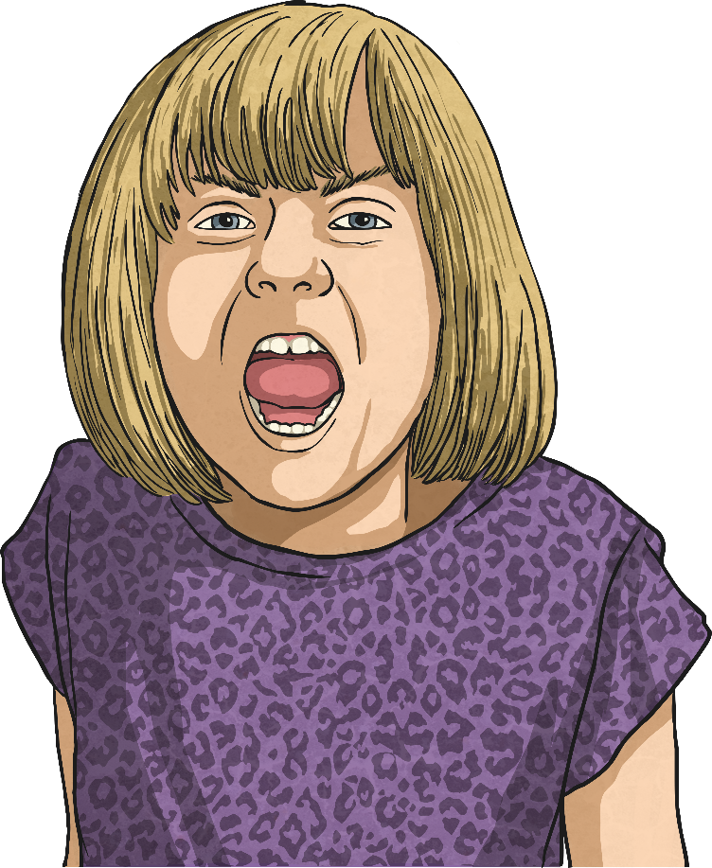
Which Sentence Do You Prefer and Why?
Sophie’s face turned bright red and she started to clench her fists.
Sophie was angry.

Slide 7
Which Sentence Do You Prefer and Why?
Lucy was cold.
Lucy started to shiver and rubbed her hands together to keep warm.

Slide 8
Show Don’t Tell
Improve this sentence and think of ways to show what the character is feeling.
He was tired.

Slide 9
Show Don’t Tell
Improve this sentence and think of ways to show what the character is feeling.
She was shocked.

Slide 10
Show Don’t Tell
Improve this sentence and think of ways to show what the character is feeling.
He was afraid.

Slide 11
Show Don’t Tell
Improve this sentence and think of ways to show what the character is feeling.
She was excited.

Slide 12
Show Don’t Tell
Can you make up your own sentence for a friend to improve?
Write down a simple sentence and ask a friend to improve it. Make sure they show what the character is feeling by describing their actions.

