Slide 1
Tuesday 30th November 2021
LO: To draw and describe a Tyne Mud Dragon

Slide 2
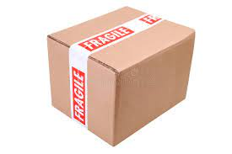
What an exciting day we had yesterday with the special delivery we received!

Slide 3
Today we are going to think about what a Tyne Mud dragon might look like and how it might behave.
What do you think?

Slide 4
Here are some questions to think about:
What does it look like?
What does it breathe?
Where does it live?
Where does it hide?

Slide 5
And also…
How or when does it move about?
Is it dangerous?
What does it eat?
What is the most interesting thing about it?

Slide 6
Your task
Draw and label what you think the Tyne Mud Dragon might look like.
Then, complete the sheet with more information about it. Following is an example. These were my ideas, but I would like you to think of your own.

Slide 7
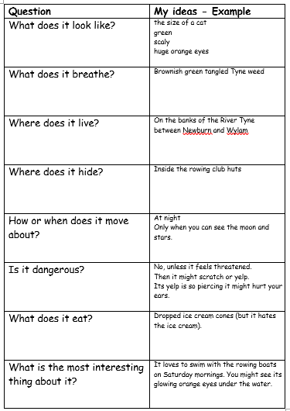
Example:
This example sheet is also available in the resources for today’s lesson.

