Slide 1



Slide 3

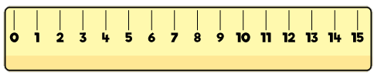
Use the word bank to compare the
red tower to the pink tower:
the same
shorter
taller

Slide 4
Use the word bank to compare the
red tower to the pink tower:
the same
shorter
taller

Slide 6

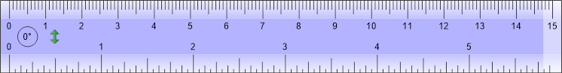
Tommy is trying to measure the brick.
He is struggling.

Slide 7
Our Top Tips for Tommy
1. Make sure you’re using the cm side of the ruler
2. Line up the edge of your item with 0 on the ruler
3. Look to see where the other edge of your item lines up with the ruler.
The brick is 5 cm long.

Slide 8
Tommy wants to measure the height
of the brick too.
The brick is 2 cm tall.

Slide 9
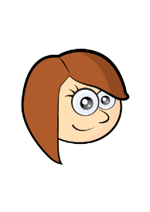
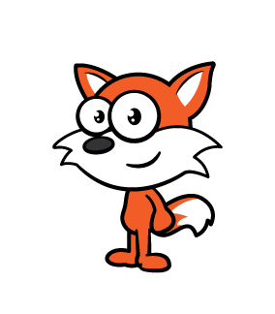
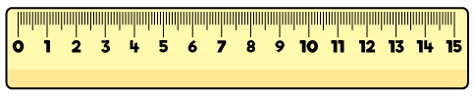
Rosie is measuring the height of this fox.

Slide 10
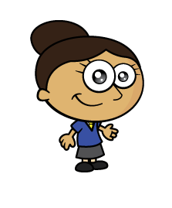

Dora is drawing a line 7 cm long.

Slide 11
Dora is drawing another line 7 cm long.

Slide 12

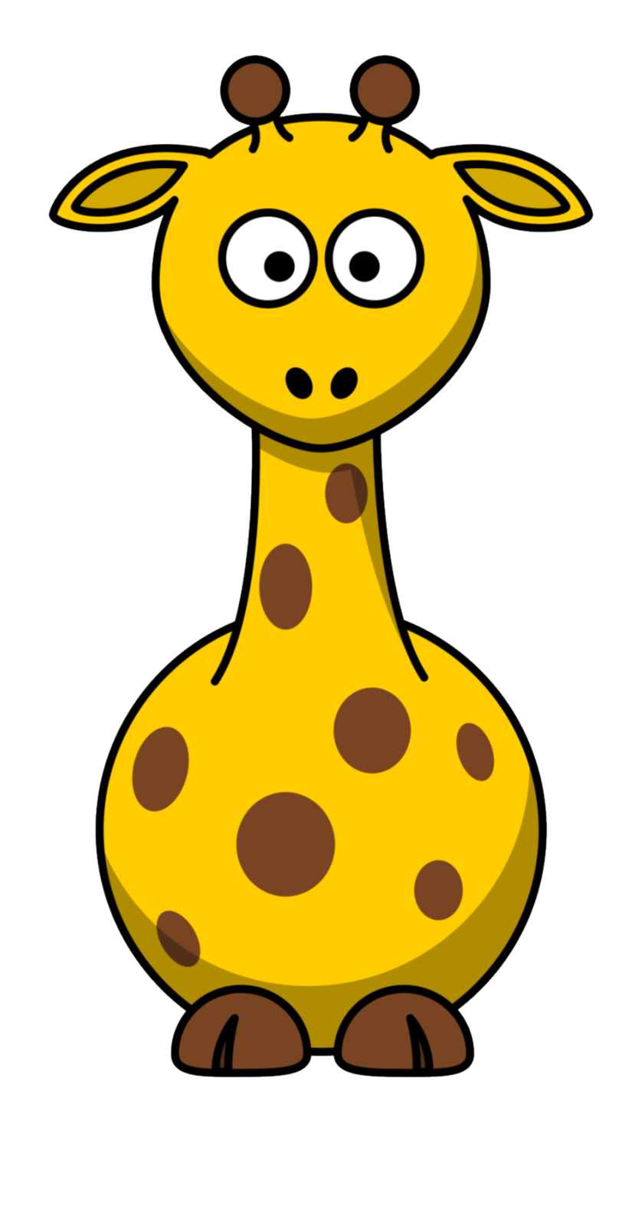

Alex has a giant giraffe teddy. She wants to know the height its ossicones reach.

Slide 13

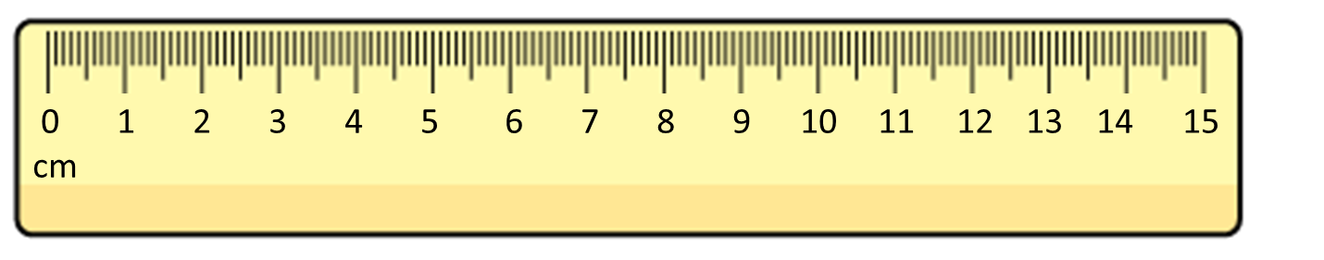
What do you notice?
Have a think
The green bar is 5 cm long.
The orange bar is 6 cm long.
The orange bar is 1 cm longer than the green bar.
There is a gap of 3 cm between the bars.
The total length of the bars is 11 cm

Slide 14
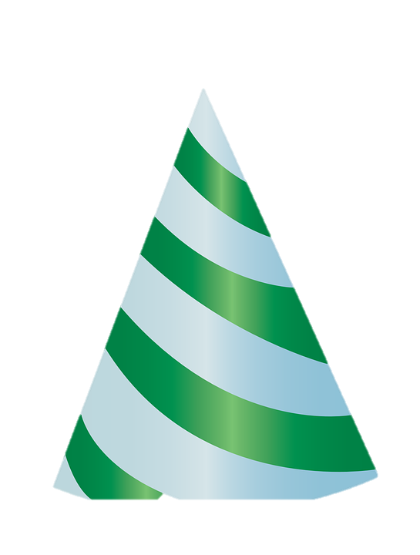
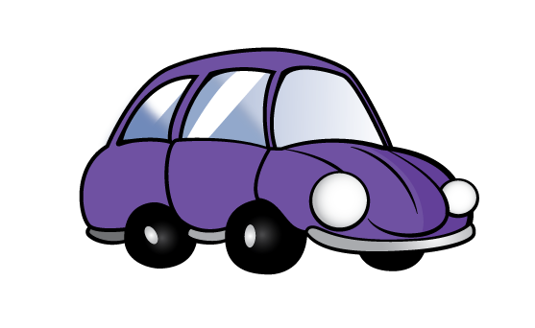
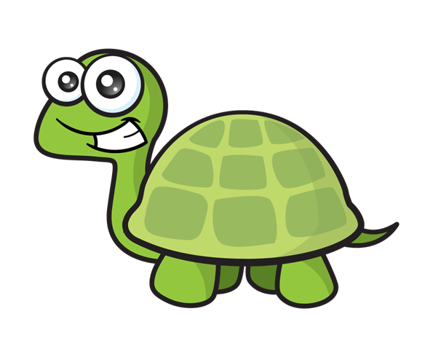

True or false?
Tiny’s car is 13 cm long.
Have a think

Slide 15
Have a go at the questions on the worksheet

